Slide 1
ERCOT: Transmission Planning Criteria For Valuation of GTC Exit Solutions NPRR 1070
June 15th, 2021
Alexandra Miller, Transmission Markets and Analytics, EDF Renewables
Ankit Pahwa, Transmission, Pattern Energy

Slide 2
Executive Summary
The content in this deck presents additional information in response to comments and feedback received
NPRR 1070 is consistent with PUCT rules which mandate the metric of production cost savings and allow for indirect benefits to be accounted for, but which do not prescribe specific modeling assumptions
Five modeling practices are proposed:
Reflect accurate bid price for categories of generators which typically bid negative, while fuel cost is kept at $0 for renewables
Reflect the typical limit derate due to transmission outages or model an expected outage case
Reflect derates of limits for safety margins as applied by Operations
Include the avoided cost of all avoided reliability projects
Estimate the value of avoiding curtailment of generation due to GTCs during load shedding events

Slide 3
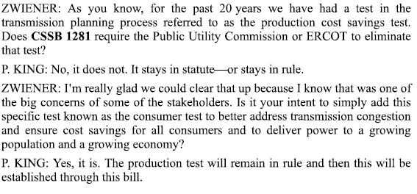
Relevant Legislative Outcomes
Moving forward with this NPRR is consistent with new law that encourages transmission development and the reduction of costly congestion
SB1281
Calls for biennial grid assessment of grid reliability in severe weather
Adds Consumer Cost Test
Legislative Intent of Customer Cost Test in Conference Committee May 25 and May 30:

Slide 4
Bid Price
General Comment:
The discussion is not about the societal impacts and costs of Production Tax Credits (PTC), which is a federal policy decision
The ask is that the planning models reflect what is happening in the market:
Different bid prices will change the dispatch, flows, and congestion costs.
Models need to accurately estimate the production cost change when the transmission topology is changed
Such approach is used in other RTOs as well (see table)
Impact: The change in bid prices is not necessarily going to lead to an increase in benefits – some evaluations may have lower benefits with this change – we are seeking better accuracy not more benefit.
Legislative Outcome: SB1281 calls for the addition of a consumer impact test which will evaluate congestion cost, potentially more directly dependent on bid prices.
Bid Assumptions in Other RTO Planning Models
RTO | Wind PTC Bid Assumption ($/MWh)
SPP | -35.00
PJM | -20.00
MISO | -36.69
CAISO | -25.00

Slide 5
Bid Price
Scope of change:
The language can be made more general by removing the word “wind” in case of future changes to PTC qualification.
We do not want to be prescriptive with actual numbers in order to allow flexibility for future legislative changes or changing behavior of market participants. Current suggestions:
Grossed up PTC round number: -$30.00
Depending on in-service year, use phase-out percentages: 2022 at 80%, 2023 at 60%, etc.
Post PTC impact of RECs: Appropriate to keep it simple and stay with $0, due to small impact and uncertainty.
Actual bidding behavior could be evaluated and considered in developing assumptions for individual or groups of project types.
SB1281 impact, either:
Remove and defer to PUCT guidance or
Include so models are appropriate for both measures

Slide 6
Outages
Current approach using sensitivities is labor intensive and disregards that outages are common and expected; however, the outage statistics and experience can inform the proposed approach
Proposed language allows for ERCOT’s discretion on whether to model outages explicitly (affecting limits and topology) or to simply derate the limits by an expected amount.
We support the simpler approach of derating seasonally by incorporating general expectations of future outage levels for prior outage lines.
The range observed in recent history for a sample of GTCs ranges from 1% to 9%, however there is a short history for some GTCs, while Panhandle GTC derates are inclusive of the more exceptional CREZ repair outages
GTC | Panhandle Export | Valley Export | West Texas Export | Nelson Sharpe-Rio Hondo | Nedin-Lobo
Impact of Outages on Limit* | 9% | 1% | 4% | 4% | 3%
*Calculated impact from outages as average RT Generic Constraint Limit / maximum RT Generic Constraint Limit, (used monthly data as available from Jan 2019 to April 2021) – results can be considered conservative because there could have been outages spanning a full month and setting the maximum limit

Slide 7
Outages
Example calculation of Base Case Rating
Assumptions for illustration:
Outages are not overlapping
Fall outage rate scaled down slightly to total 100%
Source: ERCOT - Impact of Weather Uncertainty and Transmission Outages on Economic Project Evaluations
http://www.ercot.com/content/wcm/key_documents_lists/89026/Whitepaper_EcononmicPlanning.pdf
 | Fall | Spring | Summer | Winter | Annual
345 kV | 0.059 | 0.027 | 0.009 | 0.021 | 0.028
Probabilistic Rating | 10.98 | 11.31 | 11.54 | 11.39 | 11.30
Outage Derate | 5.8% | 3.0% | 1.0% | 2.3% | 3.1%
WESTEX |  | Probability
Prior Outage | Rating | Fall | Spring | Summer | Winter | Annual
None | 11.66 | 0.000 | 0.487 | 0.829 | 0.601 | 0.468
SCKT 1 | 11.46 | 0.053 | 0.027 | 0.009 | 0.021 | 0.028
DCKT 1 | 11.46 | 0.053 | 0.027 | 0.009 | 0.021 | 0.028
DCKT 2 | 11.24 | 0.053 | 0.027 | 0.009 | 0.021 | 0.028
DCKT 3 | 11.24 | 0.053 | 0.027 | 0.009 | 0.021 | 0.028
SCKT 2 | 11.24 | 0.053 | 0.027 | 0.009 | 0.021 | 0.028
SCKT 3 | 11.24 | 0.053 | 0.027 | 0.009 | 0.021 | 0.028
SCKT 4 | 11.18 | 0.053 | 0.027 | 0.009 | 0.021 | 0.028
SCKT 5 | 11.18 | 0.053 | 0.027 | 0.009 | 0.021 | 0.028
SCKT 6 | 11.18 | 0.053 | 0.027 | 0.009 | 0.021 | 0.028
SCKT 7 | 11.10 | 0.053 | 0.027 | 0.009 | 0.021 | 0.028
SCKT 8 | 11.10 | 0.053 | 0.027 | 0.009 | 0.021 | 0.028
SCKT 9 | 11.10 | 0.053 | 0.027 | 0.009 | 0.021 | 0.028
SCKT 10 | 11.10 | 0.053 | 0.027 | 0.009 | 0.021 | 0.028
DCKT 4 | 10.84 | 0.053 | 0.027 | 0.009 | 0.021 | 0.028
DCKT 5 | 10.62 | 0.053 | 0.027 | 0.009 | 0.021 | 0.028
DCKT 6 | 10.54 | 0.053 | 0.027 | 0.009 | 0.021 | 0.028
DCKT 7 | 10.45 | 0.053 | 0.027 | 0.009 | 0.021 | 0.028
DCKT 8 | 10.33 | 0.053 | 0.027 | 0.009 | 0.021 | 0.028
DCKT 9 | 10.00 | 0.053 | 0.027 | 0.009 | 0.021 | 0.028
Aligns closely with the observed history of 4% derate (over the past partial fall-winter-spring)
Need to confirm Double vs Single circuit rates, and could consider circuit length
Fall rates indicate there will be some overlap and potentially lower ratings (∑>100%)

Slide 8
Avoided Reliability Upgrades
Document current practice:
Time frame of avoided projects?
How are avoided projects identified?
Cost Estimate method, source, or rule of thumb?

Slide 9
Reserve Margin Impact due to GTC-related Curtailments
Currently there is no reflection of transmission constraints in reserve margin study and no accounting for impact to reserves in transmission planning
Goal of proposal is to leverage existing reserve margin studies to estimate the impact of this cost to the system (load at risk) that is not currently included
SB1281 Sec. 39.159. GRID RELIABILITY ASSESSMENT
“a biennial assessment of the ERCOT power grid to assess the grid ’s reliability in extreme weather scenarios” could provide some additional evaluation of high impact scenarios
We can generalize language to leverage this assessment and develop appropriate methodology for assessing the impact and costs of GTCs and other transmission constraints on resource adequacy

Slide 10
Appendix – prior slides for reference
Safety Margin Derates
Outage and Safety margin Example
Reserve Margin Impact

Slide 11
Safety Margin Derates
Export GTCs often have lower operational limits than the defined GTC limit, while Import GTCs may have lower or higher operational limits than the defined GTC limit due to required reserves for the load pockets
Example IROL: “WHEN: The BASECASE WESTEX flow is approaching 85% of the limit; THEN: Activate the BASECASE WESTEX constraint and control to 90% of the limit.”:
Models should therefore reflect the most likely limit used by Operations when the GTCs will be binding (90% or 98%) for export GTCs, which is currently being done but needs to be documented in protocols to ensure continued best practice
Export Limit | If flow approaches: | Then derate limit to:
IROL (Panhandle, West Texas) | Flow -> 85% Flow -> 92% | Limit -> 90% Limit -> 85%
GTC Stability | Flow -> 85% | Limit -> 98%

Slide 12
Example of GTC Limit Derates from Both Outages and Operational Margins
*Calculated as maximum Generic RT Constraint Limit
**Calculated as average Generic RT Constraint Limit
***Calculated as average Combined Constraint Limit

Slide 13
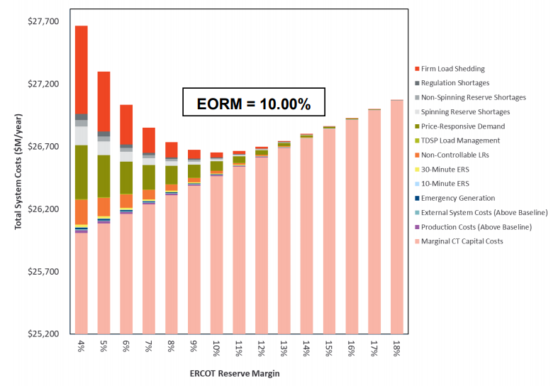
Reserve Margin Impact due to Curtailments
∆Cost
∆Reserves
Quantify total constrained generation
Determine impact on system reserve margin
Use EORM study results to determine change in cost for change in reserves
Allocate to each constraint
Source: 2020 EORM Study SAWG Presentation 10/26/2020

