Slide 1
Discussion on Solar Regions
Nitika Mago
Manager, Balancing Operations Planning
CMWG
June 14, 2021

Slide 2
Discussion Outline
Recap of Stakeholder discussions on solar regions
2019 March and April ROS (solar “forecast” regions)
2020 December and 2021 May SAWG (solar “capacity contribution” regions)
Current status of market facing Reports that will include solar aggregations by regions/zones
Proposed aggregation options for CMWG’s consideration

Slide 3
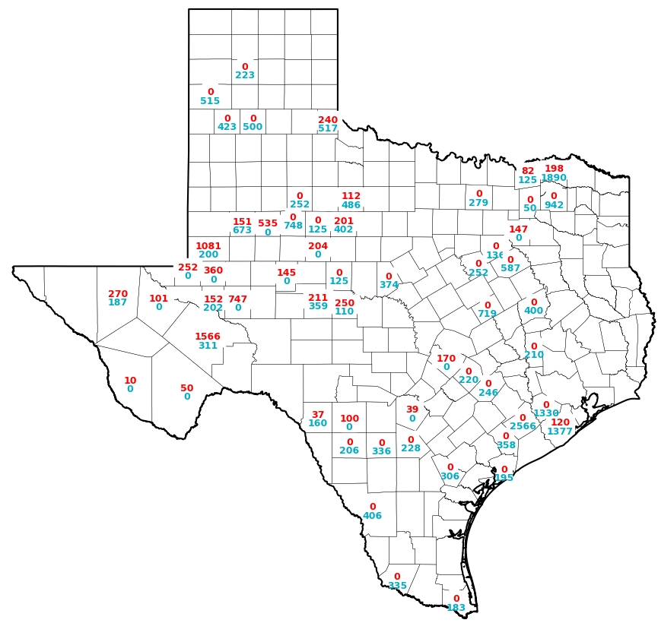
Existing and Projected Installed Solar Capacity*
*Capacity Changes by Fuel Type Charts, May 2021
Current Solar Units (MW) | New Solar Projects with IA Signed (MW)
7,360 | 20,790
Legend
### - Existing Capacity
### - Projected New Capacity
Notes:
The Capacity Changes by Fuel Type Charts, May 2021 includes around 225 MW of Distributed Generation Resource that have been excluded from the “Current Solar Units (MW)”

Slide 4
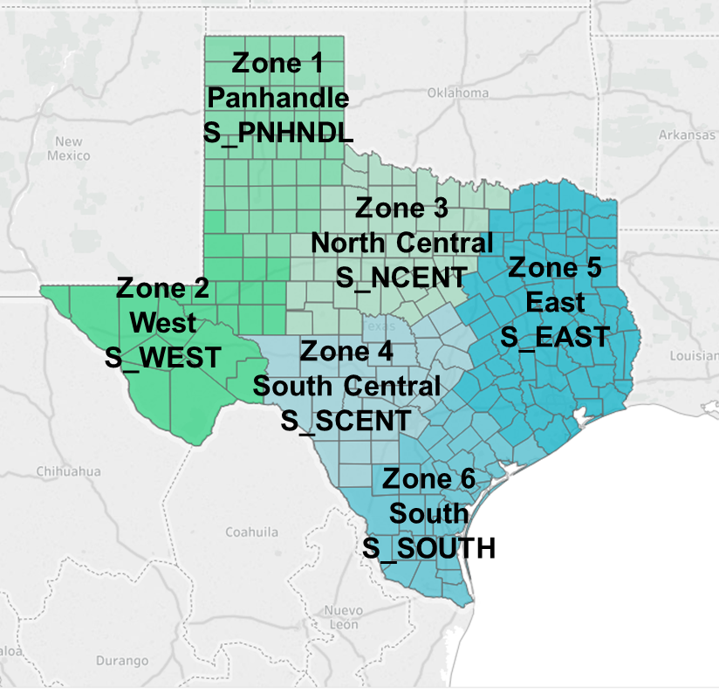
Recap of 2019 ROS discussion
With the continued growth of solar and expected geographic diversity in installations, there was interest in defining PhotoVoltaic i.e. solar regions (solar “forecast” regions).
The March and April 2019 Reliability Sub Committee meetings discussed the outline solar regions that ERCOT could consider.
The discussions clarified that solar regions are solely an aggregation construct that are used to characterize solar generation/irradiance profiles and forecasts; solar regions do not impact pricing or any of the hub/load-zone definitions.
The discussions focused on the count of region definitions (between 2 and 10) that could be considered to represent the diversity in ERCOT’s solar production potential. ROS recommended using six solar zones.
An illustrative aggregation that was shared during this discussion is included.

Slide 5
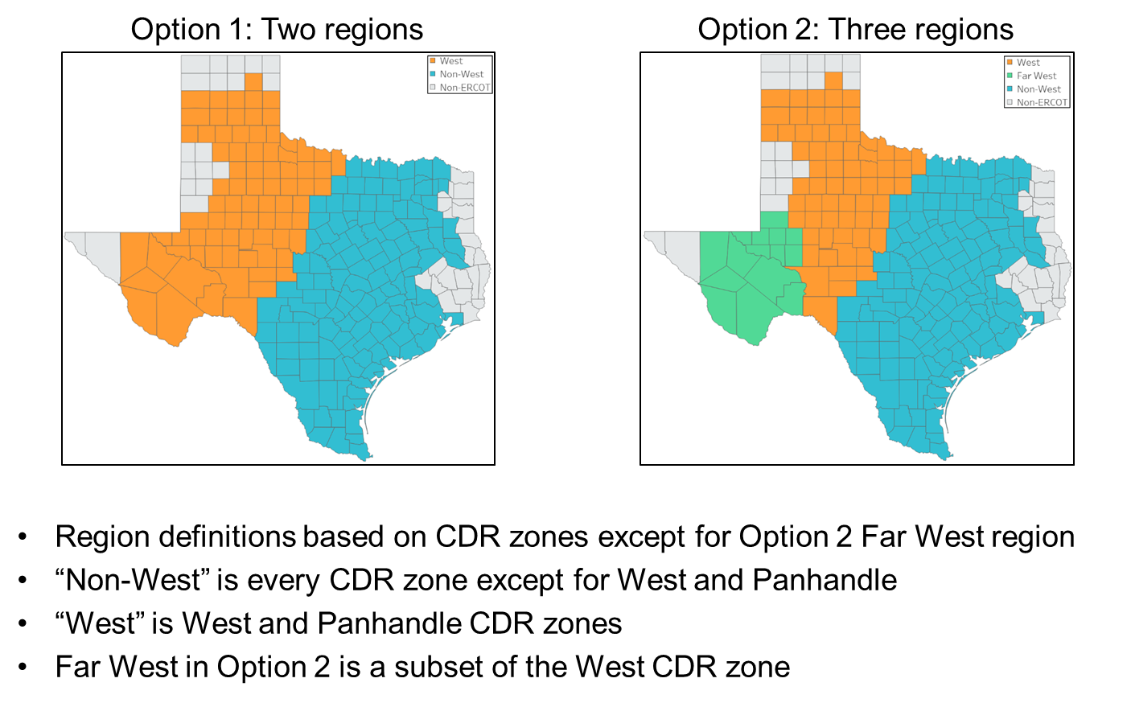
Recap of 2020/2021 SAWG discussion
In December 2020, Supply Analysis Working Group (SAWG) kicked off discussions on incorporating a solar region concept in Capacity, Demand and Reserves (CDR) Report to improve the solar capacity contribution calculations (solar “CDR” regions).
Solar “CDR” regions are not 1:1 with solar “forecast” regions, but will be aggregations of the solar “forecast” regions
Analysis for solar “CDR” regions is focusing on a two vs. three region option.
Analysis on final option to be used in CDR is still underway.
Notes:
Dec 18, 2021
http://www.ercot.com/content/wcm/key_documents_lists/195775/SAWG__Meeting_12-18-2020_SolarCapacityContributionZones.pptx
May 18, 2021
http://www.ercot.com/content/wcm/key_documents_lists/215939/SAWG__Meeting_5-18-2021_Initial_Analysis_of_Regional_Solar_Capacity_Contributions.pptx

Slide 6
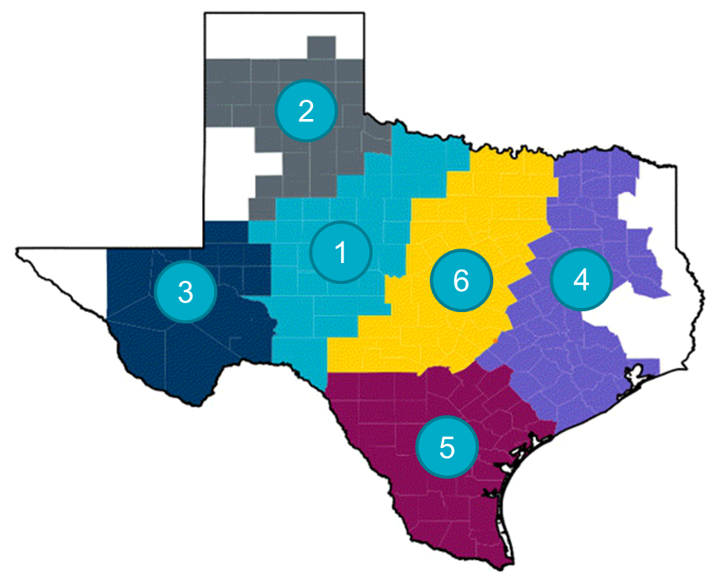
Revised Solar Region Definition
In light of the work being done at SAWG, ERCOT is planning to build the six solar “forecast” regions in a manner that these respect the West and non-West solar “CDR” region boundary.
Today, there exists two solar regions wherein the number of unit/QSE per region is less than 3.
Solar Region | Current Solar Units |  |  | New Solar Projects with IA Signed
 | No. Of Units | No. Of QSEs | Total MW | No. Of New Projects | Total New MW
1 | 14 | 10 | 1,660 | 11 | 2,358
2 | 4 | 3 | 392 | 9 | 3,106
3 | 37 | 15 | 4,412 | 5 | 902
4 | 4 | 3 | 548 | 49 | 11,024
5 | 3 | 1 | 177 | 14 | 2,357
6 | 2 | 1 | 171 | 4 | 1,042

Slide 7
Current Solar Region based Reports
Nodal Protocol 3.2.5(1)(c) requires ERCOT to post aggregate solar power production data by 2003 Congestion Management Zones (i.e. North, South, West and Houston) two days after the Operating Day.
These reports are currently not being posted since there exists a zone wherein the number of unit/QSE/DME/CP per zone is less than 3. Posting will commence once the count of QSE, DME and CP per zone is greater than or equal to 3.
Similarly, NPRR 935 had introduced protocol language in Section 4.2.3 (1), (6) to incorporate solar “forecast” regions into MIS reports on solar power generation and solar power forecast.
This language is still gray-boxed.
Note that posting reports by individual solar “forecast” region will follow current approach used to protect confidential information specifically in solar regions where the count of units per region is low.

Slide 8
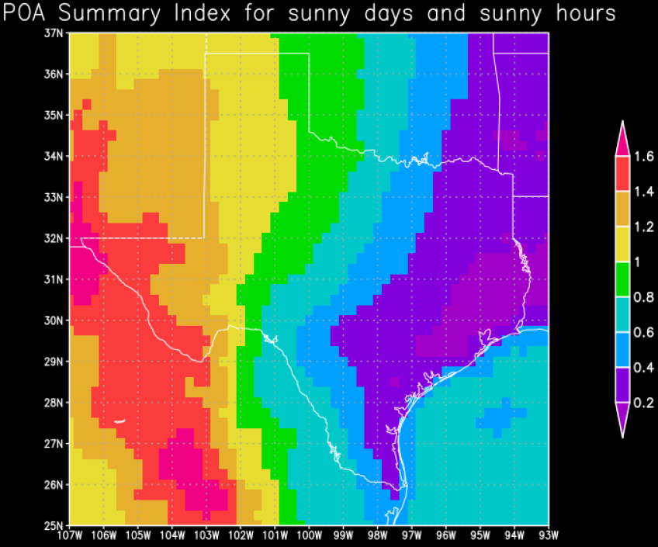
Potential Solar Aggregation for new Reports - 1
If the stakeholders desire a new set of reports that track aggregation of solar generation and forecast, included below is a potential aggregation that may be considered.
Approach 1: By Congestion Management Zones
North
West
South + Houston
Points to Consider
Proposed aggregation comes close in representing the irradiance profile for the region.
Mapping between Solar unit and Congestion Management Zone already exists and/or is derivable today.
Reports based on similar aggregation are being produced currently for wind.
Irradiance Profile
Zone | Current Solar Units
 | No. Of Units | No. Of QSEs | Total MW
North | 3 | 3 | 428
West | 55 | 24 | 6,464
South, Houston | 6 | 3 | 468
*The map in this slide is from an old reference and is for illustrative purposes only.

Slide 9
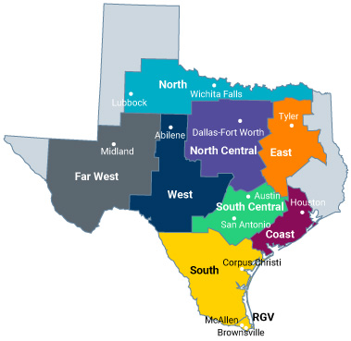
Potential Solar Aggregation for new Reports - 2
If the stakeholders desire a new set of reports that track aggregation of solar generation and forecast, included below is a potential aggregation that may be considered.
Approach 2: By Weather Zones
Far West
West
North + North Central + East + South + South Central + Coast
Points to Consider
Proposed aggregation comes close in representing the irradiance profile for the region.
Mapping between Solar unit and Weather Zone already exists and/or is derivable today.
Irradiance Profile
Zone | Current Solar Units
 | No. Of Units | No. Of QSEs | Total MW
Far West | 43 | 19 | 5,099
West | 11 | 7 | 1,150
North, North Central, East, South, South Central, Coast | 10 | 5 | 1,111

Slide 10
Potential Solar Aggregation for new Reports - 3
If the stakeholders desire a new set of reports that track aggregation of solar generation and forecast, included below is a potential aggregation that may be considered.
Approach 3: By Solar “forecast” Region
1 through 4 independently
5 + 6
Points to Consider
Solar “forecast” region definitions do not exist in ERCOT systems and hence a mapping between Solar unit and solar “forecast” region is not derivable today.
Irradiance Profile

Slide 11
Summary
With the continued growth of solar and expected geographic diversity in installations, there is an interest in monitoring solar generation and forecast at an “lower” aggregation level than system-wide.
ERCOT is in the process of defining and incorporating solar regions.
“Two day disclosure reports” are setup to provide solar generation data by Congestion Management Zones. These are not being produced today as there exists a zone wherein the number of unit/QSE/DME/CP per zone is less than 3.
If the stakeholders desire that new reports (different from the ones that are currently contemplated in the protocols) be created on solar generation and forecast, a few potential aggregations can be considered, namely,
By Congestion Management Zone
By Weather Zone

Slide 12
Appendix

Slide 13
Solar Unit Count by Zones
Congestion Management Zones | Current Solar Units
 | No. Of Units | No. Of QSEs
Houston | 1 | 1
North | 3 | 3
West | 55 | 24
South | 5 | 2
Weather Zones | Current Solar Units
 | No. Of Units | No. Of QSEs
Coast | 1 | 1
Far West | 43 | 19
North | 5 | 3
North Central | 1 | 1
South Central | 3 | 2
South | 0 | 0
West | 11 | 7

