Slide 1
Review of RENA for Mar. 2021
Market Analysis and Validation
CMWG
June 14th, 2021

Slide 2
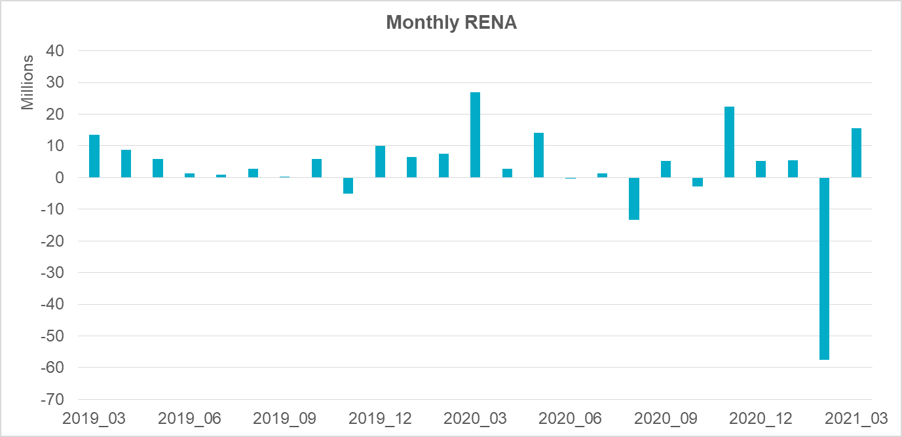
Monthly Sum of RENA

Slide 3
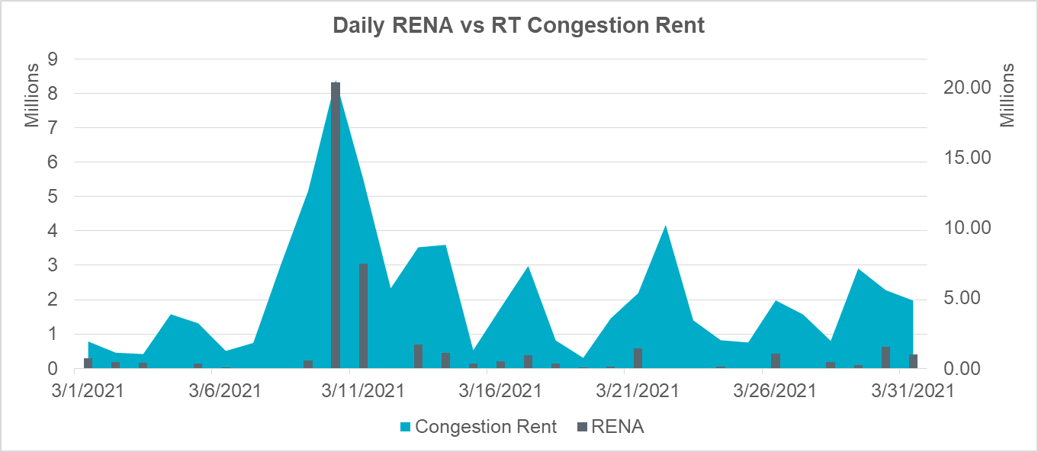
Daily RENA with RT Congestion
The total RENA was around $15.5M, while the total SCED congestion rent was around $161M.

Slide 4
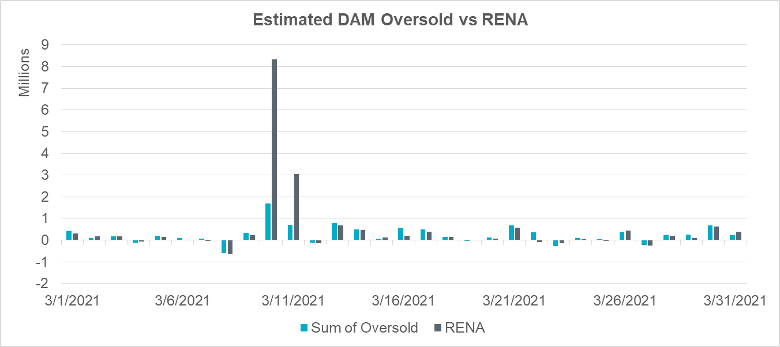
Daily RENA and estimated DAM oversold
The total estimated DAM oversold amount was around $8.0M.

Slide 5
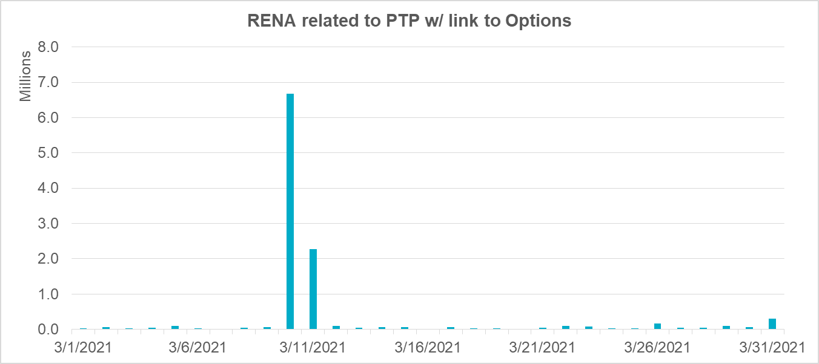
Daily contribution to RENA from PTP w/link to Options
The total contribution to RENA from PTP with links to options was $10.7M

Slide 6
OD 3/10 and 3/11
$11.4M of RENA observed.
About $9M came from PTP w/link to Options PTPs. Most was due to high prices in the South and Valley, affecting options sourced from resource nodes like those at NEDIN.
About $2.4M came from DAM overselling on RT constraints. About $2.1M was related to RT constraint XNED258: NEDIN_138H.

Slide 7
CRR Balancing Account

Slide 8
Summary
A total of $15.5M RENA observed, which is relatively high.
DAM overselling and PTP w/ links to options were the primary contributors.
Most RENA came on 3/10 and 3/11.

