Slide 1
PDCWG Report to ROS
Chair: Chad Mulholland, NRG
Vice Chair: Jimmy Jackson, CPS
ROS
June 03, 2021

Slide 2
Report Overview & Notes
Report Overview
Meeting Minutes
BAL-001-TRE-2 FMEs & IMFR
2 FMEs in the month of April
Frequency Control Report

Slide 3
Meeting Minutes
PDCWG Meeting 04/08/2021
Review of emergency conditions list from ROS
February cold weather event follow up discussion
Review of Southern Cross Directive 9 White Paper
SCR-811 Incorporation of PVGR in GTBD for Summer 2021
ERCOT reports

Slide 4
Frequency Measurable Events Performance

Slide 5
Frequency Measurable Events
There were 2 FMEs in April
4/28/2021 21:03:22
Loss of 529 MW
Interconnection Frequency Response: 1080 MW/0.1 Hz
12 of 66 Evaluated Generation Resources had less than 75% of their expected Initial Primary Frequency Response.
13 of 66 Evaluated Generation Resources had less than 75% of their expected Sustained Primary Frequency Response.
4/30/2021 22:14:50
Loss of load of 780 MW
Interconnection Frequency Response: 867 MW/0.1 Hz
8 of 42 Evaluated Generation Resources had less than 75% of their expected Initial Primary Frequency Response.
7 of 42 Evaluated Generation Resources had less than 75% of their expected Sustained Primary Frequency Response.

Slide 6
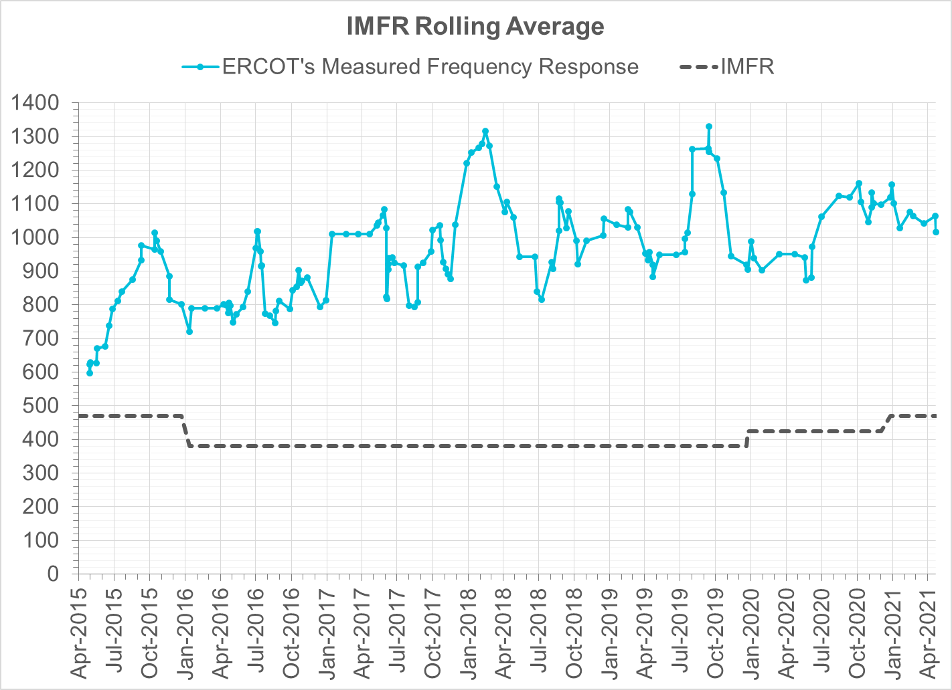
Interconnection Minimum Frequency Response (IMFR) Performance
Frequency Response Obligation (FRO): 471 MW/0.1 Hz

Slide 7
Frequency Control Report
March 2021

Slide 8
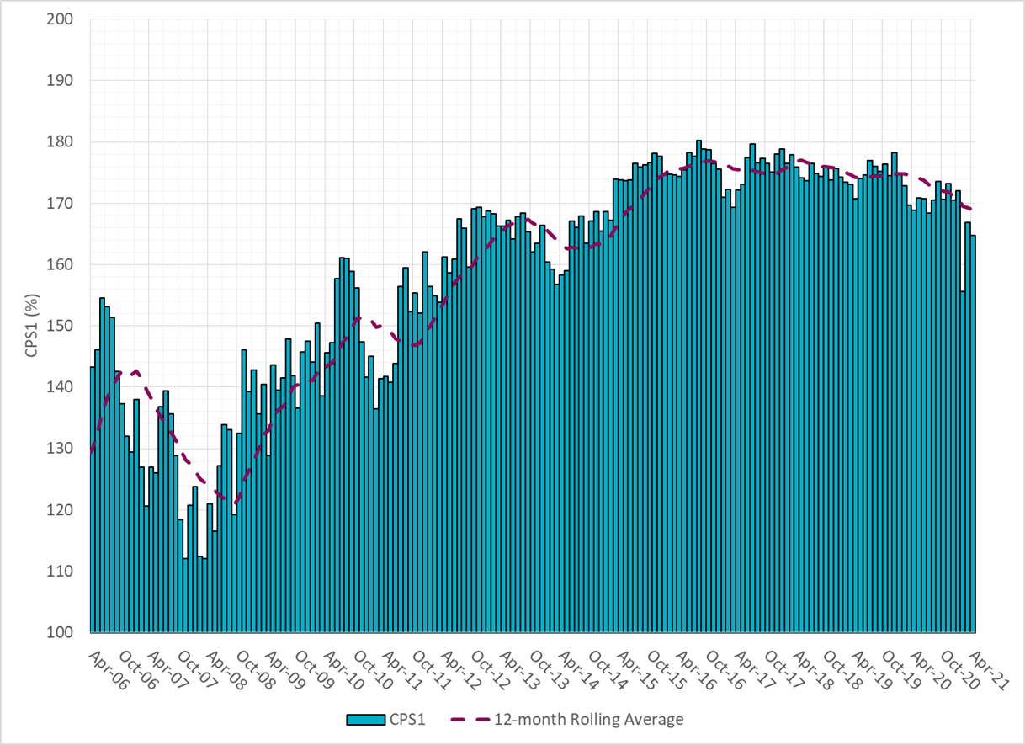
CPS1 Performance

Slide 9
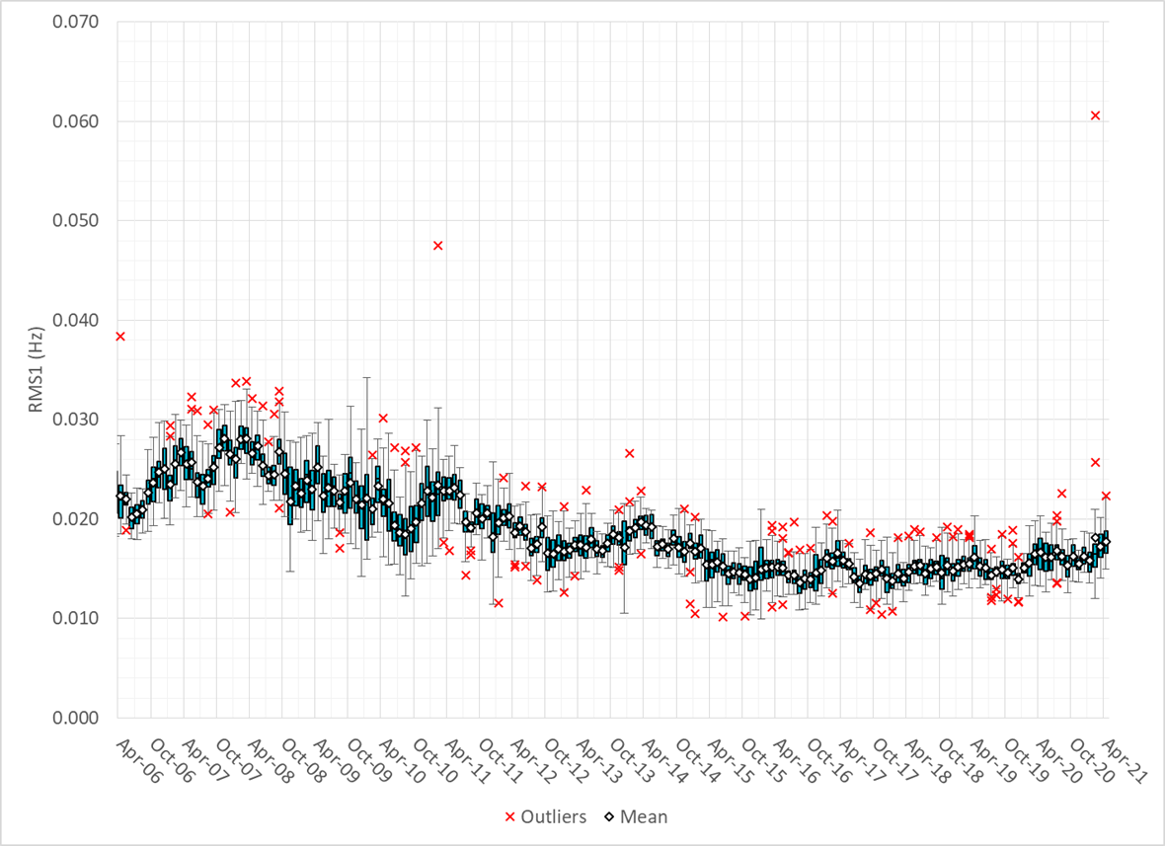
RMS1 Performance of ERCOT Frequency

Slide 10
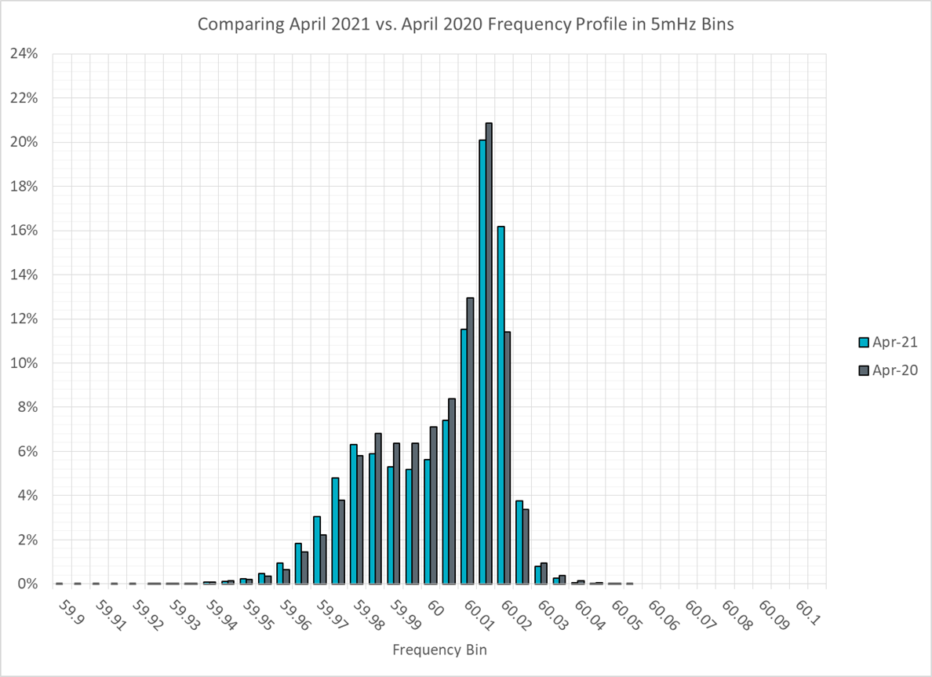
Frequency Profile Analysis

Slide 11
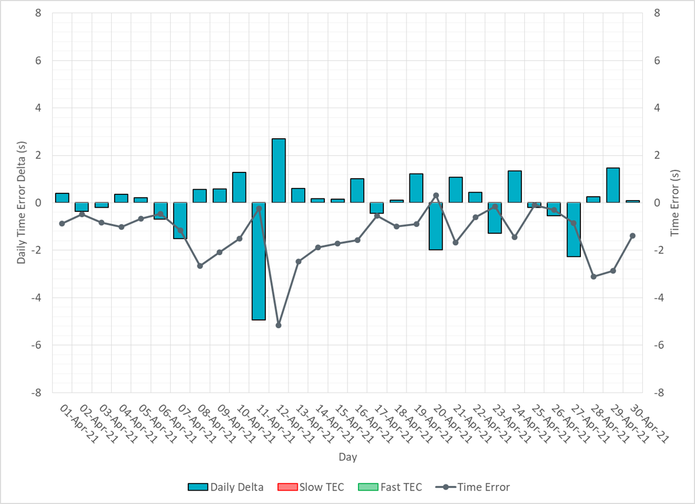
Time Error Corrections

Slide 12
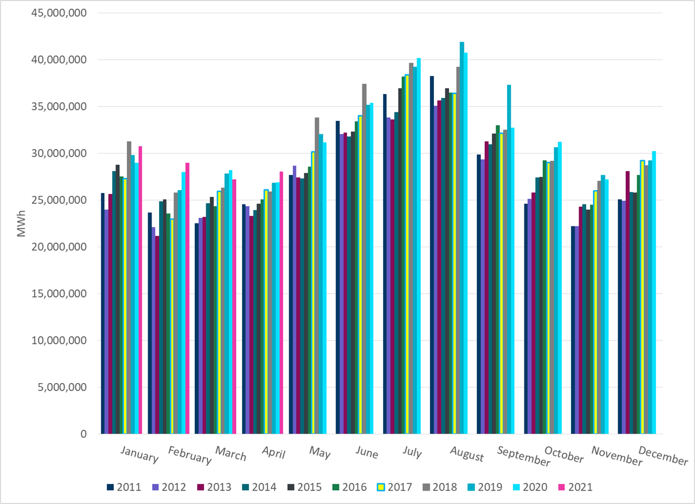
ERCOT Total Energy
Notes:
28,071,084 MWh

Slide 13
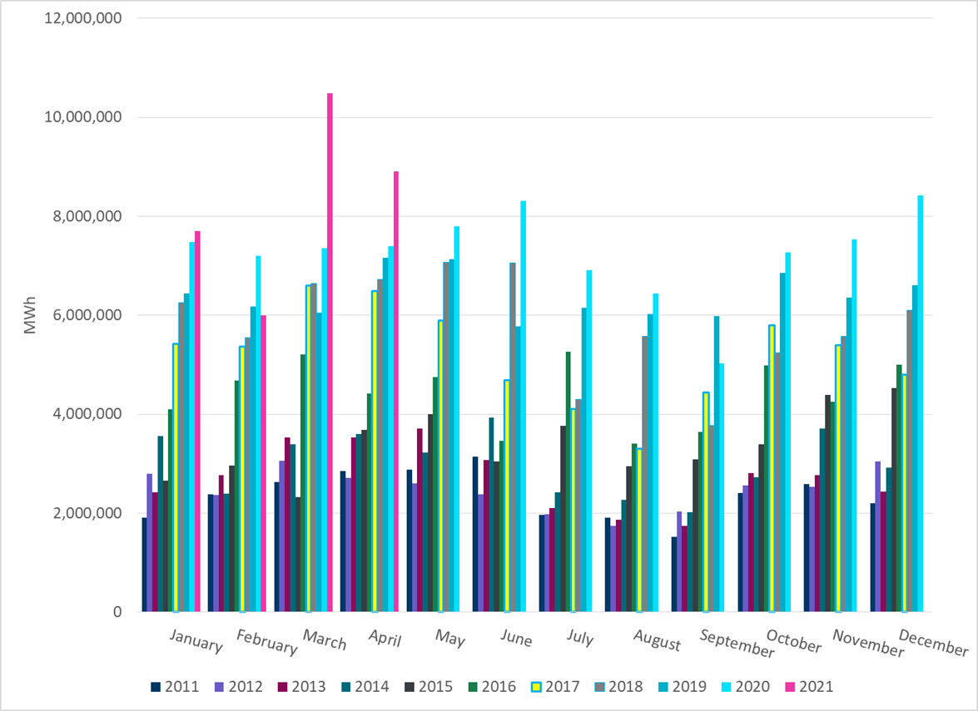
ERCOT Total Energy from Wind Generation
Notes:
8,907,804 MWh

Slide 14
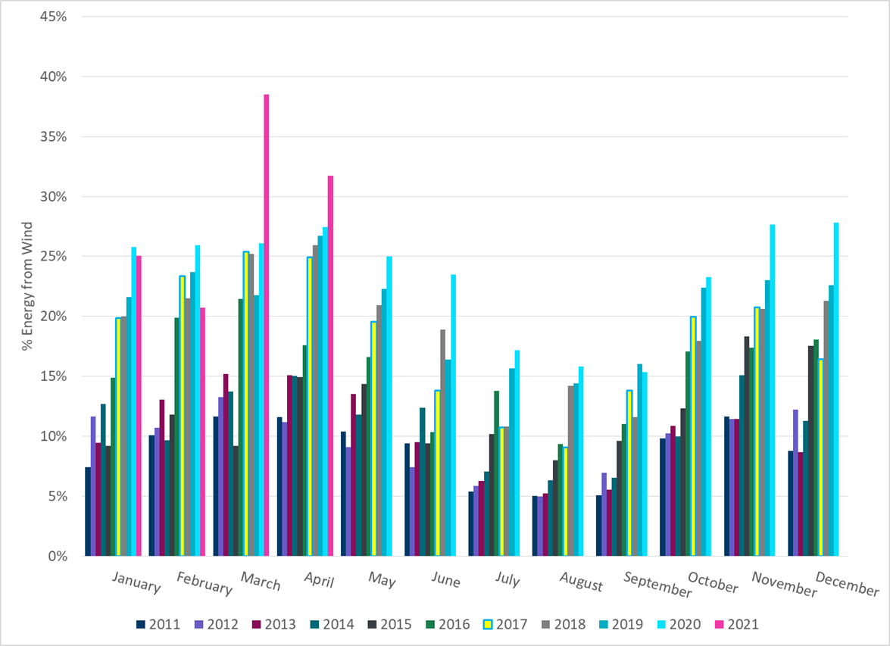
ERCOT % Energy from Wind Generation
Notes:
31.73%

Slide 15
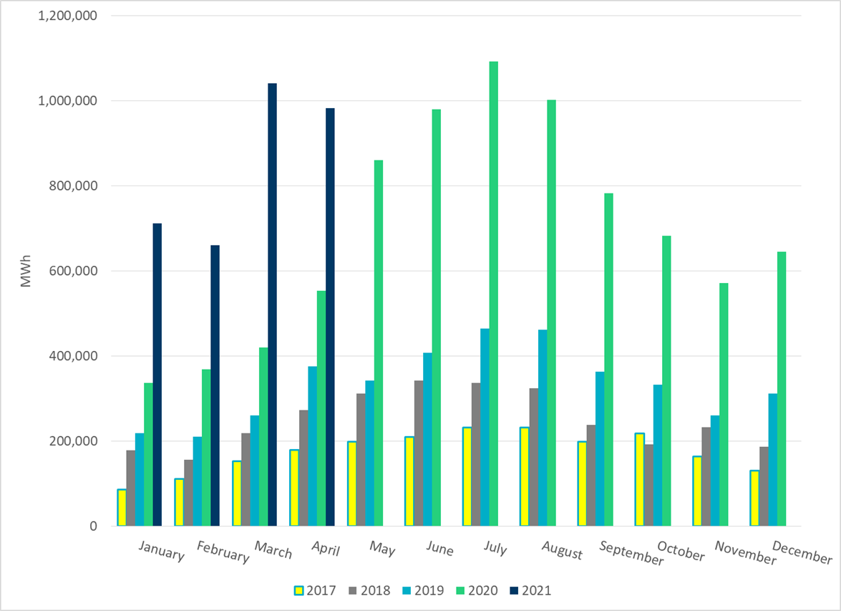
ERCOT Total Energy from Solar Generation
Notes:
982,403 MWh

Slide 16
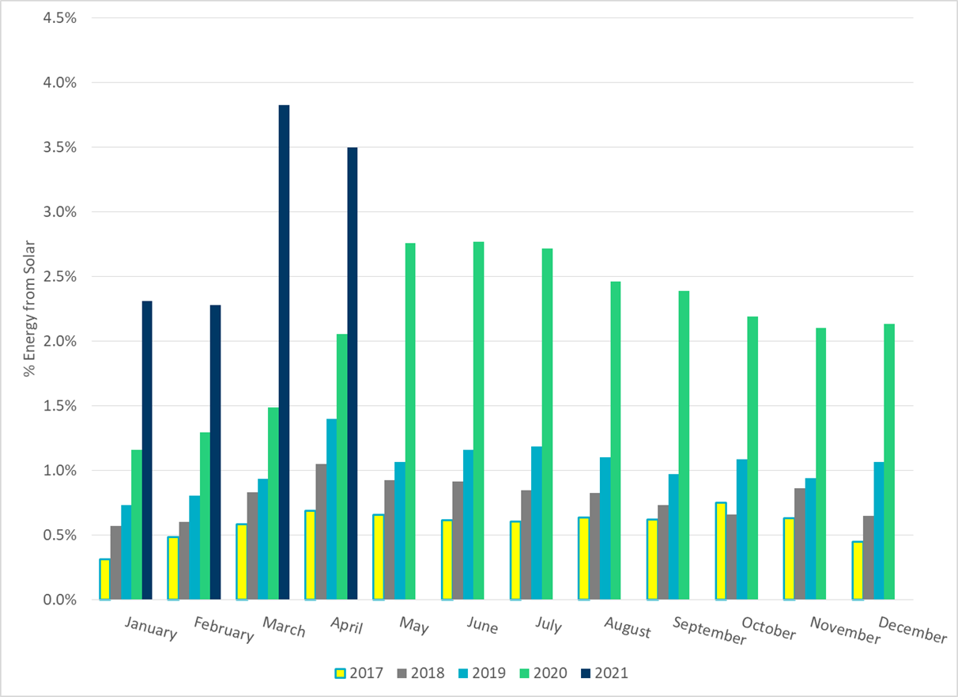
ERCOT % Energy from Solar Generation
Notes:
3.50%

Slide 17
Questions?

