Slide 1
Supply Analysis Working Group Report to WMS
June 2, 2021
Caitlin Smith, Chair
Ian Haley, Vice Chair (is in charge today)
Pete Warnken, Vice Chair

Slide 2
May SAWG Topics
Battery RFI
Data fields for Batteries, Self-Limiting Facilities (NPRR1026) and DC-coupled Resources (NPRR1029) included in RRGRR023, but not yet available in RIOO
ERCOT sent RFIs in early February
Transmission connected projects
DGRs that submitted RARF
The template can be downloaded at http://www.ercot.com/content/wcm/lists/168307/Battery_RFI_Template.xlsx
IEs with planned storage projects that have signed IAs should complete the template and upload to RIOO-IS as an “Other” file type

Slide 3
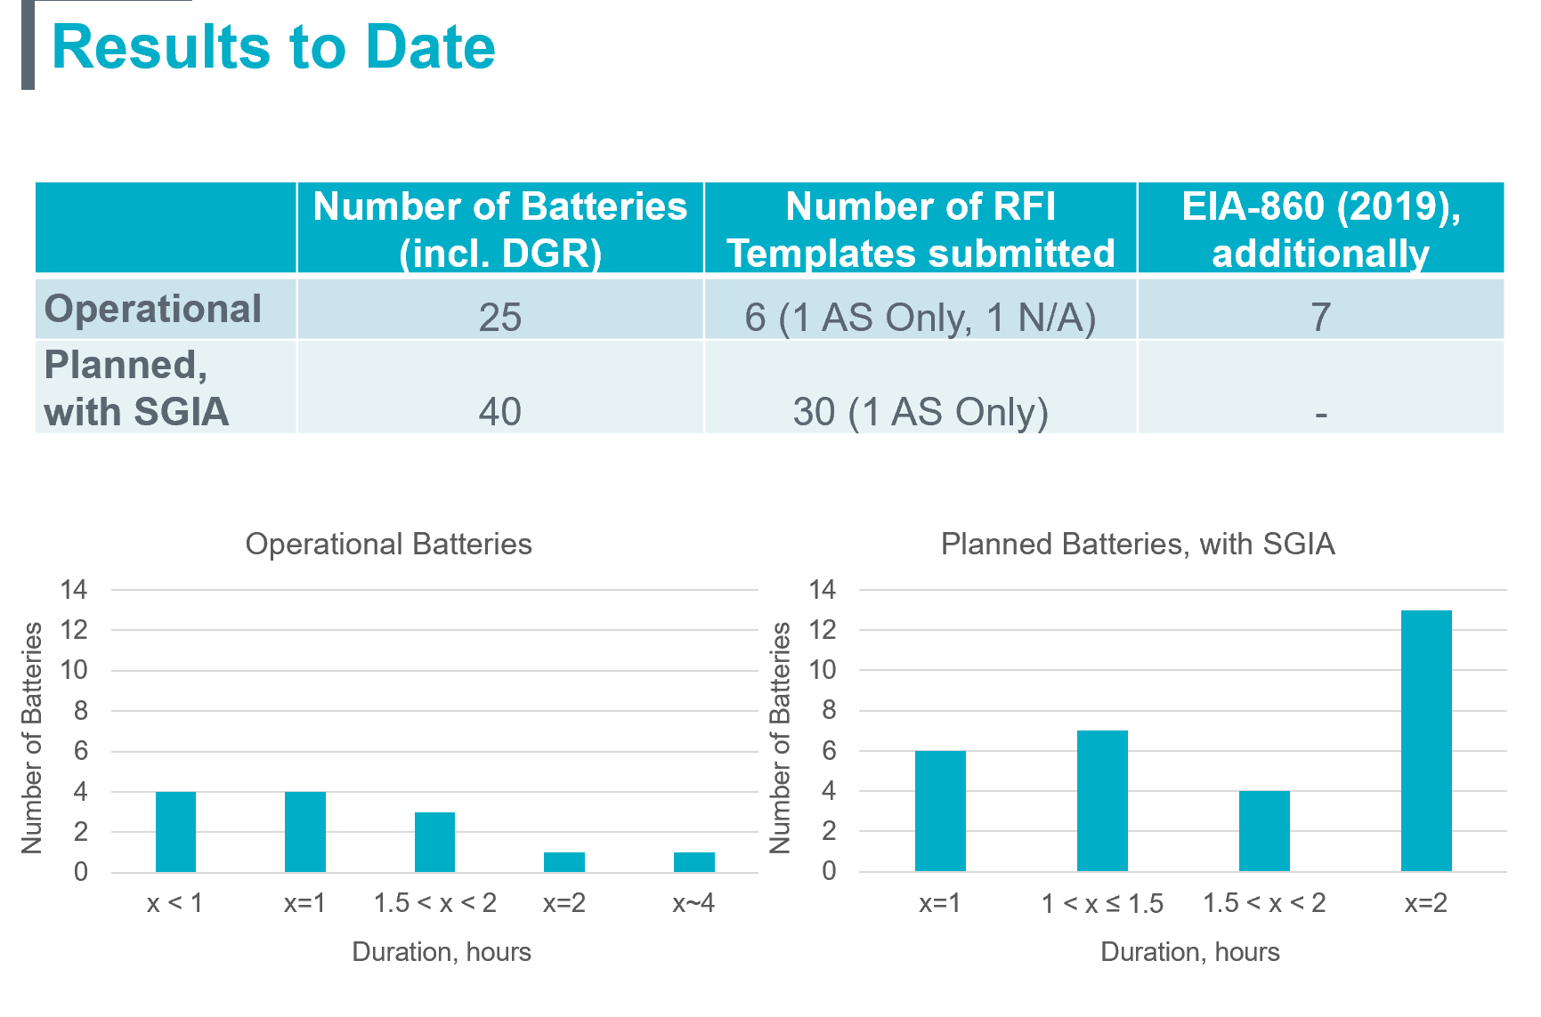
May SAWG Topics
Battery RFI – Results to Date

Slide 4
May SAWG Topics
Battery RFI – Next Steps:
RFI information is needed for resource adequacy assessments (so turn those in!)
Julia Matevosyan is the ERCOT lead if you have questions. Julia.Matevosyan@ercot.com
ERCOT will come back to October SAWG with:
Update on RFIs
Analysis of capacity contribution over peak summer hours

Slide 5
May SAWG Topics
Distributed Generation Trends Update

Slide 6
May SAWG Topics
Distributed Generation Trends Update

Slide 7
May SAWG Topics
Proposed NPRR language for DG in the CDR
Found here: http://www.ercot.com/calendar/2021/5/18/215938-SAWG
Firm Peak Load
ERCOT is proposing to add a new variable to the Firm Peak Load calculation that incorporates incremental forecasted peak load reductions from DG solar
Note – ERCOT is already separating out rooftop solar on the CDR and this would just memorialize it
Total Capacity Estimate
Add a new variable to report total DG capacity, along with categorization of DG types in the detailed unit capacities tabs (a current practice)
Plan to discuss language at June 18th SAWG Meeting

Slide 8
May SAWG Topics
Wind/Solar Capacity Contributions:
Proposal to develop a separate summer Summary tab for consideration of possible multi-hour reporting. The tab has the following elements:
Displays summer 2022 forecast year
Multiple columns representing the current summer highest-risk hours, HE 1600, 1700, 1800
Use the associated hourly peak load forecasts
Develop separate renewable capacity contribution percentages for each of the three hours using several approaches for comparison purposes
This is currently just a discussion item and not being proposed at this time to replace or augment the current CDR
Probabilistic SARA
Plan to run again for Summer 2021 like for Summer 2020
Waiting for updated wind/solar output profiles
Progress report at June 18th SAWG Meeting

Slide 9
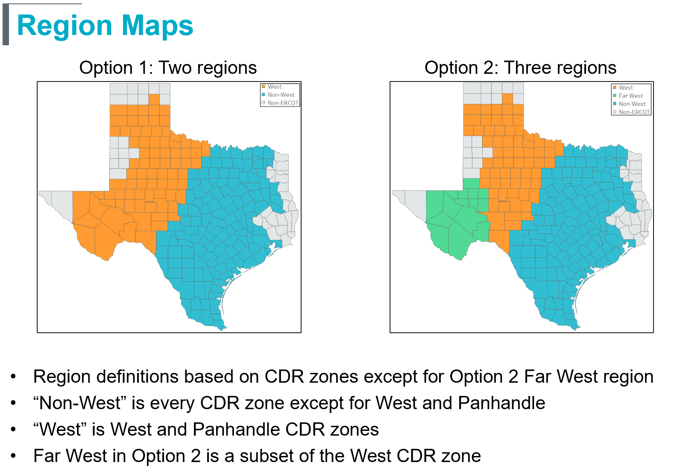
May SAWG Topics
Solar Regions Capacity Contributions

Slide 10
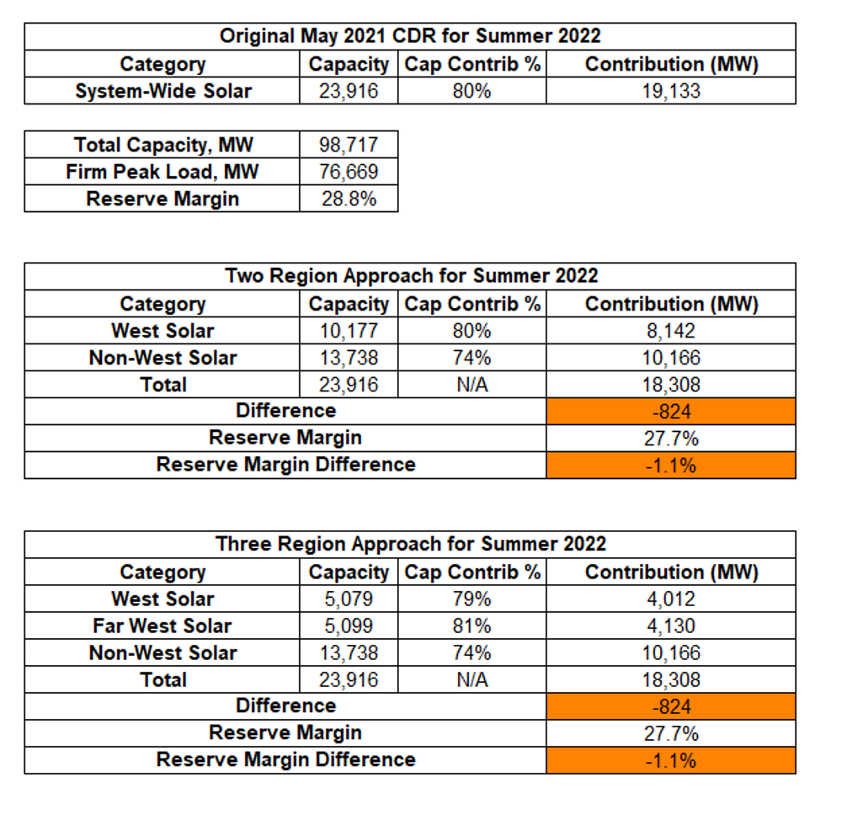
May SAWG Topics
Solar Regions Capacity Contributions
Planned solar units are significantly more geographically diverse than operational units
Noticeable difference in summer capacity contribution between West and Non-West
Little difference between West and Far West
Downsides to analysis
Capacity contribution calculations heavily influenced by the current fleet’s concentration in Far West
Did not look at the possibility of subdividing Non-West rather than West
Will further look at analysis after new vendor profiles

Slide 11
Emergency Conditions List from TAC/WMS
*Not discussed at May meeting*
Three Categories of items for SAWG:
1. Efforts to include risk, extreme weather and impacts of Winter Storm Uri into CDR, SARA and reserve margin reports
Plan: Address through ongoing efforts at SAWG
2. Planning items including load forecast methodology and transmission planning studies
Plan: Possible joint meeting with PLWG
3. Gas item: “How should capacity reports be modified to include gas market coincident and offsetting risks with electric system?”
Plan: Continue to coordination with ERCOT and GEWG
SAWG plan likely limited in scope to adding a reserve margin report scenario with a certain percentage of fuel unavailable over events of certain amounts of time (hours or days)

