Slide 1
Market Credit Working Group update to the Wholesale Market Subcommittee
Brenden Sager, Austin Energy, Chair
Seth Cochran, Direct Energy, Vice Chair
2 June 2021

Slide 2
MCWG update to WMS
General Update
19 May 2021 Joint MCWG/CWG WEBEX Meeting
3 NPRRs reviewed for their credit impacts
NPRR 1075, 1005 and 1063 considered operational without credit impacts
NRG introduced NPRR 1078 after the meeting regarding potential uplift calculations to exposure and collateral calculations

Slide 3
MCWG update to WMS
ERCOT Credit is about to calc the uplift which will hit total potential exposure and result in margin calls. Given the amount is about ~$3BN the uplift calculations could result mass departures, defaults and a second cascade of financial turmoil.
Separately, ERCOT Credit thought the original language, which was adopted in the zonal market, was ambiguous on how the future exposures beyond one year were to be calculated in PUL.
The group wanted pursue an urgent NPRR with goals of clarifying the language and stopping a mass departure/default scenario among market participants.
Discussed clarification around what the future exposure actually is after a bankruptcy in which the most likely case is ERCOT, as an unsecured creditor, would see most of its claims “written off.”
Defaulting entity receives bankruptcy court order and the entity will not pay anything further. It appears the uplift process contemplates that net original amount to be enforceable in full against the uplift pool.
No ERCOT process to cover a “write off” from bankruptcy
At a minimum, that Counterparty would be removed of the market but obviously that is not happening in this case.
Mitigations under consideration at the legislature; BK cases ongoing

Slide 4
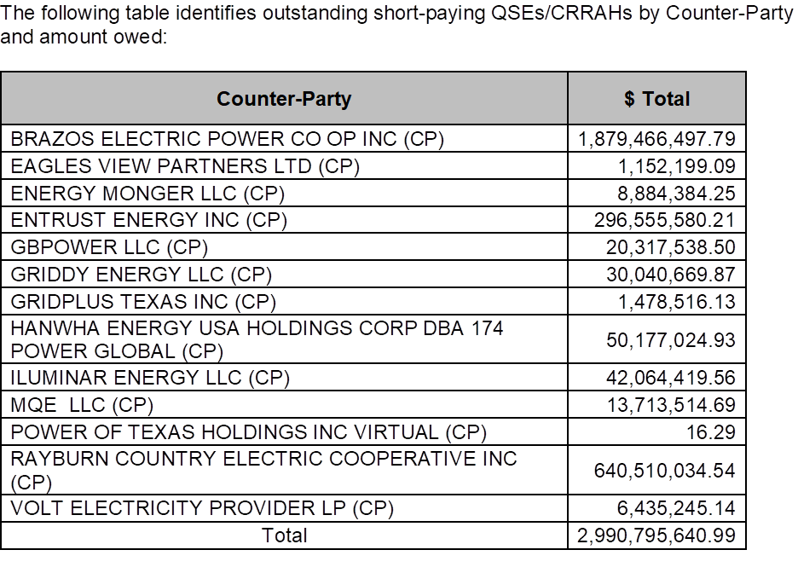
MCWG update to WMS

Slide 5
MCWG update to WMS
Potential Uplift Interpretation
Protocol Section 16.11.4.1 defines Potential Uplift (PUL) as:
Potential uplift to the Counter-Party, to the extent and in the proportion that the Counter-Party represents Entities to which an uplift of a short payment will be made pursuant to Section 9.19, Partial Payments by Invoice Recipients. It is calculated as the sum of:
(a) Amounts expected to be uplifted within one year of the date of the calculation; and
(b) 25%, or such other percentage based on available statistics regarding payment default under bankruptcy reorganization plans, of any short payment amounts being repaid to ERCOT under a bankruptcy reorganization plan that are due more than one year from the date of the calculation.

Slide 6
MCWG update to WMS
Because of the ambiguity in paragraph (b), ERCOT Legal looked at the derivation of the language to clarify the original intent.
PUL language was initially introduced in PRR 522, Collateral Requirements and Credit Changes, in 2004. As adopted, and throughout the zonal Protocols, the language was:
The sum of:
Amounts expected to be uplifted within one year of the date of the calculation; and
(2) Twenty-five percent (25%) [or such other percentage based on available statistics regarding default of reorganized Entities of any short payment amounts being repaid under a payment plan ordered by a bankruptcy court for a defaulting QSE] of amounts due more than one year from the date of the calculation

Slide 7
MCWG update to WMS
The highlighted clause is best interpreted as parenthetical, providing an exception for bankrupt entities to the general requirement of adding 25% of amounts to be uplifted after one year to the 100% of amounts to be uplifted within one year.
Therefore the original intent was that PUL equal
100% of amounts to be uplifted within one year, plus
25% of amounts to be uplifted after one year, plus
25% or another appropriate percentage of amounts expected to be repaid under a bankruptcy plan.
The changes in punctuation that change the meaning of the clause appear to have occurred when the language was incorporated in nodal Protocols (there is no supporting NPRR).
Given the conflict between the plain reading of the existing language, and what appears to be the original intent, ERCOT believes a clarifying NPRR is necessary, and seeks market feedback.

Slide 8
NRG Proposal
NPRR 1078 is to clarifies the definition of potential uplift within the calculation of a Counter-Party’s “Total Potential Exposure Any” (TPEA)
NRG proposed to cap the posting requirement to either the lesser of 25% of the uplift exposure (as is the protocol language today) or 10 years’ worth of expected uplift charges
Potential Uplift—Potential uplift to the Counter-Party, to the extent and in the proportion that the Counter-Party represents Entities to which an uplift of a short payment will be made pursuant to Section 9.19, Partial Payments by Invoice Recipients.
It is calculated as the sum of: (a) Amounts expected to be uplifted within one year of the date of the calculation; and (b) the lesser of: (1) 25% of amounts expected to be uplifted beyond one year of the date of the calculation; or (2) ten years’ worth of uplift charges, or such other percentage based on available statistics regarding payment default under bankruptcy reorganization plans, of any short payment amounts being repaid to ERCOT under a bankruptcy reorganization plan that are due more than one year from the date of the calculation.
~$3.0BN shortpays x .25 =750MM as a very rough cut.
Discussion of whether 10 years is the appropriate number

Slide 9
Review Default Uplift Estimated Share
ERCOT adjusted the PUL amount on April 29 and May 17
Default Uplift Invoices that collectively total no more than $2.5 million each month. The initial adjustment, totaling $15 million in the aggregate, made on April 29, 2021. The remaining $15 million adjustment to PUL made on May 17, 2021
The PUL adjustment will be for one year of Counter-Party expected uplift ($30m * activity share ratio).
In addition, ERCOT will adjust TPE for voluntarily terminating Market Participants with their total accrued Default Uplift obligation.
ERCOT does not expect to issue Default Uplift Invoices any sooner that the scheduled end of the legislative session on May 31, 2021.

Slide 10
Total Potential Exposure
TPEA = Max [0, MCE, Max [0, ((1-TOA) * EAL _{q} + TOA * EAL _{t} + EAL _{a})]] + PUL
TPES = Max [0, FCE _{a}] + IA
EAL _{q} = Max [IEL during the first 40-day period only beginning on the date that the Counter-Party commences activity in ERCOT markets, RFAF * Max {RTLE during the previous lrq days}, RTLF] + DFAF * DALE + Max [RTLCNS, Max {URTA during the previous lrq days}] + OUT _{q} + ILE _{q}
EAL _{t} = Max [RFAF * Max {RTLE during the previous lrt days}, RTLF] + DFAF * DALE + Max [RTLCNS, Max {URTA during the previous lrt days}] + OUT _{t}
EAL _{a} = OUT _{a}

Slide 11
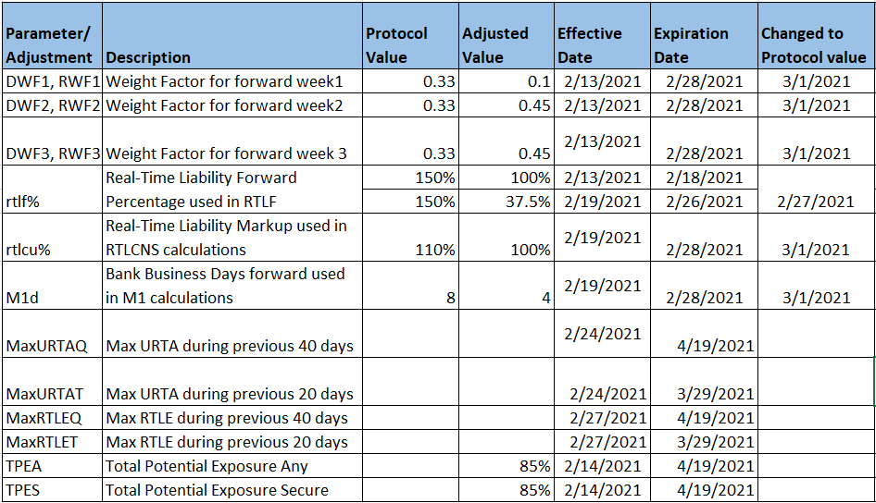
Adjustments to Total Potential Exposure (TPE)

Slide 12
MCWG update to WMS
Market-wide average TPE decreased from $ 716.6 million in March to $ 550.8 million in April
TPE decreased mainly due to RTLE and URTA from high price days rolling off of MAXRTLE and MAXURTA
Discretionary Collateral is defined as Secured Collateral in excess of TPE,CRR Locked ACL and DAM Exposure
Average Discretionary Collateral decreased from $2,091.7 million to $1,508.7 million
The decrease in Discretionary Collateral is largely due to decrease in Secured Collateral.
Short pay entities are excluded from the above calculations to remove data skew
Discussion on how TPE coverage of settlements needs to be recalculated to show “normal” TPE in terms of how it was calculated outside of the adjustments made for Uri
ERCOT Credit indicated it cannot perform “hypothetical” recalculations of past exposures
Discussion of ERCOT reviewing what the TPE / Collateral requirements would have been if they had not changed various credit factors prior to the Storm
Forward Adjustment Factor weekly weightings,
the Real Time Liability Forward (RTLF) component, and
the RFAF and DFAF adjustment factors

Slide 13
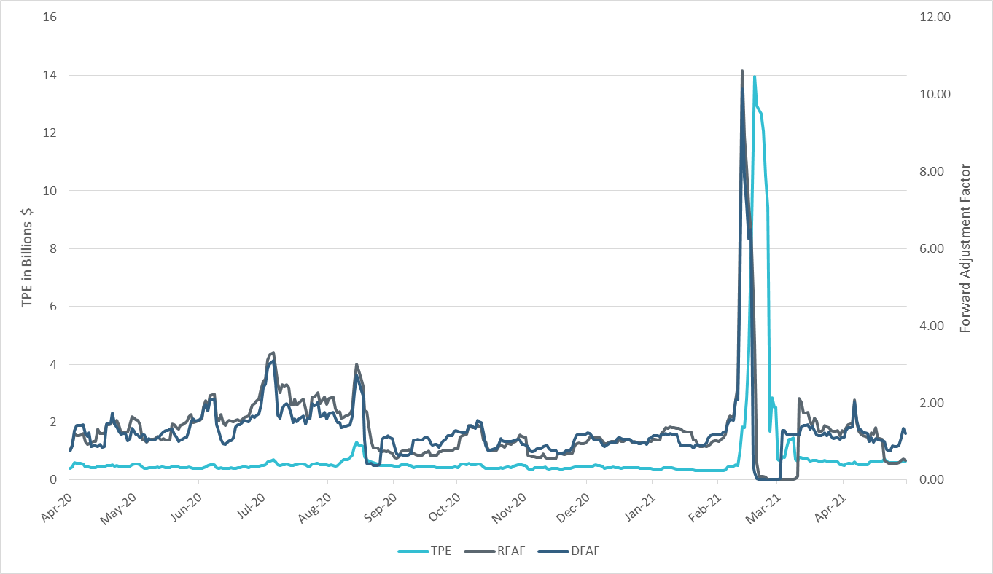
TPE and Forward Adjustment Factors Apr 2020- Apr 2021
*Short pay entities are excluded from the above calculations to remove data skew

Slide 14
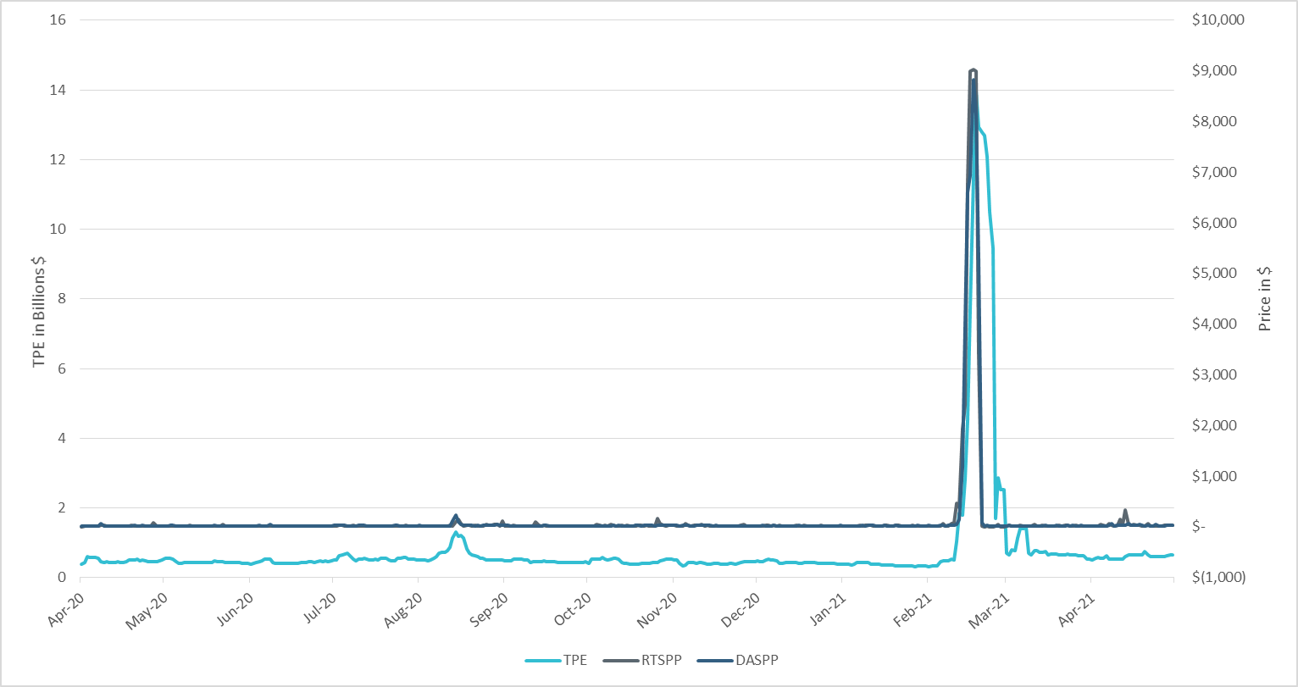
TPE/Real-Time & Day-Ahead Daily Average Settlement Point Prices for HB_NORTH Apr 2020- Apr 2021
*Short pay entities are excluded from the above calculations to remove data skew

Slide 15
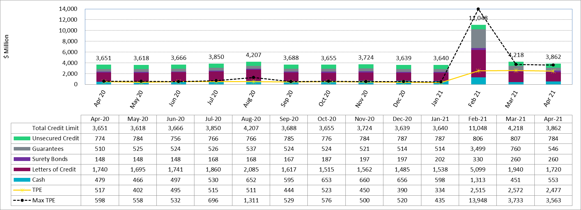
Available Credit by Type Compared to Total Potential Exposure (TPE) Apr 2020- Apr 2021
* Numbers are as of month-end except for Max TPE

Slide 16
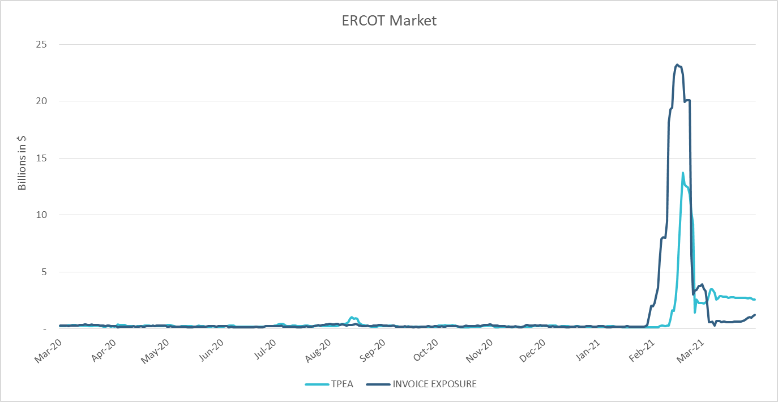
TPE Coverage of Settlements Mar 2020 - Mar 2021
TPEA closely approximates actual/invoice exposure except during weather event

