Slide 1
2021 Update to Rooftop Solar PV Growth Projections
Supply Analysis Working Group
May 18, 2021

Slide 2
S-Curve Growth Projections
Initial Methodology Proposed at April 12, 2019 SAWG Meeting
http://www.ercot.com/calendar/2019/4/12/172702-SAWG
Adoption of conservative, moderate, and high renewables scenarios at the April 17, 2020 13, 2019 meeting
AWS rooftop projections used
Consensus 3 curves adopted adjusted to match 2015-2019 baseline data
http://www.ercot.com/content/wcm/key_documents_lists/195745/SAWG_April_2020_Solar_PV_Growth_Projection_Discussion.pptx
Curves revised for 2020
2020 installed capacity data now available
2020 Updated UL (previously AWS) rooftop capacity values
Available capacity increases from 23 GW to 30 GW
Accounts for advances in Solar panel power output
Average installed system size increasing
Result in Increased values for all scenarios

Slide 3
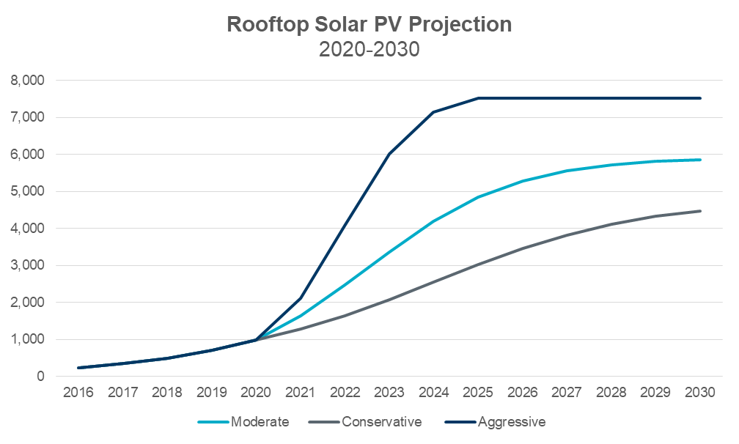
2020 Rooftop Solar PV Summary
Total of 990 MW for NOIES plus Competitive Choice areas
2019 moderate curve projection was 1047 MW (pre-Covid)

Slide 4
Observations
Scenarios deviate significantly
Conservative reaches ~2500 by 2024 and ~4500 MW by 2030
Moderate reaches ~4200 MW by 2024 and ~5900 MW by 2030
Aggressive reaches ~7100 MW by 2024 and ~7500 MW by 2030
2016-2020 Data matches the “Moderate” profile best (so far).
Discussion?

