Slide 1
Initial Analysis on Regional Solar
Capacity Contributions
Supply Analysis Working Group
Connor Anderson
Resource Adequacy
May 18, 2021

Slide 2
Outline
Region maps
Current and planned units by region
Capacity contributions by region and season
Effects on summer reserve margins
Next steps

Slide 3
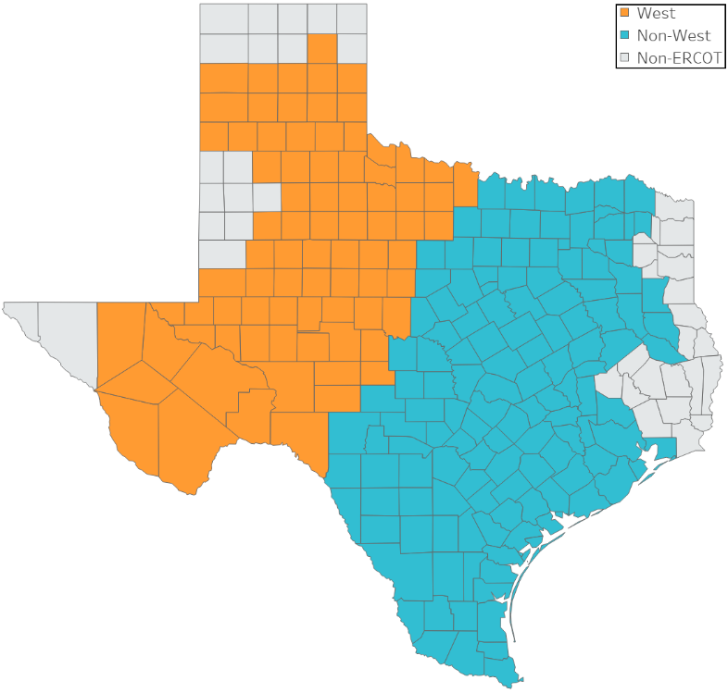
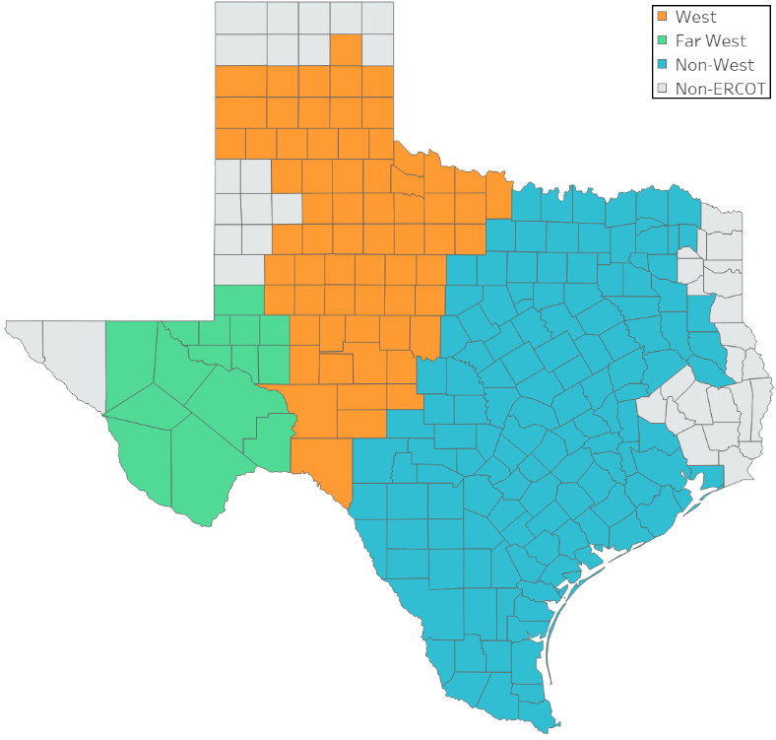
Region Maps
Option 1: Two regions
Option 2: Three regions
Region definitions based on CDR zones except for Option 2 Far West region
“Non-West” is every CDR zone except for West and Panhandle
“West” is West and Panhandle CDR zones
Far West in Option 2 is a subset of the West CDR zone

Slide 4
Three-Region Current and Planned Capacities
 | Non-West (MW) | West (MW) | Far West (MW)
Current (May 2021) | 323 | 813 | 2,942
End of 2021 | 4,083 | 2,911 | 4,791
End of 2022 | 13,738 | 5,079 | 5,099
End of 2023 | 15,693 | 7,248 | 5,302

Slide 5
Summer and Winter Capacity Contributions
Summer
2 Region - Summer
Year | Non-West % | Non-West MW | West % | West MW
2020 | 80% | 204 | 84% | 2,238
2019 | 67% | 204 | 74% | 1,444
2018 | 73% | 199 | 81% | 1,056
2 Region - Summer 3-yr Capacity-Weighted Capacity Contributions
Non-West | 74%
West | 80%
System-Wide | 80%
3 Region - Summer
Year | Non-West % | Non-West MW | West % | West MW | Far West % | Far West MW
2020 | 80% | 204 | 80% | 498 | 85% | 1,740
2019 | 67% | 204 | 78% | 264 | 73% | 1,180
2018 | 73% | 199 | 76% | 208 | 82% | 848
3 Region - Summer 3-yr Capacity-Weighted Capacity Contributions
Non-West | 74%
West | 79%
Far West | 81%
Winter
2 Region - Winter
Year | Non-West % | Non-West MW | West % | West MW
2020-2021 | 6% | 204 | 7% | 3,378
2019-2020 | 9% | 204 | 4% | 1,727
2018-2019 | 5% | 199 | 10% | 1,206
2 Region - Winter 3-yr Capacity-Weighted Capacity Contributions
Non-West | 7%
West | 7%
System-Wide | 7%
3 Region - Winter
Year | Non-West % | Non-West MW | West % | West MW | Far West % | Far West MW
2020-2021 | 6% | 204 | 8% | 668 | 8% | 2,680
2019-2020 | 9% | 204 | 4% | 294 | 4% | 1,433
2018-2019 | 5% | 199 | 16% | 208 | 9% | 998
3 Region - Winter 3-yr Capacity-Weighted Capacity Contributions
Non-West | 7%
West | 8%
Far West | 7%

Slide 6
Spring and Fall Capacity Contributions
Spring
2 Region - Spring
Year | Non-West % | Non-West MW | West % | West MW
2020 | 75% | 204 | 71% | 1,828
2019 | 46% | 199 | 49% | 1,438
2018 | 77% | 199 | 80% | 826
2 Region - Spring 3-yr Capacity-Weighted Capacity Contributions
Non-West | 66%
West | 65%
System-Wide | 65%
3 Region - Spring
Year | Non-West % | Non-West MW | West % | West MW | Far West % | Far West MW
2020 | 75% | 204 | 75% | 294 | 70% | 1,534
2019 | 46% | 199 | 49% | 258 | 49% | 1,180
2018 | 77% | 199 | 79% | 208 | 81% | 618
3 Region - Spring 3-yr Capacity-Weighted Capacity Contributions
Non-West | 66%
West | 67%
Far West | 64%
Fall
2 Region - Fall
Year | Non-West % | Non-West MW | West % | West MW
2020 | 62% | 204 | 75% | 3,179
2019 | 57% | 204 | 65% | 1,444
2018 | 60% | 199 | 59% | 1,206
2 Region - Fall 3-yr Capacity-Weighted Capacity Contributions
Non-West | 60%
West | 69%
System-Wide | 68%
3 Region - Fall
Year | Non-West % | Non-West MW | West % | West MW | Far West % | Far West MW
2020 | 62% | 204 | 75% | 498 | 75% | 2,681
2019 | 57% | 204 | 62% | 264 | 65% | 1,180
2018 | 60% | 199 | 66% | 208 | 57% | 997
3 Region - Fall 3-yr Capacity-Weighted Capacity Contributions
Non-West | 60%
West | 70%
Far West | 69%

Slide 7
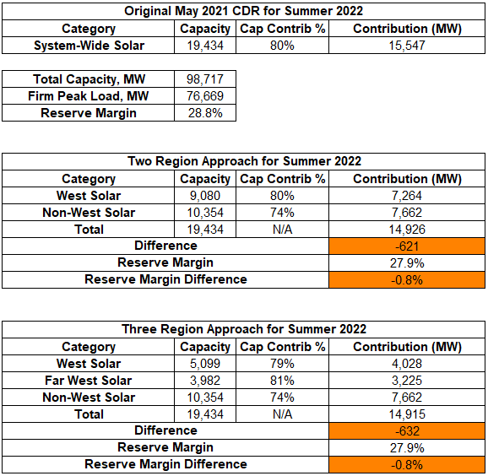
Summer 2022 Reserve Margin Impact

Slide 8
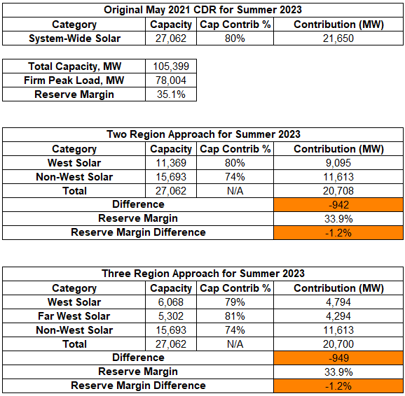
Summer 2023 Reserve Margin Impact

Slide 9
Conclusions of Initial Analysis
Planned solar units are significantly more geographically diverse than operational units
Noticeable difference in summer capacity contribution between West and Non-West
Little difference between West and Far West
Downsides to analysis
Capacity contribution calculations are heavily influenced by the current fleet’s concentration in Far West
Did not look at the possibility of subdividing Non-West rather than West

Slide 10
Next Steps
We will receive new solar planning profiles in the near future
Using the new profiles, we will:
Assign profiles to each CDR-eligible planned unit
Redo calculations using this larger, more diverse fleet
Look at the effect of subdividing Non-West rather than West (do not want to have more than 3 zones)

