Slide 1
Distributed Generation Trends Update
Includes Registered and Unregistered DG
Supply Analysis Working Group
May 18, 2021

Slide 2
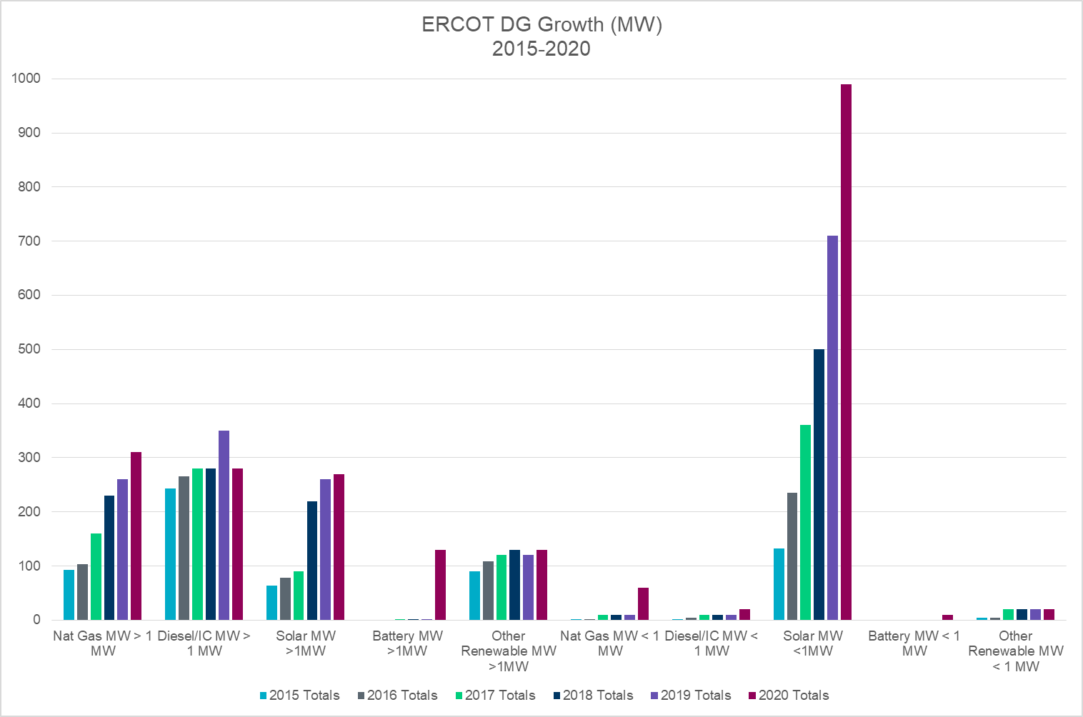
ERCOT Estimated Total DG Growth 2015-2020 (MW)
181%
*
31%
**
Note: The 2020 estimate includes NOIE data from their Annual Report to ERCOT, and TDSP data from their PUC reports excluding generation data informally reported by investor-owned utilities for generation that would typically be considered backup or emergency generation.
*2019 Transmission-connected generation incorrectly registered as SODG with ERCOT
** Other Renewable category includes: Wind, Landfill Gas and Hydro which were previously reported separately.
Notes:
Major areas of DG growth in ERCOT
Solar PV <1 MW
Natural gas > 1 MW (co-located with load)
DGR Energy Storage> 1 MW
Detail for Systems > 1 MW
New applications for Energy Storage
Continuation of upward trend for Nat Gas
Decreased growth for solar > 1 MW
Stagnant Diesel growth
Declining Landfill Gas, Hydro, Wind
Detail for Systems < 1 MW
Accelerating Solar PV trend (even during Covid!)
Increased small energy storage and Nat Gas (some registered as SODG)
Note that there seems to be a significant increase in interest for systems providing resiliency since Winter Event.
Nat gas
Batteries

Slide 3
Settlement-Only Distributed Generation in ERCOT 2010-2020
SODGs are:
<10 MW
If >1 MW and inject to grid, must register with ERCOT
If <1 MW, registration optional
Accumulated Count
Non-renewables
Renewables

Slide 4
DER Reporting Complexities in ERCOT
  Distribution Generation Resource
  Manual ERCOT extract (not in INR/RIOO database)
  Not included in Load Profile data or NOIE reported data.
  Most included in TDSP Annual report to PUC.
  Settlement-Only Distribution Generator
  Manual ERCOT extract (Not in INR/RIOO database)
  Not included in Load Profile data or NOIE reported data.
  Most included in TDSP Annual reports to PUC
  Unregistered Distributed Self-Generator ( >1 MW)
  No ERCOT database
  Included in NOIE data
  May be included in Load Profile data
  Included in TDSP Annual reports to PUC
  Unregistered Distributed Generator (< 1 MW)
  No ERCOT database
  Included in NOIE reported data
    Does not include Batteries (a few NOIEs report separately)
  Included in TDSP Annual reports to PUC
    Includes batteries
  Included in TDSP Load Profile data, but not updated
    Does not include batteries

