Slide 1
Useful Reports for Chronic Congestion
SCR813
ECEII Changes

Slide 2
Useful Reports
For Congestion Review

Slide 3
Chronic Congestion – Related MIS Reports
Congestion Related Reports on MIS
  NSA Active Constraints (NP6-6-CD)
    Contains contingency/element pairs beings sent to SCED for consideration in dispatching.
  Assessment of Chronic Congestion (NP3-767-M)
    ERCOT’s ROS monthly report
  Monthly Real-Time Congestion Report - Chronic or Severe Constraints (NP6-572-ER)
    Provides reasons for irresolvable, highly loaded, or long duration congestion

Slide 4
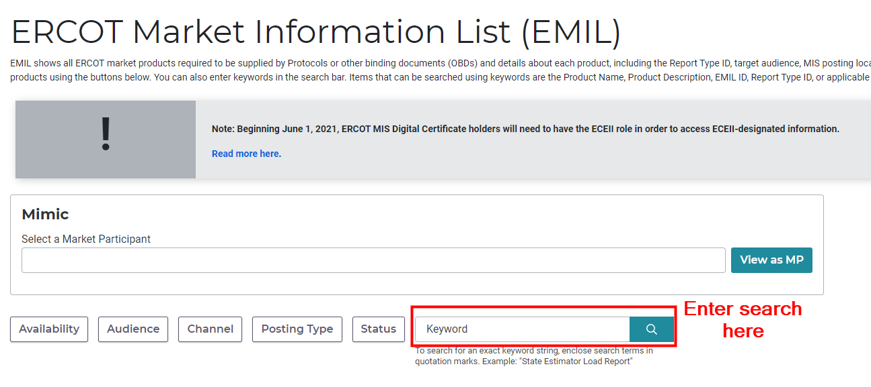
Chronic Congestion – Find MIS Reports by Name or EMIL ID
Navigate to https://mis.erecot.com/secure
Select your Digital Certificate
Select “Data Products” from the left
Search for the report name or EMIL ID

Slide 5
Chronic Congestion – NMMS_POSTINGS Reports
Location
  On Citrix within the NMMS_POSTINGS\NMMS_MODELS folder
  Contained with a Zip file named NMMS_Model_Reports_CIM_xxx.zip
  Reports exist for each model load
Line Ratings – AC_LINE_RATINGS_xxx.csv
  Contains a row for each rating of an element.
  Example, the 2-hour rating for 75° would be a row
  A line will be repeated if it is jointly rated
Line Parameters – AC_LINE_PARAMETERS_xxx.csv
  Contains R, X, BHC, PSSE Name, PSSE Number, and more!
Similar reports are present for Series Devices

Slide 6
SCR813

Slide 7
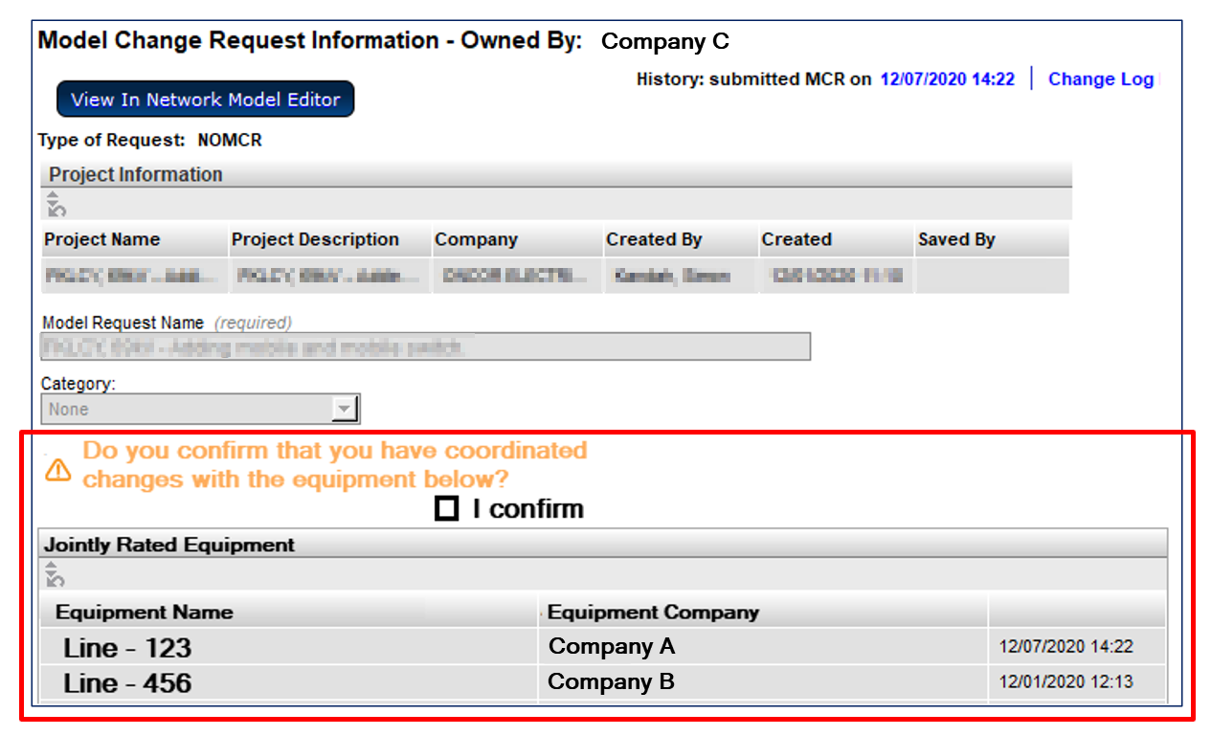
SCR813 - Submitter Shown Jointly-Rated Equipment and Coordination Confirmation Requested

Slide 8
SCR813 - Enhanced Notifications – “Walking the Tree”
Add functionality to send notifications to model-instance owners when “nearby” changes are made.
Currently notifications are only sent to owners of modified instances
Ratings sets are only owned by one company
  Each company will have their own ratings set if jointly owned
Example
  A notification would be sent to Company B if Ratings Set #1 were modified by Company A
Changing the impedance will send a notification to Company A and Company B
Changing the ratings in Ratings Set #1 will only send a notification to Company A
Changing the ratings in Ratings Set #1 will only send a notification to Company B

Slide 9
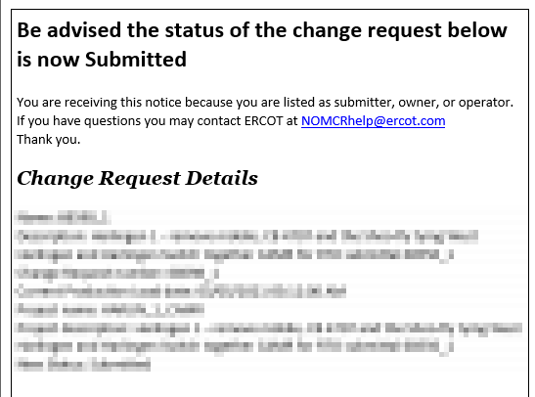
SCR813 - Additional Notification
The notification currently sent when a NOMCR is submitted would also be sent to all associated companies

Slide 10
ECEII – NPRR902

Slide 11
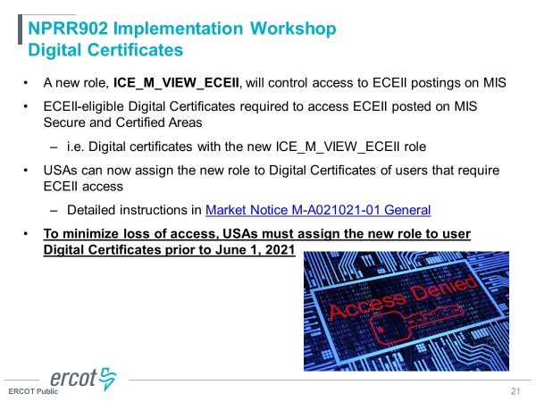
ECEII
and NMMS_M_IMM_ECEII
New role required to access ECEII data
PTC Postings which will require new role:
  TSP version of CIM Network Model
  TSP version of Test Network Operations Model
  Redacted CIM Network Model
Standard Contingency List (NP5-615-SG) will be classified as ECEII

