Slide 1
Update on Intra-Hour Solar Forecast and SCR811
Balancing Operations Planning Staff
WMWG
May 17, 2021

Slide 2
Discussion Outline
Intra-Hour Solar Forecast Performance Update
Next Steps

Slide 3
Predicted Solar Ramp Error Update
Performance Metric | Persistence (4/23 – 5/10) | Intra-Hour Solar Forecast (4/23 – 5/10) | Short-term Solar Forecast (STPPF) (4/23 – 5/10)
MAE (MW) | 79.29 | 60.12 | 57.60
MAE (MW) when 5-Min. Solar Ramp > 100 MW | 190.12 | 114.38 | 105.64
MAE (MW) when 5-Min. Solar Ramp < -100 MW | 195.40 | 109.68 | 113.03
Over Forecast
Under Forecast

Slide 4
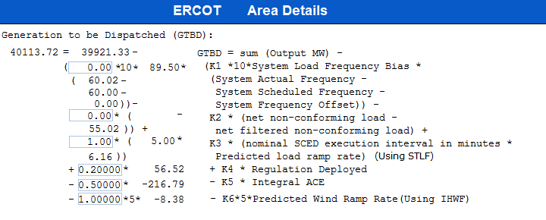
K8 and Max PSRR Threshold in GTBD
- K8 *5* PSRR
- K8*5*Predicted Solar Ramp Rate (Using STPPF/IHPPF)
|PSRR| ≤ Max PSRR Threshold
Implementation of SCR811
Notes:
3/12/18 – Integral ACE Time Constant Changed from 60 min to 45 min
5/17/18 – K4 Changed from 0.3 to 0.2 and K5 Changed from 0.4 to 0.5
12/4/18 – 10:05 AM – K6 Changed from 0 to 0.5
2/12/19 – 2:15 PM – K6 changed from 0.5 to 1.0
3/12/19 – 2:10 PM – PWRR Threshold from 10 to 15 MW/min
3/19/19 – 2:15 PM – PWRR Threshold from 15 to 20 MW/min
4/01/19 – 10:00 AM – K5 changed from 0.5 to 0.4 and Max. Integral ACE Feedback changed from 250 to 150
4/24/19 – 1:15 PM – Max. Integral ACE Feedback changed from 150 to 160. PWRR Threshold changed from 20 to 25.
5/22/19 – 1:10 PM – K5 changed from 0.4 to 0.5, Max Integral ACE feedback changed from 160 to 200, PWRR Threshold changed from 25 to 30
6/17/20 – 10 AM - PWRR Calculation method changed from Direct to Interpolated
9/1/20 – 11 AM - Max Integral ACE Feedback changed from 200 to 250
9/3/20 – 3 PM - Max Integral ACE Feedback changed from 250 to 300
9/4/20 – 3 PM - Max Integral ACE Feedback changed from 300 to 250

Slide 5
Next Steps
ERCOT will implement SCR811 during 2021 R3 between May 25 and May 27.
Initially, K8 will be set to 0 so that it will not impact GTBD calculation.
ERCOT is planning to tune K8 (K8 becomes non-zero) and potentially other GTBD parameters in the first week of June.
A market notice will be sent out prior to activation of K8 to a non-zero value.

