Slide 1
GGOV1 Matlab Modeling for Significant Frequency Events
Bracy Nesbit
Bailey Barksdale

Slide 2
Background
In late 2017 studies were presented that analyzed Primary Frequency Response and Responsive Reserve Services needed to ensure system stable interconnection frequency is maintained if the target category C (N-2) event occurs. It was recognized that assumed Combined Cycle unit response did not account for the affect of large frequency deviations.
To adequately understand the impact of the large frequency deviations on turbine generator primary frequency responses LCRA Generation worked with Burns & McDonnell to analyze the models used in the study. One of the recommendations from the Burns & McDonnell study was to update the governor models for the extreme frequency events so that these parameters can be entered into the most accurate model of the ERCOT grid.
LCRA Generation has been able to update the GGOV1 model for the 59.3 Hz event condition.
Notes:
The ETAP GGOV1 model has good modeling tools, but Matlab had different tools that were desired to express the modeling of a GGOV1 governor.

Slide 3
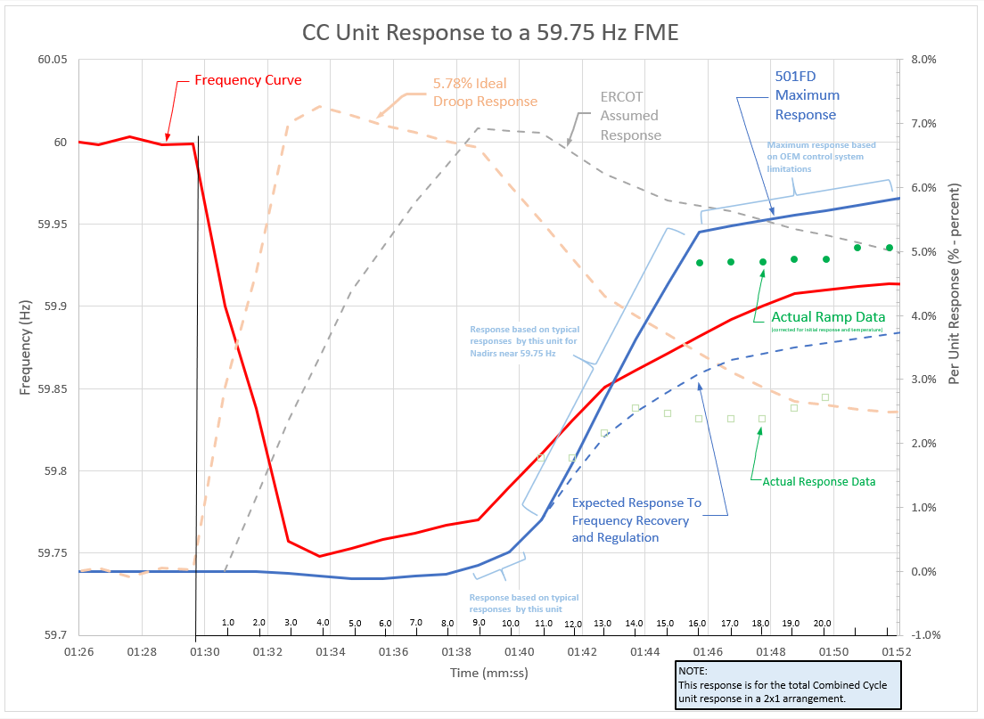

Slide 4
Process
Matlab and Simulink were implemented to build a replica of the ETAP version of the GGOV1 model.
This model has been adjusted a little bit based on other sources and the desired output curve of the model.
The goal of this process was to accurately model a unit’s response for large frequency events such as 59.3 Hz.
As a result of trial and error, it was determined that five variables/input parameters of the GGOV1 model would need to be adjusted to accurately reflect the response for each event.
These parameters were Tb (Turbine lag time constant), Kturb (turbine gain), Wfnl (no load fuel flow), Kigov (governor integral gain), and Pref (power reference)
This GGOV1 model has not been tested via PSS/E yet

Slide 5
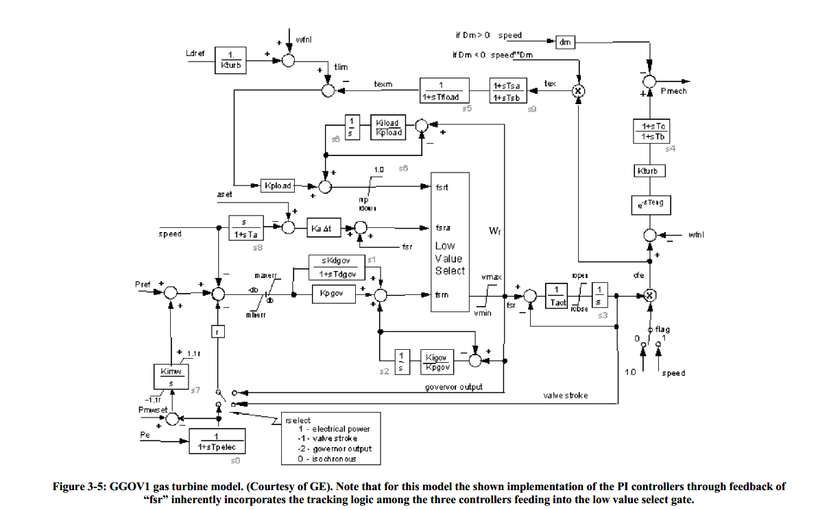
GGOV1 Gas Turbine Model (Courtesy of GE)

Slide 6
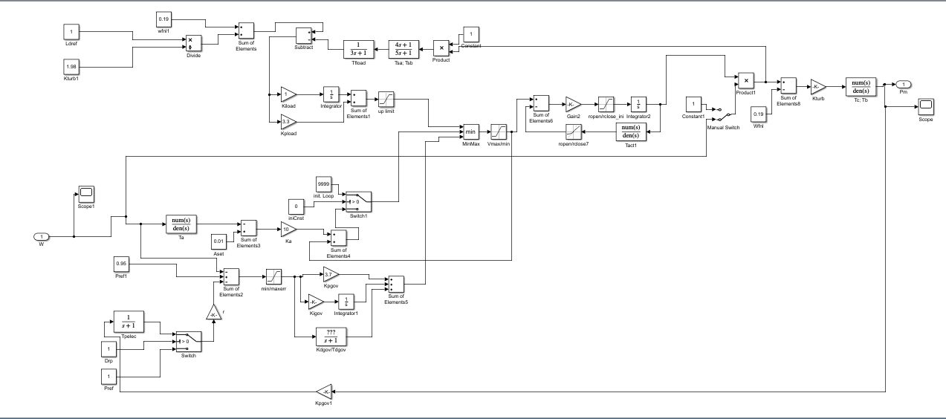
Matlab GGOV1 Model

Slide 7
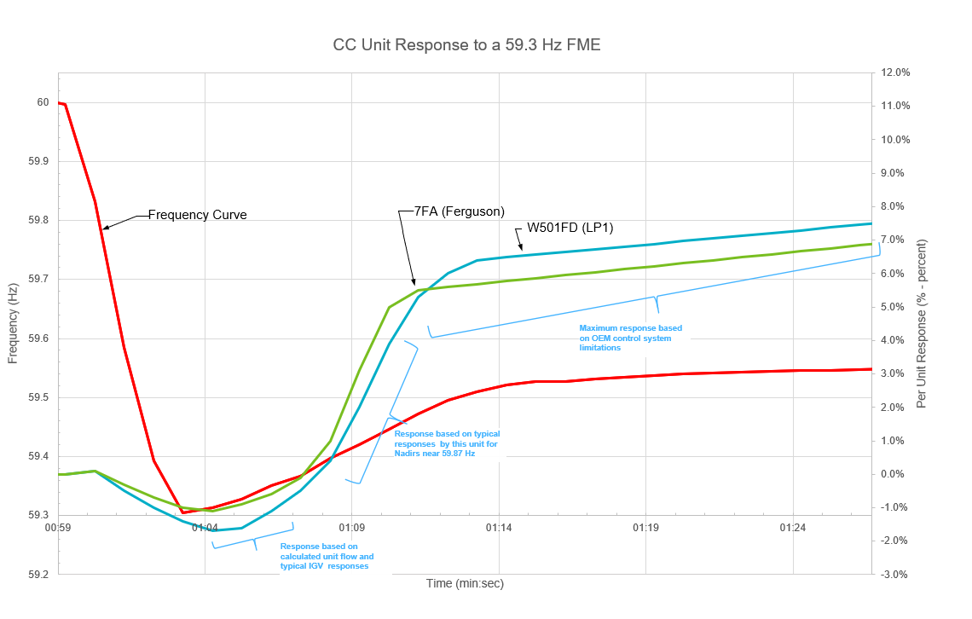

Slide 8
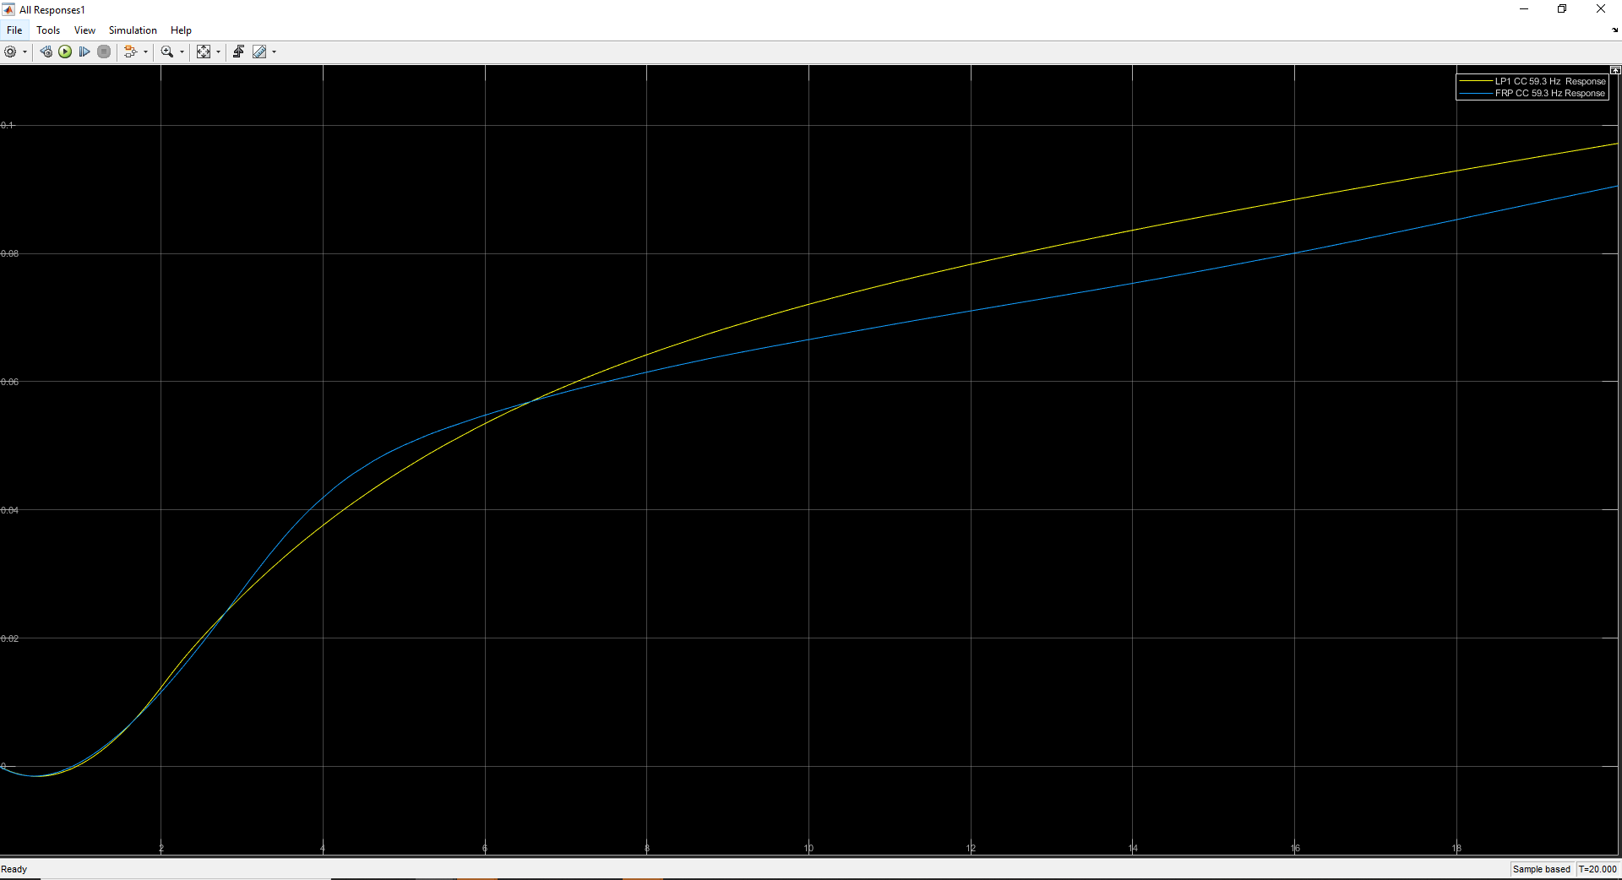
GE 7FA 59.3 Hz Response
Westinghouse 501FD 59.3 Hz Response
59.3 Hz All Matlab CC Responses

Slide 9
CC Response Parameter Adjustments
Parameter | GE 7FA ERCOT Submitted Parameter Value |  | GE 7FA 59.3 Hz Response Parameter Value | Westinghouse 501FD ERCOT Submitted Parameter Value | Westinghouse 501FD 59.3 Hz Response Parameter Value
Tb | 0.5 (For Both CTs) |  | 1.4 | 0.1 (For Both CTs) | 3.5
Kturb | 1.7 (CTG1) | 1.67 (CTG2) | 0.105 | 1.98 (For Both CTs) | 0.24
Wfnl | 0.16 (CTG1) | 0.17 (CTG2) | 0.05 | 0.19 (For Both CTs) | 0.05
Pref** | 0.95 (For Both CTs) |  | 1.0149 | 0.95 (For Both CTs) | 1.12
Kigov | 1.4 (For Both CTs) |  | 0.65 | 0.75 (For Both CTs) | 0.085
**Pref is an assumed input value for the model

Slide 10
Questions?

Slide 11
References
ETAP. “ETAP GGOV1 Model.”
NERC. “Reliability Guideline – Application Guide for Modeling Turbine Governor and Active Power-Frequency Controls in Interconnection-Wide Stability Studies.” June 2019.
Gu, Qinxu, "Real-Time Modeling of Gas-Electric Dependencies: An Optimal Control Approach" (2018). Theses and Dissertations. 4282. https://preserve.lehigh.edu/etd/4282
Menon, A. S., Babu, N. R., & Desabatla, S. (2016). Study on the Impact of Turbine Controls on Transient Stability of Synchronous Machine. Journal of Green Engineering, 6(2), 1-22. doi:10.13052/jge1904-4720.624
NERC. “MOD-027-1 Verification of Models and Data for Turbine/Governor and Load Control or Active Power/Frequency Control Functions.” 26 Nov. 2014.
Power System Dynamic Performance Committee, Power System Stability Subcommittee, & Task Force on Turbine-Governor Modeling. (2013, January). Dynamic Models for Turbine-Governors in Power System Studies (Rep. No. PES-TR1).
NERC. “Modeling Notification – Gas Turbine Governor Modeling.” August 2017.

Slide 12
Appendix A
Matlab Overall GGOV1 Model
3
1
2
4

Slide 13
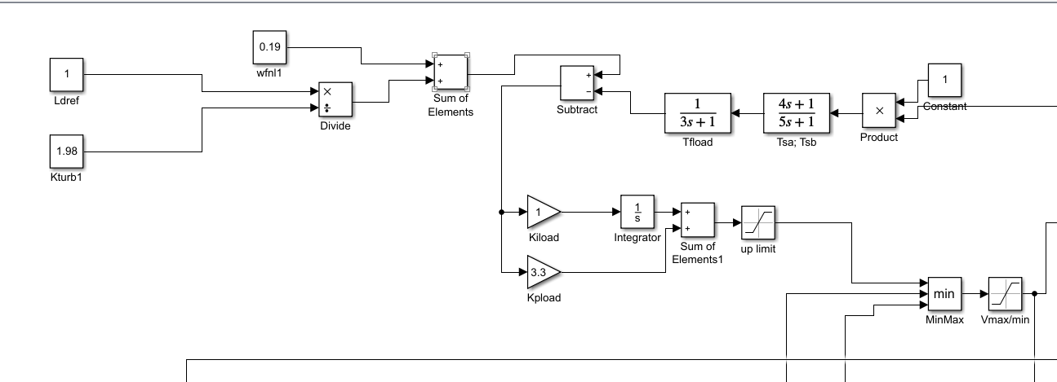
Appendix A
Matlab GGOV1 Model Section 1

Slide 14
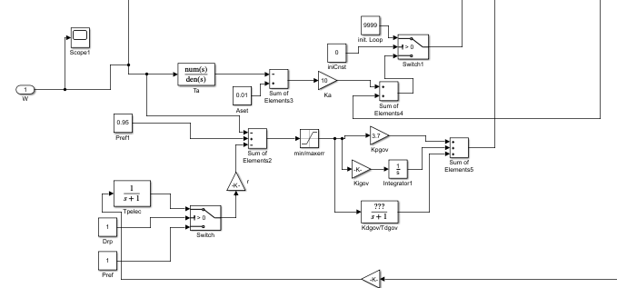
Appendix A
Matlab GGOV1 Model Section 2

Slide 15
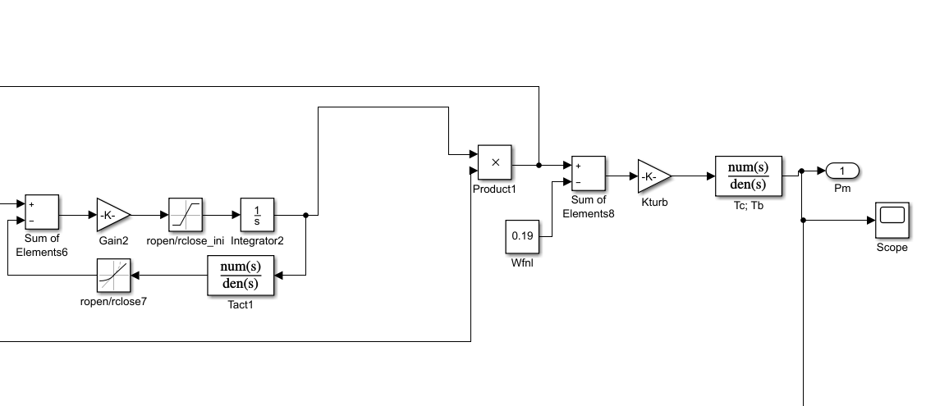
Appendix A
Matlab GGOV1 Model Section 3

