Slide 1
Feb 2021 Winter Event
Performance Of ESRs When Providing RRS-PFR
ERCOT Staff
May 14, 2021
PDCWG

Slide 2
Agenda
Update on individual ESR Performance Review
Comparison of aggregate level ESR output data between the ESRs that were providing RRS vs. those that were not.
Market Rules related to ESR Charging during EEA

Slide 3
Update on ESR Performance Review
Per the posted Capacity Changes by Fuel Type report as of Feb. 28 2021 cumulative installed capacity of Energy Storage Resources (ESRs) was 235 MW.
During the Feb 14 through Feb 20 timeframe, Energy Storage Resources provided upto about 9.9 MW of Regulation Down, 65 MW of FRRS Up and 78 MW of RRS-PFR as a Generation Resource; and 18 MW of Regulation Down, 10 MW FRRS Up, 35 MW FRRS Down and 54 MW of RRS-PFR as a Controllable Load Resource.
During the same timeframe, no ESR provided RRS-FFR.
ERCOT has been reviewing performance of individual ESRs during the Feb 14th through Feb 20th timeframe. ERCOT has several observations to share,
ESRs were switching RRS responsibility from ESR-Gen to ESR-CLR in the middle of a deployment. On some occasions the ESR-Gen HSL was concurrently being reduced.
Some ESRs had a very blocky output telemetry.
Several telemetry issues were noticed. Ex 1. ESRs were at times telemetering MW/output greater than HSL. Ex 2. inconsistent Resource Status code and A/S telemetry.
ERCOT will be reaching out to the QSEs that are responsible for these ESRs to better understand their behavior and associated telemetry in the next couple weeks.
ERCOT will bring back more data to the PDCWG upon completion of this effort.

Slide 4
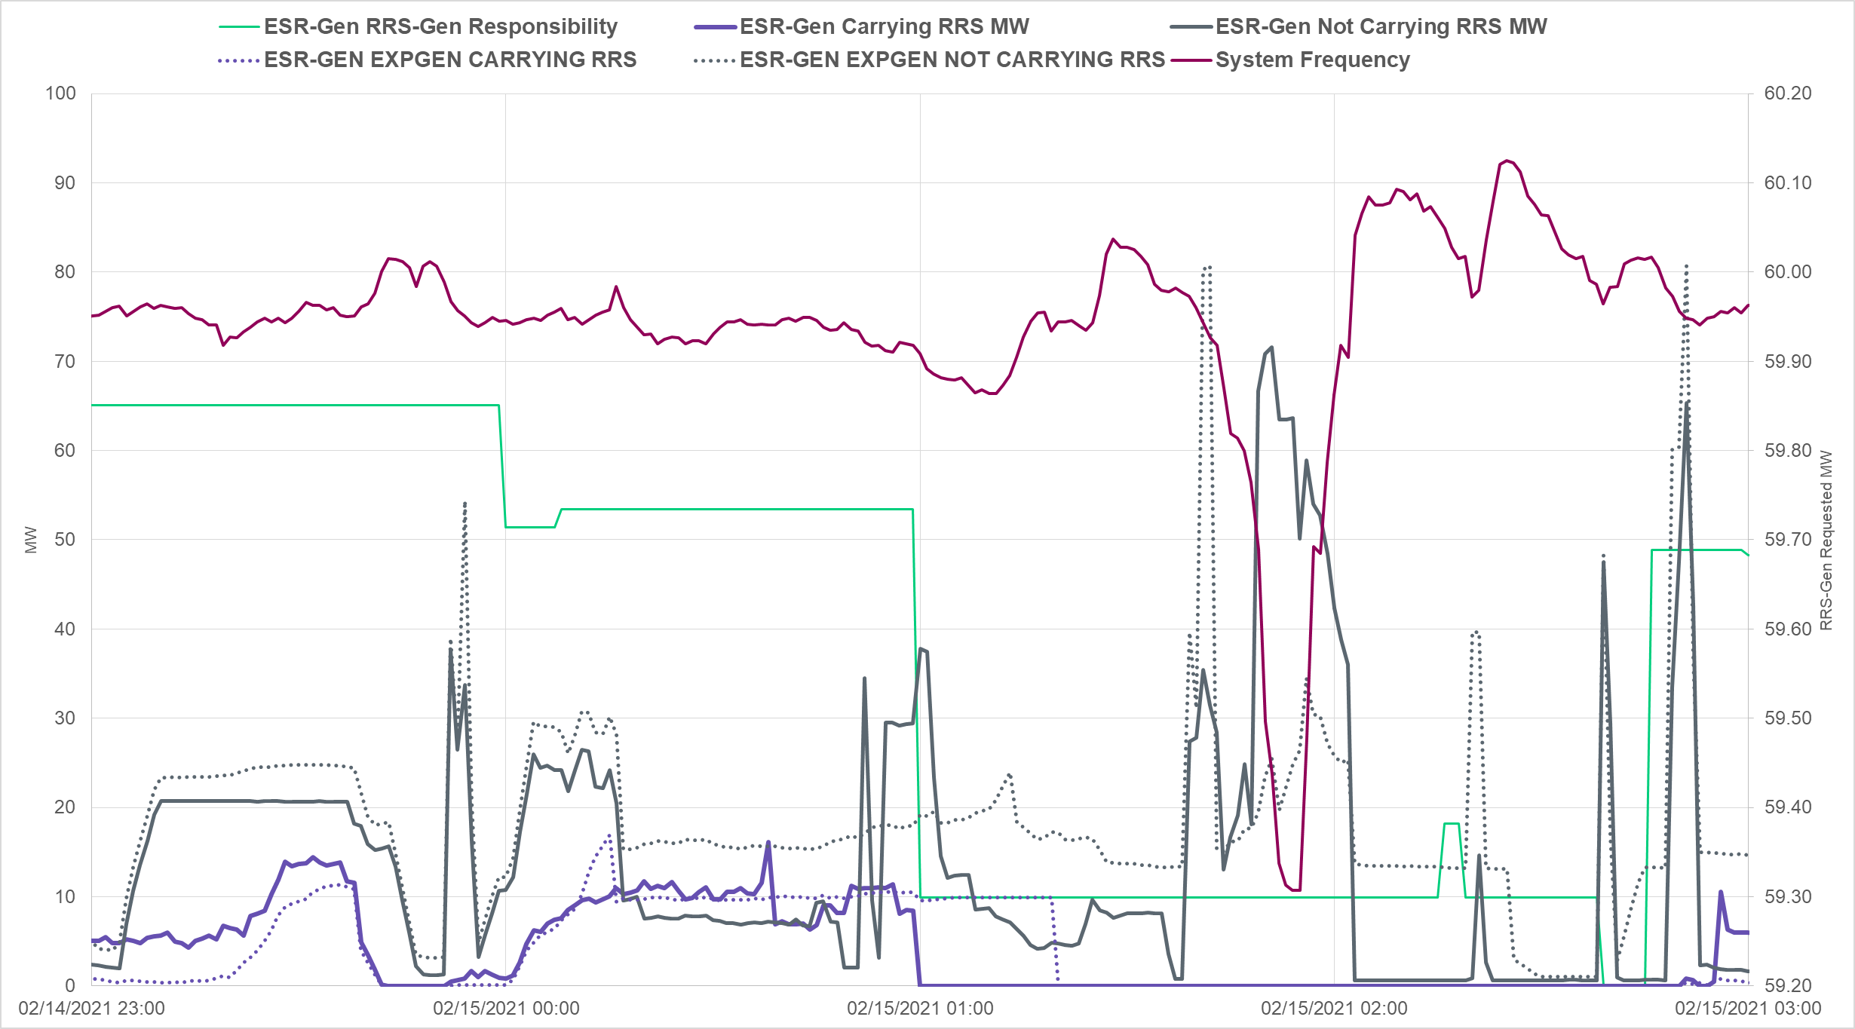
Output of ESR-Generators During Feb 15th Low Frequency Event
This graph now includes an estimation of expected generation (in dashed lines) from ESR-Generators.
Estimated expected generation is computed as sum of UDBP, Regulation Instruction and primary frequency response (computed for using 5% droop). Since most ESRs are set at 1% droop this is a conservative estimate of the expected generation.
RRS was being released between 11:19 pm and 2:03am.

Slide 5
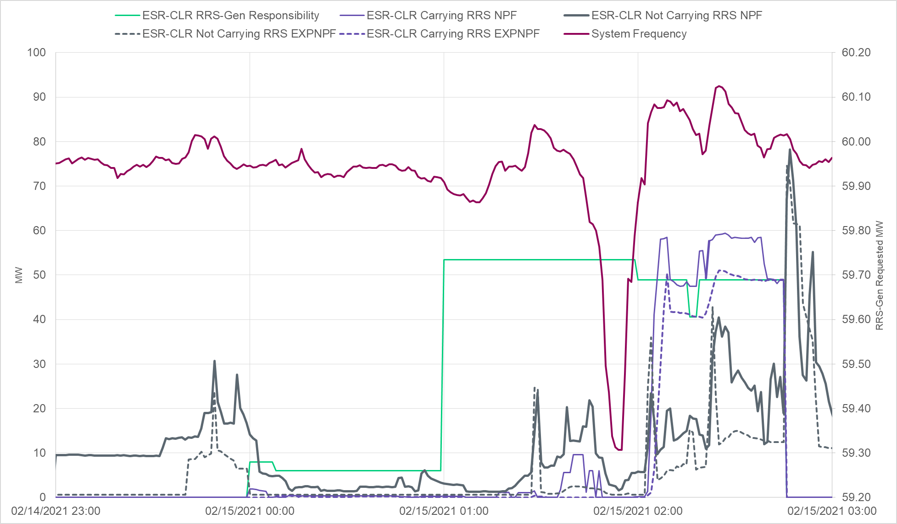
Net Power Flow (NPF) of ESR-CLRs During Feb 15th Low Frequency Event
This graph now includes an estimation of expected consumption (in dashed lines) from ESR-CLRs.
Estimated expected consumption is computed as sum of UDBP, Regulation Instruction and primary frequency response (computed for using 5% droop). Since most ESRs are set at 1% droop this is a conservative estimate of the expected consumption.
RRS was being released between 11:19 pm and 2:03am.

Slide 6
Rules on ESR Charging During an EEA - PUCT Rule 25.501 (m)
§25.501. Wholesale Market Design for the Electric Reliability Council of Texas.
(m) Energy Storage.
For a storage facility that has more than one delivery point, ERCOT shall net the impact of those delivery points on the ERCOT system for settlement purposes.
Wholesale storage occurs when electricity is used to charge a storage facility; the storage facility is separately metered from all other facilities including auxiliary facilities; and energy from the electricity is stored in the storage facility and subsequently re-generated and sold at wholesale as energy or ancillary services. Wholesale storage is wholesale load and ERCOT shall settle it accordingly, except that ERCOT shall settle wholesale storage using the nodal energy price at the electrical bus that connects the storage facility to the transmission system, or if the storage facility is connected at distribution voltage, the nodal price of the nearest electrical bus that connects to the transmission system. Wholesale storage is not subject to retail tariffs, rates, and charges or fees assessed in conjunction with the retail purchase of electricity. Wholesale storage shall not be subject to ERCOT charges and credits associated with ancillary service obligations, or other load ratio share or per megawatt-hour based charges and allocations. The owner or operator of electric storage equipment or facilities shall not make purchases of electricity for storage during a system emergency declared by ERCOT unless ERCOT directs that such purchases occur.

Slide 7
Rules on ESR Charging During an EEA – NPRR 1002
6.5.9.4.2 EEA Levels
ERCOT will declare an EEA Level 1 when PRC falls below 2,300 MW…..
QSEs shall:
Ensure COPs and telemetered HSLs are updated and reflect all Resource delays and limitations
Suspend any ongoing ERCOT required Resource performing testing; and
Ensure that each of its ESRs suspends charging until the EEA is recalled, except under the following circumstances:
The ESR has a current SCED Base Point Instruction, Load Frequency Control Dispatch Instruction, or manual Dispatch Instruction to charge the ESR;
The ESR is actively providing Primary Frequency Response; or
The ESR is co-located behind a Point of Interconnection (POI) with onsite generation that is incapable of exporting additional power to the ERCOT System, in which case the ESR may continue to charge as long as maximum output to the ERCOT System is maintained.
NPRR 1002 allows ESRs to charge during EEA1 only if it has a BP from SCED, LFC/Regulation instruction or a manual instruction or is providing PFR.

Slide 8
Rules on ESR Charging During an EEA – NPRR 1002
6.5.9.4.2 EEA Levels
ERCOT may declare an EEA Level 3 when
ERCOT shall instruct ESRs to suspend charging via a SCED Base Point instruction, or, if otherwise necessary, via a manual Dispatch instruction. An ESR shall suspend charging unless providing Primary Frequency Response or LFC issues a charging instruction to ESRs that are carrying Reg-Down. However, an ESR co-located behind a POI with onsite generation that is incapable of exporting additional power to the ERCOT System may continue to charge as long as maximum output to the ERCOT System is maintained.
NPRR 1002 allows ESRs to charge during EEA3 only if it LFC/Regulation-Down instruction or is providing PFR.

Slide 9
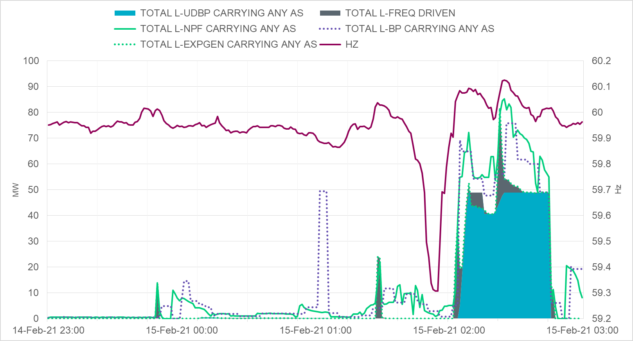
NPF of ESR-CLRs that were providing A/S During Feb 15th Low Frequency Event
Below is an estimation of expected consumption from ESR-CLRs that were providing A/S.
Estimated expected consumption is computed as sum of UDBP, Regulation Instruction and primary frequency response (computed for using 5% droop). Total UDBP: shaded blue; Rest: shaded gray.
This graph also includes total BPs (in dotted line) for these ESR-CLRs that were providing A/S.
RRS was being released between 11:19 pm and 2:03am.

Slide 10
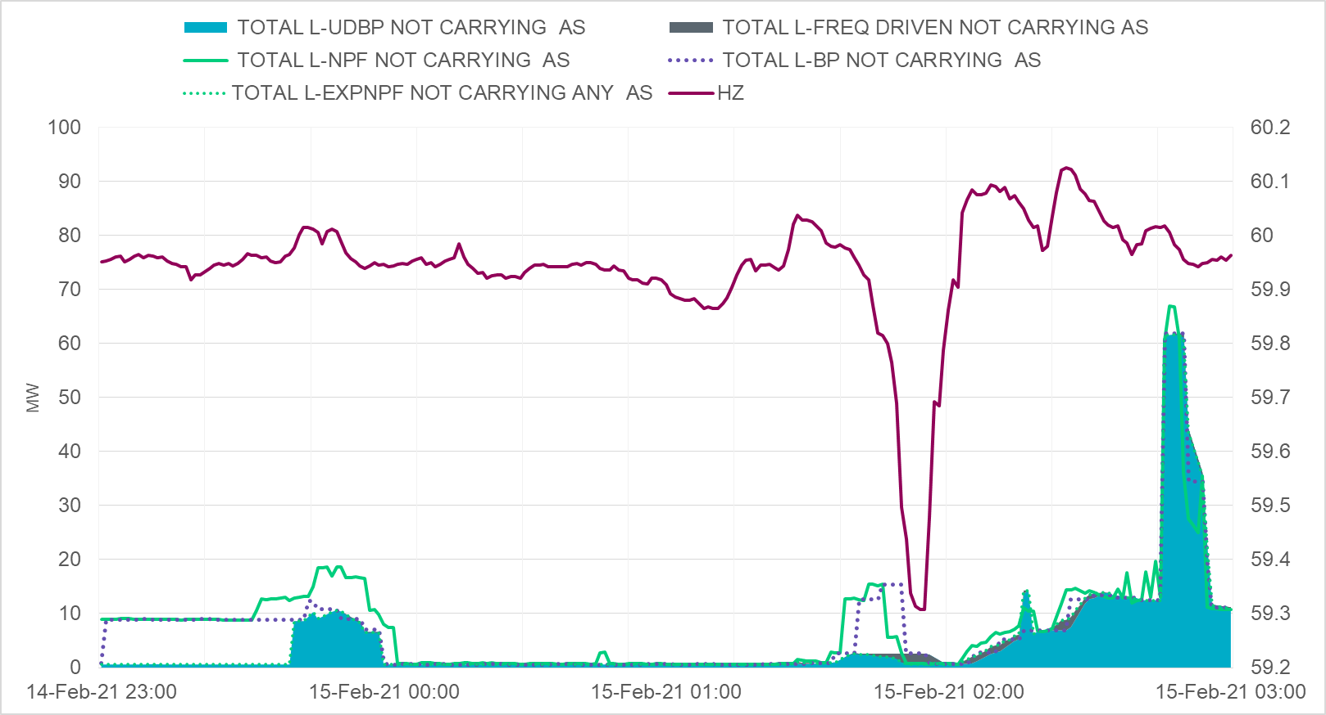
NPF of ESR-CLRs that were not providing A/S During Feb 15th Low Frequency Event
Below is an estimation of expected consumption from ESR-CLRs that were not providing A/S.
Estimated expected generation is computed as sum of UDBP, Regulation Instruction and primary frequency response (computed for using 5% droop). Total UDBP: shaded blue; Rest: shaded gray
This graph also includes total BPs (in dotted line) for these ESR-CLRs that were not providing A/S.
RRS was being released between 11:19 pm and 2:03am.

Slide 11
Summary
ERCOT has been reviewing performance of individual ESRs during the Feb 14th through Feb 20th timeframe.
ERCOT has several observations on the behavior of the ESRs during this timeframe that need to be analyzed further.
ERCOT will be reaching out to the QSEs that are responsible for these ESRs to better understand their behavior and associated telemetry in the next couple weeks.
ERCOT will bring back more data to the PDCWG upon completion of this effort.

