Slide 1
Continued Discussion on the CDR and Wind/Solar Capacity Contributions
Supply Analysis Working Group
Pete Warnken
Resource Adequacy
May 18, 2021
Notes:
Welcome to

Slide 2
CDR / Capacity Contribution Evaluation Proposal
Develop a separate summer Summary tab that has the following elements:
  Displays summer 2022 forecast year
  Multiple columns representing the current summer highest-risk hours, HE 1600, 1700, 1800
  Use the associated hourly peak load forecasts
  Develop separate capacity contribution percentages for each of the three hours
  Determine multi-hour values for other CDR resource line items as appropriate
  Column groupings for showing multiple scenarios if desired
Sample template shown on next slide…

Slide 3
Sample – Multi-hour Summary Tab with Scenarios
FAKE DATA

Slide 4
Hourly Capacity Contribution Calculations
Two approaches can be evaluated:
  Use current weighted-average capacity factor approach, but sample would consist of the summer output values for the given hour; for example, for solar HE 4:00 PM, 122 observations for each year (2018, 2019, 2020) for a total of 366 observations
  Calculate the 50th percentile of a fitted distribution of the UL profiles for each of the three hours, which is the same approach used for the Probabilistic Summer SARA model
    Scale up distribution to account for planned resources
    Also calculate the 5th and 95th percentiles to represent high and low tail risks, respectively

Slide 5
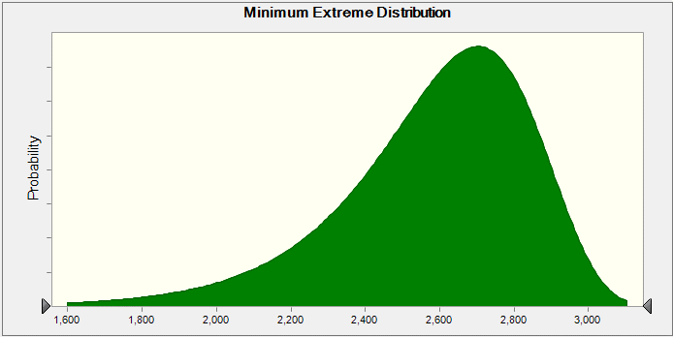
Fitted Distribution for Solar, Hour-ending 4 PM
50th percentile = 2,626 MW
5th percentile = 2,082 MW
95th percentile = 2,932 MW

Slide 6
Next Steps
Populate the sample template with the hourly peak load forecasts; duplicate the summer 2022 tab for showing alternate capacity contribution methods
Develop capacity contribution values for each tab
If scenarios are desired, agree on which ones to display
Present the Summary tabs at a SAWG meeting (TBD), and agree on any further research
This exercise is just for discussion purposes; it is not being proposed to replace or augment the current CDR

