Slide 1
BESS RFI Status
Supply Analysis Working Group
Julia Matevosyan
Resource Adequacy
May 18, 2021

Slide 2
Background
Data fields for Batteries, Self-Limiting Facilities (NPRR1026) and DC-coupled Resources (NPRR1029) included in RRGRR023, but not yet available in RIOO, are needed for resource adequacy assessments and transmission planning studies
In early February ERCOT started using requests for information (RFI) template to gather the information needed from transmission connected projects with signed interconnection agreements and DGRs that submitted RARF

Slide 3
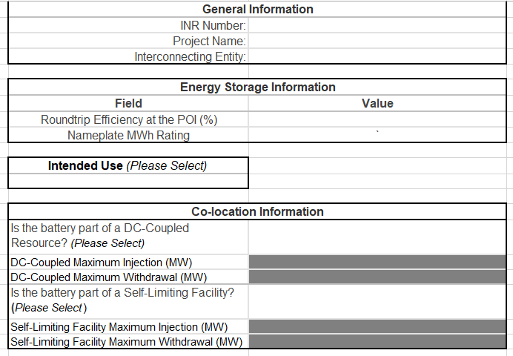
Battery RFI Template
The template can be downloaded from the Resource Integration page at http://www.ercot.com/content/wcm/lists/168307/Battery_RFI_Template.xlsx
IEs with planned storage projects that have signed IAs should complete the template and upload to RIOO-IS as an “Other” file type
ERCOT also sent the RFI to Resource Entities with existing operational batteries

Slide 4
Results to Date
 | Number of Batteries (incl. DGR) | Number of RFI Templates submitted | EIA-860 (2019), additionally
Operational | 25 | 6 (1 AS Only, 1 N/A) | 7
Planned, with SGIA | 40 | 30 (1 AS Only) | -

Slide 5
Results to Date
Three developers stated that their planned projects were part of a Self-Limiting Facility, but the details were unclear and require follow-up
No projects were identified as DC-Coupled
Still a large number of RFI templates missing from Operational and Planned Resources

Slide 6
Questions?
Questions or comments can be sent to:
John.Bernecker@ercot.com
Julia.Matevosyan@ercot.com

