Slide 1
ERCOT Frequency Control Report
April 2021
ERCOT
Operations Planning
PDCWG | May 14th, 2021

Slide 2
Summary of April 2021
CPS1: 164.75%
Current CPS1 12-Month Rolling Average: 168.95%
9 BAAL Exceedance(s)
2 hourly CPS1 score below 100%
BAAL-003 Events have updated through 2019
2019 BAAL-003 FRM Performance: -811.14
2021 RMS1 Statistics
Mean: 17.20 mHz
Min: 12.01 mHz
Max: 60.59 mHz
Energy Statistics
Total Energy: 28,071,084 MWh
Wind Energy: 8,907,804 MWh
Percent Energy from Wind: 31.73%
Solar Energy: 982,403 MWh
Percent Energy from Solar: 3.50%
Minimum System Inertia
Mean: 158,897 MW*s
Max: 197,238 MW*s on Apr 14th
Min: 120,857 MW*s on Apr 3rd
Notes:
2018 BAAL-003 FRM Performance: -843.17

Slide 3
Frequency Control
CPS1, BAAL, & RMS1

Slide 4
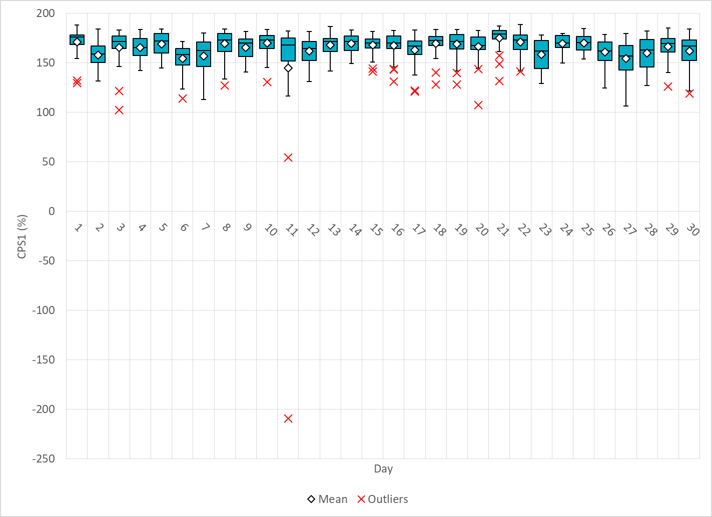
Hourly CPS1 by Day
Apr-21 CPS1 (%): 164.75
Notes:
54.24% @ 04/11/2021 18:00 and -209.23% @ 04/11/2021 19:00
Expected Generation Deviation
Expected gen dev remained negative for entire two hour of period. The largest expected gen dev was -2693 MW @ 19:30 mostly due to wind and solar.
IRR Ramps
Wind generation consistently ramped down during the entire two-hour period from 7285MW to 4980 MW.
Solar generation consistently ramped down during the entire two-hour period from 3952MW to 64 MW.
Regulation: Regulation up exhausted for the majority of the two-hour period
Other
SCED Manual offset of 250 MW @ 18:37
A total of 1350 MW of RRS was deployed at 19:28 and additional 500 MW of RRS was deployed at 20:02.
Approximately 1600 MW of Non-Spin deployed by 20:00.

Slide 5
BAAL Exceedances & Violations
There were 9 BAAL exceedance(s) in Apr
Notes:
Occurred on 04/11/2021 (7) and 4/30/2021 (2)

Slide 6
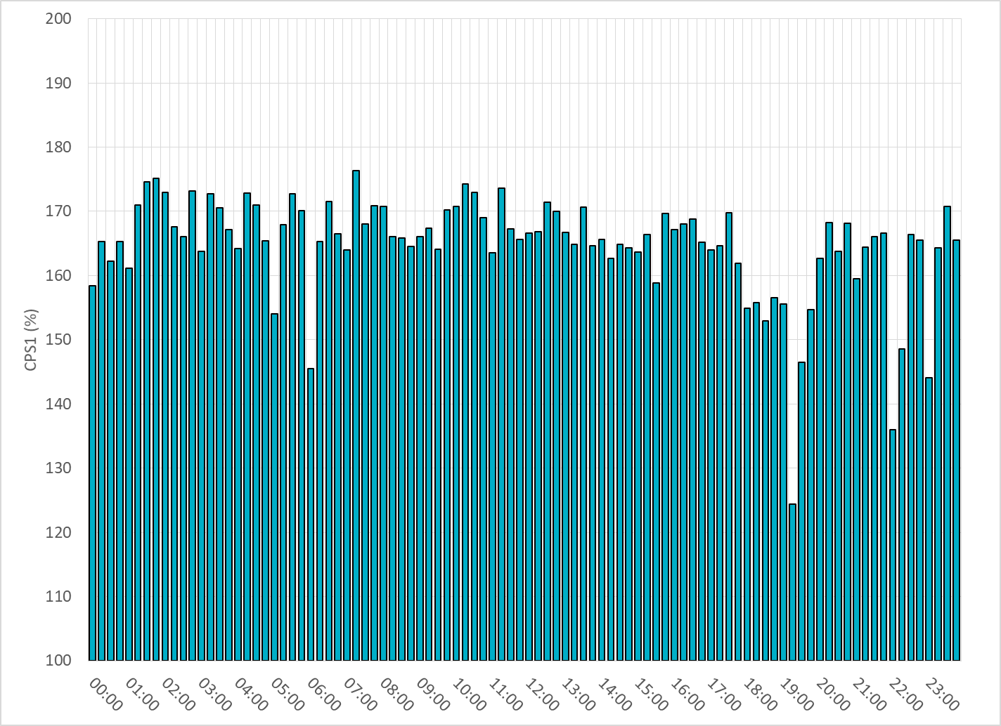
15-Minute Average CPS1%
Apr-21 CPS1 (%): 164.75

Slide 7
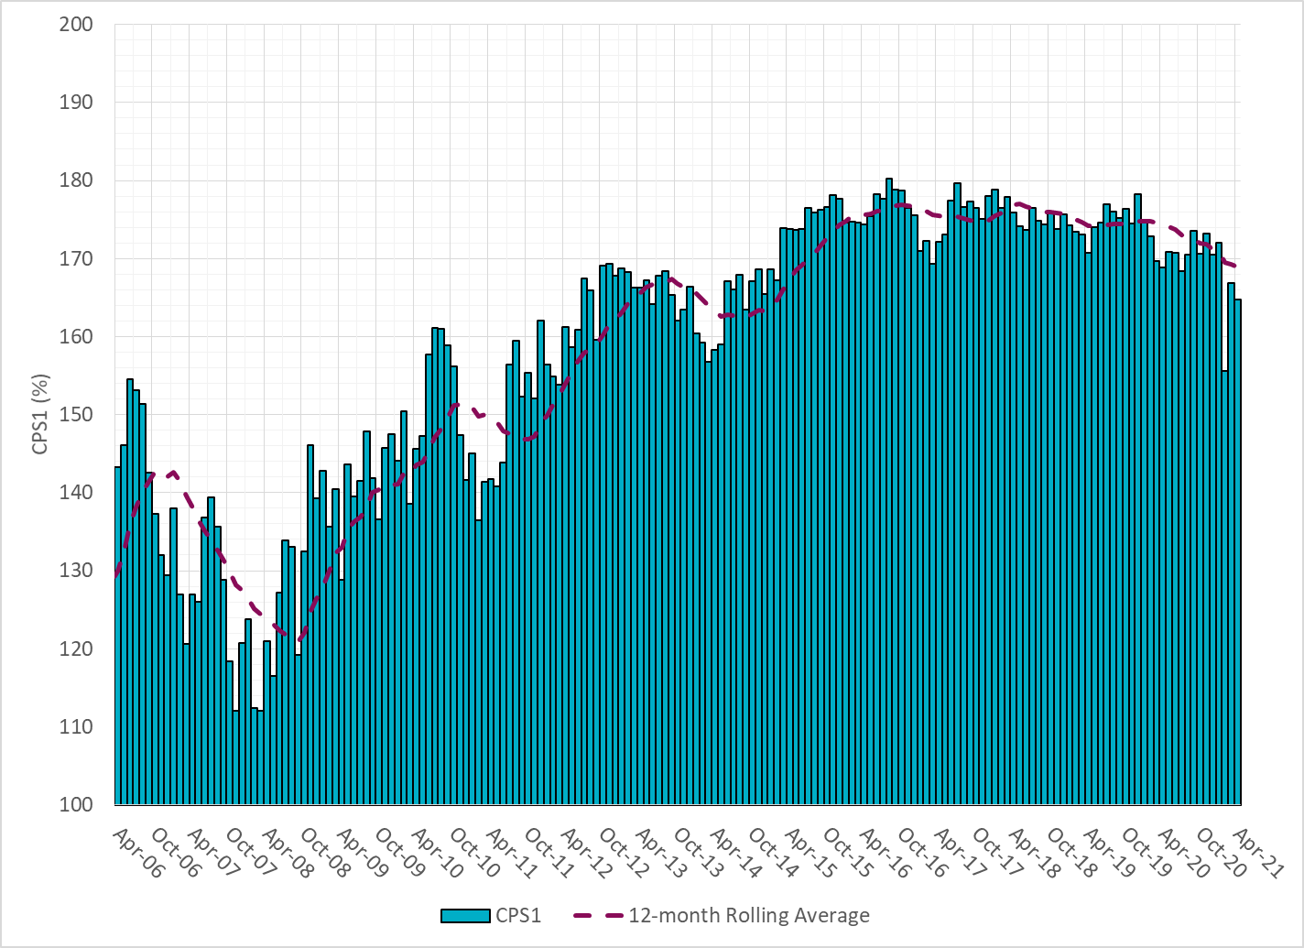
12-Month Rolling Average CPS1
Current 12-Month Rolling Average: 168.95%

Slide 8
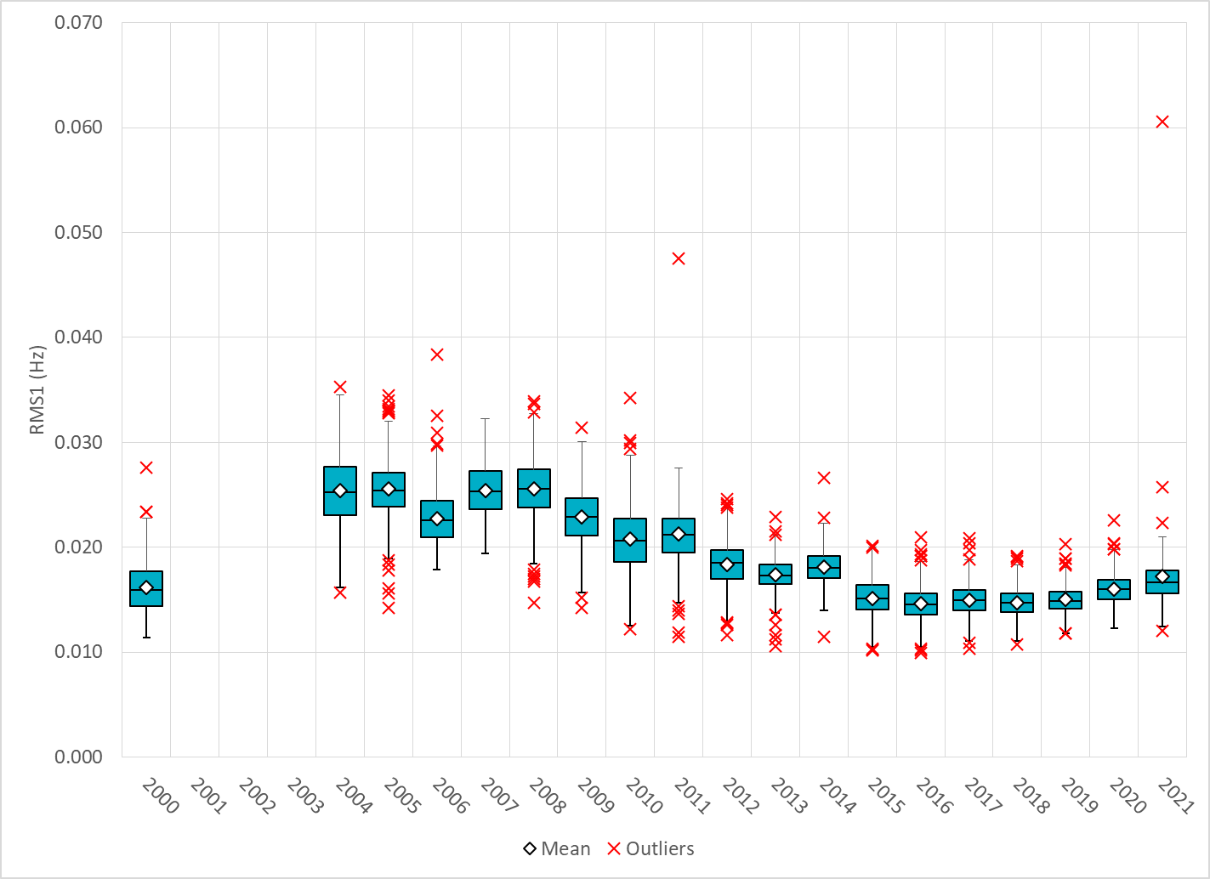
Daily RMS1 of ERCOT Frequency by Year
Notes:
Mean: 17.20 mHz
Min: 12.01 mHz
Max: 60.59 mHz

Slide 9
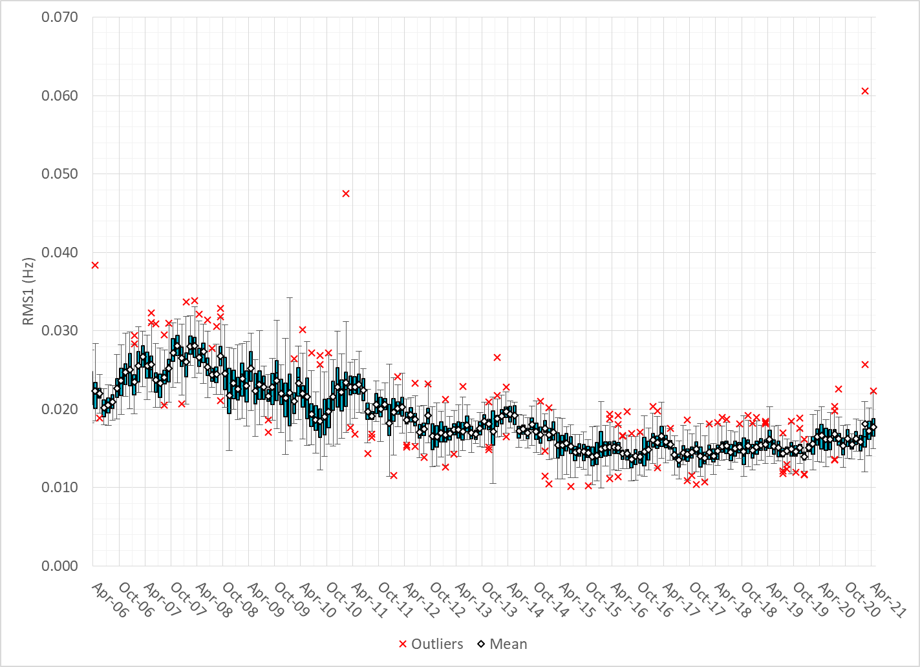
Daily RMS1 of ERCOT Frequency by Month

Slide 10
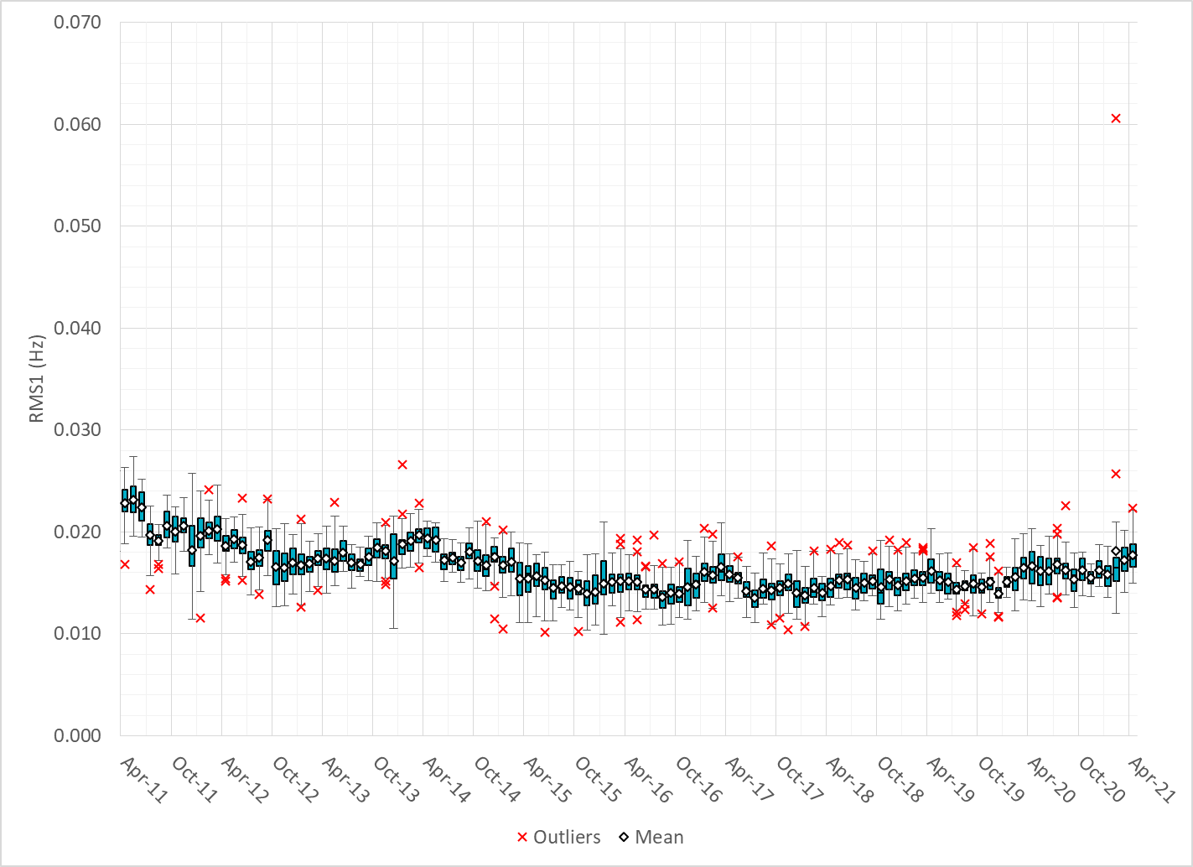
Daily RMS1 of ERCOT Frequency by Month

Slide 11
Frequency Profile Comparison

Slide 12
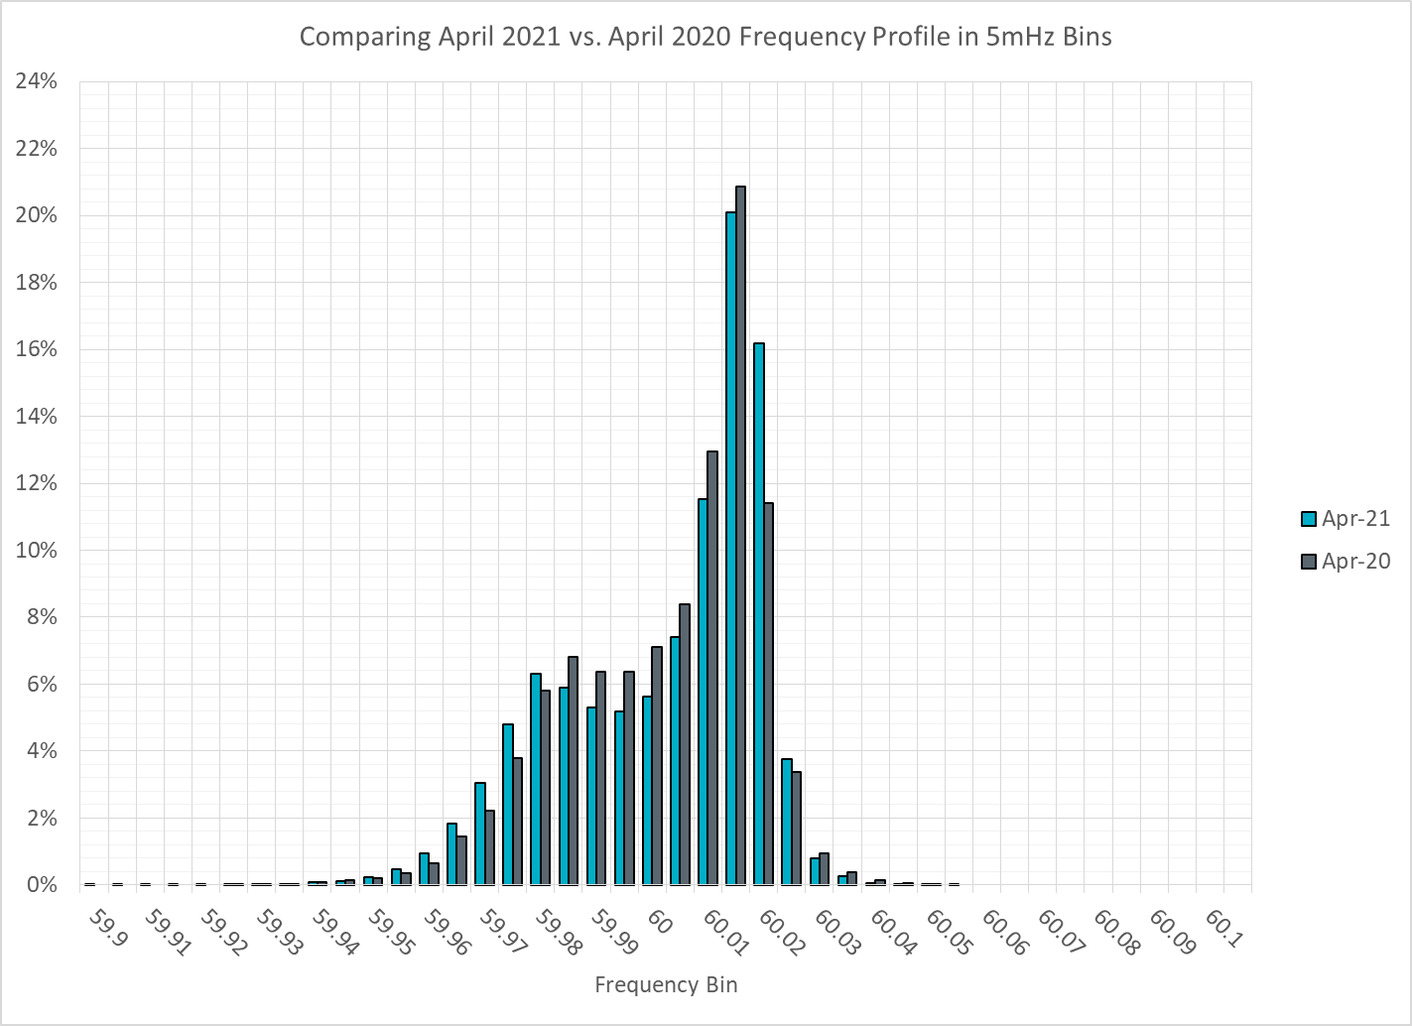
Frequency Profile Comparison

Slide 13
Frequency Profile Comparison

Slide 14
Time Error Correction

Slide 15
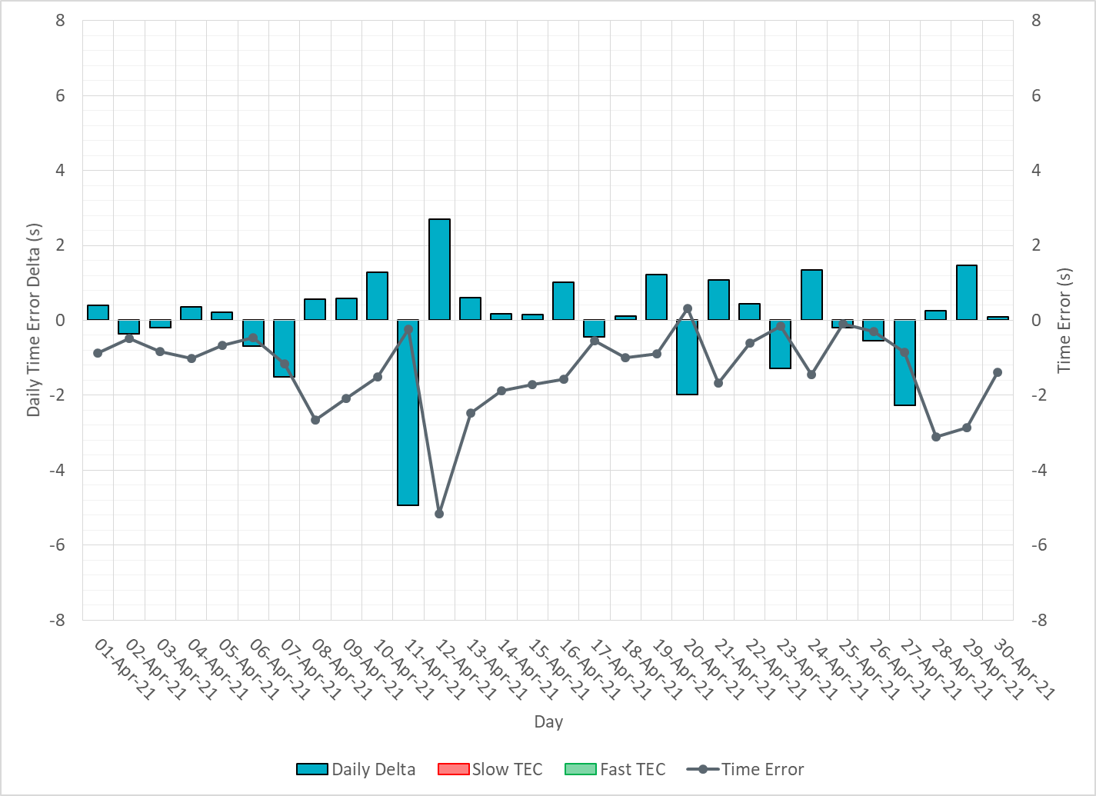
ERCOT Daily Time Error

Slide 16
Time Error Corrections Log Summary
There have been no time error corrections since December 2016

Slide 17
BAL-003 Performance

Slide 18
Op. Year 2019 BAL-003 Selected Events – Update
Notes:
BAL-003

Slide 19
Op. Year 2019 BAL-003 FRM Performance - Update
Notes:
OP2018: FRO = -381.0, FRM_median = -843.17, FRM_average = -959.7
OP2019: FRO = -381.0, FRM_median = -811.14, FRM_average = -892.5
OP2020: FRO = -425.0,

Slide 20
ERCOT Energy Statistics

Slide 21
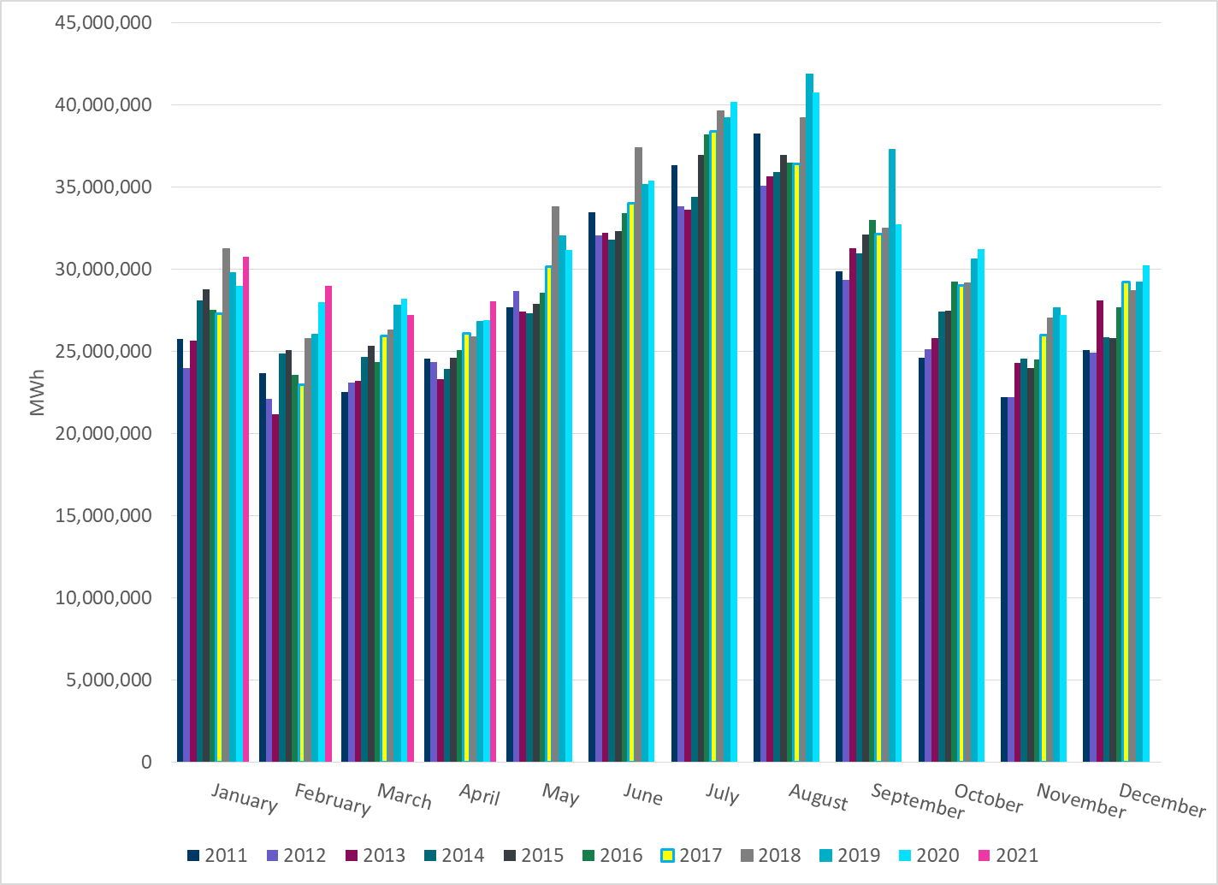
Total Energy
Notes:
28,071,084 MWh

Slide 22
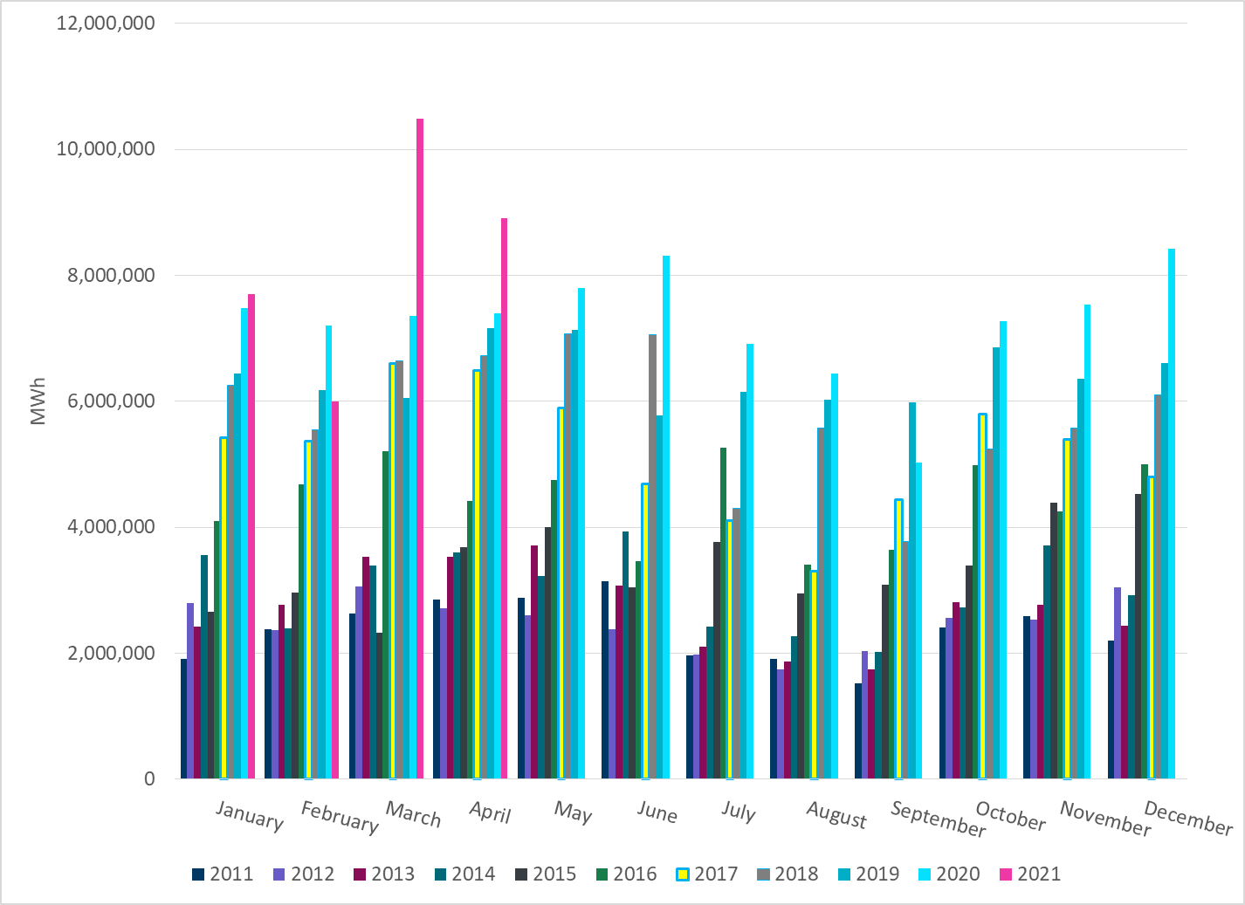
Total Energy from Wind Generation
Notes:
8,907,804 MWh

Slide 23
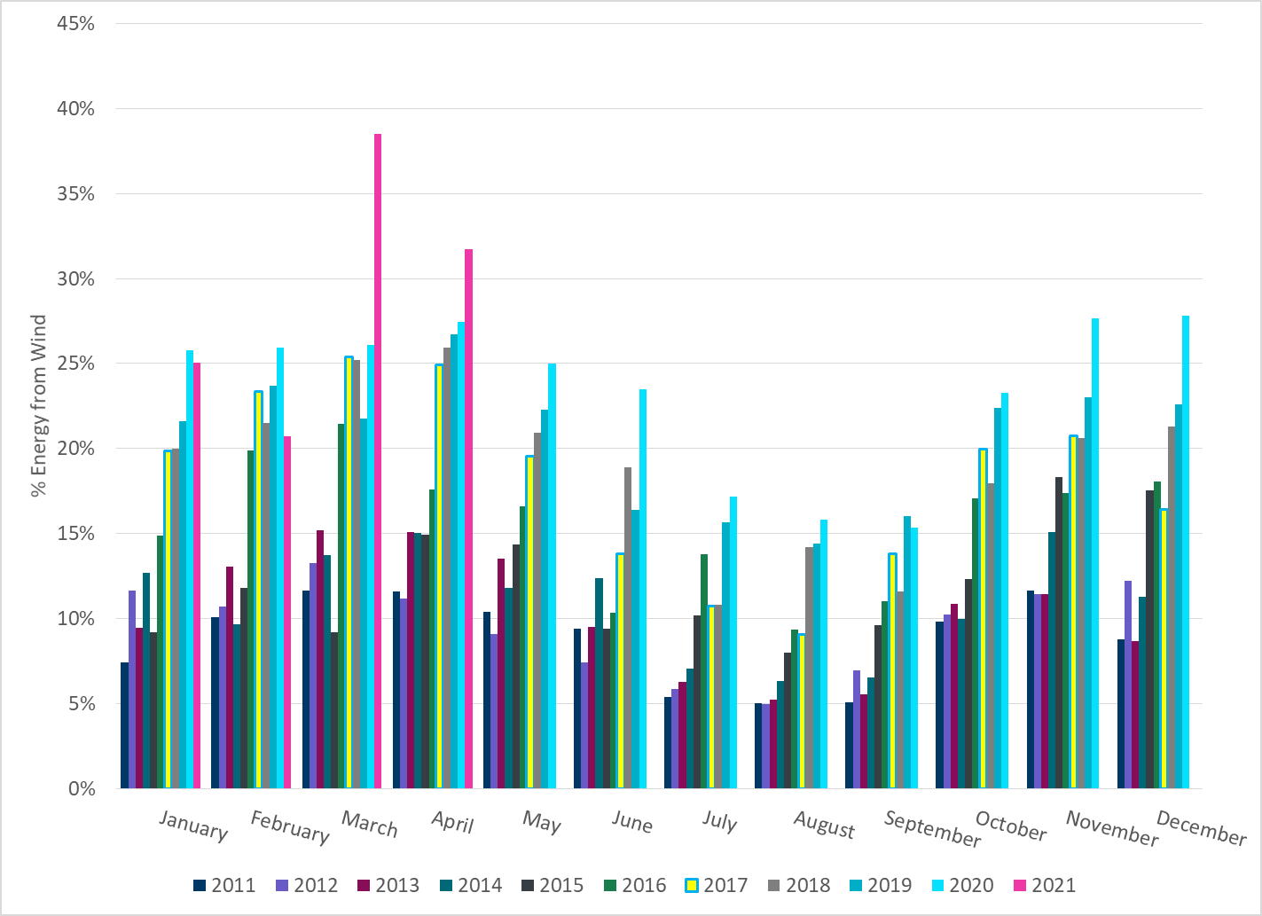
% Energy from Wind Generation
Notes:
31.73%

Slide 24
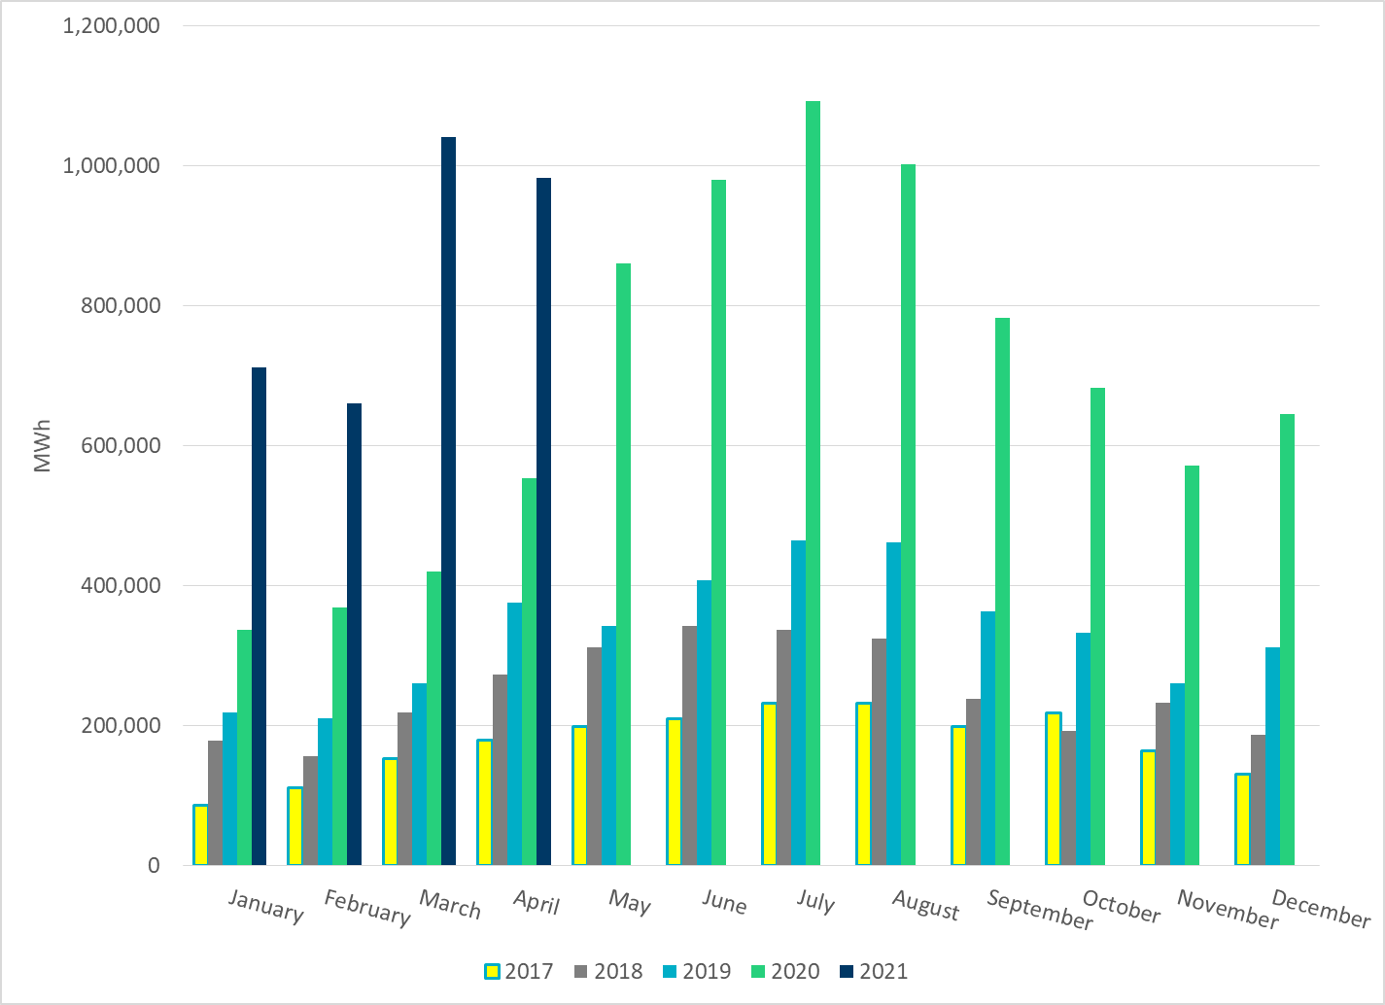
Total Energy From Solar Generation
Notes:
982,403 MWh

Slide 25
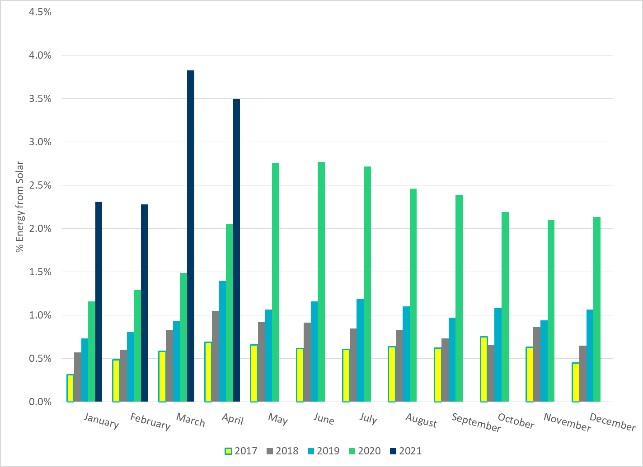
% Energy from Solar Generation
Notes:
3.50%

Slide 26
ERCOT System Inertia

Slide 27
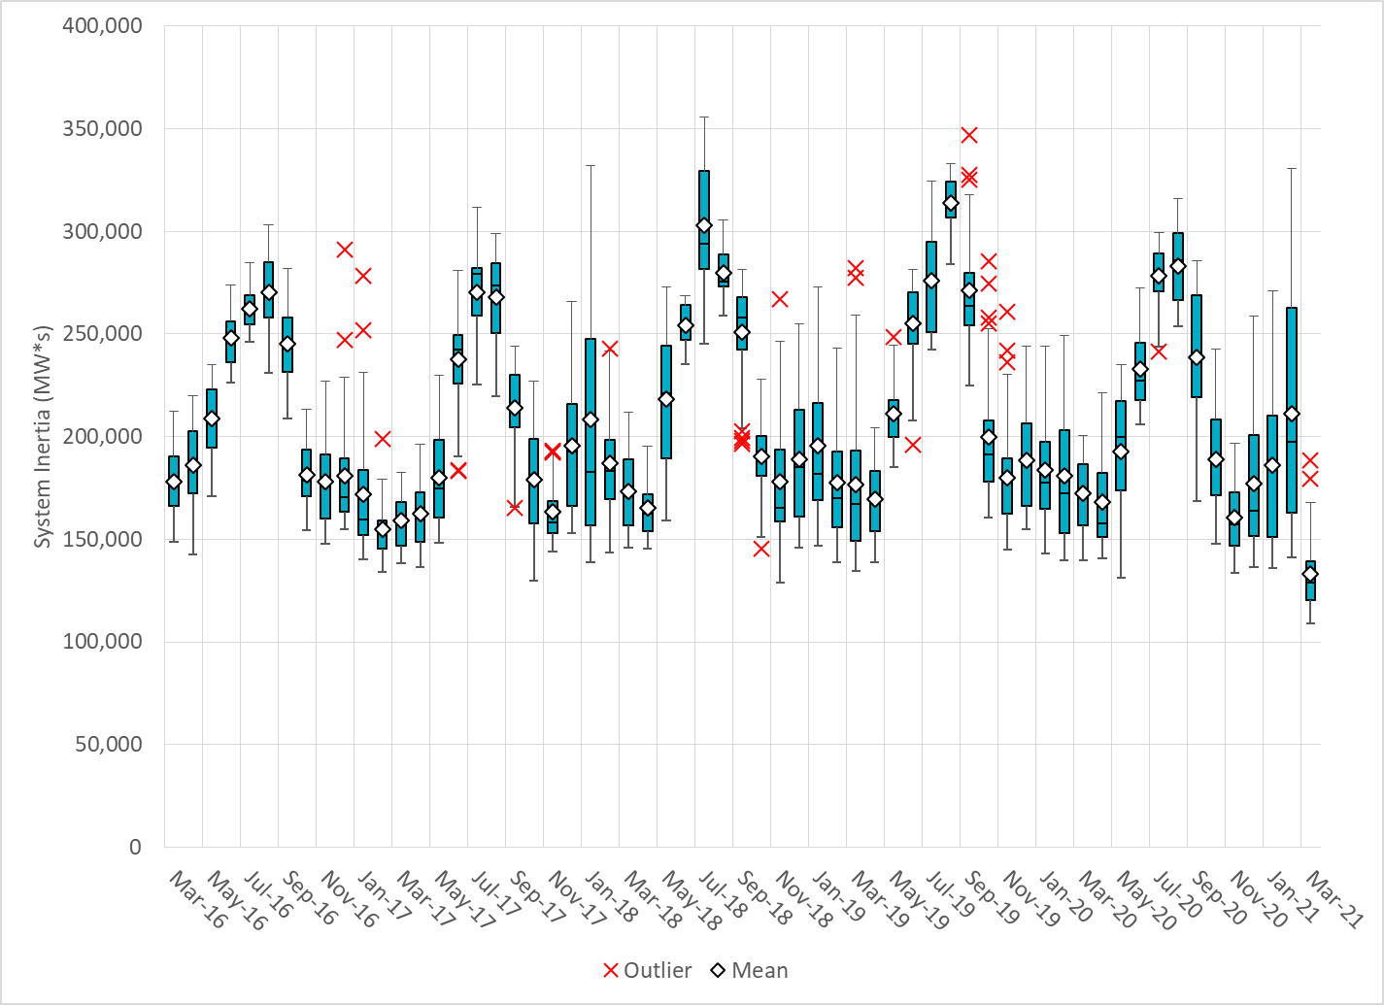
Daily Minimum System Inertia
Notes:
Minimum Inertia = 120,857 MW*s on 4/3/2021
Previous Minimum was 109,029 MW*s on 3/22/2021
Data:
Mean: 158,897 MW*s
Max: 197,238 MW*s on Apr 14th
Min: 120,857 MW*s on Apr 3rd

Slide 28
Questions?
Thank you!

