Slide 1
ERCOT Frequency Events
April 2021
ERCOT
Operations Planning
PDCWG | May 14th, 2021

Slide 2
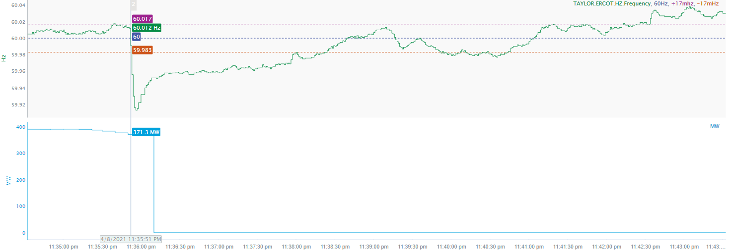
4/8/2021 23:35:51 (Non-FME)
Notes:
Unit experienced runback while carrying 390 MW and loss of 368 MW when tripped offline
Starting Frequency: 60.012 Hz
Minimum Frequency: 59.913 Hz
A-C Time: 5 seconds
Recovery Time (back to deadband): 2 minutes and 26 seconds
RRS Deployed: 0 MW
Trip Reason: Unit had a sudden loss of pressure
Contextual Information: 292 MW of regulation down was being requested at the time of the event. No regulation up was deployed.
No Selection Reason: Small event overall

Slide 3
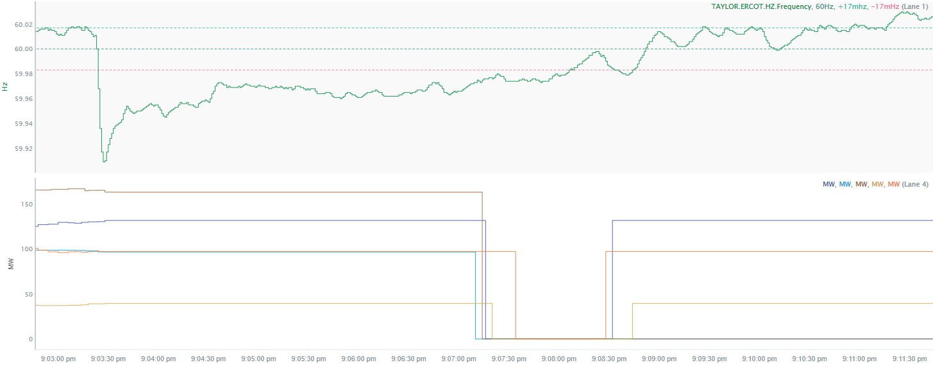
4/28/2021 21:03:22 (FME)
Notes:
5 Units tripped offline while carrying total of 529 MW
Starting Frequency: 60.011Hz
Minimum Frequency: 59.909 Hz
A-C Time: 5 seconds
Recovery Time(back to deadband): 4 minutes and 33 seconds
RRS Deployed: 0 MW
Trip Reason: Forced transmission line outage
Contextual Information: A total of 289 MW of regulation up was deployed during the event.

Slide 4
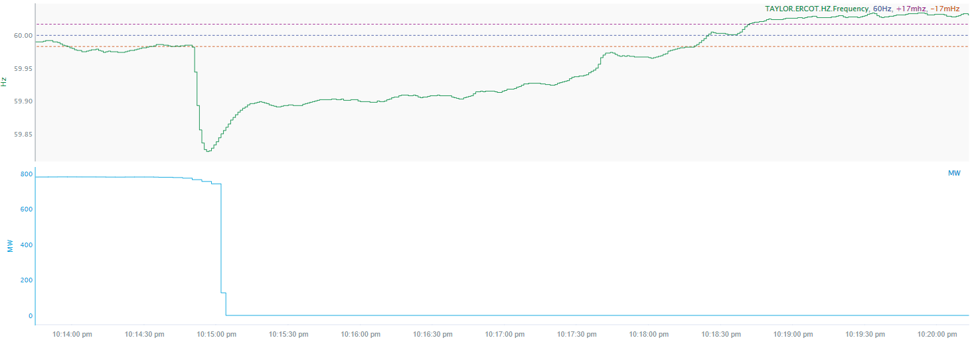
4/30/2021 22:14:50 (FME)
Notes:
Unit tripped offline carrying 779 MW
Starting Frequency: 59.982 Hz
Minimum Frequency: 59.823 Hz
A-C Time: 5 seconds
Recovery Time (back to deadband): 3 minutes and 23 seconds
RRS Deployed: 1277.1 MW
Trip Reason: Unknown at this time
Contextual Information: Total of 128 MW of regulation up was deployed during the event. A manual offset of 400 MW was applied.

Slide 5
Questions?
Thank you!

