Slide 1
Review of RENA for Feb. 2021
Jian Chen
Market Analysis and Validation
CMWG
May 10th, 2021

Slide 2
Monthly Sum of RENA

Slide 3
Daily RENA with RT Congestion in Feb. 2021
The total RENA in Feb. 2021 was around -$57.6M, while the total SCED congestion rent was around $670M.

Slide 4
Daily RENA and estimated DAM oversold in Feb. 2021
The total estimated DAM oversold amount in February 2021 was around -$111M.

Slide 5
Daily contribution to RENA from PTP w/link to Options
The total contribution to RENA from PTP with links to options during February 2021was $25.5M

Slide 6
OD 2/11/2021
About $5.0M RENA were observed on OD 2/11/2021. Most of the RENA was related to the following causes:
About $3.1M was related to the PTP w/links to options. Most of them came from the PTP w/links to options which sourced from the Resource Nodes in San Antonio area or Hub South, when several constraints raised the LMP in the area.
The rest of the RENA was related to oversold on some of the constraints. The highest oversold ($1.3M) happened on the constraint SPY2WIC8: 9025_A_1, which was related to an extended outage submitted after DAM.

Slide 7
Winter Event (OD 2/14/2021~OD 2/19/2021)
Very large amounts of negative RENA were observed during those ODs. The negative RENA was related on the significant “undersold” on some of the constraints during the event.
OD | RENA ($M) | Oversold($M)
2/14/2021 | -5.7 | -20.4
2/15/2021 | -39.4 | -60.5
2/16/2021 | -2.4 | -10.0
2/17/2021 | -8.1 | -10.7
2/18/2021 | -7.3 | -8.4
2/19/2021 | -2.1 | -2.5

Slide 8
Winter Event (OD 2/14/2021~OD 2/19/2021) - Constraints with High “Undersold”
As very high RT congestion rent was observed during the event, the so called “undersold” was also related to multiple causes, such as transmission/generation changes, LDFs.
OD | Constraint | Oversold($M) | RT Rent($M)
2/15 | SMCCGIB8: INGLES_I_DUPS1_1 | -11.4 | 9.4
2/15 | SGILNU78: GILA_HIWAY_1_1 | -11.0 | 12.4
2/14 | DHICPIL8: CKT_944_1 | -8.3 | 24.5
2/17 | BASE CASE: VALEXP | -7.3 | 7.3

Slide 9
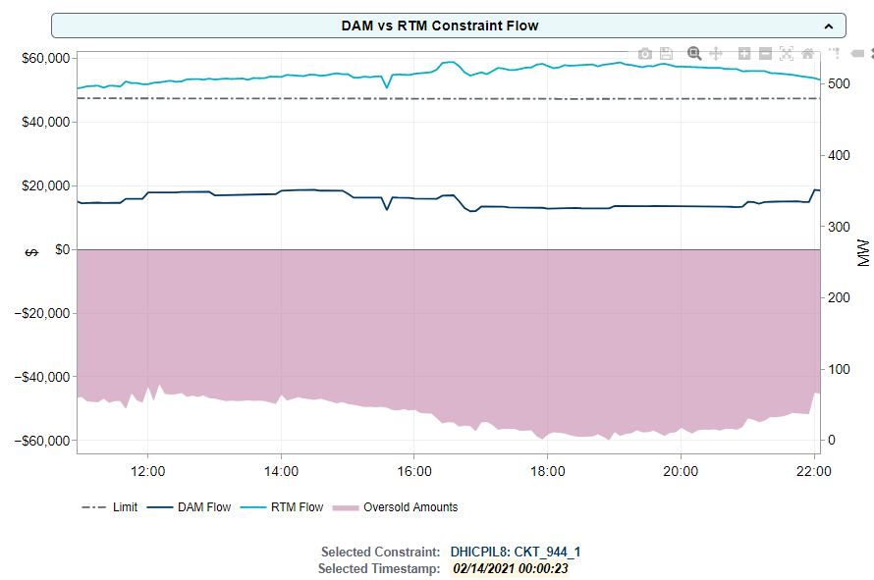
Winter Event (OD 2/14/2021~OD 2/19/2021) - Constraints with High “Undersold”
Another major cause of “undersold” is that, during the winter event, a lot of RT constraints were activated with their RT flow over their limit. From OD 2/14/2021 to 2/19/2021, the total impact from this “extra flow” was around $35.7M.
“extra flow”
“undersold”

Slide 10
Summary for February 2021
Very large negative RENA was observed in February, which was related to the winter event.
As the negative RENA was mostly related to the “undersold” flow in DAM, the real cause was the dramatic changes during winter event from day to day.
PTP with links to options also contributed $25.5M to RENA, but it was overwhelmed by the impact from the larger amount of DAM “undersold”.

Slide 11
CRR Balance Account for February 2021

Slide 12
Proposal to Change Resource Meter Price Calculation

Slide 13
RENA caused by Resource EPS meter price
RN A
RN B
Meter A1
400MW
X
X
X
G1
LN1
1000MW
Meter A2
400MW
800MW
G2
LN2
200MW
Meter B
DAM awards: 800MW sold at RN A
800MW bought at RN B
RT constraint: under the contingency loss of LN1, the flow through LN2 will be binding at the line limit of 800MW (shadow price at $200)
System lambda: $300 ( also LZ price)

Slide 14
RENA caused by Resource EPS meter price
RN A
RN B
Meter A1
400MW
X
X
X
G1
LN1
1000MW
Meter A2
400MW
800MW
G2
LN2
200MW
Meter B
 | RN A | RN B | Meter A1 | Meter A2 | Meter B | LZ
SF | 100% | 0% | 0% | 100% | 0% | 0%
LMP | $100 | $300 | $300 | $100 | $300 | $300
RENA = (-1)*RTEIAMTTOT =Resource Revenue + RTSPP* DAM Purchase –RTSPP*DAM sale - RTSPP* LZ load
RENA = ($300*400+$100*400+$300*200) + ($300*800)-($100*800) - ($300*1000)
= $80,000

Slide 15
Proposal to Change Resource Meter Price Calculation
Currently, the Resource EPS meter price is determined based on the Electrical Bus LMP at the location where it is measuring energy (MWh). (defined in Protocol 6.6.3.1)
Under some scenarios where contingencies disconnect the meter but not Resource/Resource Node, it will result in RENA.
To mitigate this issue, a new proposal is to calculate the meter price based on the Resource Node price which is associated to the Resource mapped to the meter.

Slide 16
Proposal to Change Resource Meter Price Calculation
Mapping among Resource/Resource Node/Resource Meters
EPS Meter 1
Resource A
RN A-B
EPS Meter 2
Resource B
EPS Meter 3
RN C
EPS Meter 4
Resource C
Use Resource Node LMP, but not Resource LMP to have better convergency between DAM and RTM

Slide 17
Proposal to Change Resource Meter Price Calculation
Proposed new calculation at 5-min SCED interval
$${RTLMP}_{me,y}=\sum_{RN−me}{{RNLMP}_{RN,y}×{RTRNWF}_{RN,y}}$$
RTLMP_{me,y} - The Real-Time LMP for EPS meter me for the SCED interval y.
RNLMP_{RN, y} - The Real-Time Resource Node LMP for the SCED interval y of Generator mapped to EPS meter me. For combined cycles it is the Physical Resource Node of the Generators (not Logical Resource Node).
RTRNWF_{RN,y} = TG _{RN} / ∑_{RN} TG _{RN}
TG_{RN} = ∑_{g-RN} max(0.001,TG _{g} )
TG _{g} - Physical Generator MW telemetered output of Generators for a given Resource Node RN
15-min interval RTRMPR is then calculated based on new RTLMP_{me,y}
Similar change will be applied to the meter price for charging load (WSL or non-WSL) of ESR, using ESR RN

