Slide 1
DSWG Report
Christian powell
WMS Meeting – mAY 2021

Slide 2
Overview
Previous meeting – April 16
WMS Update: Winter Storm Emergency Conditions List
Feb. Storm ERS ERCOT Presentation
Feb. Storm Load Resource ERCOT Presentation
Feb. Storm REP Demand Response ERCOT Presentation
June-Sept. ERS Standard Contract Term Update
DSWG Goals Update

Slide 3
February Storm Items - ERS

Slide 4
ERS Fleet Performance – Loads and Generators
Monday February 15th, 2021 most significant day of ERS deployment and obligation during the Winter Event
The majority of the fleet is deployed and exhausted on the same day within 12 hours of the first deployment. A few ERS Loads remain obligated into subsequent days.
MW baseline significantly higher than MW actuals prior to first ERS VDI
Baselines account for what demand (MW) would have been under normal operating conditions for the day – most ERS Loads were consuming much lower than normal heading into the event
As an ERS fleet in aggregate, the response generally met or exceeded the aggregate obligation
EEA Level 3 forced outages start ~1:20am and remain in effect throughout the entire event day

Slide 5
ERS Fleet Performance – Load Only
Demand on Sunday February 14th, 2021 shows signs of load reduction prior to the first ERS deployment
Based on responses to ERCOT RFIs, this was driven by a number of factors including weather related issues, local TDSP outages, closed businesses due to weather, in response to conservation notices, and price response.
As a fleet in aggregate, ERS Loads generally over-provided relative to their combined obligation during the Winter Event
On average, fleet-level ERS Load reduction was 30%-35% above the combined fleet-level obligation during the first 12 hours after the first deployment (prior to majority of ERS Load fleet exhaustion)
Preliminary analysis indicates ERS Load portfolios also performed relatively well during the individual deployment events
ERS Loads experiencing forced outages generally performed successfully relative to their baselines and obligations
Loads still provide reduction during forced outages as their demand goes to zero, which may have also contributed to over-provision

Slide 6
ERS Fleet Performance – Generator Only
Activity on Sunday February 14th, 2021 shows export from ERS Generators prior to the first ERS deployment
As a fleet in aggregate, ERS Generators generally failed to meet their combined obligation during the Winter Event
On average, fleet-level ERS Generator exports were 50%-55% below the combined fleet-level obligation during the first 12 hours after the first deployment (prior to exhaustion of the ERS Generator fleet)
Based on responses to ERCOT RFIs, supply constraints, refueling issues, and forced outages were the primary factors affecting performance
Unlike ERS Loads, ERS Generators experiencing forced outages generally failed to perform relative to their obligations
Generators are unable to perform (export) for ERS during forced outages
Even prior to the forced outages, the ERS Generator Fleet was only meeting 70%-75% of its combined obligation

Slide 7
Lessons learned – ERS
Review Weather-Sensitive limitations on deployments based on Winter event
Discuss and add clarifying language related to ERS Renewal start date
Discuss modification/elimination of scheduled unavailability / planned maintenance
Discuss whether certain types of Loads should be prohibited from ERS participation and, if so, who should be responsible for managing prohibition

Slide 8
February Storm Items - LR

Slide 9
Load Resource Response
Load Resources load level starts declining on Feb. 12th
List of reasoning based on RFI responses
Controls affected by extreme cold temperatures resulting in shut down of processes
TDSP outages affected LRs ability to return to operation and therefore meet their AS responsibility
Extreme temperatures affected various fluids in the processes resulting in equipment failures
Lack of raw materials during event impacted ability to make final products
Fuel supply issues to back up generation
Telemetry issues prevented remote control of loads
Loss of other essential utilities resulting in shutdown
Some oil production sites rely on trucking options to move oil and water. These were limited due to weather conditions and in some cases sites had to be shut down
Supplier limitations were not able to respond and provide assistance when needed to restore processes
Load Resources still not at pre-event load levels by Feb. 22nd

Slide 10
Load Resource Response
Initial response did not meet 10 minute requirement
~70% in 10 minutes
Total response
~130% sustained response during event based on telemetered responsibility at VDI
~97% sustained response during event based on telemetered responsibility at on Feb. 14th
Several Failures at QSE level requiring resource level performance evaluation
NPC-LPC less than RRS obligation for many resources leading up to event
Oscillations during event due to telemetry issues

Slide 11
February Storm Items – Competitive Area DR Info

Slide 12
Overview
Initially targeted TDSP controlled outages considering substations they reported to PUCT
Shifted to include ESIIDs with storm-related outages – many ESIIDs had outages prior to the load shedding and were subject to TDSP load shed as well
Analysis targeted ESIIDs identified with outages as well as ESIIDs
Deployed for ERS
Containing Load Resources deployed for RRS
Previously Identified as on Indexed pricing (Day-Ahead/Real-Time) and/or 4CP responders
Other ESIIDs identified as responding during the event
4 million deployed ESIIDs to analyze (3.8 million Residential, 468,000 Non-Residential
Developed algorithms to identify outage ESIIDs and control group ESIIDS
Algorithms varied across the load type
Based on number of zero intervals (15-min) Feb 1 – Feb 4
Outage ESIID - lots of zeros on Feb 15 – 19 compared to earlier days
Control group ESIID – small number of zeros throughout
Some ESIIDs were neither
Examined interval data for every ESIID (~8 million)

Slide 13
Overview
Goal was to analyze load response for all 28 days in February to capture anything happening before, during and after the event.
Performed analysis generally in categories of Profile Type
Created two new ones for analysis, not necessarily reporting, purposes
‘LOWUSE’ for ESIIDs with very low usage (< 2 KWh per day)
‘LIGHT’ for ESIIDs with > 75% night-time use
Note: excluded ESIIDs with ‘DG’ and ‘WD’ profile types, ESIIDs with zero use for most days prior to the event
Also have not yet started analysis of NOIE load reductions
Baselines developed for all ‘deployed’ ESIIDs:
‘Control’ groups for Residential and smaller Business ESIIDs
Used ‘near-day’ baselines for large Business (subject to 4CP billing)
Used ‘near-day’ baselines for Business Load Factor ESIIDs (not subject to 4CP billing) for which sufficiently similar ESIIDs were not found
Peak demands for these ESIIDs range from 5/10 KW to 700 KW
MAPE: Residential 1%, Business 0.5% (based on days with no reductions)

Slide 14
Competitive Res Plus Bus Load Reductions

Slide 15
Daily Load Reductions Feb 14 – 20, 2021
Total Competitive Residential Plus Business Load Reductions
Event Day | Max Reduce Interval | Max Reduce MW | Min Reduce Interval | Min Reduce MW | Average Day Reduce MW
2/14/2021 | 96 | 4,276 | 1 | 2,360 | 3,094
2/15/2021 | 80 | 22,460 | 1 | 5,013 | 18,070
2/16/2021 | 34 | 22,487 | 96 | 14,818 | 18,578
2/17/2021 | 36 | 16,477 | 95 | 8,224 | 13,101
2/18/2021 | 31 | 9,382 | 2 | 7,626 | 8,327
2/19/2021 | 32 | 8,640 | 96 | 5,848 | 7,313
2/20/2021 | 33 | 6,036 | 95 | 4,280 | 5,327

Slide 16
Next Steps
NOIE Load response
Response from ESIIDs
Deployed for ERS
Deployed as Load Resources providing RRS
Price Response (including 4CP responders)
Settlement Only Generators/Puns
Additional Subgroup break outs e.g. by Weather Zones, TDSP, etc (feedback please)

Slide 17
Summer ERS SCT Update

Slide 18
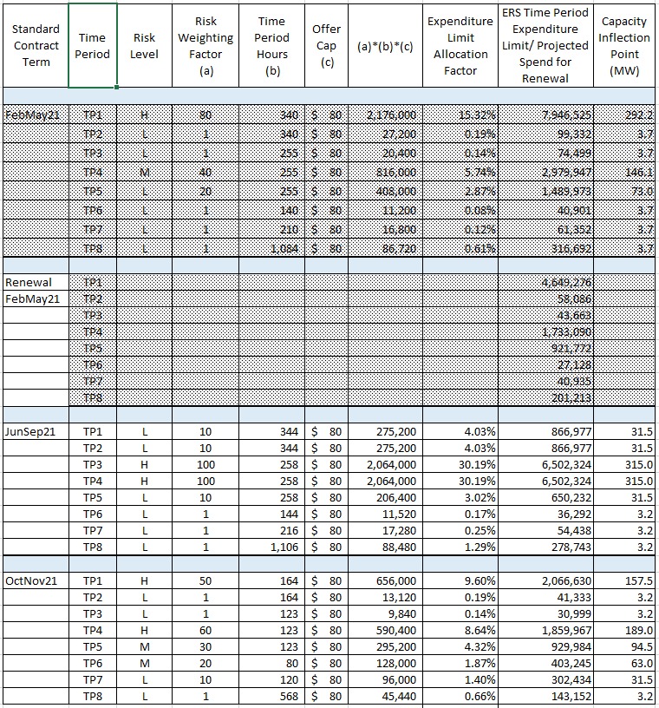
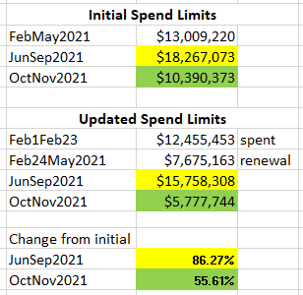
Review of ERS RFP for Jun-Sep SCT
$12,455,453
$7,675,163
Note: Offers for all subsequent SCTs in 2021 need to take into consideration the reduced spend limits

Slide 19
DSWG Goals
# | Goal Description | Status
1 | Review existing reports on DR/DER and identify areas where additional analysis is needed | Reviewed recommendations from stakeholders, and implemented changes to the DR Report. ERCOT will be making additional changes to the 2021 ERS Report based on recommendations. DSWG will revisit following ERS Report.
2 | WMS Assignments on ERS Deployments, Load Resources, Demand Response, and 2021 Emergency Conditions List | Completed protocol changes resulting from 2019 ERS deployments. Reviewing Emergency Conditions List items referred from WMS and will continue to address to resolution in 2021.
3 | Evaluate new operational opportunities and needs for DR / DERs in ERCOT | Discuss DR/DER participation relative to reserve shortages in ERCOT. Discuss potential for additional Load Participation via multiple services including AS and ERS. ERCOT will lead offline discussion and update DSWG.
4 | Formalize REP/ NOIE reporting requirements, process & compliance on demand response, and recommend changes in frequency as needed | Reviewed 2020 DR Report and potential changes to survey process for 2021. Changes for 2021 currently under review in stakeholder process.
5 | Continue to assess the way DR, DGRs, UDG, ESRs, retail rate structures, and energy efficiency is reflected in the CDR, SARA, etc. | SAWG will continue to address reporting. DSWG will review the possibilities for capturing/including additional price responsive demand information that can be input into SARA.
6 | DR deployment impacts on SCED | Completed in 2020 regarding up-to-date deployments. Will review any new deployments and will revisit.

Slide 20
Next Meeting – May 28

