Slide 1
Supply Analysis Working Group Report to WMS
May 5, 2021
Caitlin Smith, Chair
Ian Haley, Vice Chair
Pete Warnken, Vice Chair

Slide 2
Emergency Conditions List from TAC/WMS
Three Categories of items for SAWG:
  1. Efforts to include risk, extreme weather and impacts of Winter Storm Uri into CDR, SARA and reserve margin reports
    Plan: Address through ongoing efforts at SAWG
  2. Planning items including load forecast methodology and transmission planning studies
    Plan: Possible joint meeting with PLWG

Slide 3
Emergency Conditions List from TAC/WMS
Three Categories of items for SAWG:
  3. Gas item: “How should capacity reports be modified to include gas market coincident and offsetting risks with electric system?”
    Plan: Continue to coordination with ERCOT and GEWG
    SAWG plan likely limited in scope to adding a reserve margin report scenario with a certain percentage of fuel unavailable over events of certain amounts of time (hours or days)

Slide 4
April SAWG Topics
Drought Risk Monitoring Tool:
  Key Model Inputs:
    Monthly storage levels for reservoirs and aquifers from Texas Water Development Board
    Short-term three-month weather forecast from ERCOT meteorologist
    Max discharge temperature measurements into cooling reservoirs across coal and nuclear units
  Current Actions:
    When a reservoir is expected to reach “at-risk” conditions, ERCOT contacts resource owners that use the reservoir to understand mitigation strategies and when units could become unavailable
  Next Steps
    ERCOT developing an RFI in order to validate information used in drought model
    Update at June SAWG

Slide 5
April SAWG Topics
CONE Action Item:
  “Develop and implement updated methodology used to determine cost of new entry (CONE)”
    Action item from TAC from 2019 and Reviewed following winter storm
    Next steps:
      Recommend this be on hold until after Legislative Session and PUCT action
      If value is needed to be changed for EORM/MERM reserve margin study, ERCOT would have consultant come to SAWG and describe methodology for any change

Slide 6
April SAWG Topics
Summer 2021 Probabilistic Loss-of-Load Study
  Background:
    A new requirement for the summer 2021 NERC Summer Reliability Assessment (SRA) was to conduct a probabilistic risk assessment of the highest-risk hours:
    To support the NERC requirement as well as evaluate a model-based approach for ERCOT hourly energy adequacy analysis, Astrape Consulting ran the Strategic Energy & Risk Valuation Model (SERVM) for the 2021 summer season

Slide 7
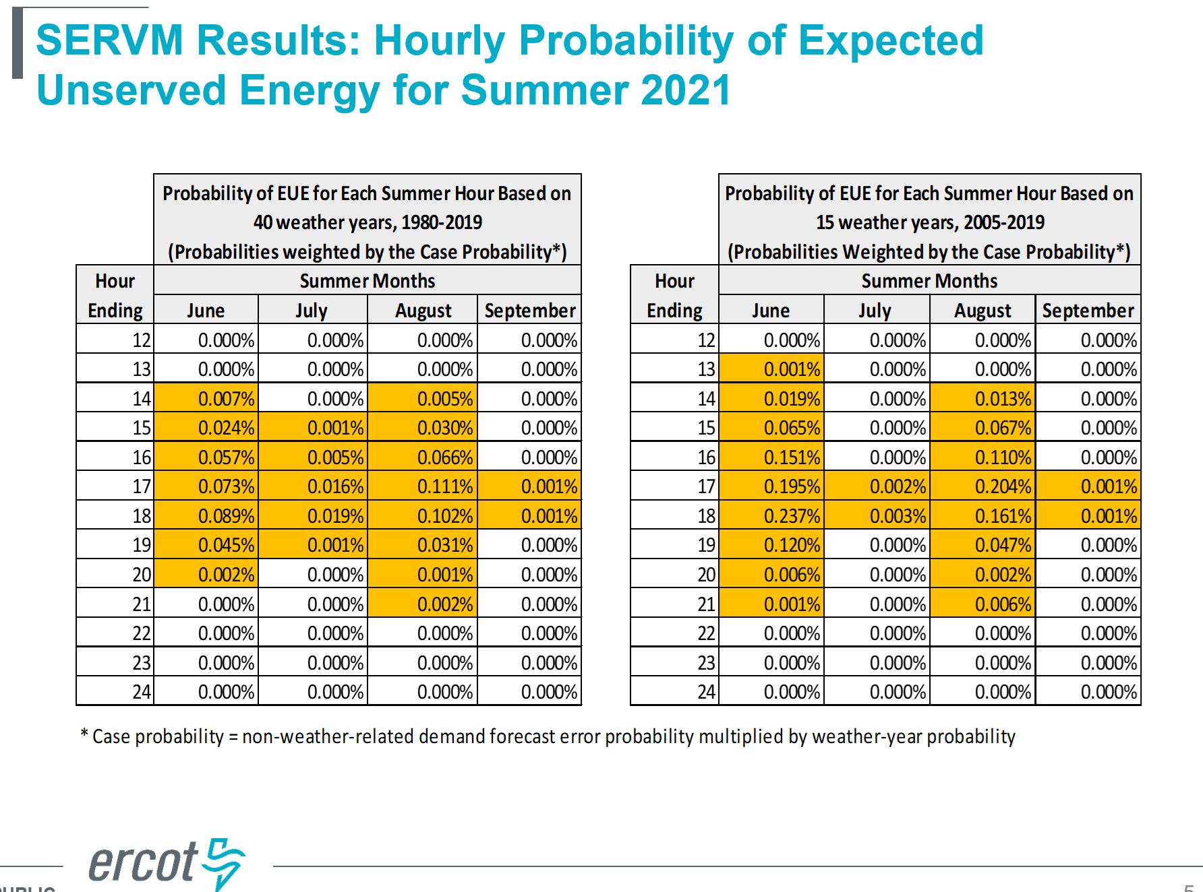
April SAWG Topics
Summer 2021 Probabilistic Loss-of-Load Study

Slide 8
April SAWG Topics
Distributed Generation in the CDR NPRR
  Planning on Two NPRRS:
    1st NPRR:
      Memorialize what we are already doing
      rooftop solar forecast
      fossil fuel DG
    2nd NPRR:
      Small generator interconnect process in RIOO
      Need a process for when DG retires

Slide 9
May SAWG
CDR out on May 6th
SAWG Meeting May 18th (rescheduled from May 21st)
  Distributed Generation in the CDR follow up on upcoming NPRRs
  Wind capacity contributions in CDR – change to peak
  Battery Energy Storage Capacity contribution in CDR
  Regions for Solar Capacity contribution in CDR
  Annual DG Report

Slide 10
Voting Item: New Scope
Current Scope Approved December 2014
  At the direction of the Wholesale Market Subcommittee (WMS), SAWG evaluate proposals for market design as they pertain to Resource adequacy and the resource reporting methodologies. SAWG Annually reviews the components and construction of the Capacity, Demand, and Reserves Report (CDR), the Seasonal Assessment of Resource Adequacy Report (SARA), the Long Term Load Forecast, the NERC Long Term Reliability Assessment, and recommend necessary changes to WMS.
  SAWG also reviews and recommends market design principles, issues, and proposals related to supply side adequacy as assigned by WMS.

Slide 11
Voting Item: New Scope
Proposed Scope for May 2021 WMS
  At the direction of the Wholesale Market Subcommittee (WMS) and the Technical Advisory Committee (TAC), SAWG evaluates proposals, issues, and principles for market design as they pertain to resource adequacy and planning and operating reserves. SAWG also manages ongoing review of reporting methodologies of resource adequacy and reserve margin reports, including evaluating options for inclusions of reliability risk.
  SAWG reviews, on an ongoing basis, the components and methodology of reports including, but not limited to: the Capacity, Demand, and Reserves Report (CDR); the Seasonal Assessment of Resource Adequacy Report (SARA); the Long Term Load Forecast; the NERC Long Term Reliability Assessment; reserve margin studies and other resource adequacy risk assessments; and studies regarding the Cost of New Entry (CONE). SAWG recommends changes to resource adequacy and reserve margin reports and their methodologies to WMS.

