Slide 1
Summer Preparedness Workshop
Technical Advisory Committee
Woody Rickerson
Grid Planning and Operations
ERCOT Public
May 3, 2021

Slide 2
Summer Expectations
• Final Summer SARA will be released later this week
• Preliminary SARA indicates a peak above 77,000 MW which would be a new load record
• December CDR reported a 15.5% reserve margin
• This will be the first summer where we anticipate some impact from Battery Storage
devices with almost 1000MW available by summer peak
Reserve Margin Percentage
25
21.8
20
December
2020 CDR
15.9
15.7
16.5
16.9
15.5
15
15.8
12.1
13.2
13
9.3
10.6
10
8.1
5
0
2009
2010
2011
2012
2013
2014
2015
2016
2017
2018
2019
2020
2021

Slide 3
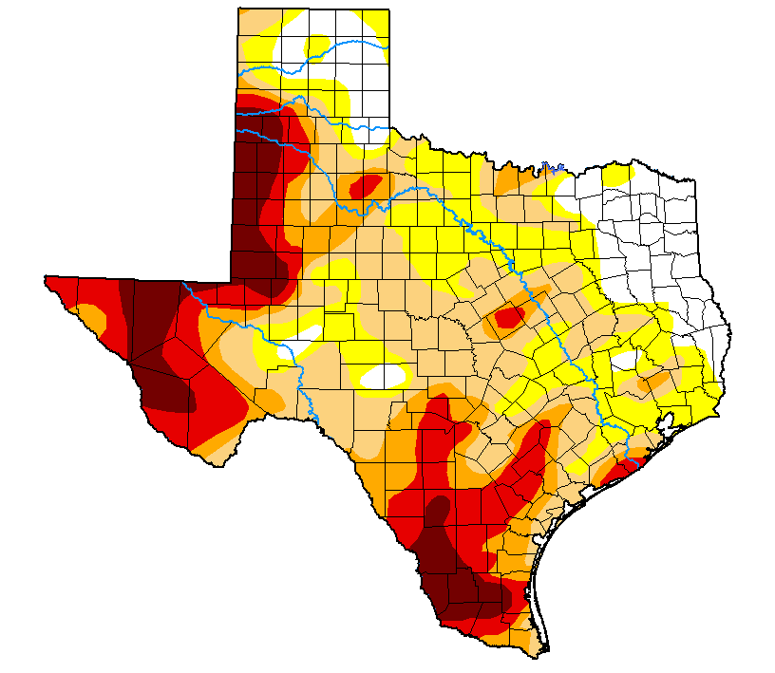
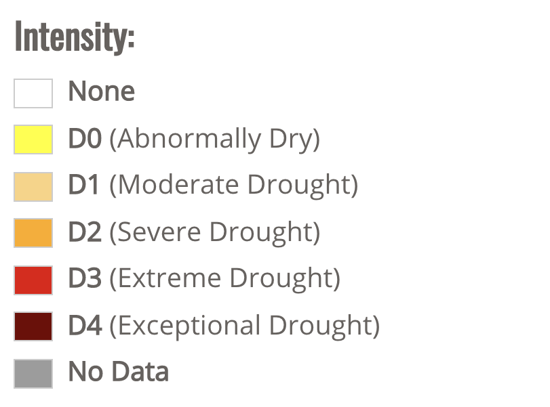
Current Drought Assessment
Released: April 29, 2021

Slide 4
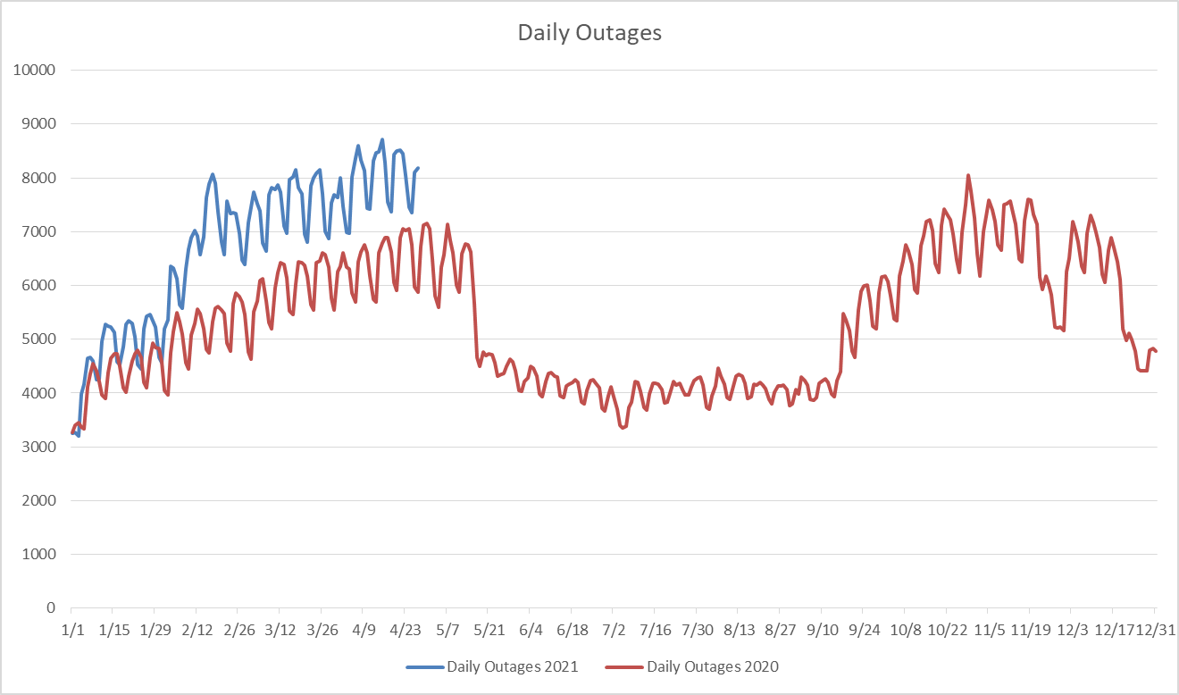
Spring Outage Coordination
• Graph represents both Transmission and Resource Outages.
• Large number of outages being processed this Spring in preparation for Summer.
• Several factors are involved in the increased number of outages.
• Important to reduce the number of outages during the summer months.

Slide 5
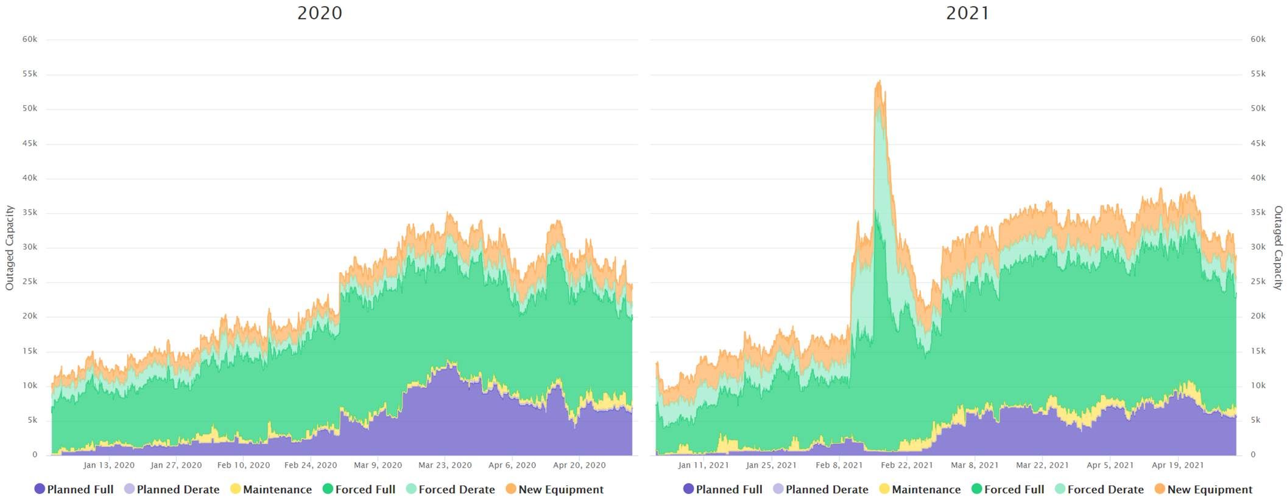
Resource Outage Coordination
  Resource Outages in Spring of 2020 and 2021.
  March and April are traditionally months in which a large amount of thermal generation undergoes routine maintenance in preparation for Summer.
  The effects of Winter Storm Uri can be seen in 2021.

Slide 6
Planned Transmission Outage Restrictions
• Market Notice January 26th, 2021: Planned Transmission Outage
Restrictions for Summer.
• Manage Transmission Outages that might limit generation availability
during high load conditions.
• Revision of standards from Summer 2020

Slide 7
Planned Transmission Outage Restrictions continued
  May 15 through September 15
  345kV
    No Outages during Hour Ending (HE) 1300 through HE 2000.
    No 345kV bus Outages that alter system topology (pre- or post-contingency). Outages on
    double breaker or breaker-and-a-half buses may be allowed with a 4-hour restoration. Transmission Service Providers (TSPs) are required to ensure proper interim contingency definitions are included in the Network Operations Model prior to the Outage occurring so
    that ERCOT systems can properly assess system conditions during the bus Outage.
  138kV
    No Outages during HE 1300 through HE 2000 if the Outage may affect generation dispatch.
    No continuous 138 kV Outages longer than 7 days.
    No continuous 138 kV Outages with a restoration time greater than 6 hours.
  69kV
    No Outages during HE 1300 through HE 2000 if the Outage would affect generation dispatch.

Slide 8
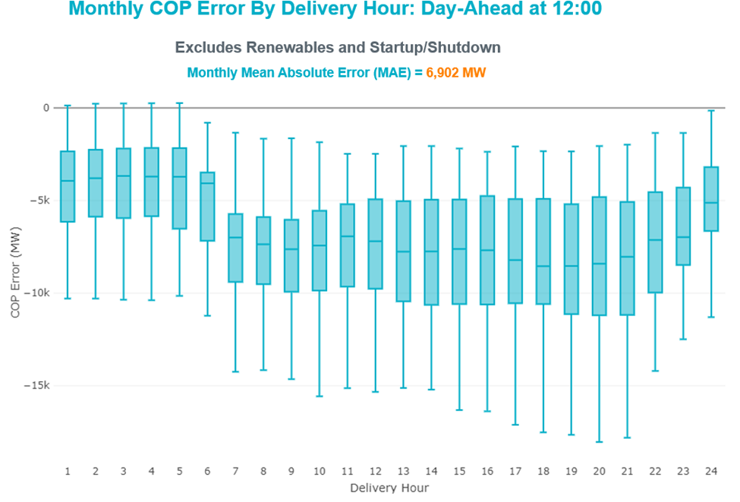
Resource (COP Values)
March 2021 - Monthly COP Error by Delivery Hour: Day-Ahead at 12:00
Excludes Renewables and Startup/Shutdown Monthly Mean Absolute Error (MAE) = 6,902 MW

Slide 9
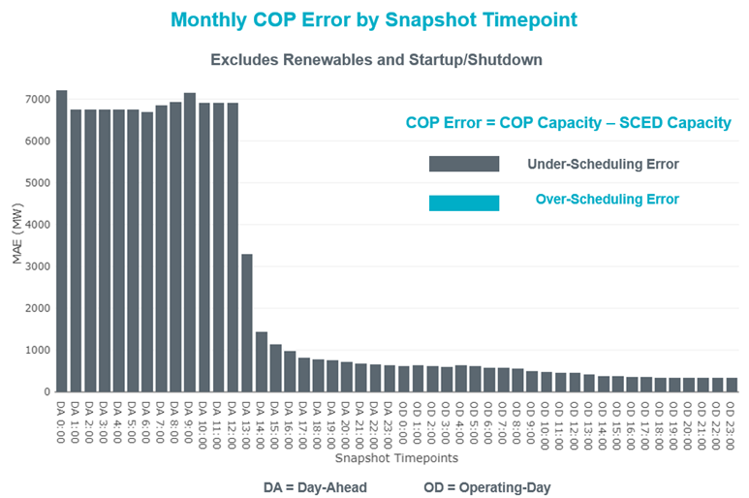
Resource COP Values
Monthly Mean Absolute Error for March
Day Ahead Market Completes
Operating Day
6,902 MW from Slide 8

Slide 10

Generator Weatherization
Generation owners and operators are not required to implement any minimum weatherization standard or perform an exhaustive review of weather vulnerability. No entity, including the PUC and ERCOT, currently has rules to enforce compliance with weatherization plans or enforce minimum weatherization standards.
In 2011, the PUC amended its rules to authorize ERCOT to conduct generator site visits to review compliance with weatherization plans. Spot checks include reviewing the weatherization plan, verifying that plant personnel are following the plan and providing recommendations based on PUC requirements, lessons learned or best practices.
While we request and review detailed plant records, the only entity that can confirm that a plant is “weatherized” to any particular standard is the entity that owns or operates the plant.
Similar to the Winter Spot Checks, ERCOT will implement Summer Spot Checks for a limited number of units in May and June of 2021.
The Spot Checks will consider the implementation of each unit’s Weatherization Plan, with the focus being on preparations for summer operations.

Slide 11
Gas and Electric Coordination
NOTICE DATE: April 30, 2021
NOTICE TYPE: W-A043021-01 Operations
SHORT DESCRIPTION: Reminder of Upcoming Submission Period for Declarations of Completion of Generation Resource Summer Weatherization Preparations and Natural Gas Pipeline Coordination for Resource Entities with Natural Gas Generation Resources
INTENDED AUDIENCE: Resource Entities with Generation Resources
DAYS AFFECTED: May 1, 2021 to June 1, 2021

