Slide 1
TDTMS Update
RMS
May 4th, 2021

Slide 2
TDTMS
DRAFT SCR Switch Hold Repository Proposal
Switch Hold Notification Process
PROPOSED Process:
CURRENT Process: files delivered by TDSPs to secured FTP sites by 9 AM weekdays
Master files submitted by TDSPs to ERCOT via NAESB for posting via secured MIS site no later than 5 AM each day representing SH revisions of the day prior
ERCOT to receive and post the five .csv formatted switch hold files (one from each TDU) in a designated location on ERCOT MIS behind a digital certificate by 6 AM each day
Files will be formatted the same as today (RMG Appendices J1)
Naming convention will remain the same
Files may be delivered daily. ERCOT will post files if made available.
Current files will replace historical files, so only one file from each of the five TDUs will be in the repository at one time.

Slide 3
TDTMS
Update
May Retail Release – extended outage – Saturday, May 1st @ 2PM impacted same day enrollments from 2PM – 7PM. A big thank you to the TDUs for accommodating work-around processes.Discussion of ERCOT MIS API functionality w/ ability to view via API as is in the GUI
All system SLAs are met
Future API performance: half dozen new entities soon to be utilizing API functionality- may put pressure on performance. GUI performance to improve, API performance may decrease. ERCOT assures API SLOs will not be compromised.
MarkeTrak API performance was slower 2/7 – 3/21 due to site failover and ‘debug’ functionality was processing 50K – 60K records that normally processes 200 - 400
ERCOT MIS API functionality: ERCOT will consider sponsoring a workshop to reach a broad audience regarding this need. Request for a revision to the original architecture and detailing ask is forthcoming.

Slide 4
TDTMS
ERCOT Communications - Listserves
Request sent to Ted Hailu framing TDTMS’s questions and offering to monitor performance SLOs around listserves
ERCOT IT is reviewing alternative solution platforms and considering bringing the functionality “on premises”
While the above represents long-term solutions, the question was raised what short-term solutions were being brought forth. It was suggested to leverage distribution lists for Client Services teams
ERCOT IT and TDTMS agreed a listserve SLO could easily fold into the Market Data Transparency SLOs currently under the purview of TDTMS

Slide 5
TDTMS
DRAFT RMGRR Switch Hold Removal Documention
Re-arranges the order of “other” acceptable additional documentation
Requires all fields on the New Occupant Statement be completed *noting the ESI may be completed by the customer or the submitting REP
Adds clarity indicating “cell phone invoices are not accepted” and “warranty deeds are not acceptable closing documents”
Aligns RMG language on the New Occupant Statement for clarity to customers
ACTION: please review proposed language and offer your input at the next TDTMS meeting
Clarifies/Revises documentation required for the removal of a Switch Hold:

Slide 6
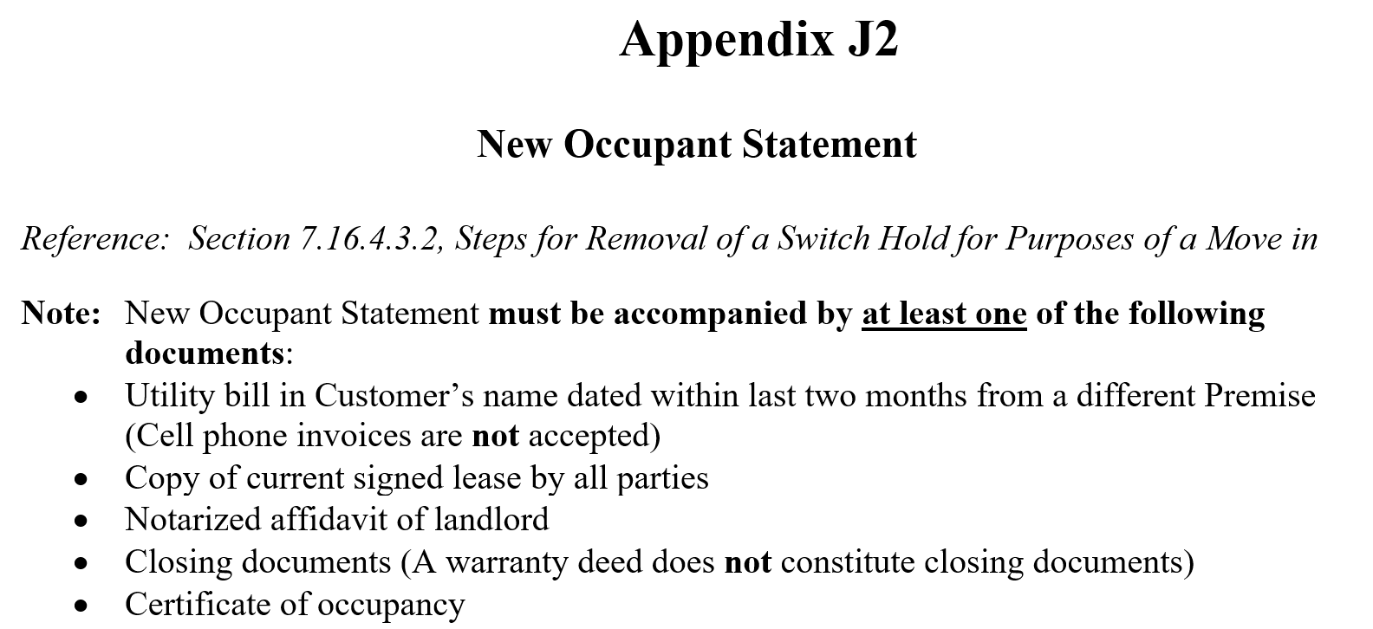
TDTMS
DRAFT RMGRR Switch Hold Removal Documention - NOS

Slide 7
TDTMS
DRAFT SCR – Administrative MarkeTrak Enhancements & MarkeTrak Upgrade
ERCOT plans to introduce upgrade late Q2/early Q3
List of 8 “administrative” issues/opportunities for consideration. Goal is to align enhancements with possible MarkeTrak Upgrade 2021 features/functionality…
Some upgrade features that may possibly alignment with SCR:
The Rolodex would require re-creation and efficiencies in streamlining might be gained
Removal of sub-types
Aligning market training of tech upgrade with proposed enhancements

Slide 8
TDTMS
DRAFT SCR – Administrative MarkeTrak Enhancements
Align drop down choices for IAS with current language in RMG and MT User’s Guide
Develop a common list of unexecutable reasons for each subtype to assist with monitoring and tracking
Downsize and streamline the current Rolodex feature
Escalation emails for IAS if “begun working” and not transitioned within 7 days
Escalation emails for Rescission process if have not transitioned within 2 days AND/OR submitted BDMVI in 2 days
Escalation reports to include ESI and MT#
Reporting on ‘last modified date’ if MT was auto-closed
Delete unused subtypes

Slide 9
TDTMS
Next Meeting – May 20th, Thursday @ 9:30 WebEx
On the Agenda:
System instances and MarkeTrak Monthly Performance Review
Market Data Transparency SLOs
DRAFT RMGRR Switch Hold Removal Required Documents
Update SCR Switch Hold Repository
DRAFT SCR Administrative MT Enhancements
ERCOT Communications Update – listserves
ERCOT MIS API Functionality Workshop

