Slide 1
Unregistered Distributed Generation Reports:
2020 Annual Report
2021 Q1 Report
Resource Adequacy
5/5/2021

Slide 2
2020 Annual Report Background
Competitive TDSP data: Same as quarterly report
NOIE data: All NOIEs required to report all capacity in annual report
Unlike 2019 annual report, no reporting exemption for 2020 report
NOIE response rates:
2019: 60%
2020: 96%
If the totals meaningfully change from the few remaining NOIE reports, we will post a revised report

Slide 3
2020 Annual Unregistered Distributed Generation Report
Load Zone | 2020 Annual Distributed Generation Cumulative Installed Capacity in MW (AC)
 | SOLAR |  | WIND |  | OTHER RENEWABLE |  | OTHER NON-RENEWABLE |  | TOTAL
 | < 50 kW | ≥ 50 kW | < 50 kW | ≥ 50 kW | < 50 kW | ≥ 50 kW | < 50 kW | ≥ 50 kW | < 50 kW | ≥ 50 kW | Combined
LZ_AEN | 63 | 24 | - | - | - | - | - | - | 63 | 24 | 87
LZ_CPS | 161 | 33 | - | - | 2 | - | - | 20 | 163 | 53 | 216
LZ_HOUSTON | 77 | 2 | - | - | - | - | - | 4 | 77 | 6 | 83
LZ_LCRA | 55 | 14 | - | - | - | 1 | - | - | 56 | 15 | 70
LZ_NORTH | 263 | 28 | 2 | 1 | - | - | - | 7 | 265 | 37 | 302
LZ_RAYBN | 16 | 3 | - | - | - | - | - | - | 17 | 3 | 20
LZ_SOUTH | 100 | 20 | 1 | - | - | - | - | 1 | 101 | 20 | 121
LZ_WEST | 37 | 6 | 1 | - | - | - | - | - | 37 | 6 | 43
TOTAL | 772 | 130 | 4 | 2 | 2 | 1 | - | 32 | 778 | 164 | 942
Totals may not match the sum of their columns/rows due to rounding
Notes:
Competitive vs. Municipal vs. Cooperative breakdown:
Competitive: 447 MW
Municipal: 336 MW
Cooperative: 159 MW

Slide 4
2021 Q1 Unregistered Distributed Generation Report
Load Zone | 2021 Q1 Distributed Generation Cumulative Installed Capacity in MW (AC)
 | SOLAR |  | WIND |  | OTHER RENEWABLE |  | OTHER NON-RENEWABLE |  | TOTAL
 | < 50 kW | ≥ 50 kW | < 50 kW | ≥ 50 kW | < 50 kW | ≥ 50 kW | < 50 kW | ≥ 50 kW | < 50 kW | ≥ 50 kW | Combined
LZ_AEN | 65 | 26 | - | - | - | - | - | - | 65 | 26 | 90
LZ_CPS | 169 | 39 | - | - | 2 | - | - | 20 | 171 | 58 | 229
LZ_HOUSTON | 89 | 2 | - | - | - | - | - | 4 | 90 | 6 | 96
LZ_LCRA | 60 | 17 | - | - | - | 1 | - | - | 61 | 18 | 79
LZ_NORTH | 286 | 30 | 2 | 1 | - | - | - | 5 | 289 | 35 | 324
LZ_RAYBN | 18 | 3 | - | - | - | - | - | - | 18 | 3 | 21
LZ_SOUTH | 92 | 21 | 1 | - | - | - | - | 1 | 93 | 21 | 114
LZ_WEST | 41 | 6 | 1 | - | - | - | - | - | 42 | 7 | 49
TOTAL | 821 | 143 | 4 | 2 | 2 | 1 | 1 | 29 | 828 | 175 | 1,003
Totals may not match the sum of their columns/rows due to rounding
Notes:
NOIE data is submitted through surveys. Competitive TDSP data is submitted through load profile codes.

Slide 5
2020 Q4 → 2021 Q1 Change
Load Zone | 2020 Q4 → 2021 Q1 Change in Distributed Generation Installed Capacity in MW (AC)
 | SOLAR |  | WIND |  | OTHER RENEWABLE |  | OTHER NON-RENEWABLE |  | TOTAL
 | < 50 kW | ≥ 50 kW | < 50 kW | ≥ 50 kW | < 50 kW | ≥ 50 kW | < 50 kW | ≥ 50 kW | < 50 kW | ≥ 50 kW | Combined
LZ_AEN | +1.78 | +2.01 | - | - | - | - | - | - | +1.78 | +2.01 | +3.79
LZ_CPS | +10.17 | +5.33 | - | - | - | - | - | - | +10.17 | +5.33 | +15.50
LZ_HOUSTON | +12.62 | +0.07 | - | - | - | - | - | - | +12.62 | +0.07 | +12.69
LZ_LCRA | +5.13 | +3.28 | - | - | - | - | +0.21 | - | +5.34 | +3.28 | +8.61
LZ_NORTH | +33.02 | +2.33 | +0.10 | - | - | - | +0.39 | -2.90 | +33.52 | -0.57 | +32.95
LZ_RAYBN | +2.03 | - | -0.01 | - | - | - | - | - | +2.01 | - | +2.02
LZ_SOUTH | +3.64 | +1.60 | - | - | - | - | +0.14 | - | +3.79 | +1.60 | +5.39
LZ_WEST | +6.40 | +0.64 | -0.03 | - | - | - | - | - | +6.38 | +0.64 | +7.01
TOTAL | +74.79 | +15.26 | +0.06 | - | - | - | +0.75 | -2.90 | +75.60 | +12.36 | +87.96
Notes:
- A revised 2020 Q4 report has been posted to add NOIE data that had not been reported to ERCOT prior to the annual report. This slide reflects the revised report.

Slide 6
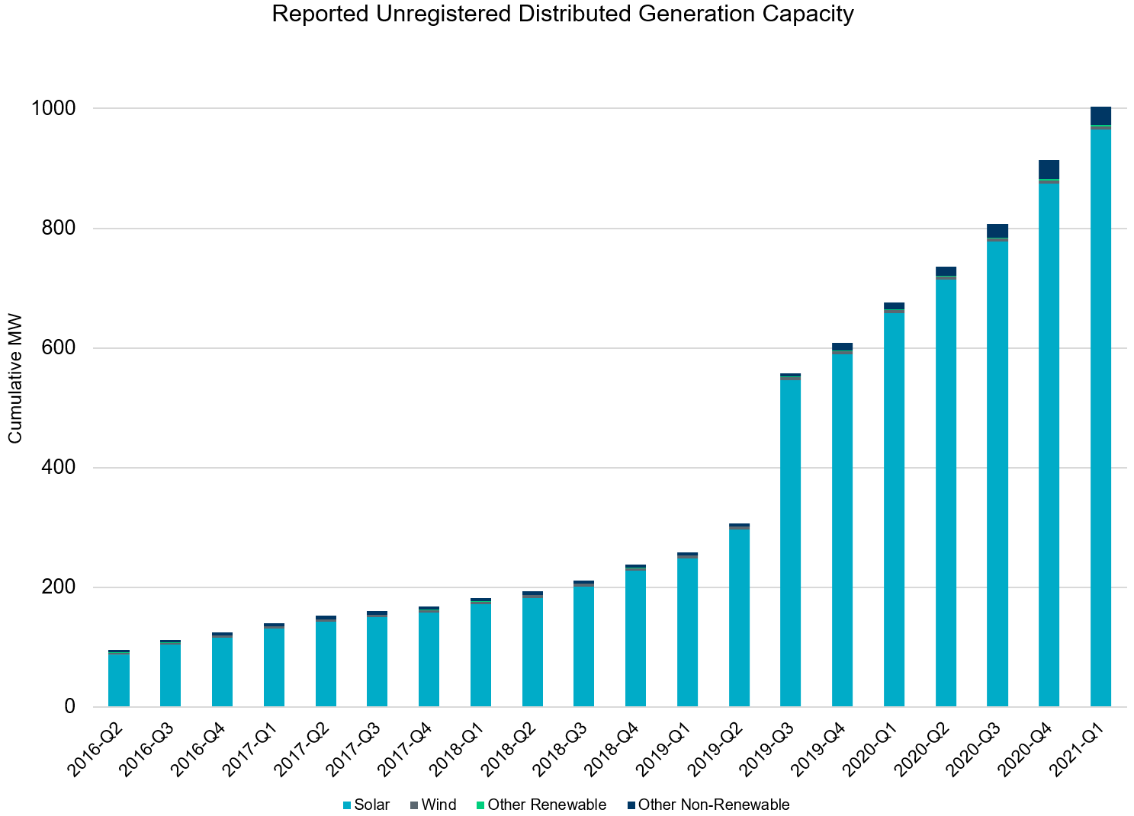
Unregistered DG Growth: 2016-Q2* to 2021-Q1
Large increase due to reporting requirement change**
* 2016-Q2 was the first report published after implementation of report changes per NPRR794/COPMGR044
** 2019-Q3 was the first report published after implementation of report changes per NPRR891

