Slide 1
PDCWG Report to ROS
Chair: Chad Mulholland, NRG
Vice Chair: Jimmy Jackson, CPS
ROS
April 29th, 2021

Slide 2
Report Overview & Notes
Report Overview
Meeting Minutes
BAL-001-TRE-2 FMEs & IMFR
1 FME in the month of February
2 FMEs in the month of March
Frequency Control Report

Slide 3
Meeting Minutes
PDCWG Meeting 04/08/2021
Review of emergency conditions list from ROS
February cold weather event follow up discussion
ERCOT reports

Slide 4
Frequency Measurable Events Performance

Slide 5
Frequency Measurable Events
There was 1 FME in February
2/22/2021 5:38:48
Loss of 714 MW
Interconnection Frequency Response: 1082 MW/0.1 Hz
5 of 46 Evaluated Generation Resources had less than 75% of their expected Initial Primary Frequency Response.
7 of 46 Evaluated Generation Resources had less than 75% of their expected Sustained Primary Frequency Response.

Slide 6
Frequency Measurable Events
There were 2 FMEs in March
3/3/2021 9:56:28
Loss of 429 MW
Interconnection Frequency Response: 913 MW/0.1 Hz
13 of 51 Evaluated Generation Resources had less than 75% of their expected Initial Primary Frequency Response.
9 of 51 Evaluated Generation Resources had less than 75% of their expected Sustained Primary Frequency Response.
3/30/2021 18:01:04
Loss of load of 673 MW
Interconnection Frequency Response: 961 MW/0.1 Hz
10 of 51 Evaluated Generation Resources had less than 75% of their expected Initial Primary Frequency Response.
10 of 51 Evaluated Generation Resources had less than 75% of their expected Sustained Primary Frequency Response.

Slide 7
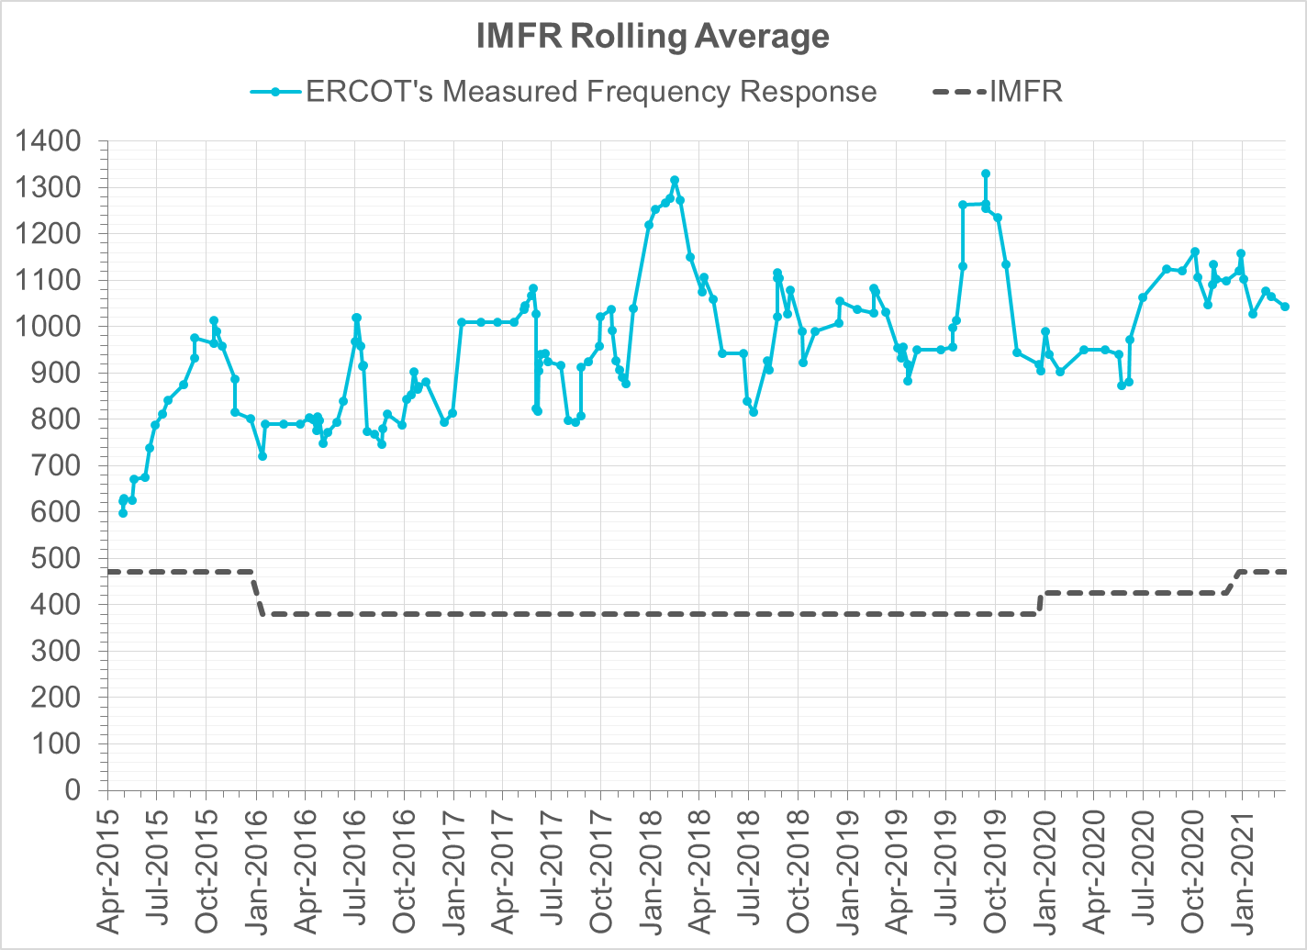
Interconnection Minimum Frequency Response (IMFR) Performance
IMFR Performance currently 1042.53 MW/0.1Hz
Frequency Response Obligation (FRO): 471 MW/0.1 Hz

Slide 8
Frequency Control Report
March 2021

Slide 9
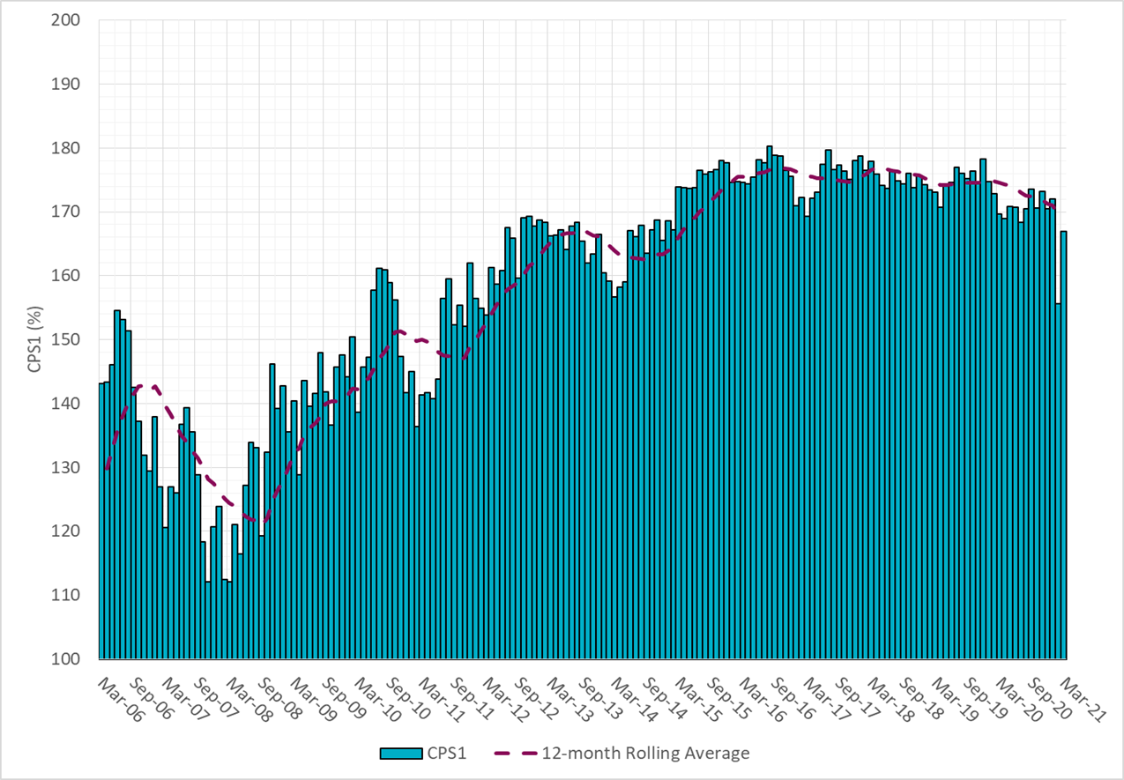
CPS1 Performance
Current 12-Month Rolling Average: 169.30%

Slide 10
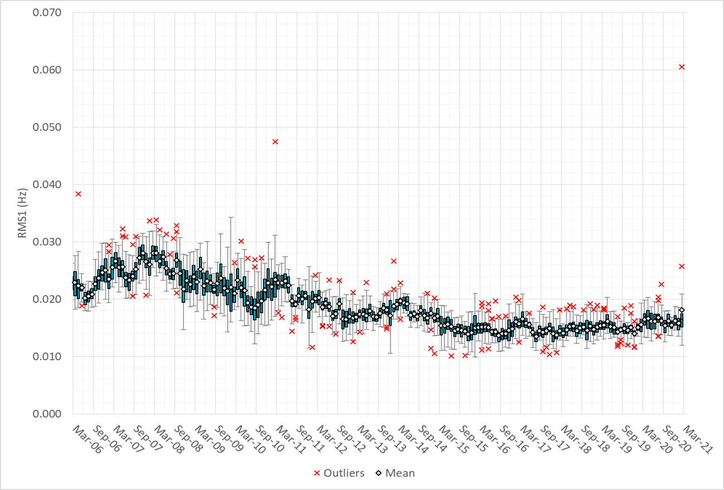
RMS1 Performance of ERCOT Frequency

Slide 11
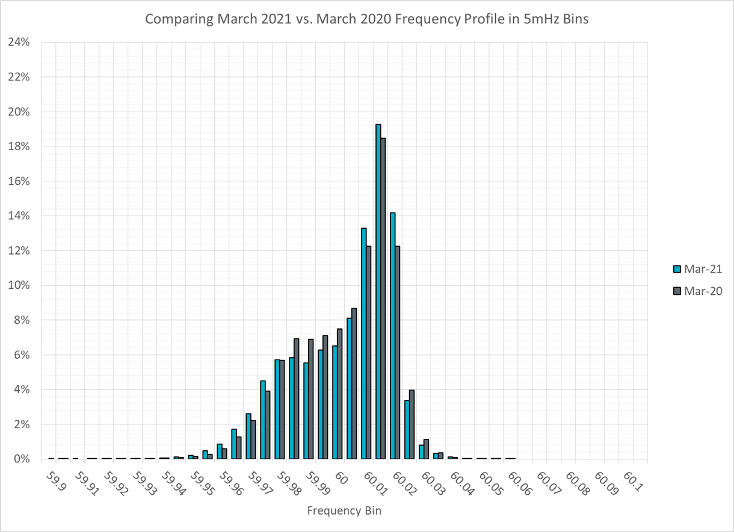
Frequency Profile Analysis

Slide 12
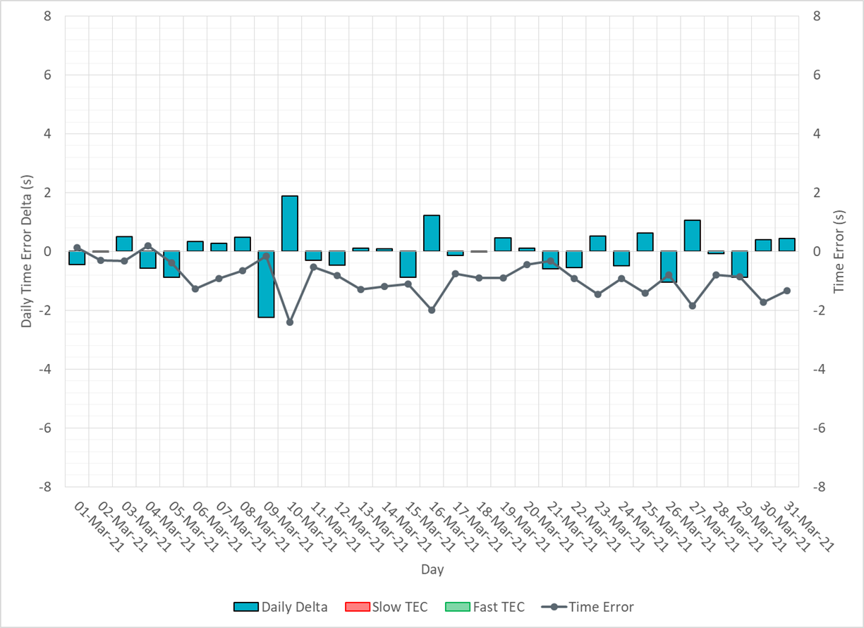
Time Error Corrections

Slide 13
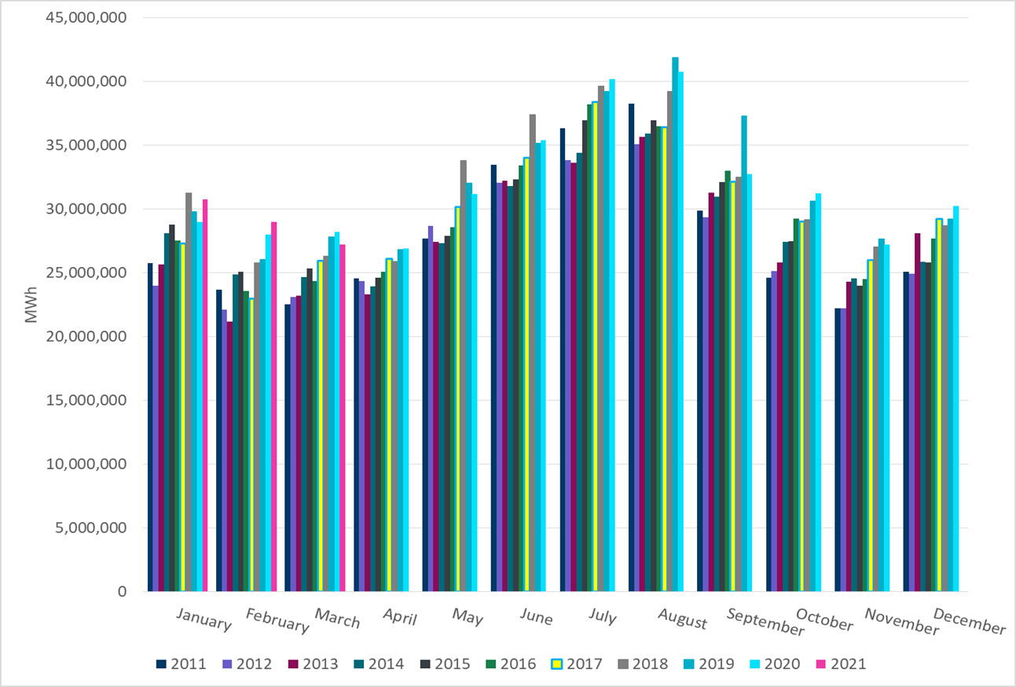
ERCOT Total Energy
Notes:
27,223,416 MWh

Slide 14
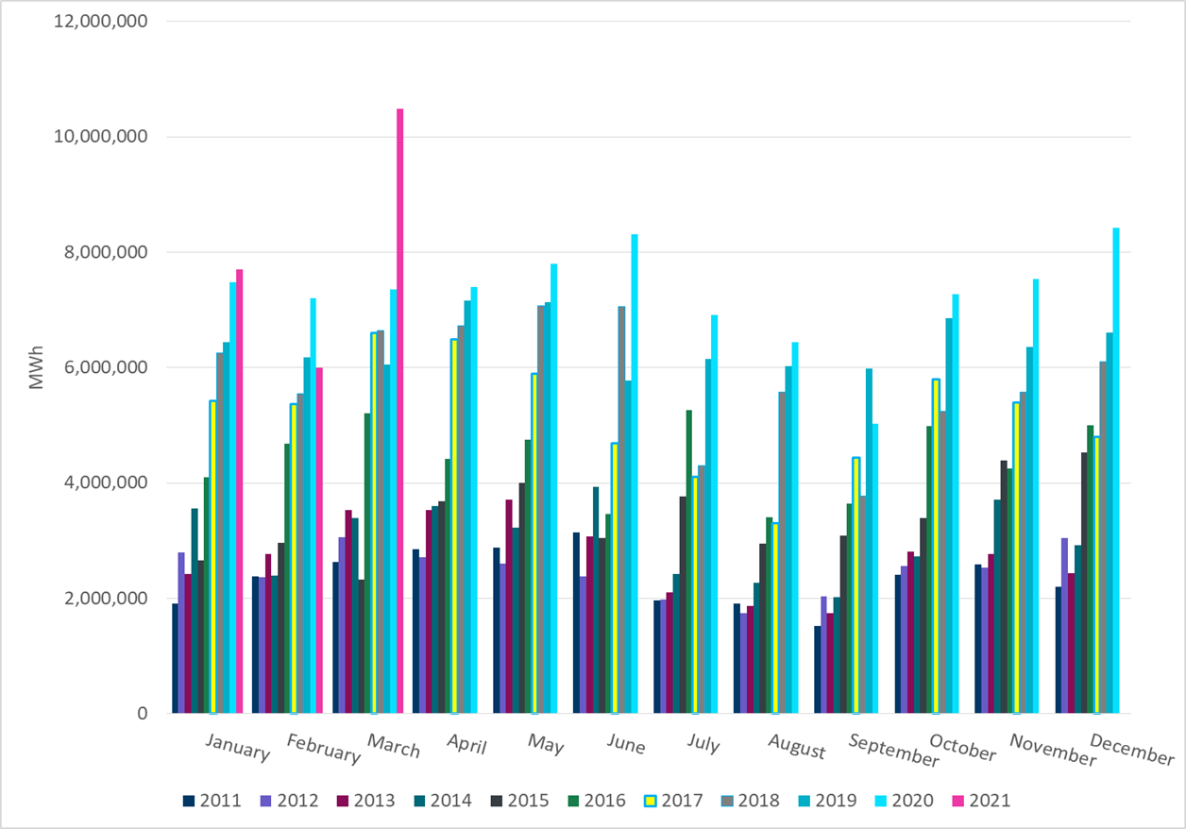
ERCOT Total Energy from Wind Generation
Notes:
10,485,979 MWh

Slide 15
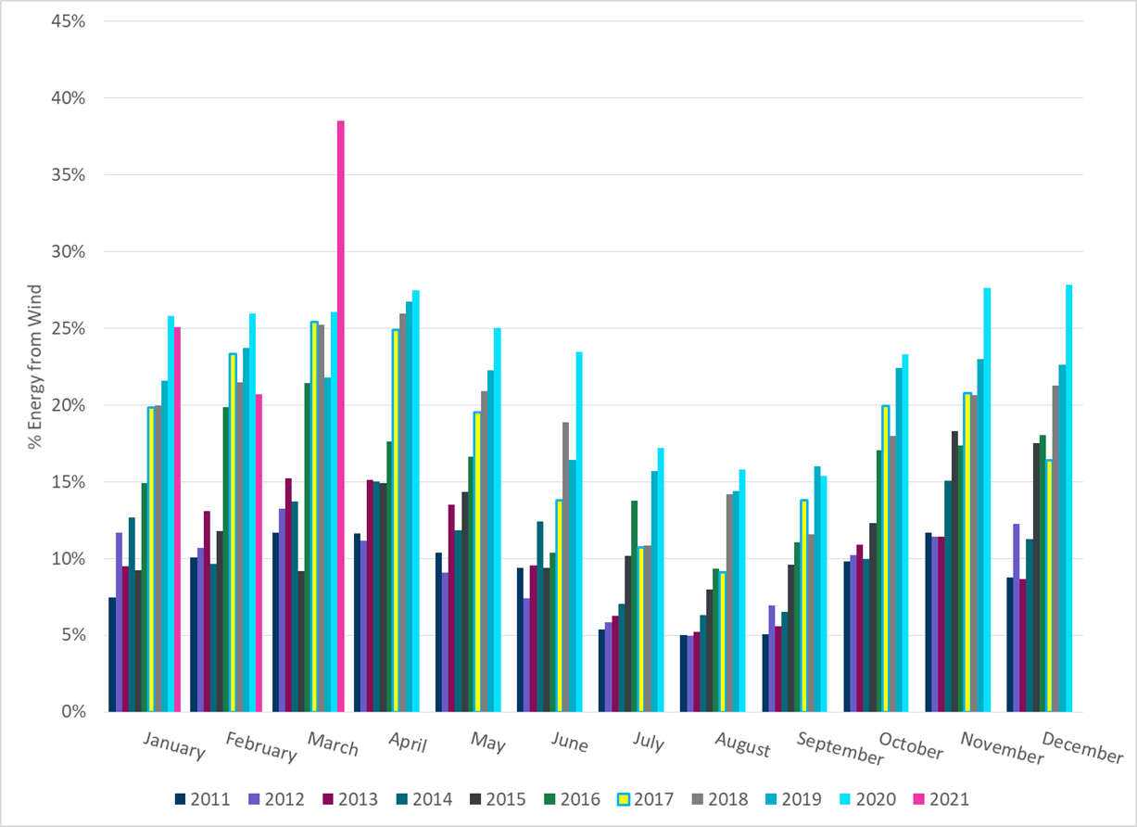
ERCOT % Energy from Wind Generation
Notes:
38.52%

Slide 16
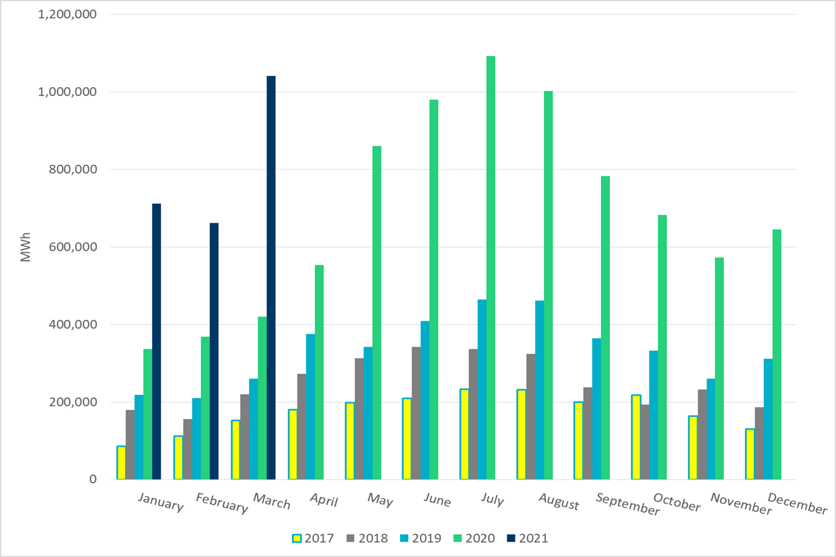
ERCOT Total Energy from Solar Generation
Notes:
10,410,55 MWh

Slide 17
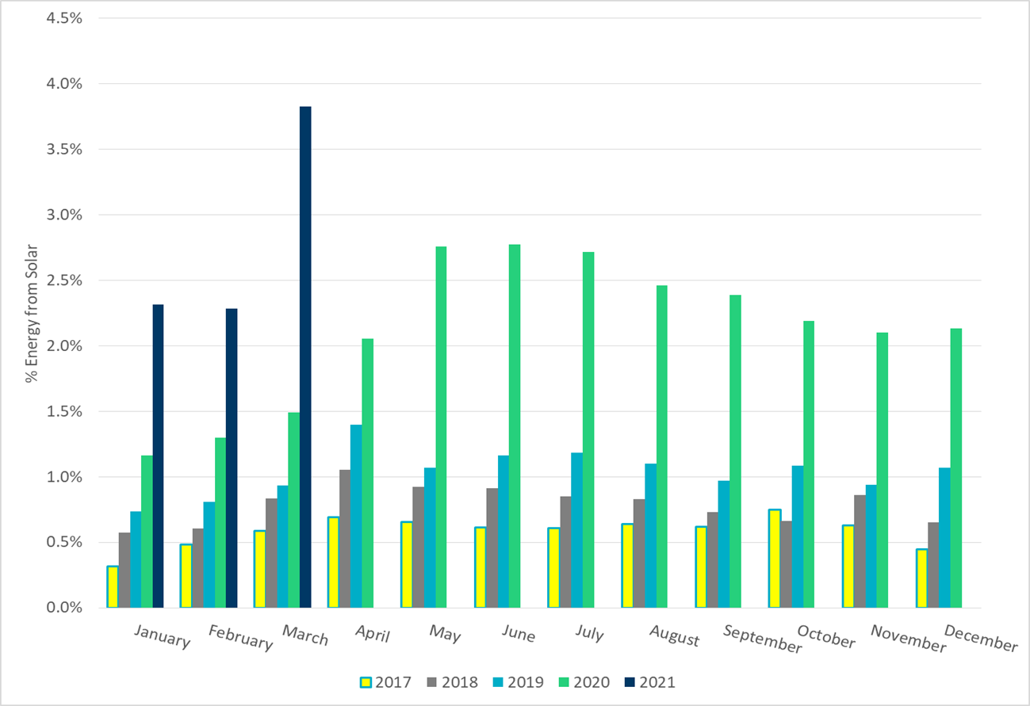
ERCOT % Energy from Solar Generation
Notes:
3.82%

Slide 18
Questions?

