Slide 1
Settlement Stability
2021 Q1 Update to WMS
Settlements Group
ERCOT
05/05/2021

Slide 2
8.2(2)(c)(i) Track number of price changes
Reporting Period: 2021 Q1
Operating Day | # of Corrected Prices |  |  |  |  | # of Intervals Affected |  |  |  |  | Market Notice
 | DASPP | MCPC | RTSPP | RTRMPR | ORDC Adders | DASPP | MCPC | RTSPP | RTRMPR | ORDC Adders
- | - | - | - | - | - | - | - | - | - | - | -
Notes:
There were no price changes in Q1 2021.
The price changes reported on this slide display the price corrections that have been done after the Settlement Statement has posted for the Operating Day.

Slide 3
8.2(2)(c)(iv) Track number of resettlements due to non-price errors
Reporting Period: 2021 Q1
Operating Day(s) Resettled | Reason for Resettlement | Affected Charge Types | Market Notice Number
02/11/2021 – 02/19/2021 | Meter Reads | LAASIRNAMT, LARDASIRNAMT, LARTRNAMT, RTASIAMT, RTEIAMT, RTRDASIAMT, ESACAMT | M-C022421-02
02/11/2021 & 02/12/2021 | Meter Reads | LAASIRNAMT, LARTRNAMT, RTASIAMT, RTEIAMT, ESACAMT | M-C022421-10
02/13/2021 & 02/14/2021 | Meter Reads | LARTRNAMT, RTEIAMT, ESACAMT | M-C022421-09

Slide 4
8.2(2)(c)(ii) Track number and types of disputes submitted 8.2(2)(c)(iii) Compliance with timeliness of response to disputes
YEAR | 2021 |  | 100% of dispute resolutions were timely.
CALENDAR QUARTER REPORTED | Q1
Disputed Charge Sub-Type | Submitted | Resolved | Denied | Granted | Granted with Exceptions
Administrative Fees | 54 | 29 | 29
Ancillary Services-DAM | 168 | 17 | 17
Ancillary Services-RTM | 329 | 1 | 1
Black Start Capacity | 41 | 22 | 22
Congestion Revenue Rights-DAM | 12 | 7 | 7
CRR Auction | 58
CRR Auction Revenue Dist. | 1 | 1 | 1
CRR Balancing Ac |  | 1 | 1
DA/RT Invoice | 299
Emergency Operations | 17 | 1 | 1
Energy-DAM | 11 | 2 | 2
Energy-RTM | 276 | 9 | 3 | 6
Gene. Res. Base Pt Deviation | 43 | 14 | 14
Invoice | 39
Reliability Must Run | 1
Reliability Unit Commitment | 8 | 1 | 1
Revenue Neutrality Allocation | 47 | 2 |  | 2
TOTAL | 1404 | 107 | 99 | 8 | 0
Submitted but not resolved disputes may be:
Not started
Open
Rejected
Withdrawn

Slide 5
8.2(2)(c)(iv) Other Settlement Metrics
NOTE: ERS Final settlement OD data is not represented in graph.
Average percent change

Slide 6
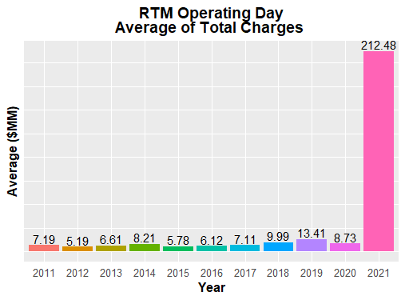
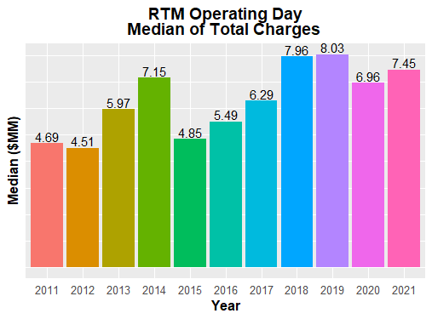
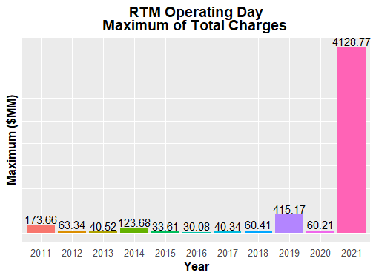
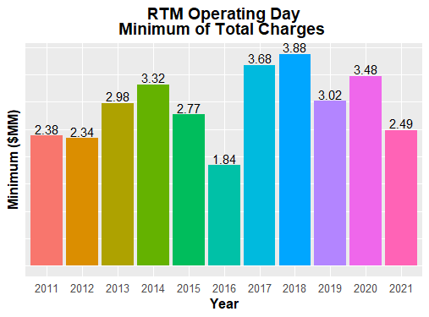
8.2(2)(c)(iv) Other Settlement Metrics
Note: These numbers are based on initial settlements.

Slide 7
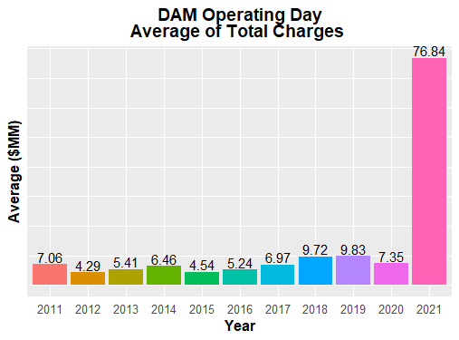
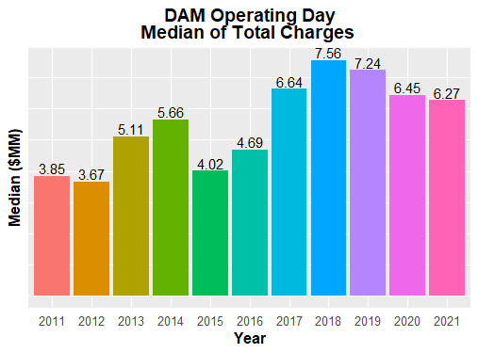
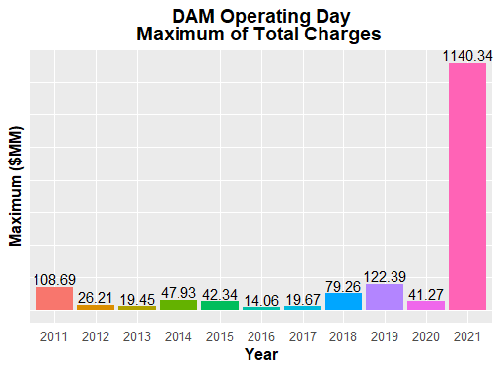
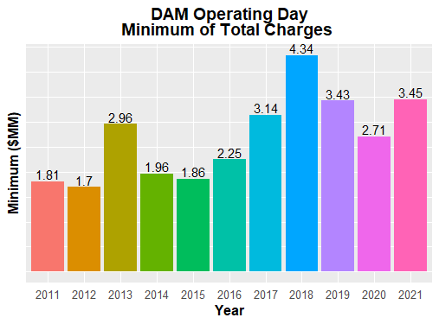
8.2(2)(c)(iv) Other Settlement Metrics

Slide 8
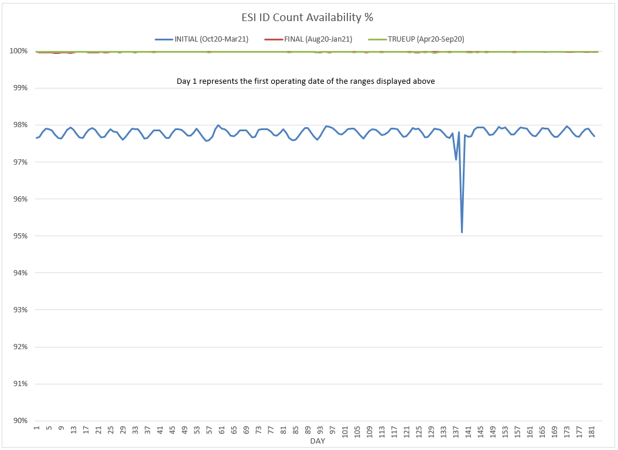
8.2(2)(c)(v) Availability of ESIID consumption data

Slide 9
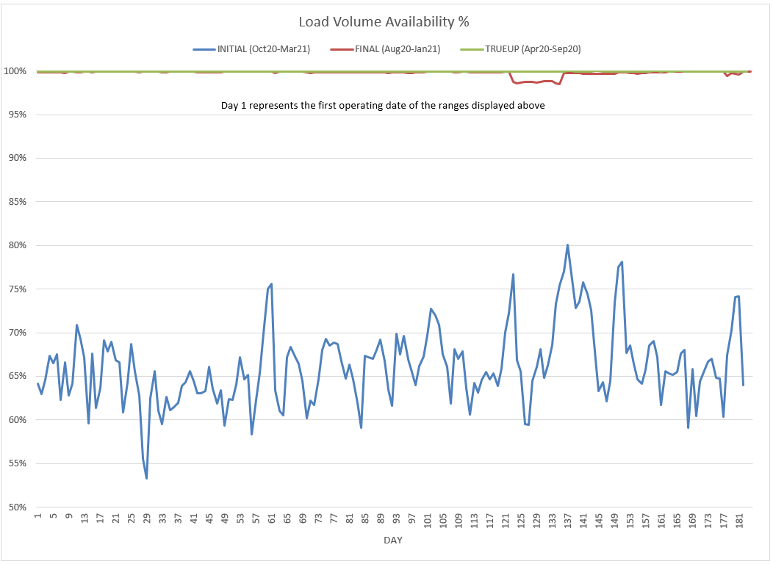
8.2(2)(c)(v) Availability of ESIID consumption data

Slide 10
8.2(2)(g) Net Allocation to Load - Totals and $/MWh
NET ALLOCATION TO LOAD ($M)
 | Mar 2020 | Apr 2020 | May 2020 | Jun 2020 | Jul 2020 | Aug 2020 | Sep 2020 | Oct 2020 | Nov 2020 | Dec 2020 | Jan 2021 | Feb 2021 | Mar 2021
Ancillary Service Settlement | 29.2 | 27.2 | 19.1 | 16.9 | 17.7 | 45.4 | 13.5 | 22.1 | 27.4 | 21.1 | 25.3 | 6,909.8 | 61.4
Balancing Account Payout to Load | -11.6 | -12.5 | -11.6 | 0.0 | 0.0 | 0.0 | 0.0 | 0.0 | 0.0 | 0.0 | -6.1 | -9.6 | 0.0
Base Point Deviation Payments | -0.2 | -0.2 | -0.2 | -0.2 | -0.2 | -0.3 | -0.2 | -0.3 | -0.3 | -0.2 | -0.2 | -31.2 | -0.2
Black Start Service Settlement | 0.6 | 0.6 | 0.6 | 0.6 | 0.6 | 0.5 | 0.5 | 0.6 | 0.5 | 0.5 | 0.6 | 0.5 | 0.5
Block Load Transfer Settlement | 0.0 | 0.0 | 0.0 | 0.0 | 0.0 | 0.0 | 0.0 | 0.0 | 0.0 | 0.0 | 0.0 | 0.0 | 0.0
Emergency Energy Charges | 0.2 | 0.1 | 0.2 | 0.0 | 0.1 | 0.1 | 0.1 | 0.2 | 0.2 | 0.1 | 0.2 | 15.9 | 0.3
ERCOT Admin Fee Settlement | 15.7 | 15.0 | 17.4 | 19.7 | 22.4 | 22.7 | 18.2 | 17.4 | 15.2 | 16.8 | 17.1 | 16.2 | 15.2
ERO Pass-Through Fee⁵ | 1.6 | 1.6 | 1.6 | 1.6 | 1.6 | 1.6 | 1.6 | 1.6 | 1.6 | 1.6 | 1.6 | 1.6 | 1.6
ERS Settlement¹ | 2.9 | 2.9 | 2.9 | 4.2 | 4.2 | 4.2 | 4.2 | 4.8 | 4.8 | 4.8 | 4.8 | 0.0 | 0.0
High Dispatch Limit Override | 0.0 | 0.0 | 0.0 | 0.0 | 0.0 | 0.0 | 0.0 | 0.0 | 0.0 | 0.0 | 0.0 | 0.0 | 0.0
Non-Zonal Auction Distribution | -14.5 | -15.4 | -14.6 | -13.1 | -10.1 | -10.9 | -10.6 | -16.7 | -13.6 | -12.6 | -14.9 | -14.3 | -22.4
ORDC Settlement | 0.5 | 1.2 | 0.9 | 0.1 | 2.0 | 10.2 | 1.5 | 3.7 | 0.4 | 0.1 | 0.0 | 1,788.0 | 0.0
Revenue Neutrality Total | 27.0 | 2.8 | 14.2 | -0.3 | 1.4 | -13.3 | 5.3 | -2.9 | 22.4 | 5.1 | 5.4 | -57.6 | 17.1
RMR Settlement | 0.0 | 0.0 | 0.0 | 0.0 | 0.0 | 0.0 | 0.0 | 0.0 | 0.0 | 0.0 | 0.0 | 0.0 | 0.0
RUC Settlement | 0.0 | 0.0 | 0.0 | 0.0 | -0.1 | -0.2 | 0.0 | 0.0 | 0.0 | 0.0 | 0.0 | -1.3 | 0.0
Voltage Services Settlement | 0.0 | 0.0 | 0.0 | 0.0 | 0.0 | 0.0 | 0.0 | 0.0 | 0.0 | 0.0 | 0.0 | 0.0 | 0.0
Zonal Auction Distribution² | -51.3 | -52.9 | -45.7 | -51.1 | -55.1 | -55.6 | -48.7 | -44.0 | -40.3 | -42.4 | -44.5 | -42.0 | -48.9
Total Allocation to Load | 0.1 | -29.6 | -15.2 | -21.6 | -15.5 | 4.4 | -14.6 | -13.5 | 18.3 | -5.1 | -10.7 | 8,576.0 | 24.6
Adjusted Metered Load (TWh) | 28.2 | 27.0 | 31.3 | 35.5 | 40.3 | 40.9 | 32.8 | 31.3 | 27.4 | 30.4 | 30.9 | 29.2 | 27.4
$/MWh³ | 0.0 | -1.1 | -0.5 | -0.6 | -0.4 | 0.1 | -0.4 | -0.4 | 0.7 | -0.2 | -0.3 | 293.7 | 0.9
Notes: The Net Allocation to Load amounts provided in this presentation are for informational purposes only and cannot be relied upon for accurate measurements or forecasts of individual QSE charges and payments. This data is based on the latest data that was available at the time that this report was run.
¹The total ERS charges have been evenly allocated across the contract period.
²Zonal Auction Distribution by 2003 Congestion Management Zone, shown below.
³The $/MWh value as calculated per PR 8.2 (2) g
⁴The $/MWh value by 2003 Congestion Management Zone, as calculated per PR 8.2(2) g
⁵Allocated to load from two years prior per the Electric Reliability Organization Fee Assessment and Collection Guide

Slide 11
8.2(2)(g) Net Allocation to Load - Totals and $/MWh
ZONAL AUCTION DISTRIBUTION PER CONGESTION MANAGEMENT ZONE ($M)
 | Mar 2020 | Apr 2020 | May 2020 | Jun 2020 | Jul 2020 | Aug 2020 | Sep 2020 | Oct 2020 | Nov 2020 | Dec 2020 | Jan 2021 | Feb 2021 | Mar 2021
HOUSTON | -4.4 | -4.4 | -5.4 | -6.2 | -8.0 | -9.3 | -7.3 | -6.3 | -4.2 | -5.0 | -4.2 | -3.8 | -4.8
NORTH | -8.6 | -6.9 | -10.4 | -13.7 | -15.3 | -14.7 | -11.7 | -8.3 | -6.7 | -8.4 | -9.0 | -7.7 | -8.1
SOUTH | -10.5 | -10.5 | -12.5 | -14.5 | -16.2 | -16.8 | -14.0 | -12.2 | -11.3 | -12.6 | -14.6 | -13.5 | -15.0
WEST | -27.8 | -31.1 | -17.4 | -16.6 | -15.5 | -14.8 | -15.7 | -17.2 | -18.0 | -16.3 | -16.7 | -17.1 | -21.0
TOTAL | -51.3 | -52.9 | -45.7 | -51.1 | -55.1 | -55.6 | -48.7 | -44.0 | -40.3 | -42.4 | -44.5 | -42.0 | -48.9
REAL-TIME ADJUSTED METERED LOAD BY CONGESTION MANAGEMENT ZONE (TWh)
 | Mar 2020 | Apr 2020 | May 2020 | Jun 2020 | Jul 2020 | Aug 2020 | Sep 2020 | Oct 2020 | Nov 2020 | Dec 2020 | Jan 2021 | Feb 2021 | Mar 2021
HOUSTON | 8.0 | 7.5 | 8.8 | 9.6 | 10.6 | 10.8 | 9.5 | 8.9 | 7.8 | 7.9 | 7.9 | 6.7 | 7.3
NORTH | 9.1 | 8.8 | 10.4 | 12.7 | 14.6 | 14.7 | 10.9 | 10.2 | 9.0 | 10.8 | 11.1 | 11.5 | 9.5
SOUTH | 7.4 | 7.2 | 8.7 | 9.4 | 10.9 | 11.0 | 8.7 | 8.5 | 7.1 | 7.8 | 7.9 | 7.8 | 7.0
WEST | 3.7 | 3.5 | 3.5 | 3.8 | 4.3 | 4.3 | 3.7 | 3.7 | 3.5 | 3.9 | 3.9 | 3.2 | 3.6
TOTAL | 28.2 | 27.0 | 31.3 | 35.5 | 40.3 | 40.9 | 32.8 | 31.3 | 27.4 | 30.4 | 30.9 | 29.2 | 27.4
ZONAL AUCTION REVENUE PER CONGESTION MANAGEMENT ZONE ($/MWh)
 | Mar 2020 | Apr 2020 | May 2020 | Jun 2020 | Jul 2020 | Aug 2020 | Sep 2020 | Oct 2020 | Nov 2020 | Dec 2020 | Jan 2021 | Feb 2021 | Mar 2021
HOUSTON | -0.6 | -0.6 | -0.6 | -0.6 | -0.8 | -0.9 | -0.8 | -0.7 | -0.5 | -0.6 | -0.5 | -0.6 | -0.7
NORTH | -0.9 | -0.8 | -1.0 | -1.1 | -1.0 | -1.0 | -1.1 | -0.8 | -0.7 | -0.8 | -0.8 | -0.7 | -0.9
SOUTH | -1.4 | -1.5 | -1.4 | -1.5 | -1.5 | -1.5 | -1.6 | -1.4 | -1.6 | -1.6 | -1.8 | -1.7 | -2.1
WEST | -7.5 | -8.9 | -5.0 | -4.4 | -3.6 | -3.4 | -4.2 | -4.6 | -5.1 | -4.2 | -4.3 | -5.3 | -5.8
TOTAL | -1.8 | -2.0 | -1.5 | -1.4 | -1.4 | -1.4 | -1.5 | -1.4 | -1.5 | -1.4 | -1.4 | -1.4 | -1.8
NET ALLOCATION TO LOAD PER CONGESTION MANAGEMENT ZONE ($/MWh)⁴
 | Mar 2020 | Apr 2020 | May 2020 | Jun 2020 | Jul 2020 | Aug 2020 | Sep 2020 | Oct 2020 | Nov 2020 | Dec 2020 | Jan 2021 | Feb 2021 | Mar 2021
HOUSTON | 1.2 | 0.3 | 0.4 | 0.2 | 0.2 | 0.6 | 0.2 | 0.3 | 1.6 | 0.6 | 0.6 | 294.5 | 2.0
NORTH | 0.9 | 0.1 | 0.0 | -0.3 | 0.0 | 0.5 | -0.1 | 0.2 | 1.4 | 0.4 | 0.3 | 294.4 | 1.8
SOUTH | 0.4 | -0.6 | -0.4 | -0.7 | -0.5 | 0.0 | -0.6 | -0.4 | 0.5 | -0.4 | -0.7 | 293.4 | 0.6
WEST | -5.7 | -8.0 | -4.0 | -3.6 | -2.6 | -1.9 | -3.2 | -3.6 | -3.0 | -3.0 | -3.2 | 289.8 | -3.1
TOTAL | 0.0 | -1.1 | -0.5 | -0.6 | -0.4 | 0.1 | -0.4 | -0.4 | 0.7 | -0.2 | -0.3 | 293.7 | 0.9

