Slide 1
Market Credit Working Group update to the Wholesale Market Subcommittee
Brenden Sager, Austin Energy, Chair
Seth Cochran, Direct Energy, Vice Chair
5 May 2021

Slide 2
MCWG update to WMS
General Update
  21 April 2021 Joint MCWG/CWG WEBEX Meeting
  4 NPRRs reviewed for their credit impacts
  NPRR 1073 and 1074 supported for positive credit impacts; remaining considered operational without credit impacts
General comment:
  the Board needs to approve NPRR 1073 & NPRR 1074 before any default uplifts occur (without defaulting market participants included everyone else will be allocated a larger share).
  The Legislature (and perhaps PUCT) may also become involved in this process
  There are securitization bills outstanding which might pay off the short payments / uplifts immediately in exchange with an ‘ERCOT administrative charge’ for the next 30 or so years – the $2.5 million a month (over > 95 years)
    Is seen as a ‘placeholder’ right now.

Slide 3
MCWG update to WMS
NPRR 1073 for Credit Implications (vote)
This Nodal Protocol Revision Request (NPRR) strengthens ERCOT’s market entry qualification for ERCOT Counter-Parties i.e., Qualified Scheduling Entities (QSEs) and Congestion Revenue Right (CRR) Account Holders, classifies information provided in the background check and credit scoring process as Protected Information, modifies application forms for QSEs and CRR Account Holder, and adds a new background check fee to the Fee Schedule.
This NPRR makes the following modifications to Section 16:
(1) Creates a new background check process as a part of ERCOT’s review of current and prospective Counter-Parties
(2) Authorizes ERCOT to review current and prospective Counter-Parties to determine whether they pose an unreasonable credit risk to ERCOT;
(3) Authorizes ERCOT to suspend a QSE or CRR Account Holder if it poses an unreasonable credit risk to; and
(4) Authorizes ERCOT to terminate the registration of a Counter-Party if it is deemed an unreasonable credit risk that cannot be remedied.

Slide 4
NPRR 1073 Concerns
An Entity left with an existing obligation for default uplift ratio shares is material breech under protocols
Impact to ERCOT staffing in evaluating relationship in reviewing this
What about if it was a decade ago?
Many concerns with the definition of a principal. Want further clarification from ERCOT
Account Receivable Representative (AR) as defined by ERCOT = Authorized Representative
  Some AR’s have no choice but to carry out company leadership’s orders. Concern about too wide a net being cast against AR’s
  Many AR Representative don’t have “Binding Authority” to commit their firm to any decision/action
ERCOT legal prefers that concerned members should file comments. What is the individuals “apparent authority”?

Slide 5
NPRR 1074
Nodal Protocol Revision Request (NPRR) changes the definition of “mp” in the credit default allocation calculations by changing “non-defaulting” to “existing”.
The original language contemplated that only non-defaulting parties would be left to be invoiced for the default.
  This change notes that some Entities still exist that have defaulted and should still be assigned a share of a default.
  Dealing with variable “mp”-define market participant MWh activity in the reference month that is currently registered QSE or CRRAH or that voluntarily terminated its QSE or CRRAH registration.
  Clarify that those MP if voluntary terminated and exit the market does not mean they are no longer liable for their default share
Two scenarios:
  1) If an entity is active in Jan, terminated in Jan and default in Feb. Until there’s a short payment, no obligation for default uplift; if the entity is fully out of the market before short payment occurs, then they would not be included in the group being allocated”
  2) If the entity is existed in Jan and at the time of default, then they will have an obligation and subject to the allocation for the uplift share

Slide 6
NPRR’s non-credit impacts
Review NPRRs for Credit Implications (vote)
NPRR 1064 & 1071
  No Credit implication
  1064 NPRR Identification of Chronic Congestion.
  1071NPRR Minor Revisions to the Reporting of Demand Response by Retail Electric Providers and Non-Opt-In Entities.

Slide 7
Review Default Uplift Estimated Share
ERCOT has estimated default uplift shares for February short-pays by market segment. Per Protocol section 9.19.1, default uplifts are based on market activity in the month prior to that of the short-pays.
NPRR 1074, “mp” Definition Revision, clarifies that uplift allocations are made to “existing” QSEs and CRRAHs. ERCOT will be filing clarifying comments before TAC.
As detailed in ERCOT’s Notice of Planned Implementation of Default Uplift Invoice Process, filed under PUC Project 51812, and accompanying Market Notice M-B041421-01, ERCOT considers Protocol Section 9.19.1 to require that Default Uplift Invoices be issued to:
  Currently-registered QSEs and CRRAHs, and
  QSEs and CRRAHs that have voluntarily terminated their registration.
The estimated default allocations are made on this basis. Therefore, the activity of the following terminated Counter-Parties is excluded from January MWh activity:

Slide 8
Review Default Uplift Estimated Share
The estimated default allocations are made on this basis. Therefore, the activity of the following terminated Counter-Parties is excluded from January MWh activity:
The activity of other short-paying Counter-Parties is included, and they will therefore be issued Default Uplift Invoices.

Slide 9
Review Default Uplift Estimated Share
MMA: Maximum MWh Activity
MMARS: Maximum MWh Activity Ratio Share
CRR activity driving ~50% of the default allocation

Slide 10
Review Default Uplift Estimated Share
ERCOT expects to adjust the PUL component of TPE after Counter-Party share reports are posted on April 26th.
The PUL adjustment will be for one year of Counter-Party expected uplift ($30m * activity share ratio).
In addition, ERCOT will adjust TPE for voluntarily terminating Market Participants with their total accrued Default Uplift obligation.
ERCOT does not expect to issue Default Uplift Invoices any sooner that the scheduled end of the legislative session on May 31, 2021.

Slide 11
Review Default Uplift Estimated Share
NPRR 1074 clarifies making these go to “existing” rather than those who have voluntarily left
Want to see count of MP’s, more than half of registered QSE’s are in the trader category
ERCOT CRR activity calculation use average method while other ISOs use weekly actually $ invoice to calculate and is more rational
For example, a purchase of 100 MW at a price of $100, phys buyers are credited with 100 MW of Market Activity – someone purchasing 100 MW of CRRs with a price of $0.50 is also credited with 100 MW of Market Activity. CRR purchasers are penalized with their $50 of activity treated the same as $1,000 of energy
  Value driving this CRR’s are disproportionately low
  Uplifts driven by cash invoices are better; CRR’s are being hit hard
  Invoices net dollar amounts

Slide 12
Review Default Uplift Estimated Share
ERCOT has not receive any bankruptcy plan direction for Brazos as of 21 April
Should discuss this change in future meetings
“Elephant in the room” no order on Bankruptcy court for two years
Lacking a Bankruptcy court plan, do not have a basis to allocate Brazos uplift
Members want ERCOT to calculate potential uplift liability
30MM is the most ERCOT can do in a year in terms of uplift; 30MM now something that goes 90+ years
When CP MMA is no longer protected info? In terms of timing of April 26, margin calls on that day?
Mark Ruane: “All collateral calls go out at once”

Slide 13
MCWG update to WMS
ERCOT Updates
Credit Exposure
Market-wide average TPE decreased from $ 4,521.1 million in February to $ 716.6 million in March
  TPE decreased mainly due to lower Real-Time and Day-Ahead Settlement Point prices and lower Forward adjustment Factors in February compared to February
  Due to the winter event, adjustments were made to the TPE calculation in February
  TPE ranged from $ 317.01 million to $13.95 billion in February
Discretionary Collateral is defined as Secured Collateral in excess of TPE,CRR Locked ACL and DAM Exposure
  Average Discretionary Collateral decreased from $3,251.2 million to $2,091.7 million
  The decrease in Discretionary Collateral is largely due to decrease in Secured Collateral.
Short pay entities are excluded from the above calculations to remove data skew

Slide 14
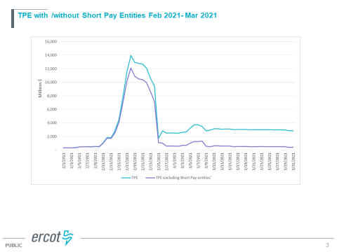
MCWG update to WMS

Slide 15
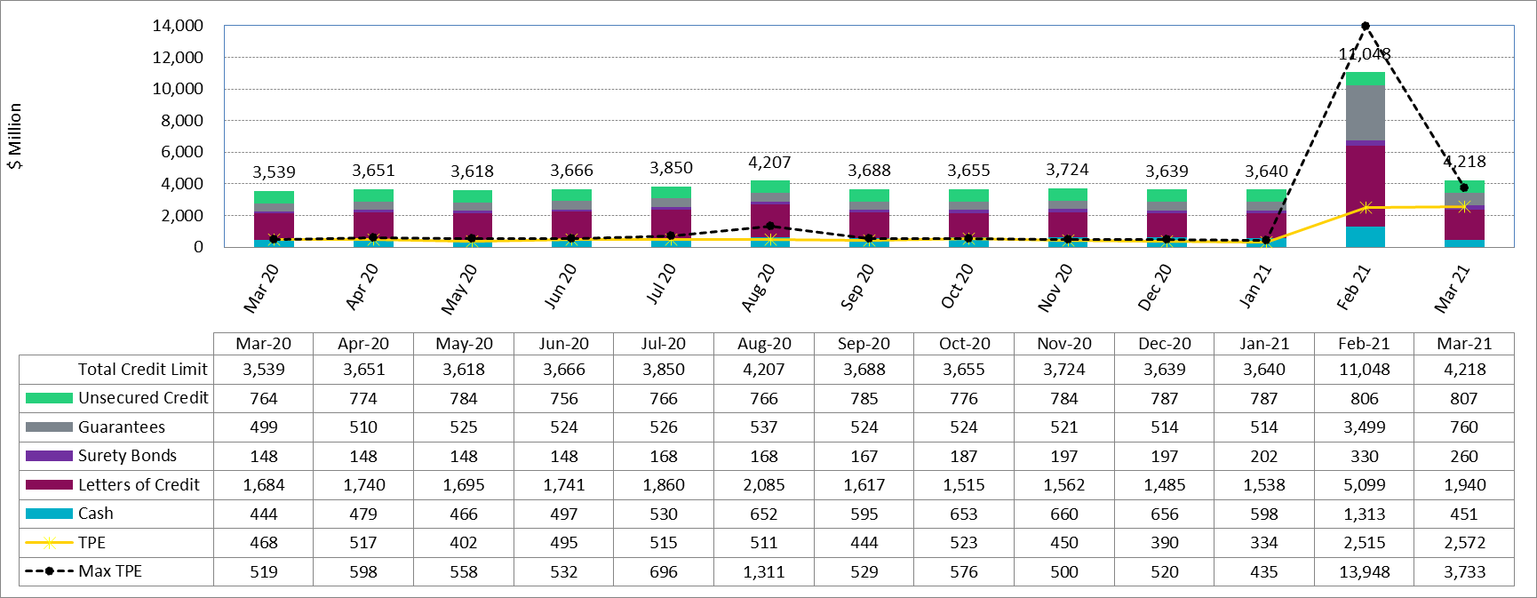
Available Credit by Type Compared to Total Potential Exposure (TPE) Mar 2020- Mar 2021

Slide 16
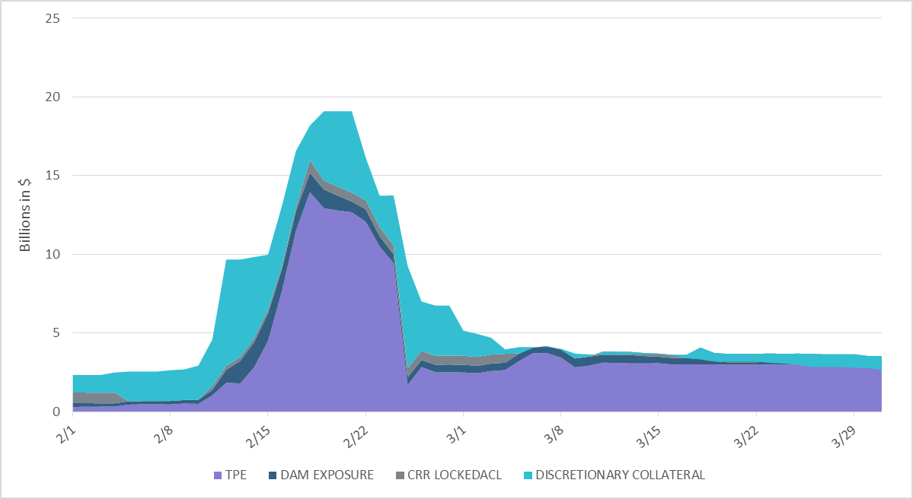
Average Discretionary Collateral increased to $3.2 bn in February

Slide 17
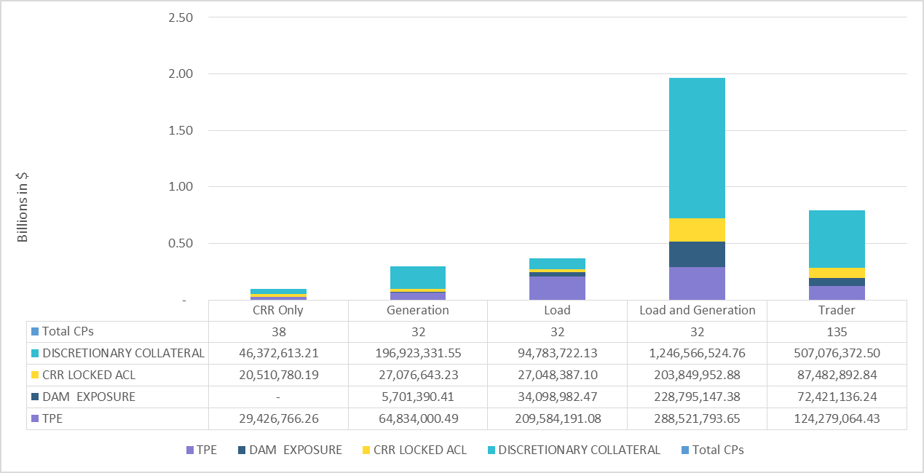
Load and Generation entities accounted for the largest portion of discretionary collateral

Slide 18
ERCOT Credit Updates
  TPEA covers Settlement/Invoice exposure and estimated Real-Time and Day- Ahead completed but not settled activity (RTLCNS and UDAA)
  The analysis was performed for the period, Feb 2020 - Feb 2021
  Only Settlement invoices due to ERCOT are considered in the calculation
  M1 values as of May 28, 2020 were used for the period Feb 2020- May 2020 and M1 values effective as of each day were used since Jun 2020
Example
  For business date 2/1/2020, if a Counter-Party has M1 value of 20, then all the charge invoices till 2/21/2020 including RTLCNS and UDAA as of 2/1/2020 is summed up to arrive at “Invoice Exposure”

