Slide 1
Online ORDC and PRC Reserves Convergence
During the 2021 February Winter Event
Wholesale Market Working Group
Market Analysis & Validation
Revised 4/27/2021

Slide 2
Background
A review of Real-Time Online Reserve Capacity (RTOLCAP) and Physical Responsive Capability (PRC) convergence during the 2021 February Winter Event was requested by TAC
The following slides will compare the RTOLCAP and PRC during periods of particularly tight system conditions and identify primary contributors to differences between the two values as they start to converge

Slide 3
PRC and RTOLCAP on 2/15/2021 to 2/17/2021

Slide 4
Primary Contributors to PRC and RTOLCAP Differences
Category | Included in RTOLCAP | Included in PRC
Resource Output Level | Uses Base Point (BP) | Uses Telemetered MW
Undergeneration | Yes | No
Capacity from STARTUP Resources carrying NSPIN | Yes | No
Non-Frequency Responsive Capacity (NFRC) | Yes | No
Headroom in excess of 20% of HSL - NFRC | Yes | No
Capacity exempted from PFR | Yes | No
Headroom from ONRUC Resources | No | Yes

Slide 5
Additional Description of Primary Contributors
Resource Output Level: Telemetered MW used in PRC is the output level of the resource at the current time, whereas SCED Base Point used in RTOLCAP is the output level where SCED expects resources to be at in the next 5 minutes.
Undergeneration: the MW quantity that SCED has decided to forego procuring from an actual generator and is instead relying on the Power Balance Penalty Curve (PBPC) for. This is either because there is insufficient SCED Dispatchable capacity to serve the generation requirement or because that MW quantity is more economically served by the PBPC. Undergeneration is removed from RTOLCAP to offset any additional headroom created as SCED has gone short in its issued Base Points.

Slide 6
Additional Description of Primary Contributors
Non-Frequency Responsive Capacity (NFRC): the telemetered portion of a Generation Resource’s HSL that represents capability from duct firing, inlet air cooling, auxiliary boilers, or other methods which do not immediately respond, arrest, or stabilize frequency excursions during the first minutes following a disturbance without secondary frequency response or instructions from ERCOT. This value is excluded from PRC, but included in RTOLCAP.
Capacity exempted from Primary Frequency Response (PFR): specific to PRC2, Wind Generation Resources that are not Primary Frequency Response-capable are excluded from PRC, but included in RTOLCAP

Slide 7
Additional Description of Primary Contributors
ONRUC Resources: headroom from ONRUC resources is excluded from RTOLCAP, and their base points are further subtracted from RTOLCAP in order to offset additional headroom created due to the out-of-market action of committing an offline resource. They are included as any other online generation resource into PRC1. The change to RTOLCAP was implemented on 5/31/2018 in accordance with OBDRR002

Slide 8
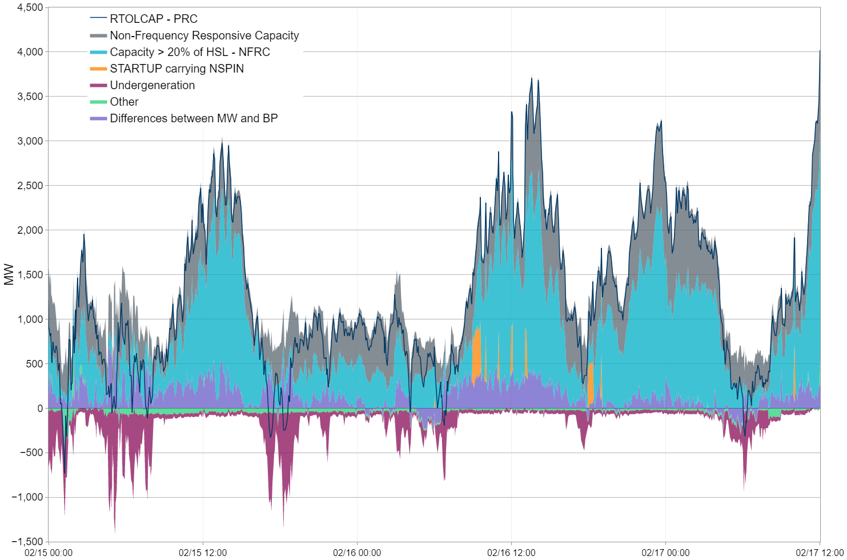
Reserve Differences for 2/15/2021 to 2/17/2021

