Slide 1
Update on Intra-Hour Solar Forecast and SCR811
Balancing Operations Planning Staff
WMWG
April 26, 2020

Slide 2
Discussion Outline
Update on SCR811
Intra-Hour Photo Voltaic Forecast and Predicted Solar Ramp Rate Forecast Performance
Applicability of other parameters in GTBD
Summary & Next Steps

Slide 3
Background on SCR811
SCR811 will incorporate a intra-hour solar forecast based ramp into Generation To Be Dispatched (GTBD) to give Security Constrained Economic Dispatch (SCED) a indication of how the solar units may ramp.
In absence of this today, SCED dispatches uncurtailed solar units to their HSL.
This means that SCED assumes output of uncurtailed solar units will persist for the next 5-min at the unit’s HSL that was telemetered at the start of the interval.
What if solar ramps? or What if an FME occurs as the sun is setting? Regulation deployment is used to make up for gain/loss of solar MW but depending upon the circumstance frequency recovery could potentially be delayed.
Equation
GTBD = Total Gen + K1*10*System Load Frequency Bias + K2*[(net non-conforming Load) – (net filtered non-conforming Load)] + K3*5*PLDRR + K4*Regulation Deployed + K5*ACE Integral – K6*5*PWRR + K7*5*DCTRR – K8*5*PSRR
|PSRR| ≤ Max PSRR Feedback
NEW ADDITIONS

Slide 4
SCR811 Update
As a part of implementing SCR811, ERCOT is in the process of integrating a 5-min Intra-hour Photo Voltaic Power forecast into ERCOT’s Energy Management System (EMS)
ERCOT’s EMS is being setup to compute a Predicted Solar Ramp Rate (PSRR) using
Hourly Short-Term Photo Voltaic Power Potential (STPPF) forecast
5-min Intra-hour Photo Voltaic Power forecast
Note that at any given 5-min SCED interval only one amongst the above two methods for PSRR calculations will be active for use in GTBD.
ERCOT will on track to complete the software changes associated with SCR811 in the 2021 R3 release (scheduled to be implemented in Production systems between May 25 and May 27).

Slide 5
Predicted Solar Ramp Error
Performance Metric | Persistence (4/10 – 4/15) | Intra-Hour Solar Forecast (4/10 – 4/15) | Short-term Solar Forecast (STPPF) (4/10 – 4/15)
MAE (MW) | 72.10 | 62.65 | 52.16
MAE (MW) when 5-Min. Solar Ramp > 100 MW | 207.38 | 136.16 | 127.15
MAE (MW) when 5-Min. Solar Ramp < -100 MW | 213.59 | 119.39 | 128.99
Over Forecast
Under Forecast

Slide 6
Predicted Solar Ramp Error

Slide 7
Potential Impact of Predicted Solar Ramp in GTBD

Slide 8
Applicability of Other GTBD Parameters

Slide 9
Other Parameters in GTBD
During SCR811 discussion last year, ERCOT was requested to share details on applicability of the various parameters in GTBD. Included are some situational examples wherein the a few recently added parameters play a role. Specifically,
Regulation Deployed Component: K4* Regulation Deployed:
Account for Regulation deployment in the past 2 minutes
ACE Integral Component: K5* Ace Integral :
Account for previous accrued ACE over an extended period of time
PWRR Component : K6*5*PWRR
Account for 5-min wind ramp for the next interval using intra-hour wind forecast

Slide 10
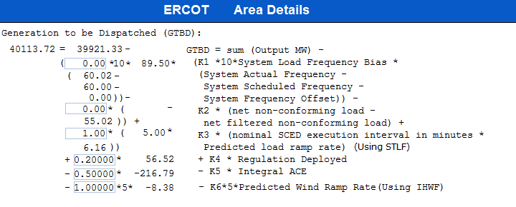
GTBD Introduction
- K8 *5* PSRR
- K8*5*Predicted Solar Ramp Rate (Using STPPF/IHPPF)
|PSRR| ≤ Max PSRR Threshold
Implementation of SCR811
Notes:
3/12/18 – Integral ACE Time Constant Changed from 60 min to 45 min
5/17/18 – K4 Changed from 0.3 to 0.2 and K5 Changed from 0.4 to 0.5
12/4/18 – 10:05 AM – K6 Changed from 0 to 0.5
2/12/19 – 2:15 PM – K6 changed from 0.5 to 1.0
3/12/19 – 2:10 PM – PWRR Threshold from 10 to 15 MW/min
3/19/19 – 2:15 PM – PWRR Threshold from 15 to 20 MW/min
4/01/19 – 10:00 AM – K5 changed from 0.5 to 0.4 and Max. Integral ACE Feedback changed from 250 to 150
4/24/19 – 1:15 PM – Max. Integral ACE Feedback changed from 150 to 160. PWRR Threshold changed from 20 to 25.
5/22/19 – 1:10 PM – K5 changed from 0.4 to 0.5, Max Integral ACE feedback changed from 160 to 200, PWRR Threshold changed from 25 to 30
6/17/20 – 10 AM - PWRR Calculation method changed from Direct to Interpolated
9/1/20 – 11 AM - Max Integral ACE Feedback changed from 200 to 250
9/3/20 – 3 PM - Max Integral ACE Feedback changed from 250 to 300
9/4/20 – 3 PM - Max Integral ACE Feedback changed from 300 to 250

Slide 11
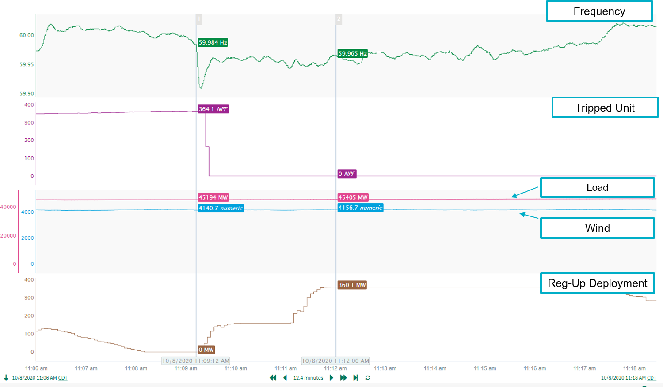
10/8/2020 11:09 Event
Notes:
10/8/2020 11:09:12 AM
Unit Loss : 365 MW
Recovery time: 8:09

Slide 12
Example: Impact of Regulation and ACE Integral in GTBD

Slide 13
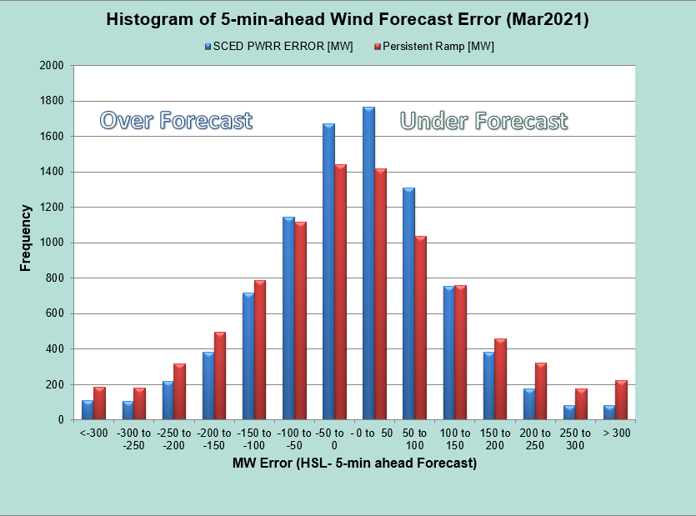
Projected Wind Ramp Rate (PWRR) Error
Performance Metric | SCED PWRR (3/1 – 3/31) | Persistence Ramp* (3/1 – 3/31)
Monthly MAE (MW) | 88 | 109
Monthly MAE when 5-Min. Wind Ramp > 100 MW | 129 | 192
* Persistence Ramp assumes using a 0 MW wind ramp in PWRR

Slide 14
Example: Impact of Projected Wind Ramp in GTBD

Slide 15
Summary & Next Steps
ERCOT will implement SCR811 during 2021 R3 between May 25 and May 27.
Initially, K8 will be set to 0 so that it will not impact GTBD calculation.
A market notice will be sent out prior to activation of K8 to a non-zero value.

