Slide 1
April 28, 2021 RMS Update to TAC
Jim Lee
RMS Chair

Slide 2
April 14th RMS Highlights
Voting items:
Approved LPGRR068 as submitted
Endorsed NPRR1071 as submitted
Endorsed OBDRR029 as submitted
Created Retail Emergency Conditions Task Force (RECTF) to serve as singular location to discuss all Retail issues identified within the TAC Emergency Conditions Issues List
Approved ERCOT’s exception request for a non-standard extended outage beginning Saturday May 1st @ 2:00pm CPT thru Sunday May 2nd @ 11:59pm (Standard outage window begins at 7:00pm)
TDUs to support Move-Ins during extended outage via TDSP Safety Net process between 2pm & 7pm
Reviewed ERCOT Winter Event Load Reduction presentation (Carl Raish)

Slide 3
April 2021 RMS WG/TF Updates
TDTMS (TX Data Transport & MarkeTrak Systems):
Reviewed TAC Emergency Conditions Issues List item re: ERCOT Listserv procedures
Collaborate w/ ERCOT to include Listserv performance within ERCOT Market Data Transparency SLA
Long-term solution is being considered by ERCOT IT Support Svcs (possibly bring listserv in-house?)
Short-term solution needed – backup plan if Listservs go down for extended periods in Summer 2021?
Reviewed proposed updates to Switch Hold Removal process
Identified required fields on forms to mitigate counterparty rejects
Clarified appropriate use of required documents (Warranty Deed, etc)
Supporting administrative MarkeTrak enhancements release (GUI refresh)
Developing SCR to transfer TDU Switch Hold lists to display/report on ERCOT MIS
TXSET
Endorsed 5 Change Controls as part of TXSET 5.0 release
Identified NPRRs and RMGRRs needed to support TXSET 5.0 release
Reviewed TXSET 5.0 Implementation details for updated project trajectory

Slide 4
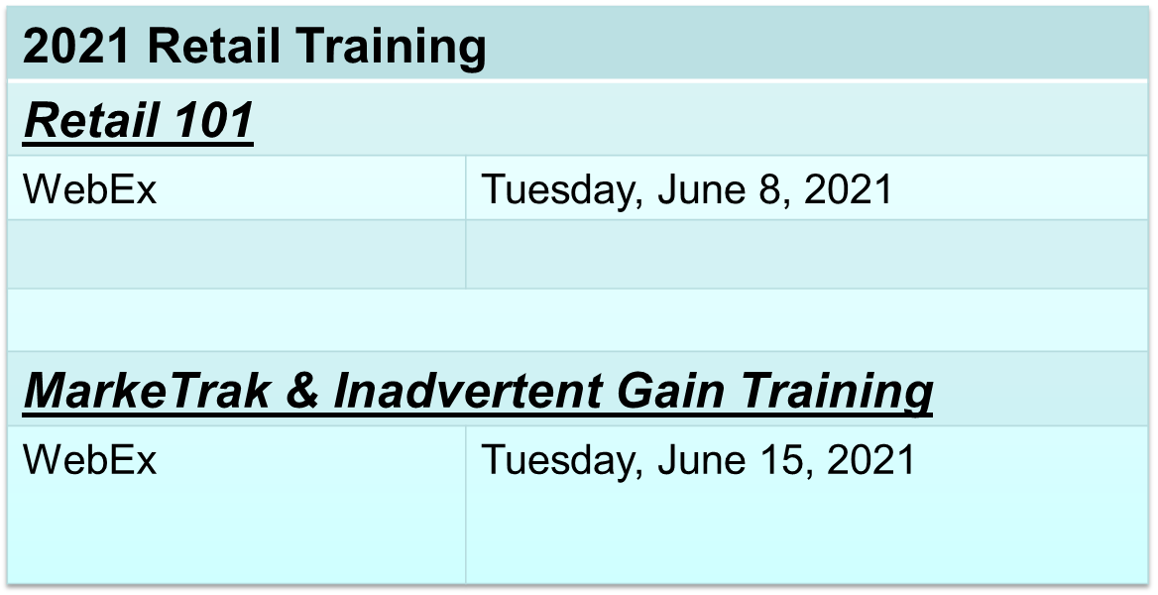
April 2021 RMS WG/TF Updates
Retail Market Training Task Force (RMTTF):
Classes available for registration:

Slide 5
Questions?
Next RMS Meeting – May 4, 2021

