Slide 1
Day-Ahead Market (DAM) Performance Issue (DAM Delays)
ERCOT Staff
April 26, 2021 WMWG

Slide 2
Recap
From the regression analysis, Total PTP intervals was identified to be the most significant variable affecting the Total DAM Run time
Top 34 CPs (20% of CPs) make up ~83% of PTP intervals on average
Top 37 make up ~85% and submit over 1k PTP intervals on average
Top 6 make up ~37% and submit over 6k PTP intervals on average
Top 2 make up ~15% and submit over 10k PTP intervals on average
The Top10 CPs are responsible for 47% of total PTP interval submissions on average
The Top 10 CPs are not affiliated with other CPs
Today we have daily CP limit of 1500 submissions which can translate to 36,000 PTP interval submissions from a single CP
Putting a daily submission limit at holding company level may not curtail the Top 10 CPs that are not affiliated
PTP intervals have doubled in the last 5 years

Slide 3
Options for mitigating DAM performance
Create a PTP interval limit
Introduce submission fees
PTP fee
PTP fee after a pre-determined number
PTP fee on un-awarded intervals
Extend fee to Energy-only Offer and Energy Bids

Slide 4
PTP interval proposal
During the March 22nd WMWG meeting, Market Participants suggested PTP interval limit per CP
ERCOT identified percentiles for OD 4/6/2019 to 12/31/2020 and analyzed numbers to propose the initial PTP interval limit
 | Percentile
Runtime | Average of 95th | 95th of 95th | Average of 98th | 98th of 98th | Average of 99th | 99th of 99th | Max PTP Interval
Long | 7,284 | 8,786 | 10,484 | 13,900 | 12,181 | 18,299 | 20,753
Normal | 5,992 | 8,075 | 9,528 | 13,742 | 11,119 | 17,057 | 23,139
Overall | 6,063 | 8,128 | 9,580 | 13,797 | 11,177 | 17,242 | 23,139

Slide 5
PTP interval proposal cont.
On any given Operating Day CPs participating (with PTPs) in the DAM range from 75 to 120, with ~100 CPs on average
ERCOT proposes 12,000 as the initial PTP interval limit, while preserving the ability to reduce the limit as necessary to ensure DAM performance is optimized

Slide 6
ERCOT Recommendation
Following the discussions at WMWG, ERCOT recommends establishing DAM daily submission limits for PTPs based on PTP Intervals
ERCOT will continue to use this limit to control the volume of PTP Intervals
To resolve DAM performance issues, ERCOT will continue to ratchet-down the allowed PTP Intervals limit per CP
In the event, PTP Intervals based limit becomes too constraining for CPs to fully participate in the DAM, ERCOT recommends establishing submission fee so that market participants who value these instruments more are not limited by daily PTP Interval limits
ERCOT will continue to monitor DAM submissions and any behavior change (Energy-only Offer and Energy Bid volumes) with the proposed solution

Slide 7
Questions?

Slide 8
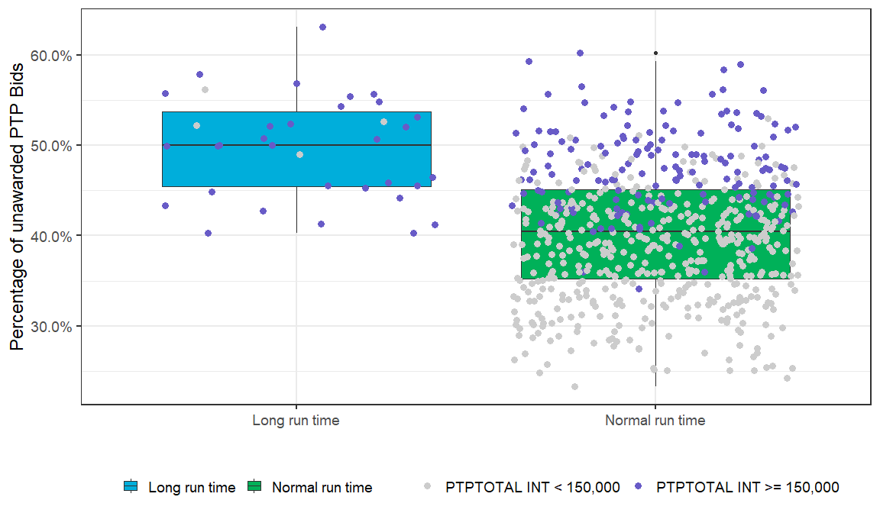
Comparison of Un-awarded and Awarded PTP Percentage
Median : 50.02 % or 87,481
Average: 49.76 % or 86,551
Median: 40.48 % or 55,641
Average: 40.25 % or 56,053

Slide 9
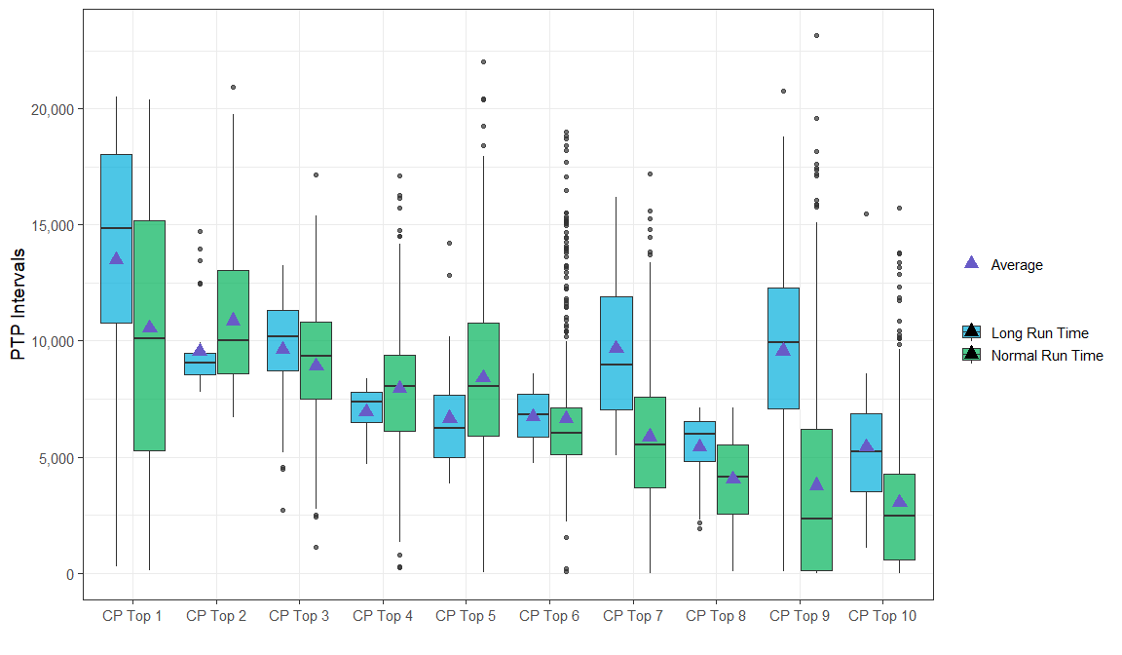
Comparison of PTP Submissions among Top 10 CP*
*Top 10 CP is determined by the median of daily PTP submissions.

