Slide 1
Online ORDC and PRC Reserves Convergence
During the 2021 February Winter Event
Wholesale Market Working Group
Market Analysis & Validation
4/26/2021

Slide 2
Background
A review of Real-Time Online Reserve Capacity (RTOLCAP) and Physical Responsive Capability (PRC) convergence during the 2021 February Winter Event was requested by TAC
The following slides will compare the RTOLCAP and PRC during periods of particularly tight system conditions and identify primary contributors to differences between the two values as they start to converge

Slide 3
PRC and RTOLCAP on 2/15/2021 to 2/17/2021

Slide 4
Primary Contributors to PRC and RTOLCAP Differences
Category | Included in RTOLCAP | Included in PRC
Resource Output Level | Uses Base Point (BP) | Uses Telemetered MW
Undergeneration | Yes | No
Capacity from STARTUP Resources carrying NSPIN | Yes | No
Non-Frequency Responsive Capacity (NFRC) | Yes | No
Headroom in excess of 20% of HSL - NFRC | Yes | No
Capacity exempted from PFR | Yes | No
Headroom from ONRUC Resources | No | Yes

Slide 5
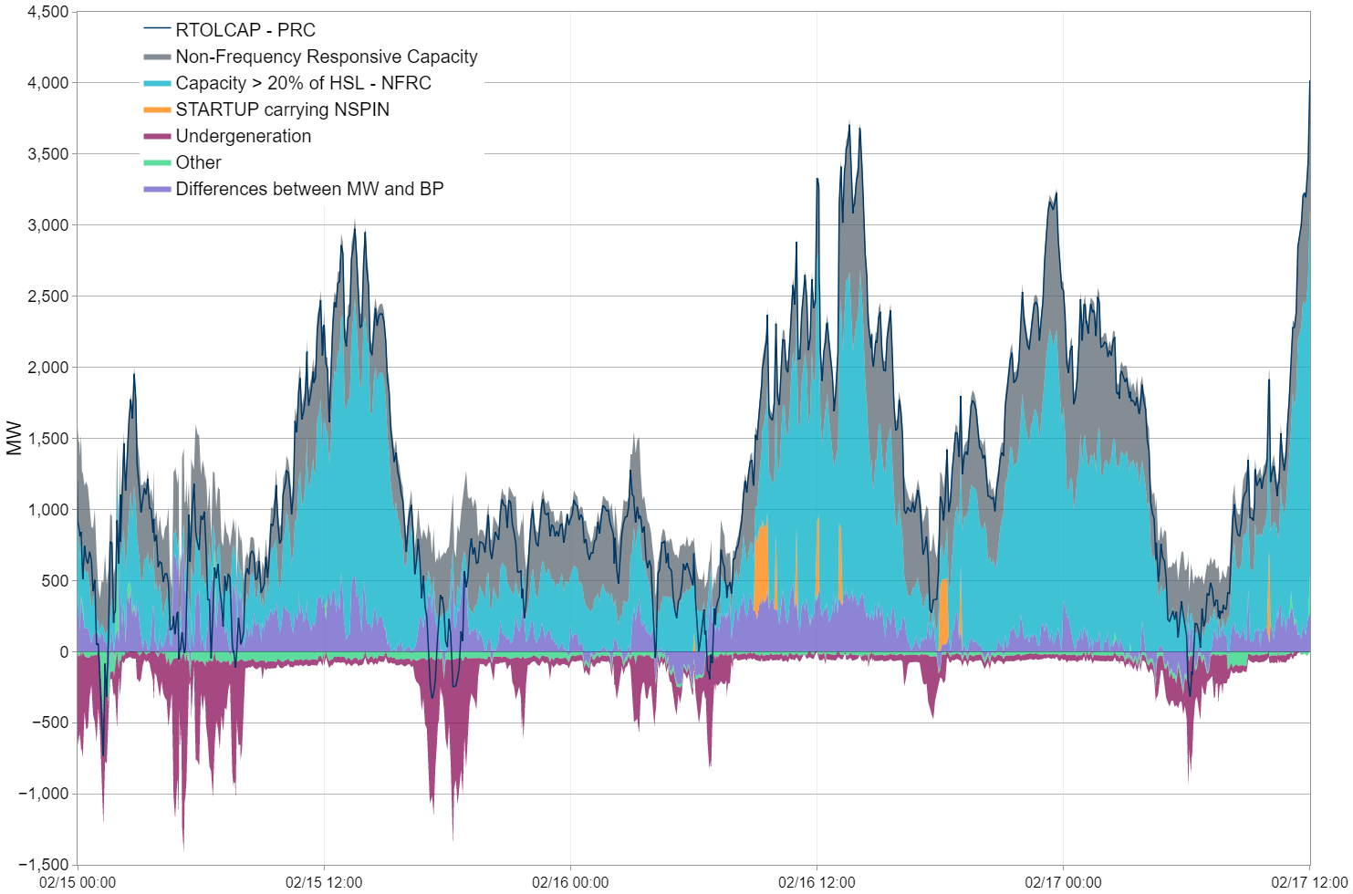
Reserve Differences for 2/15/2021 to 2/17/2021

