Slide 1
Summer 2021 Probabilistic Loss-of-Load Study
Supply Analysis Working Group
Pete Warnken
Resource Adequacy
April 23, 2021
Notes:
Welcome to

Slide 2
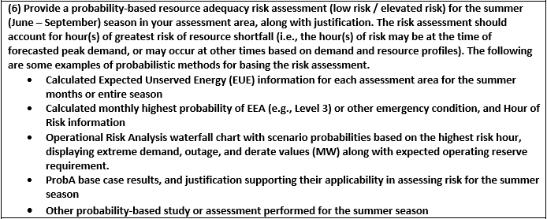
Background
A new requirement for the summer 2021 NERC Summer Reliability Assessment (SRA) was to conduct a probabilistic risk assessment of the highest-risk hours:

Slide 3
Background
To support the NERC requirement as well as evaluate a model-based approach for ERCOT hourly energy adequacy analysis, we tasked Astrape Consulting to run the Strategic Energy & Risk Valuation Model (SERVM) for the 2021 summer season
  Model set-up is the same as the one used for the 2020 Probabilistic Assessment, except for the following:
    Resources updated to reflect those in ERCOT’s 2021 preliminary summer SARA report
    The 40 weather-year hourly load forecast shapes for 2022 were scaled based on the summer 2021 load forecast prepared in November 2020
    Configured SERVM to report hourly resolution for loss-of-load metrics: Loss of Load Expectation (LOLE), Expected Unserved Energy (EUE), Loss of Load Hours (LOLH)

Slide 4
SERVM Results – Summer Monthly
Base weather-year scenario: 40 years, 1980-2019
Shortened weather-year scenario: 15 years, 2005-2019

Slide 5
SERVM Results: Hourly Probability of Expected Unserved Energy for Summer 2021

