Slide 1
Analysis of Seasonal Hourly Reserve Shortage Risk
Supply Analysis Working Group
Pete Warnken
Resource Adequacy
April 23, 2021
Notes:
Welcome to

Slide 2
Analysis Methodology
Risk metric: minimum 5-min. Physical Responsive Capability (PRC) that occurs in each hour
Evaluation scope: individual seasons and combined
Historical period evaluated: summer - prior two seasons; spring - prior two seasons and partial current season; winter - prior three seasons; fall - prior two seasons
Determine frequency and probability of “low,” “medium,” and “high” PRC risk hours
  Hourly Risk Levels:
    Low: PRC > 3,000 MW
    Moderate: 2,300 MW < PRC ≤ 3,000 MW
    High: PRC ≤ 2,300 MW

Slide 3
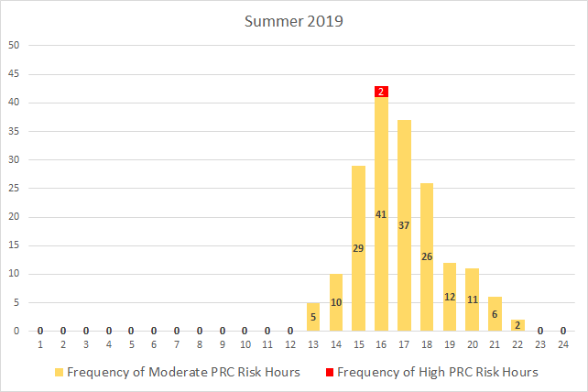
Hourly Minimum PRC Risk Analysis - Summer
Risk Levels
Low: PRC > 3,000 MW (not shown in chart)
Moderate: 2,300 MW < PRC ≤ 3,000 MW
High: PRC ≤ 2,300 MW

Slide 4
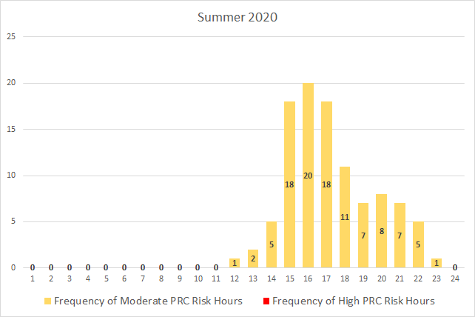
Hourly Minimum PRC Risk Analysis - Summer
Risk Levels
Low: PRC > 3,000 MW (not shown in chart)
Moderate: 2,300 MW < PRC ≤ 3,000 MW
High: PRC ≤ 2,300 MW

Slide 5
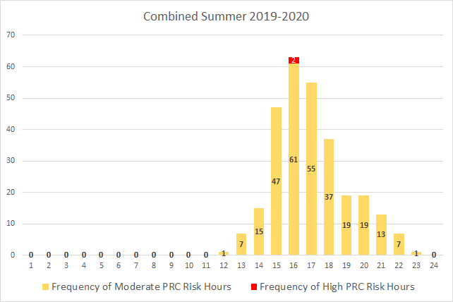
Hourly Minimum PRC Risk Analysis - Summer
Risk Levels
Low: PRC > 3,000 MW (not shown in chart)
Moderate: 2,300 MW < PRC ≤ 3,000 MW
High: PRC ≤ 2,300 MW

Slide 6
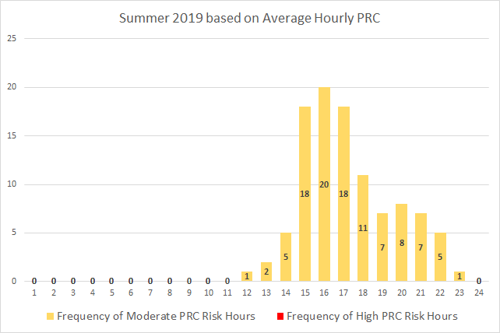
Hourly Average PRC Risk Analysis - Summer
Risk Levels
Low: PRC > 3,000 MW (not shown in chart)
Moderate: 2,300 MW < PRC ≤ 3,000 MW
High: PRC ≤ 2,300 MW

Slide 7
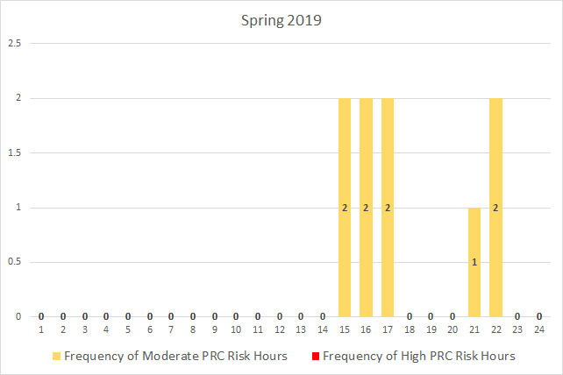
Hourly Minimum PRC Risk Analysis - Spring
Risk Levels
Low: PRC > 3,000 MW (not shown in chart)
Moderate: 2,300 MW < PRC ≤ 3,000 MW
High: PRC ≤ 2,300 MW

Slide 8
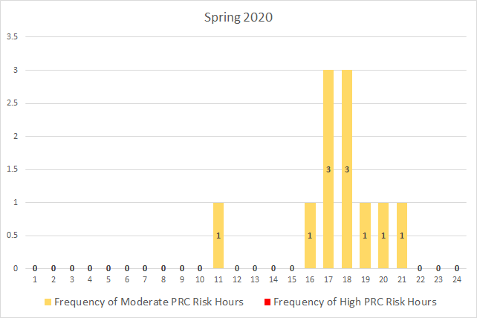
Hourly Minimum PRC Risk Analysis - Spring
Risk Levels
Low: PRC > 3,000 MW (not shown in chart)
Moderate: 2,300 MW < PRC ≤ 3,000 MW
High: PRC ≤ 2,300 MW

Slide 9
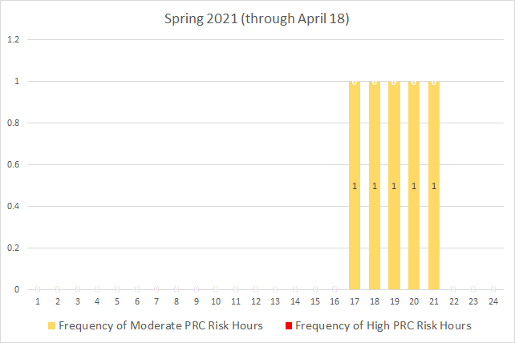
Hourly Minimum PRC Risk Analysis - Spring
Risk Levels
Low: PRC > 3,000 MW (not shown in chart)
Moderate: 2,300 MW < PRC ≤ 3,000 MW
High: PRC ≤ 2,300 MW

Slide 10
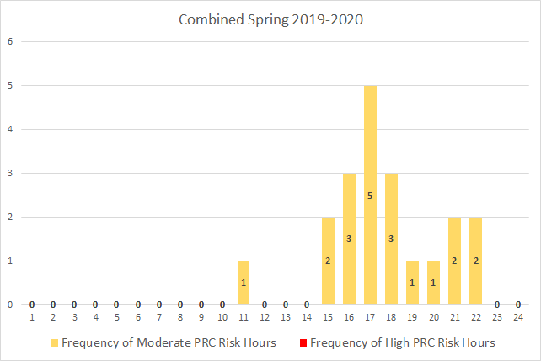
Hourly Minimum PRC Risk Analysis - Spring
Risk Levels
Low: PRC > 3,000 MW (not shown in chart)
Moderate: 2,300 MW < PRC ≤ 3,000 MW
High: PRC ≤ 2,300 MW

Slide 11
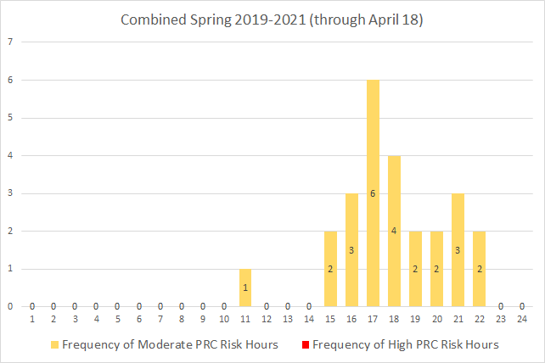
Hourly Minimum PRC Risk Analysis - Spring
Risk Levels
Low: PRC > 3,000 MW (not shown in chart)
Moderate: 2,300 MW < PRC ≤ 3,000 MW
High: PRC ≤ 2,300 MW

Slide 12
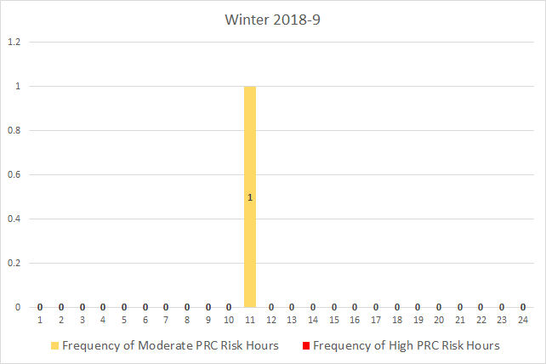
Hourly Minimum PRC Risk Analysis - Winter
Risk Levels
Low: PRC > 3,000 MW (not shown in chart)
Moderate: 2,300 MW < PRC ≤ 3,000 MW
High: PRC ≤ 2,300 MW

Slide 13
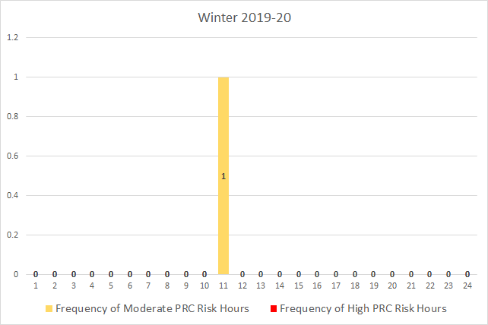
Hourly Minimum PRC Risk Analysis - Winter
Risk Levels
Low: PRC > 3,000 MW (not shown in chart)
Moderate: 2,300 MW < PRC ≤ 3,000 MW
High: PRC ≤ 2,300 MW

Slide 14
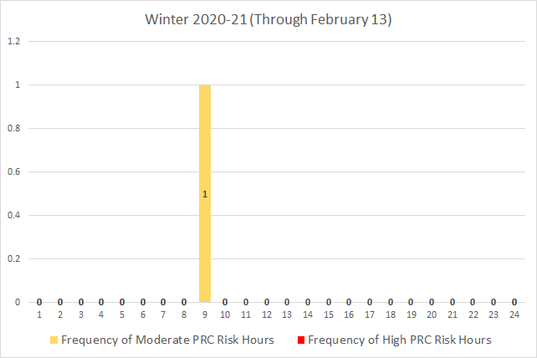
Hourly Minimum PRC Risk Analysis - Winter
Risk Levels
Low: PRC > 3,000 MW (not shown in chart)
Moderate: 2,300 MW < PRC ≤ 3,000 MW
High: PRC ≤ 2,300 MW

Slide 15
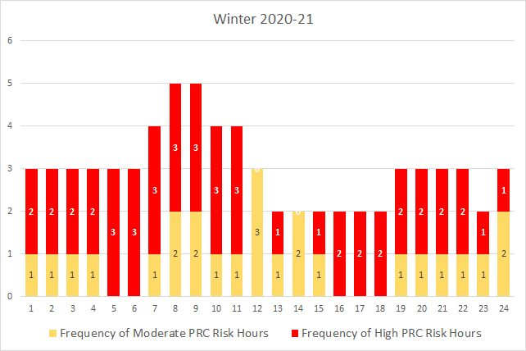
Hourly Minimum PRC Risk Analysis - Winter
Risk Levels
Low: PRC > 3,000 MW (not shown in chart)
Moderate: 2,300 MW < PRC ≤ 3,000 MW
High: PRC ≤ 2,300 MW

Slide 16
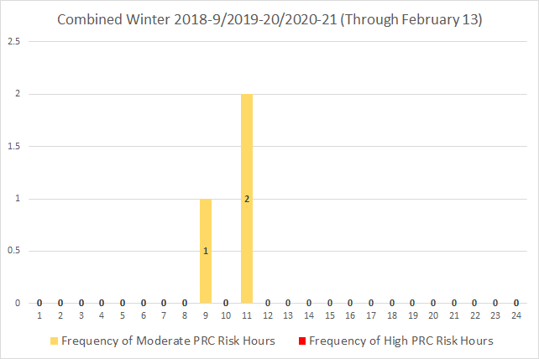
Hourly Minimum PRC Risk Analysis - Winter
Risk Levels
Low: PRC > 3,000 MW
Moderate: 2,300 MW < PRC ≤ 3,000 MW
High: PRC ≤ 2,300 MW

Slide 17
Findings
Summer:
  Range of highest-risk hours for insufficient operating reserves is HE 1500 – 1800; clear delineation relative to neighboring hours
  Highest-risk hour for the last two summers was HE 1600 (summer peak load hour was HE 1700 for both 2019 and 2020)
  The SERVM Monte Carlo simulation for Summer 2021 indicates the highest-risk hour is shifting back to HE 1700 due to late afternoon ramping down of increasing amounts of solar capacity
Spring:
  As expected, significantly lower risk than for the summer, but multiple moderate-risk hours have been typical
  Relative to summer, the range of hours with moderate risk is broader; there is no common pattern to the risk-level frequencies from one year to the next, but combining the years indicates that HE 1700 stands out as the most common moderate-risk hour

Slide 18
Findings
Winter:
  Prior to the winter storm event, frequency of moderate-risk hours is sparse, occurring just once per season, and during late mornings
  Frequency analysis lends credence to the need to use a deterministic scenario approach for risk assessment of severe winter storm events
Fall:
  No moderate- or high-risk hours observed for the last few fall seasons
  Similar to winter in terms of the PRC risk profile; risk assessment should also entail use of deterministic scenarios due to the lack of high-impact, low-probability events

