Slide 1
SAWG Open Action Items on CONE
2019 TAC Assignment: Develop and implement updated methodology used to determine cost of new entry (CONE)
Status: had consensus on an NPRR and methodology document in August 2020
TAC Winter Storm Issues list:
Are changes to the use/applicability of Peaker Net Margin methodology needed to protect ratepayers during extended scarcity events → outside of stakeholder purview
Develop and implement updated methodology used to determine cost of new entry (CONE)
April SAWG Goal:
Where do we want to go with this assignment and past documents?

Slide 2
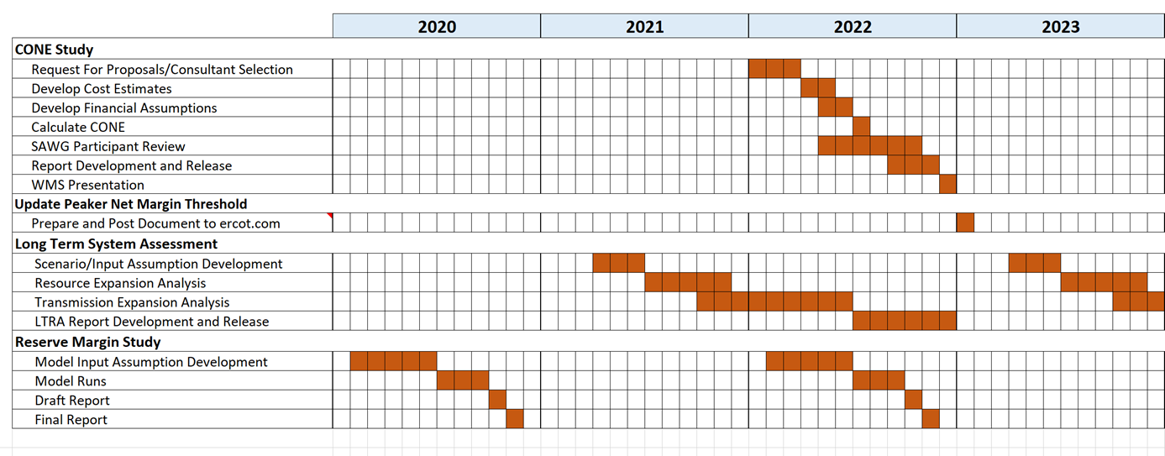
SAWG Open Action Items on CONE
CONE discussions in 2020
Study to be done in coordination with every other LTSA (=every 4 years) and to feed into the Reserve Margin Study
Documents (last consensus versions on this meeting page)
CONE Study NPRR to Protocols Section 4.4.11
CONE Study Methodology Draft

