Slide 1
MIS & ERCOT.com User Workshop
April 21, 2021

Slide 2
Agenda
2021 Project Goals
Release Schedule
Grid Conditions Communications
Public Dashboard Changes
ERCOT.com User Research

Slide 3
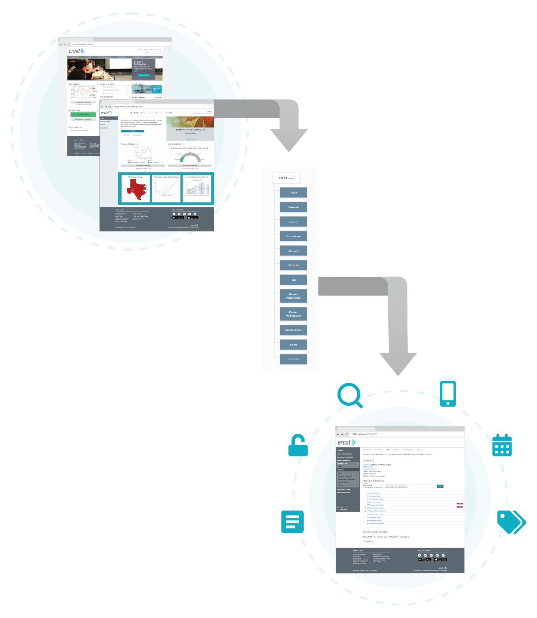
New, combined ERCOT Website
  Improved Market Data Transparency
  Public, Secure and Certified Information
  Data Catalog (EMIL)
  Improved Search
  Access to ERCOT Applications
  Single source of truth

Slide 4

Release Timeline
Jan
May
Sep
Nov
Feb
May
Nov
Q1- Q4
EMIL
Web
Interface
New
MIS Sandbox
MIS Soft
Launch for MP
Testing
MIS Prod
Release
Deploy Dashboards, GCC, Mobile API
Transition Market Info and Grid Info sections.
Business Process Flows in Alfresco
Fully transition all ERCOT.com content to new platform
Decommission Old MIS
2020
2021
2021
02/06 | Decommission old MIS ✓
05/06 | Grid Conditions Communications
05/19 | Public Dashboards
11/15 | Fully combined MIS/ERCOT.com website.
Dec 2021 | Decommission “Get Report” Pop-Up

Slide 5
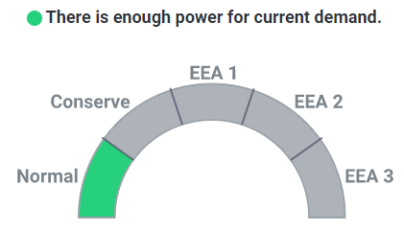
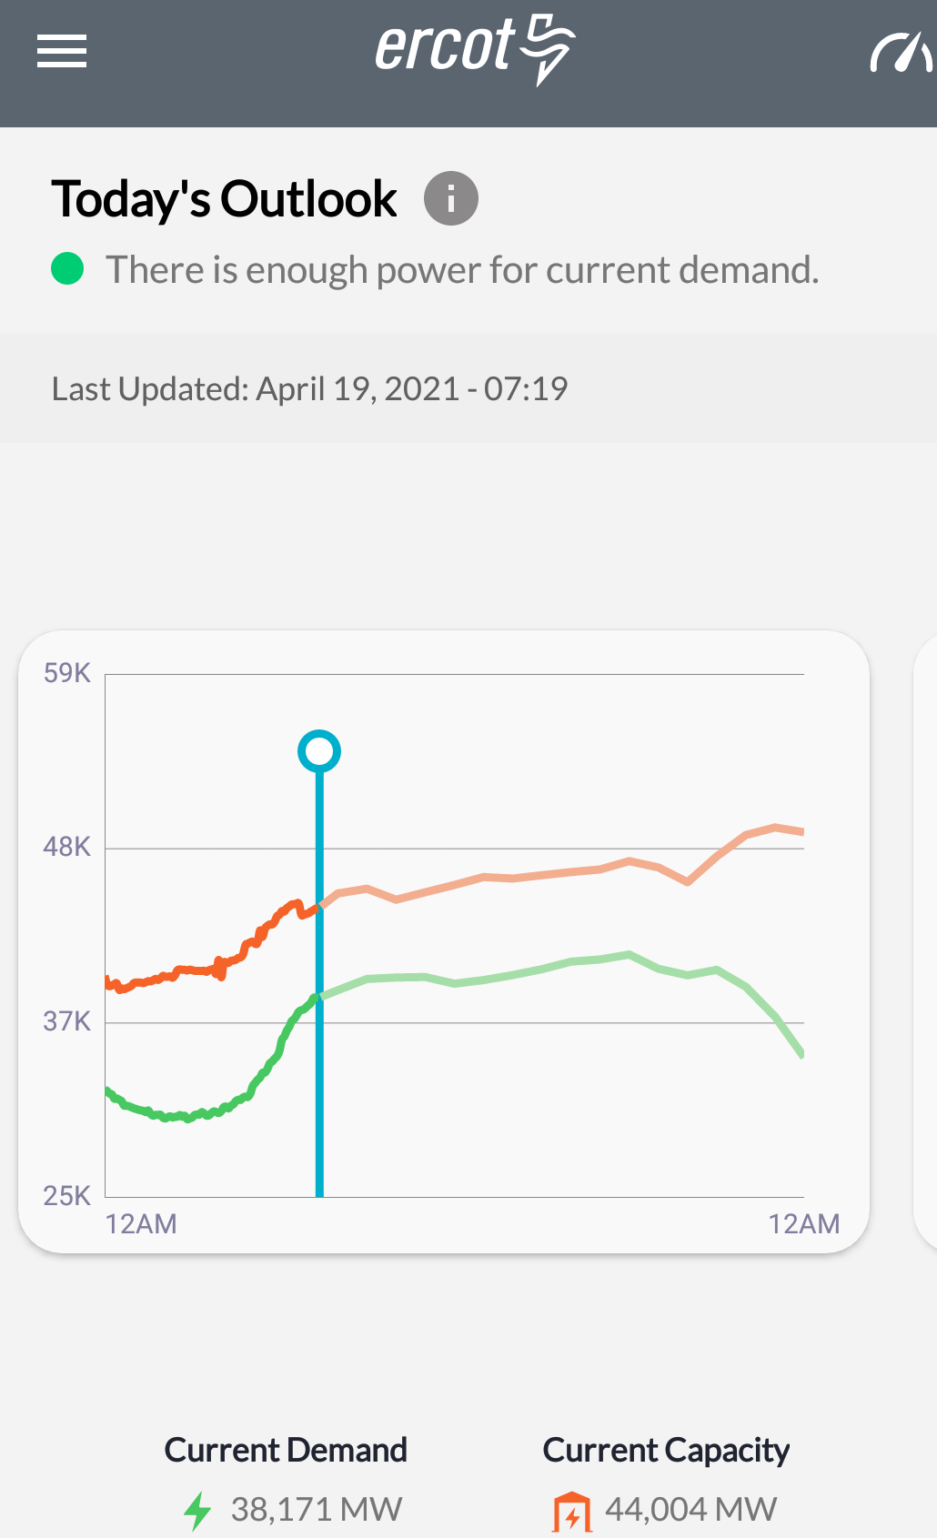
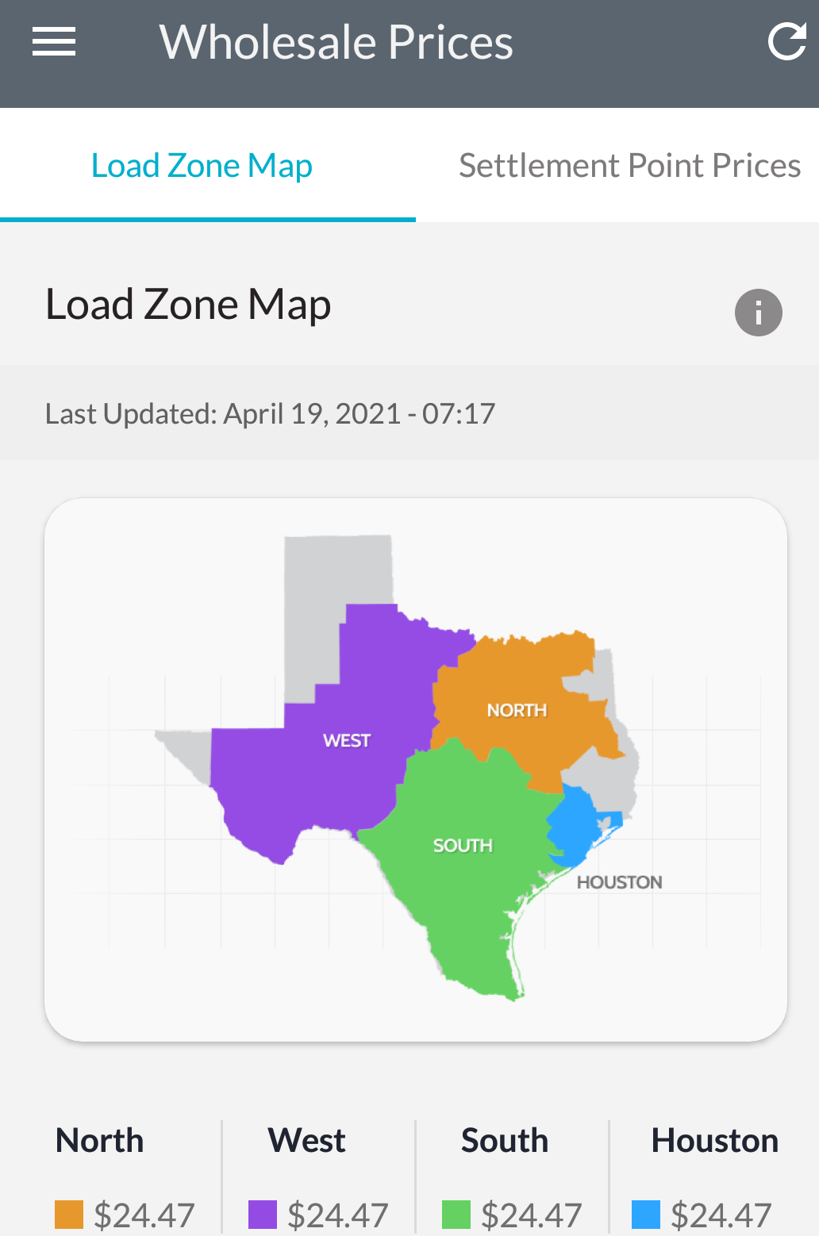
Grid Conditions Communications
ERCOT Mobile API will be https from May 6th 2021
ERCOT Mobile App will be updated. Please turn on notifications to receive alerts
Important dates in the near future –
  End to End communication test for GCC – May 08th 2021
  Load testing in production – May 22nd 2021

Slide 6
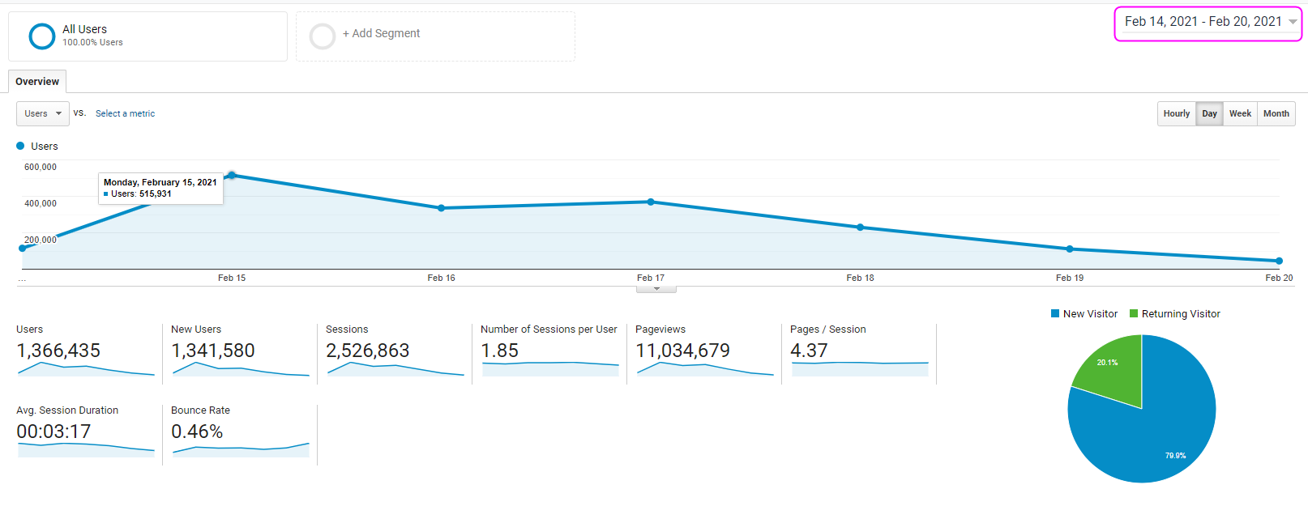
ERCOT.com analytics during weather event
Ercot.com has seen peak traffic during the recent weather event and still was able to take the load and serve our users without any lag or timeouts.

Slide 7
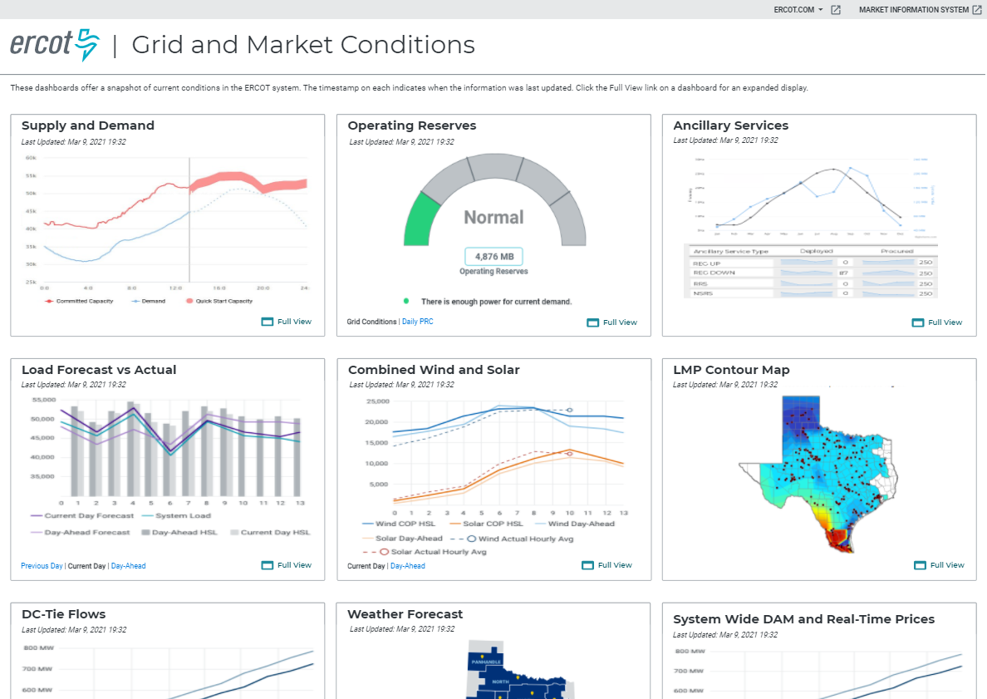
Public Dashboards - May 2021
Consistency
One-stop
Available from ERCOT.com and MIS
Real-Time and Forecasted data
Live updates

Slide 8
Next Steps
“Voice of the Citizen” coming to ERCOT.com and MIS
Site Map and Organizing Content
Focus on ERCOT.com content designs
Beta version of Search
Feedback at any time to webmaster@ercot.com
Redesign info: www.ercot.com/about/redesign

