Slide 1
NDSWG – SCR813, ECEII

Slide 2
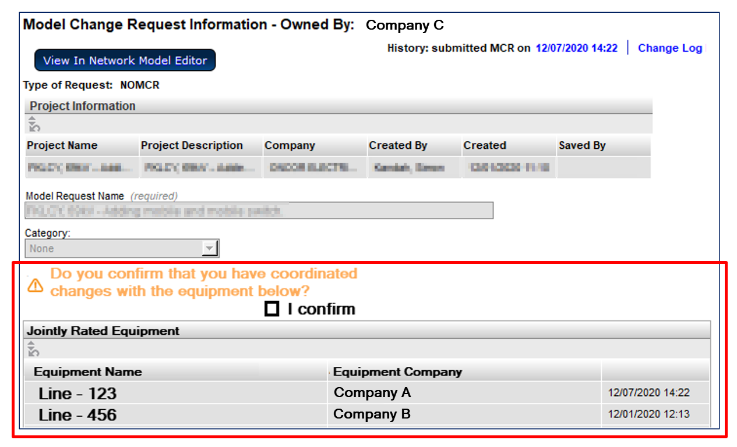
SCR813 - Submitter Shown Jointly-Rated Equipment and Coordination Confirmation Requested

Slide 3
SCR813 - Enhanced Notifications – “Walking the Tree”
Add functionality to send notifications to model-instance owners when “nearby” changes are made.
Currently notifications are only sent to owners of modified instances
Ratings sets are only owned by one company
Each company will have their own ratings set if jointly owned
Example
A notification would be sent to Company B if Ratings Set #1 were modified by Company A
Changing the impedance will send a notification to Company A and Company B
Changing the ratings in Ratings Set #1 will only send a notification to Company A
Changing the ratings in Ratings Set #1 will only send a notification to Company B

Slide 4
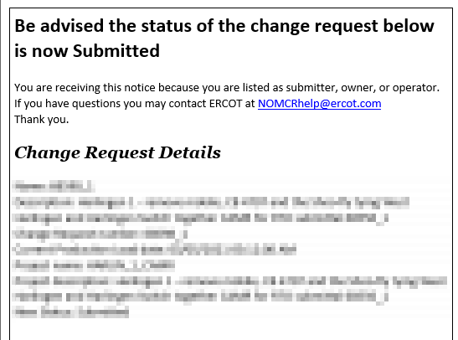
SCR813 - Additional Notification
The notification currently sent when a NOMCR is submitted would also be sent to all associated companies

Slide 5
ECEII
Workshop this Thursday (4/22)
New role required to access ECEII data
PTC Postings which will require new role:
TSP version of CIM Network Model
TSP version of Test Network Operations Model
Redacted CIM Network Model

