Slide 1
Resource Integration & On-going Operations - Resources Services
(RIOO-RS)
Project Update
20 Apr 2021

Slide 2
RIOO- RS is live
All updates required to be submitted in RIOO-RS starting 11/13
  RARFs for updates to Resource Registration data will no longer be accepted.
  Exceptions may be granted in certain cases.
New Resources, SODGs, or Load Resources will continue to use the RARF spreadsheet and submit as a Service Request through the MIS
The RIOO Create phase effort has been initiated – this will allow new generators to submit their data via the on-line application

Slide 3
RIOO- RS Update
2/26 Update
  JOU ownership changes
  Combined Cycle Config and Transition add / delete
  New CC flag – single point of failure
4/23 Update
  View a substation without having to start a Change Request
  Export to a CVS file (perhaps show an example?)
RIOO-Create - Next RIOO release in late 2021 / early 2022
  Early wireframe flow
Other things to know?
  May need to use two emails if have more than 15-20 DUNs numbers

Slide 4
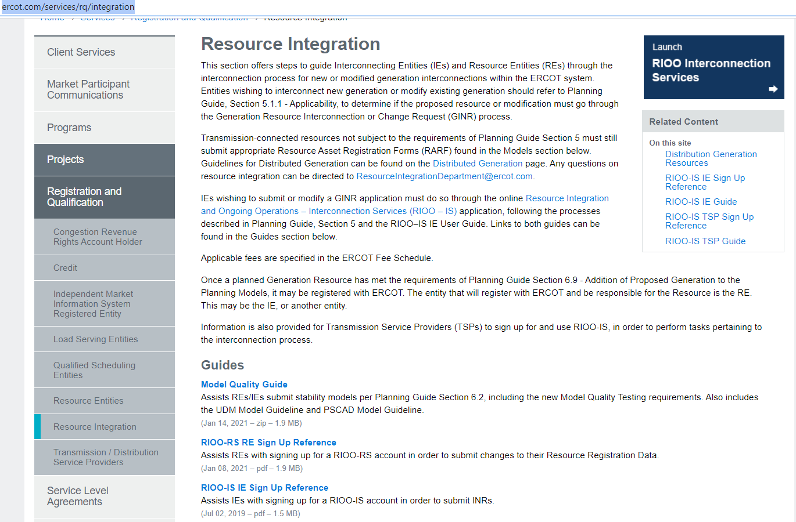
RIOO- RS is live – how do I get access?
The RIOO-RS sign-up reference is available here: http://www.ercot.com/services/rq/integration

Slide 5
How to get access - Checklist
The user:
  Gets the role “RIOORS_M_OPERATOR” from his/her USA
  Gets an email
    Clicks on “Verify my account” button
  Types in URL for the system
    Clicks “Don’t remember your password” button
  Gets a change password email
    Clicks on change my password button
  Changes his/her password
  Types in URL for the system, sign with user-id / password
  Setups authentication
    Scans code or enter mobile phone for SMS
    Saves Recovery code
    Confirms authorization method
    (Google Authenticator/ Auth0 guardian/SMS)
  Get an email
  Click on verify my account button
  Access the RIOO-RS, sign with user-id / password

Slide 6
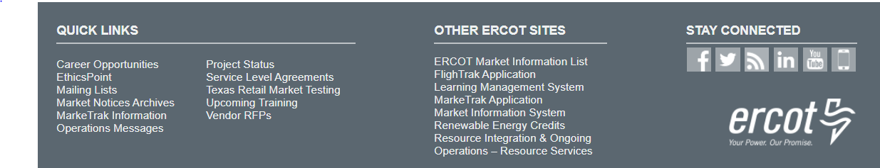
RIOO- RS is live – now what?
What is the link to RIOO-RS?
  The link for RIOO-RS is located on ercot.com and is: https://sa.ercot.com/rioo-rs/
Does RIOO-RS use a digital certificate?
  No.
What role do I need and how do I get it?
  Your company USA should provide the RIOO_M_Operator in order to gain access to RIOO-RS.

Slide 7
RIOO-RS is live – now what?
Why do I have errors on things I did not change?
  May have errors on first Change Request in the system
  Caused by update validation rules and migrated data
What do I do if I can’t see my resources?
  Check with your USA, ensure RIOO_M_Operator role has been added to desired DUNS
  Still can’t see? Send info to RIOO-HELP@ercot.com
    Email used for accessing RIOO-RS
    DUNS number of missing resource
    We can also set up a WebEx to trouble-shoot the issue

Slide 8
RIOO-RS is live – now what?
I’m getting a weird error?
  Please send a screen shot
Can Dynamic Model files be submitted via RIOO?
  Yes, RIOO has a section that accepts attachments.
  I have not been able to set up access, what do I do?
  Can’t access the system: Contact the Help Desk
  Questions: RIOO-HELP@ercot.com
  We can also set up a WebEx to trouble-shoot the issue

Slide 9
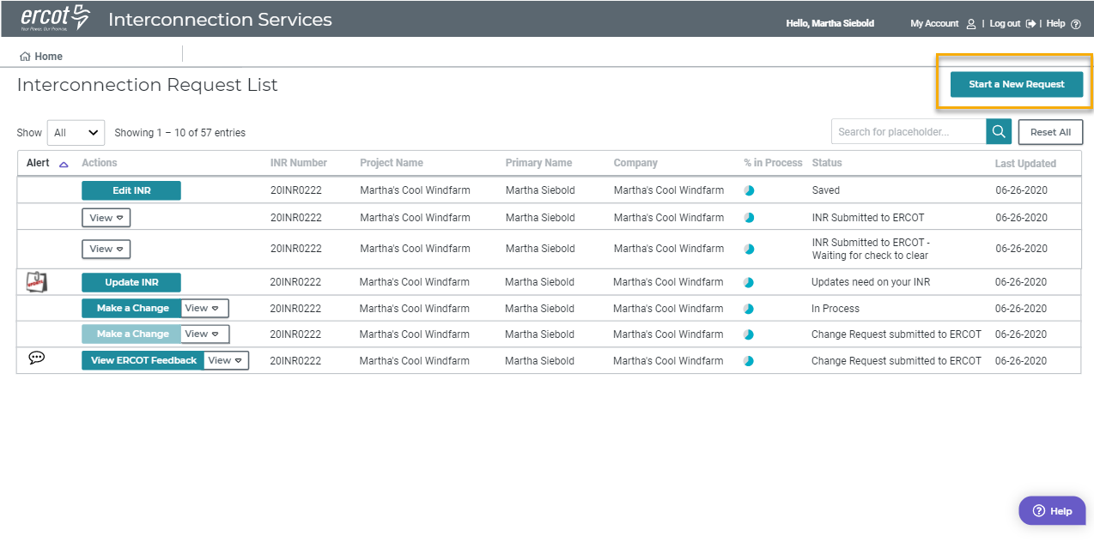
RIOO- IS Dashboard

Slide 10
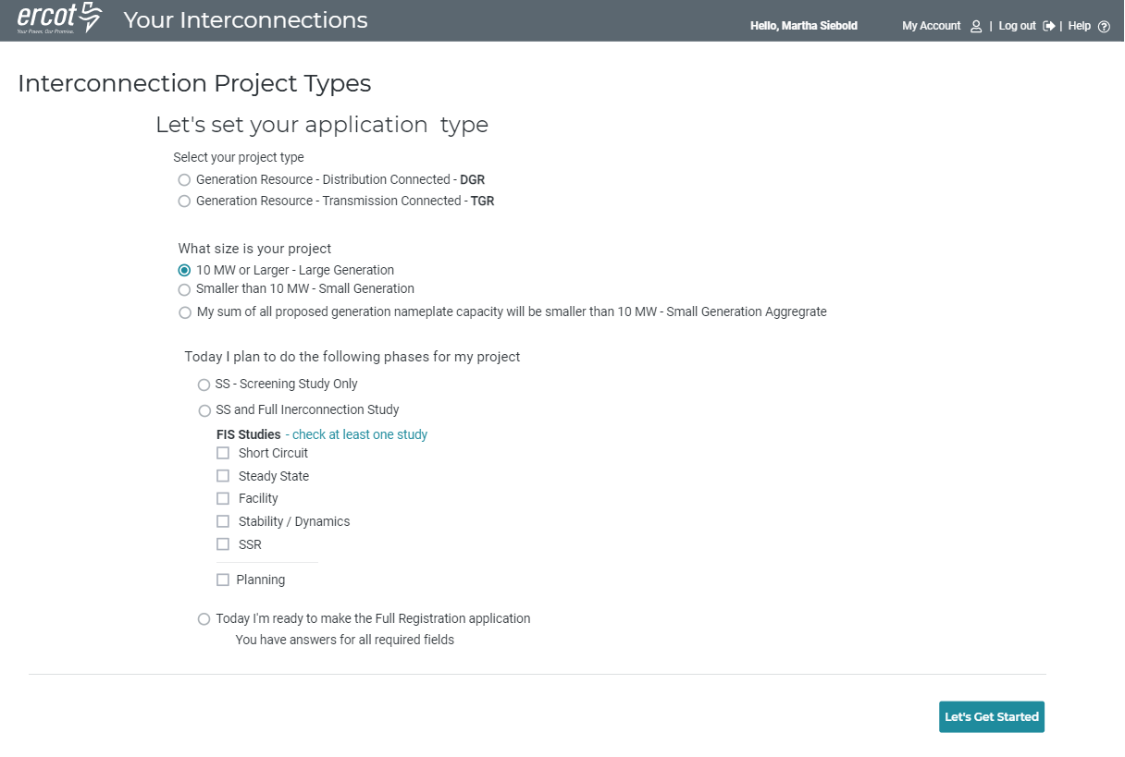
RIOO- IS Create Set Project Type

Slide 11
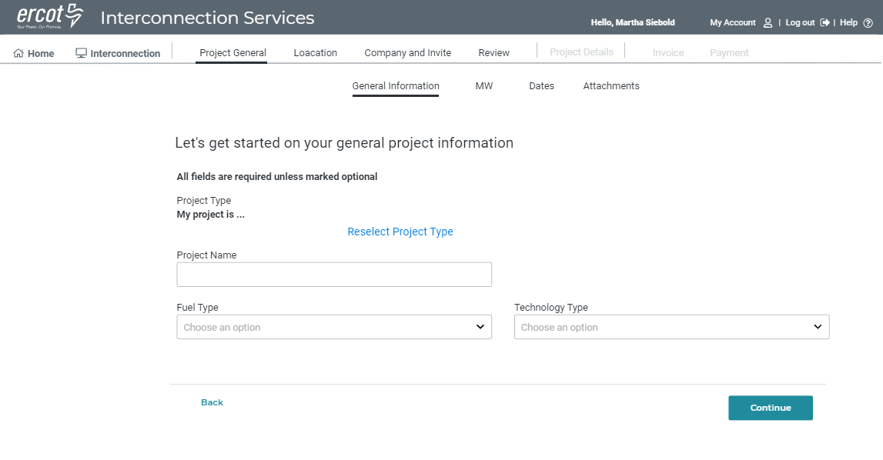
RIOO- IS - Existing Flow

Slide 12
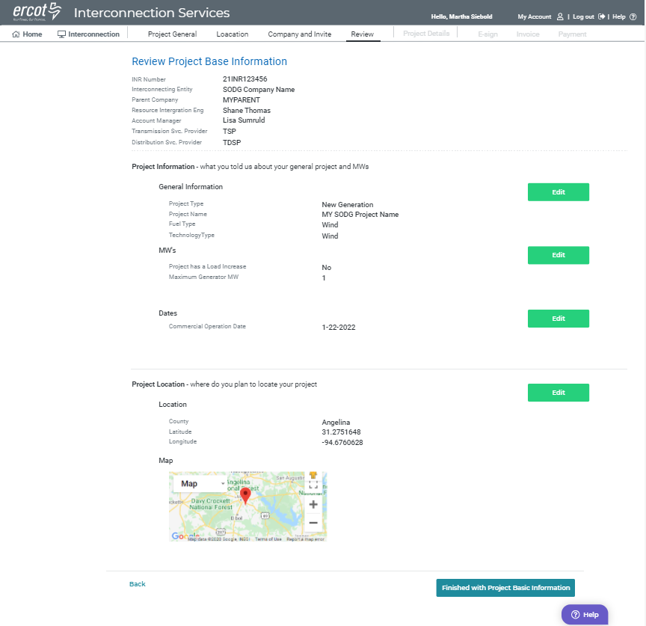
RIOO- IS - Existing Flow Review

Slide 13
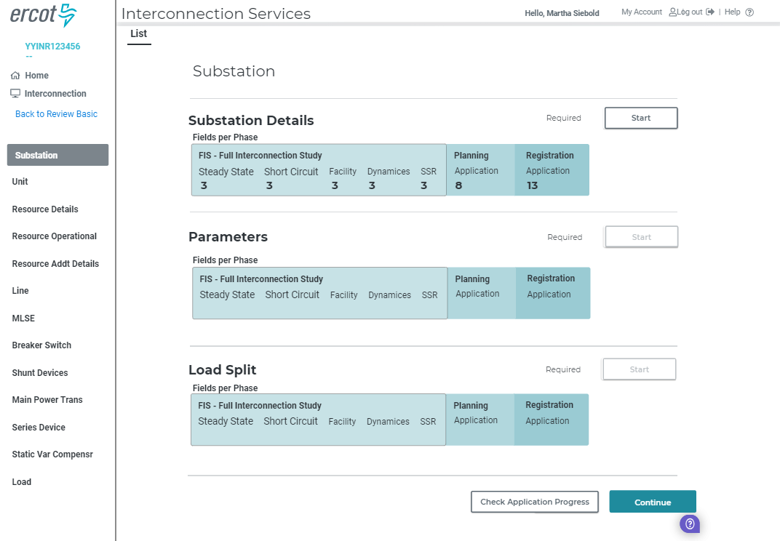
RIOO- IS - Section List

Slide 14
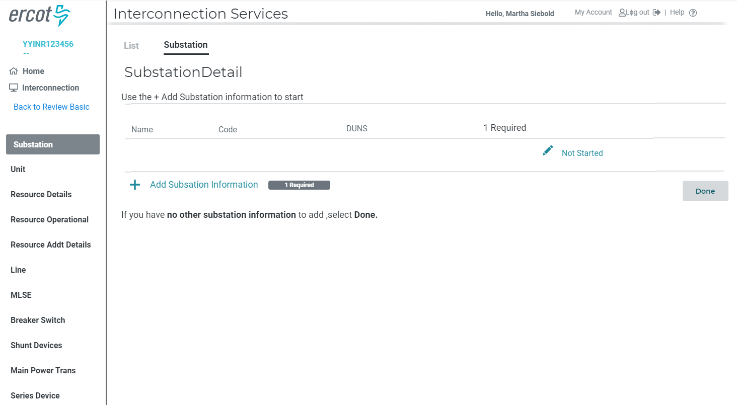
RIOO- IS - Substation Details Summary

Slide 15
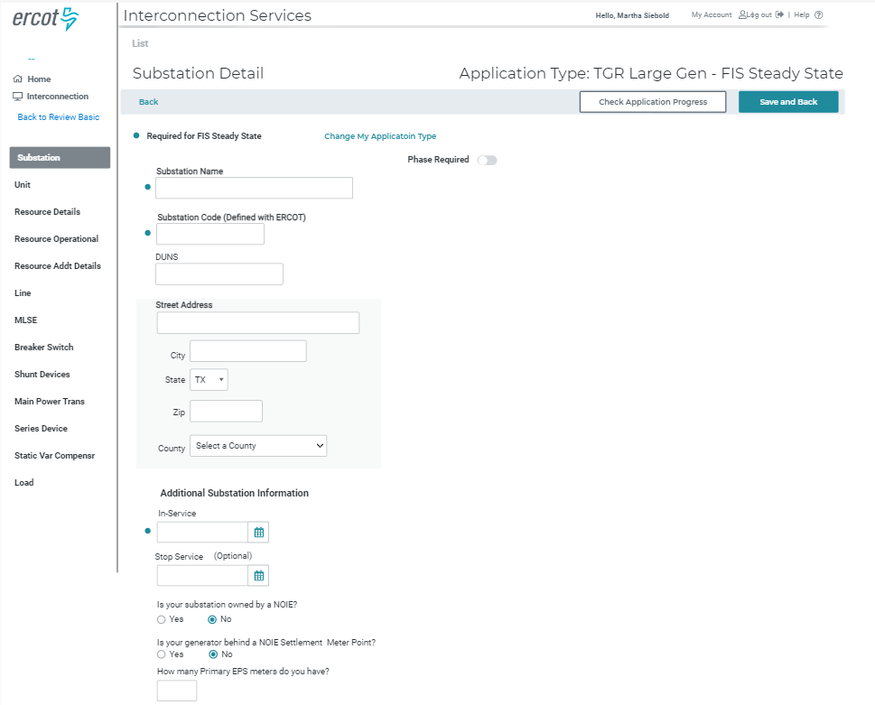
RIOO- IS - Substation - Form

Slide 16
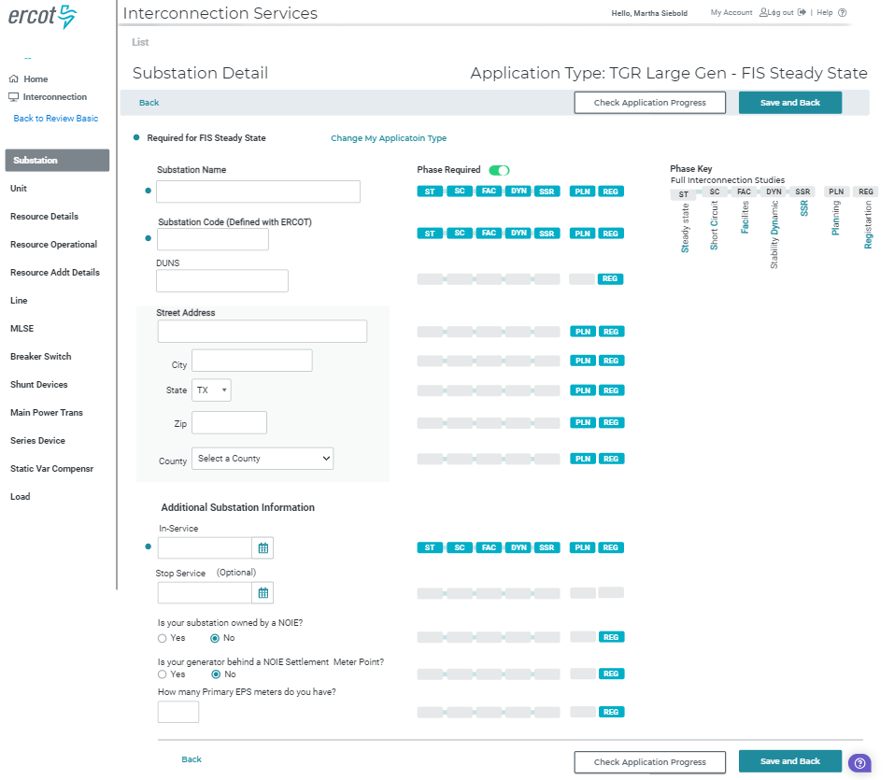
RIOO- IS - Substation – Form with Phase Key Displayed

Slide 17
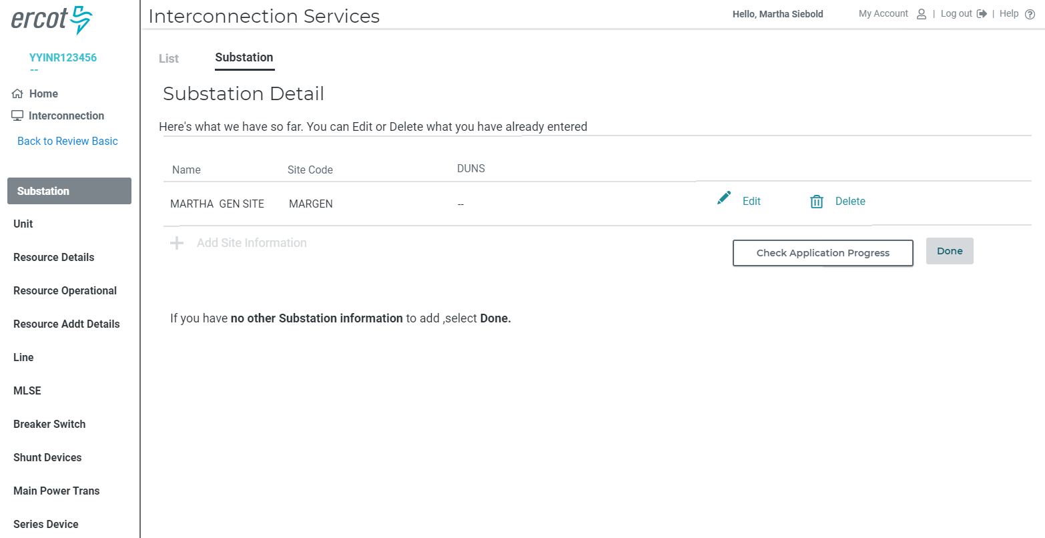
RIOO- IS - Substation Details Summary

Slide 18
Reminders
System updates will continue
  Usually Friday 10 am deployments
Need TSP input

Slide 19
Discussion
or
Questions

