Slide 1
Credit Exposure Update
Spoorthy Papudesi
Credit Work Group
ERCOT Public
March 25, 2021

Slide 2
Monthly Highlights Jan 2021- Feb 2021
Market-wide average TPE increased from $ 362.8 million in January to $ 4,521.1 million in February
  TPE increased mainly due to higher Real-Time and Day-Ahead Settlement Point prices and higher Forward adjustment Factors in February compared to January
  Due to the winter event, adjustments were made to the TPE calculation in February
  TPE ranged from $ 317.01 million to $13.95 billion in February
Discretionary Collateral is defined as Secured Collateral in excess of TPE,CRR Locked ACL and DAM Exposure
  Average Discretionary Collateral increased from $ 1,378.5 million to $3,251.2 million
  The increase in Discretionary Collateral is largely due to increase in Secured Collateral.
Number of active Counter-Parties decreased by 6

Slide 3
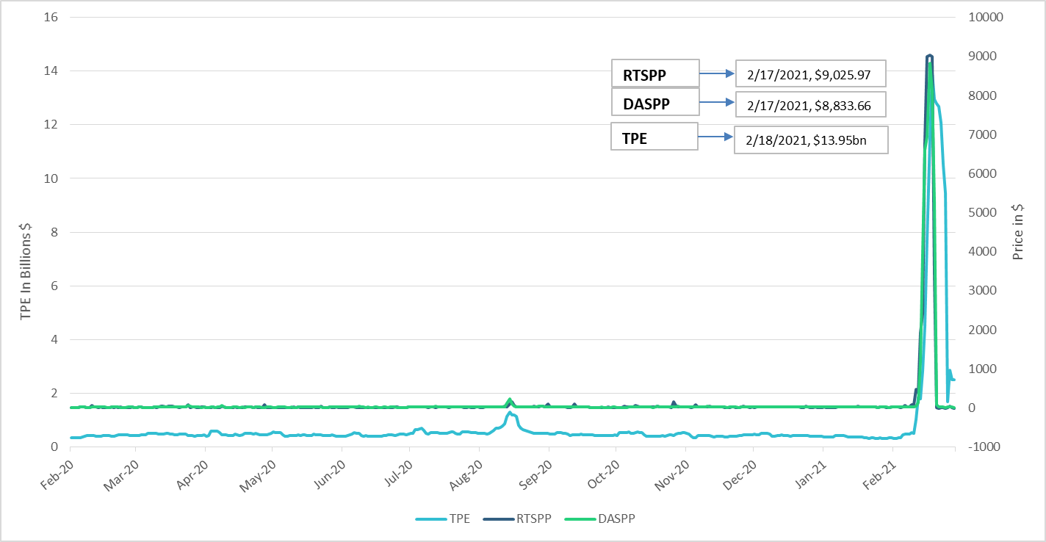
TPE/Real-Time & Day-Ahead Daily Average Settlement Point Prices for HB_NORTH
Feb 2020- Feb 2021

Slide 4
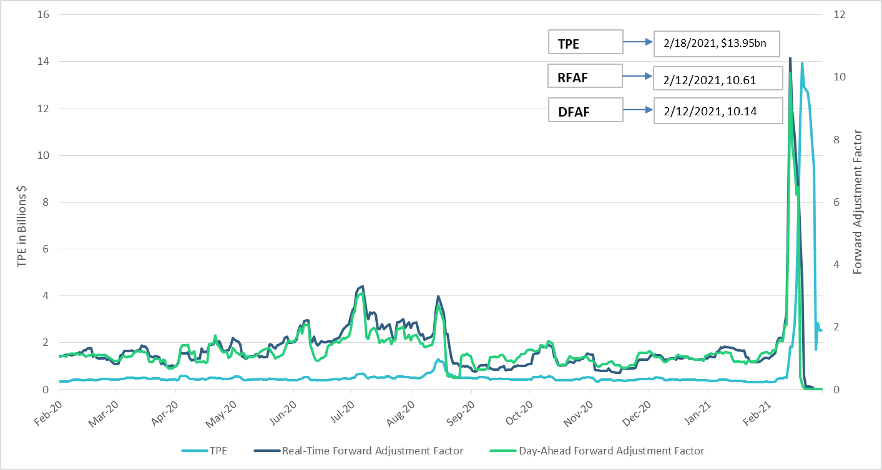
TPE and Forward Adjustment Factors Feb 2020- Feb 2021

Slide 5
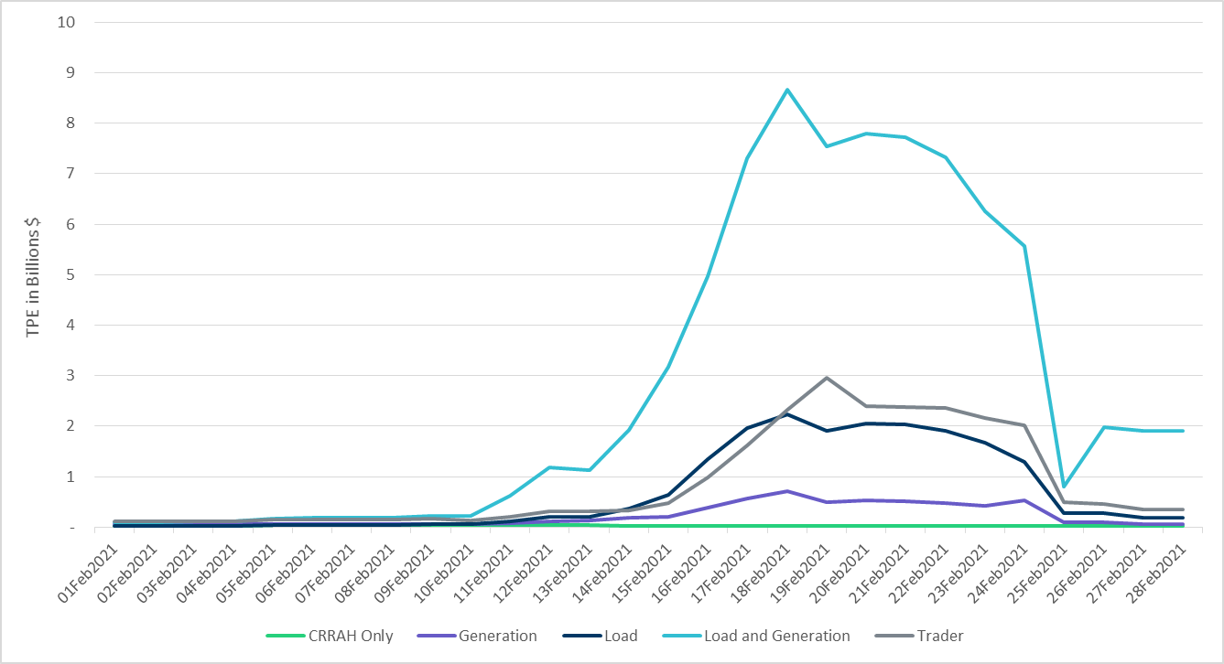
TPE by Market Segment- Feb 2021

Slide 6
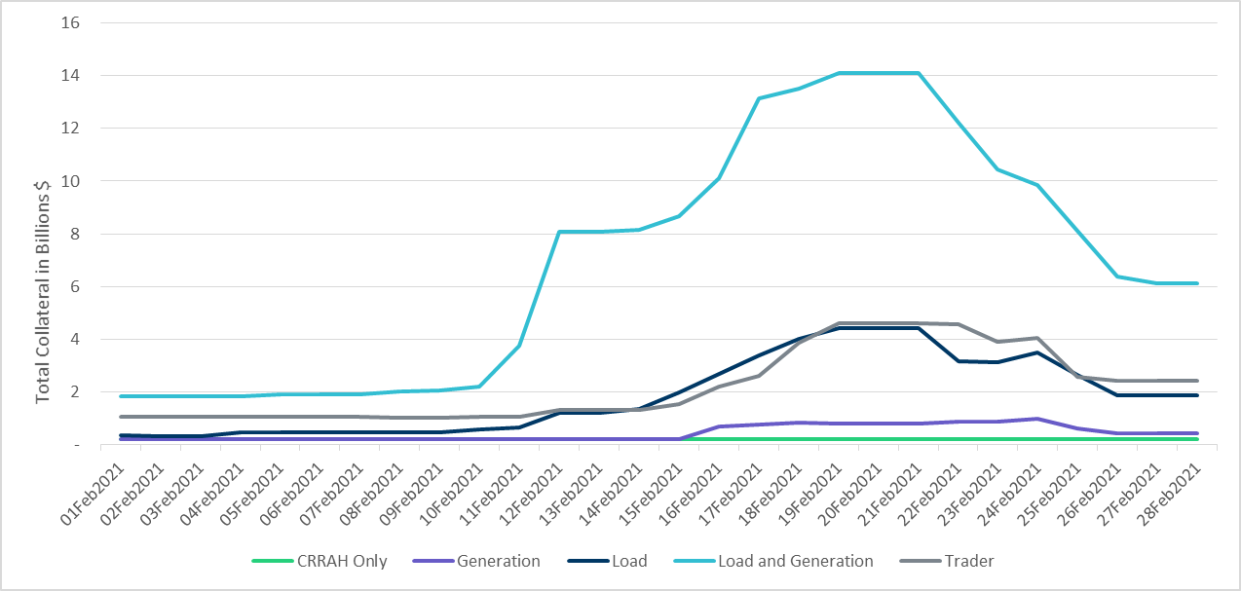
Total Collateral by Market Segment- Feb 2021

Slide 7
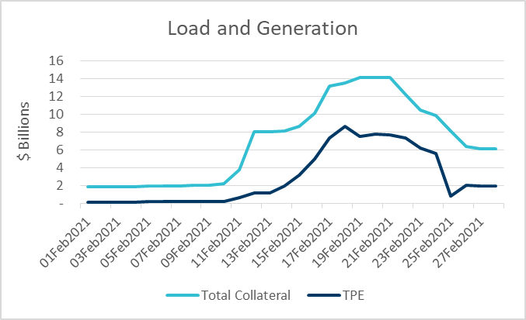
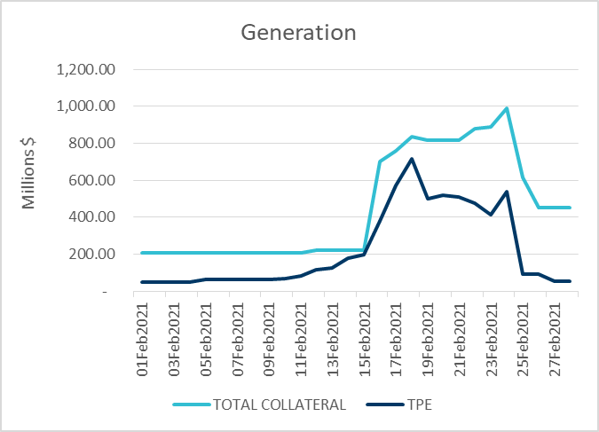
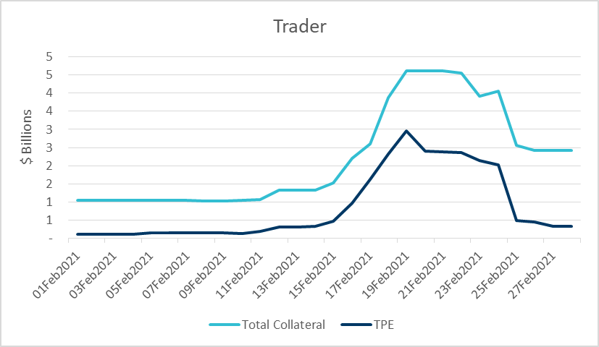
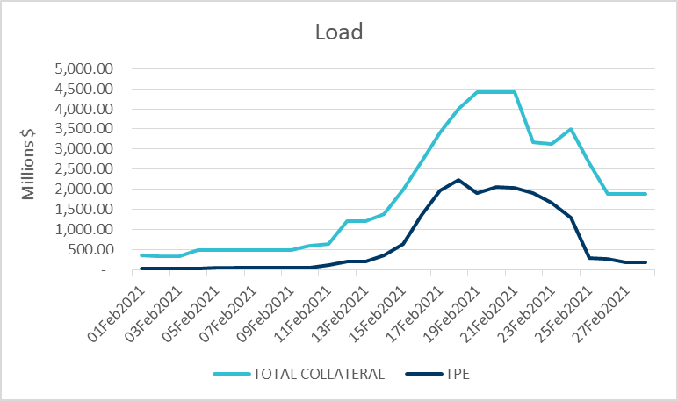
Total Collateral vs TPE by Market Segment- Feb 2021

Slide 8
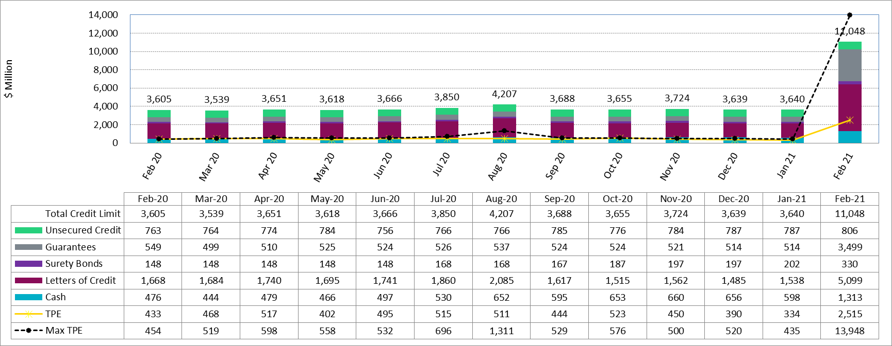
Available Credit by Type Compared to Total Potential Exposure (TPE)
* Numbers are as of month-end except for Max TPE

Slide 9
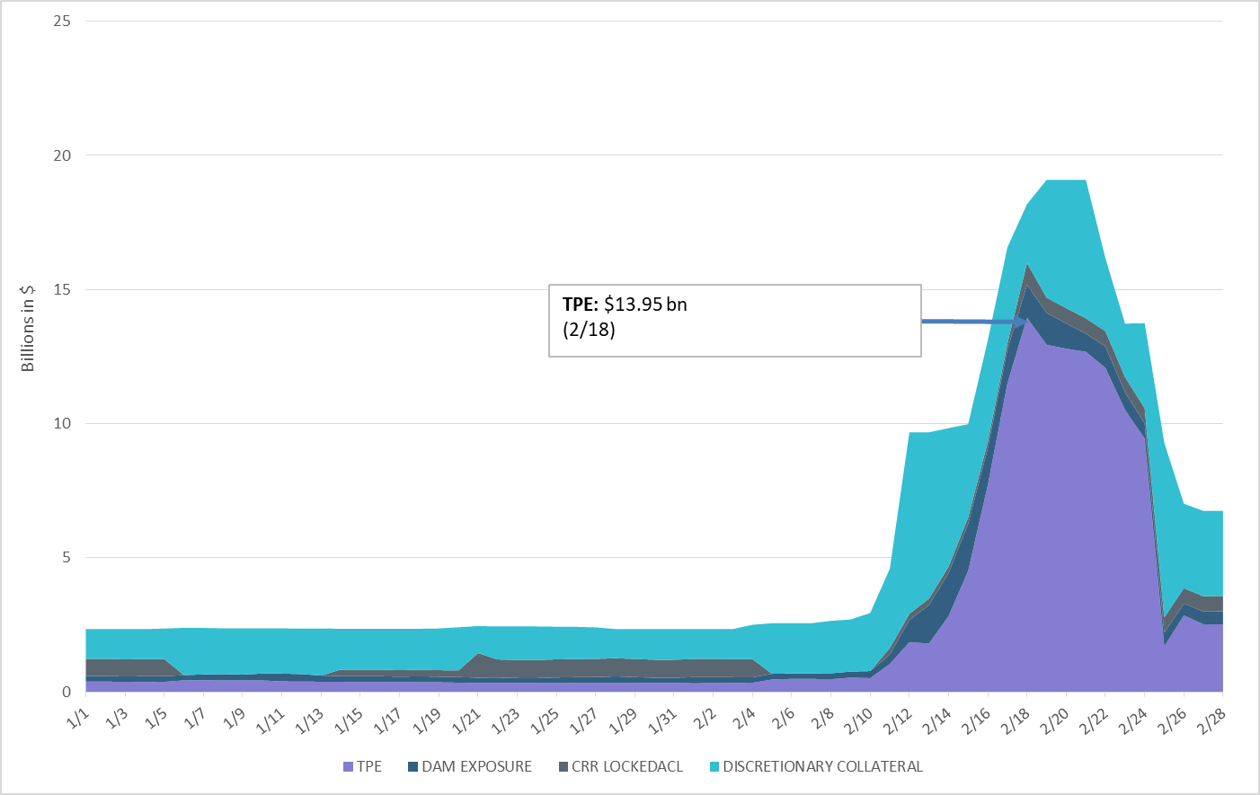
Discretionary Collateral Jan 2021 - Feb 2021
Average Discretionary Collateral increased to $3.2 bn in February
Secured Collateral: $19.1bn
(2/19,2/20,2/21)
Note: Discretionary collateral doesn’t include Unsecured Credit Limit or parent guarantees

Slide 10
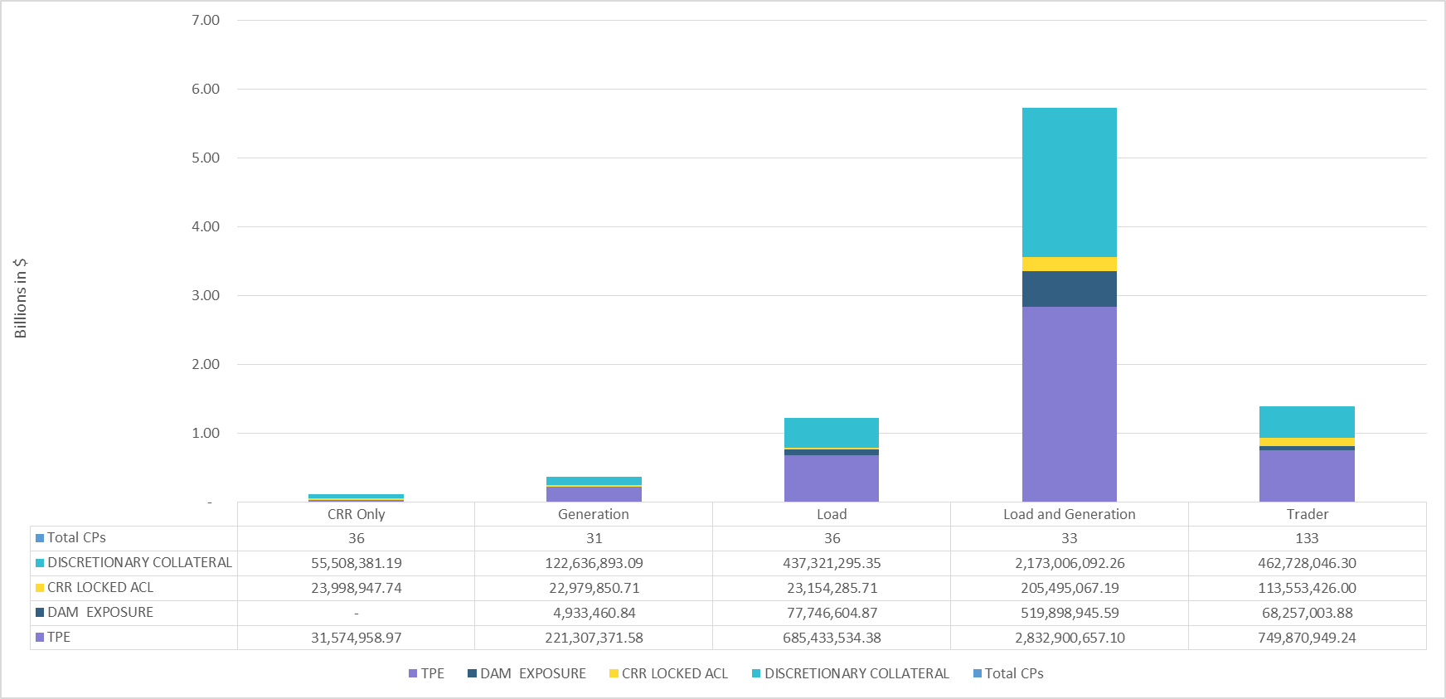
TPE and Discretionary Collateral by Market Segment- Feb 2021
Load and Generation entities accounted for the largest portion of discretionary collateral

Slide 11
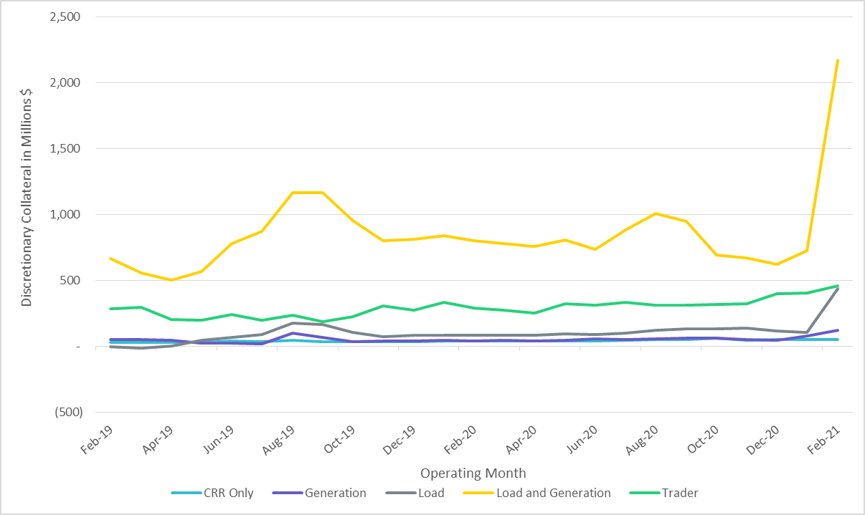
Discretionary Collateral by Market Segment Feb 2019- Feb 2021

Slide 12
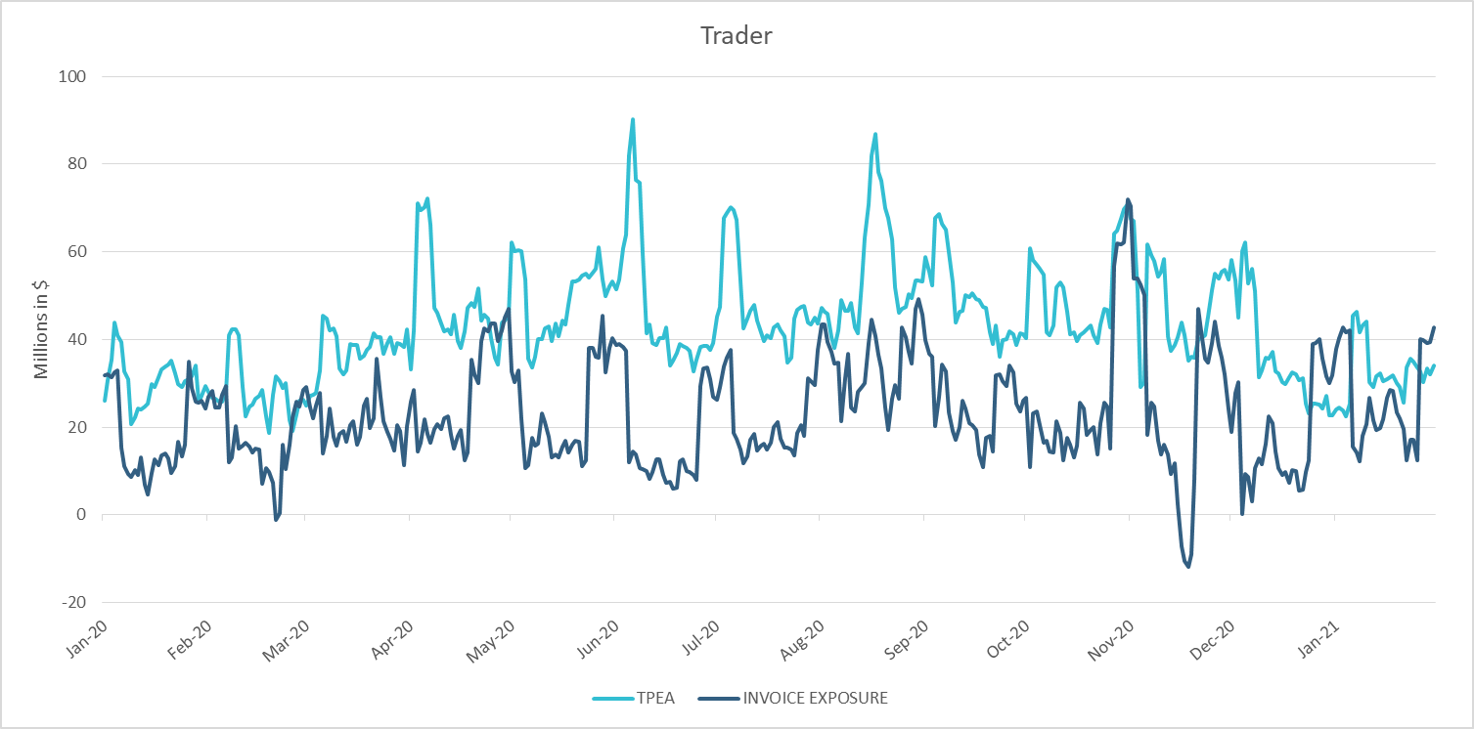
TPE Coverage of Settlements Jan 2020 - Jan 2021
TPEA generally exceeds actual/invoice exposure

Slide 13
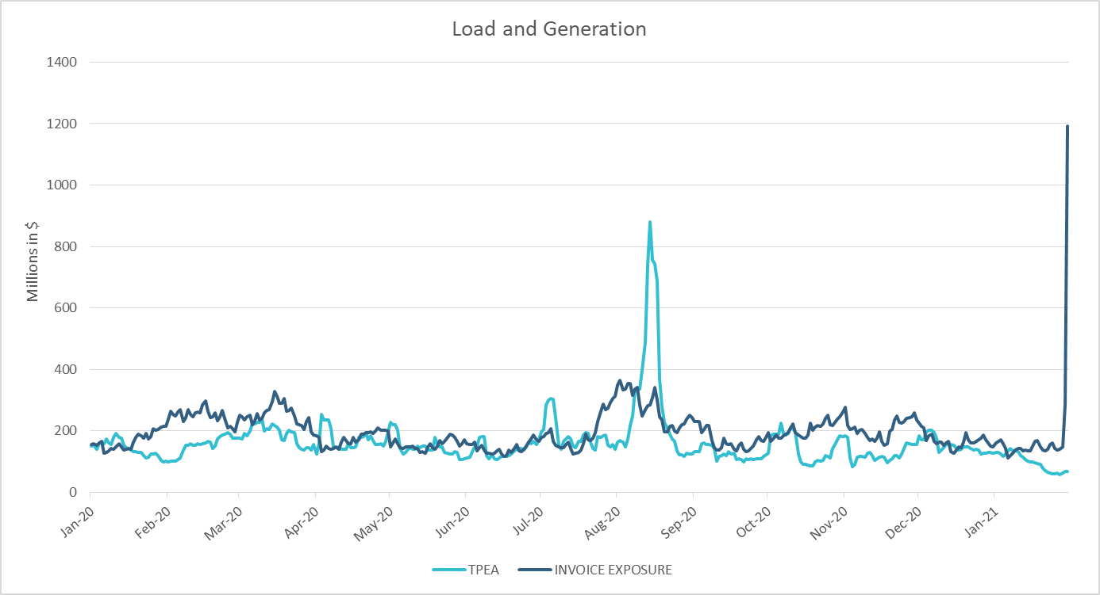
TPE Coverage of Settlements Jan 2020 - Jan 2021
Please note that spike in February invoices is reflected in January invoice exposure calculations

Slide 14
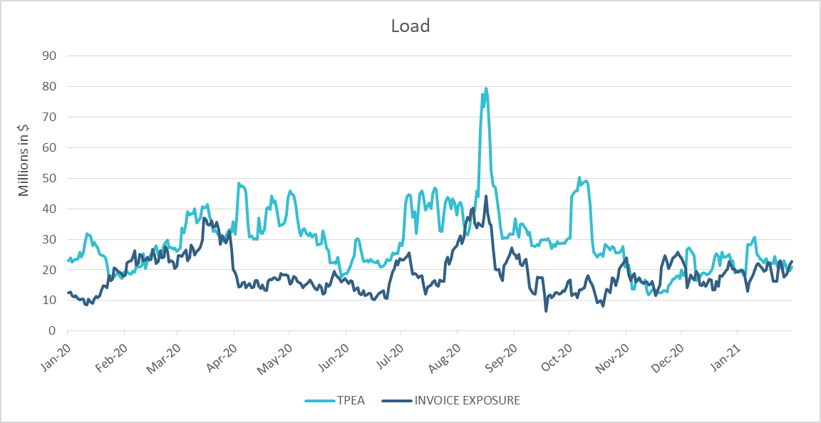
TPE Coverage of Settlements Jan 2020 - Jan 2021
TPEA closely approximates actual/invoice exposure

Slide 15
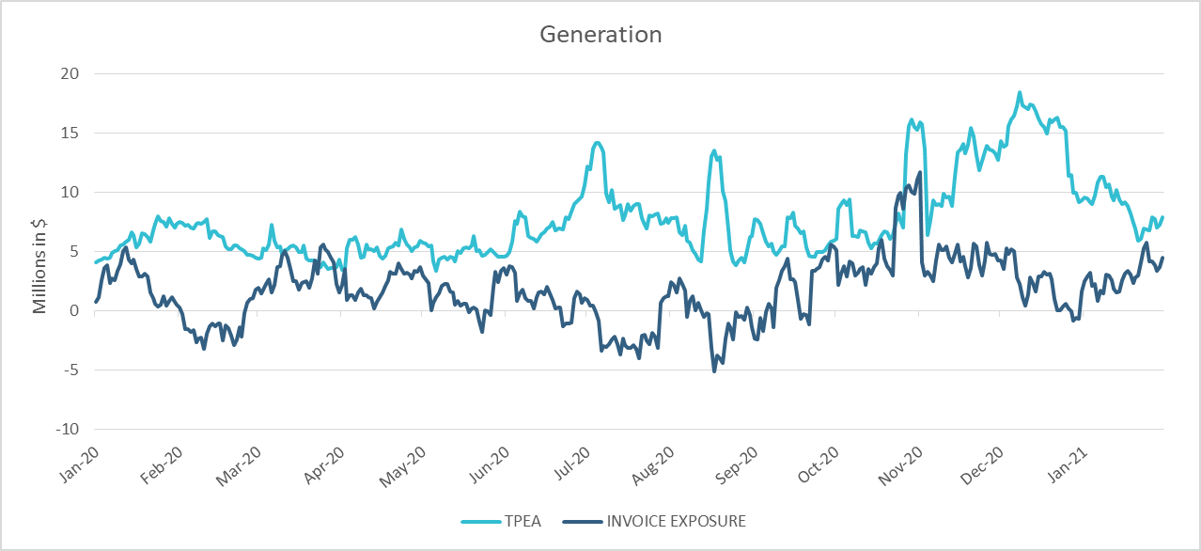
TPE Coverage of Settlements Jan 2020 - Jan 2021
TPEA generally exceeds actual/invoice exposure

Slide 16
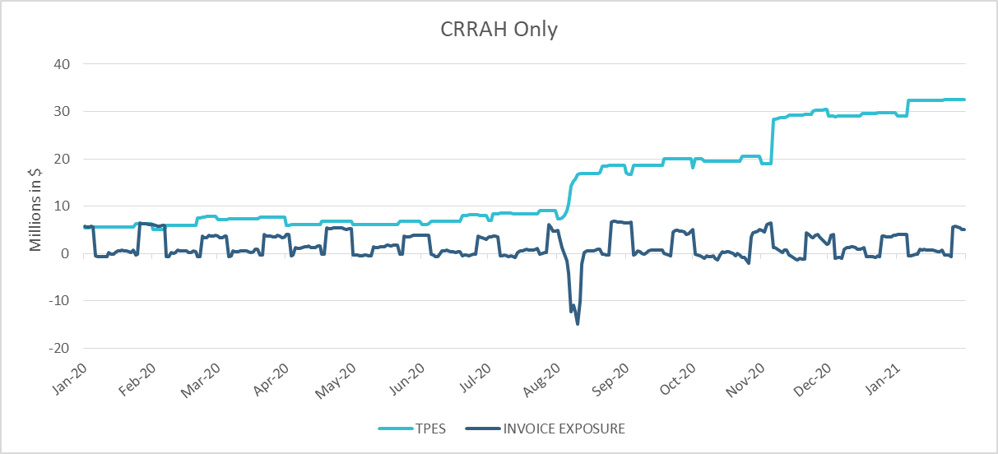
TPE Coverage of Settlements Jan 2020 - Jan 2021
TPES mostly exceeds actual/invoice exposure

Slide 17
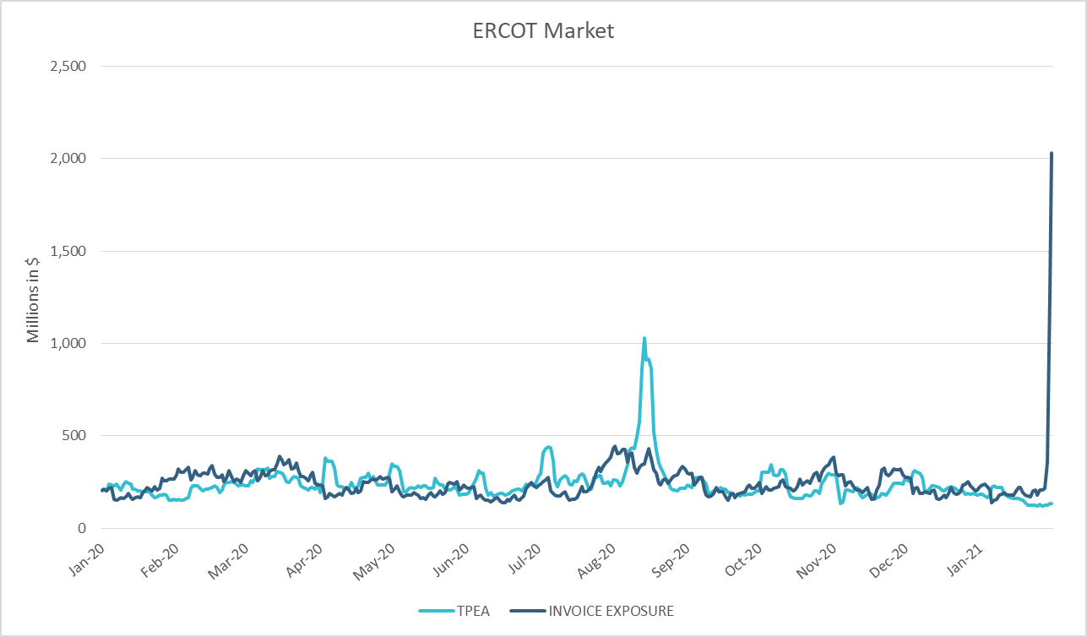
TPE Coverage of Settlements Jan 2020 - Jan 2021
TPEA closely approximates actual/invoice exposure except during weather event

Slide 18
Appendix

Slide 19
Summary of Distribution by Market Segment
Note: Excess collateral doesn’t include Unsecured Credit Limit and is defined as Collateral in excess of TPE

Slide 20
Summary of Distribution by Rating Group

Slide 21
Distribution of TPE by Rating and Category

Slide 22
Distribution of Excess Collateral by Rating and Category
Note: Excess collateral doesn’t include Unsecured Credit Limit

Slide 23
TPE Coverage of Settlements
  TPEA covers Settlement/Invoice exposure and estimated Real-Time and Day- Ahead completed but not settled activity (RTLCNS and UDAA)
  The analysis was performed for the period, Jan 2020 - Jan 2021
  Only Settlement invoices due to ERCOT are considered in the calculation
  M1 values as of May 28, 2020 were used for the period Jan 2020- May 2020 and M1 values effective as of each day were used since Jun 2020
  Example
  For business date 2/1/2020, if a Counter-Party has M1 value of 20, then all the charge invoices till 2/21/2020 including RTLCNS and UDAA as of 2/1/2020 is summed up to arrive at “Invoice Exposure”

Slide 24
Questions

