Slide 1
2021 Update on ETT CREZ Outages
CMWG Meeting April 19, 2021
Kip Fox
President, ETT

Slide 2
Agenda
Brief Timeline of Winter Storm Uri ETT Outages
Current CREZ Outage Schedule
Current Productivity
Other Discussion Items
Questions

Slide 3
Timeline of ETT Asset Outages All 345kV lines returned to service prior to Feb 11th
Midnight on 10th
Midnight
1:20 am
3:00 am
AEP WINTER STORM WARNING THROUGH 12th FOR NORTH TEXAS
AEP WINTER STORM WARNING THROUGH 15th FOR ENTIRE ETT TERRITORY
ERCOT DECLARES EMERGENCY OPERATIONS LEVEL 3
AEP WINTER STORM WARNING THROUGH 18th FOR CENTRAL AND WEST TEXAS
10:35 am
NORMAL CONDITIONS
11th
12th & 13th
14th
15th
16th
17th
18th
19th
15th 7:48 AM (3.5 days)
Trip: Laredo VFT (CFE outage)
8:05 am (15 min)
14th 9:02 am (LCRA)
14th 9:12 pm (2.8 days)
16th 11:55 pm (8.5 hours)
Trip: Clear Crossing – Dermott (Oncor) 345 kV
Trip: LCRA Big Hill – LCRA Kendall
Trip: Hamilton Road SVC2 138 kV
Trip: Lytle – Lytle (CPS outage) 138 kV
14th 1:17 pm (1.2 hrs)
14th 10:22 pm (13 hours)
17th 1:44 am (7.7 hours)
Trip: Lytle – Lytle (CPS) 138 kV CPS outage
Trip: Barney Davis – Nelson Sharpe 138 kV
Trip: Nelson Sharpe – Santa Cruz 138 kV
14th 11:35 pm (13.6 hours)
17th 11:23 am (2.3 days)
Trip: N. Edinburg – Palmito (Sharyland outage) 345 kV
Trip: Rocksprings (Pedernales Interconnection, LCRA and AEP Texas outages)
15th 12:36 am (6.5 hours)
17th 11:39 am (Developer outage with ETT support)
Trip: Razorback – Castroville (CPS outage) 138 kV
Trip: Big Hill – Wilson Ranch Wind Interconnection

Slide 4
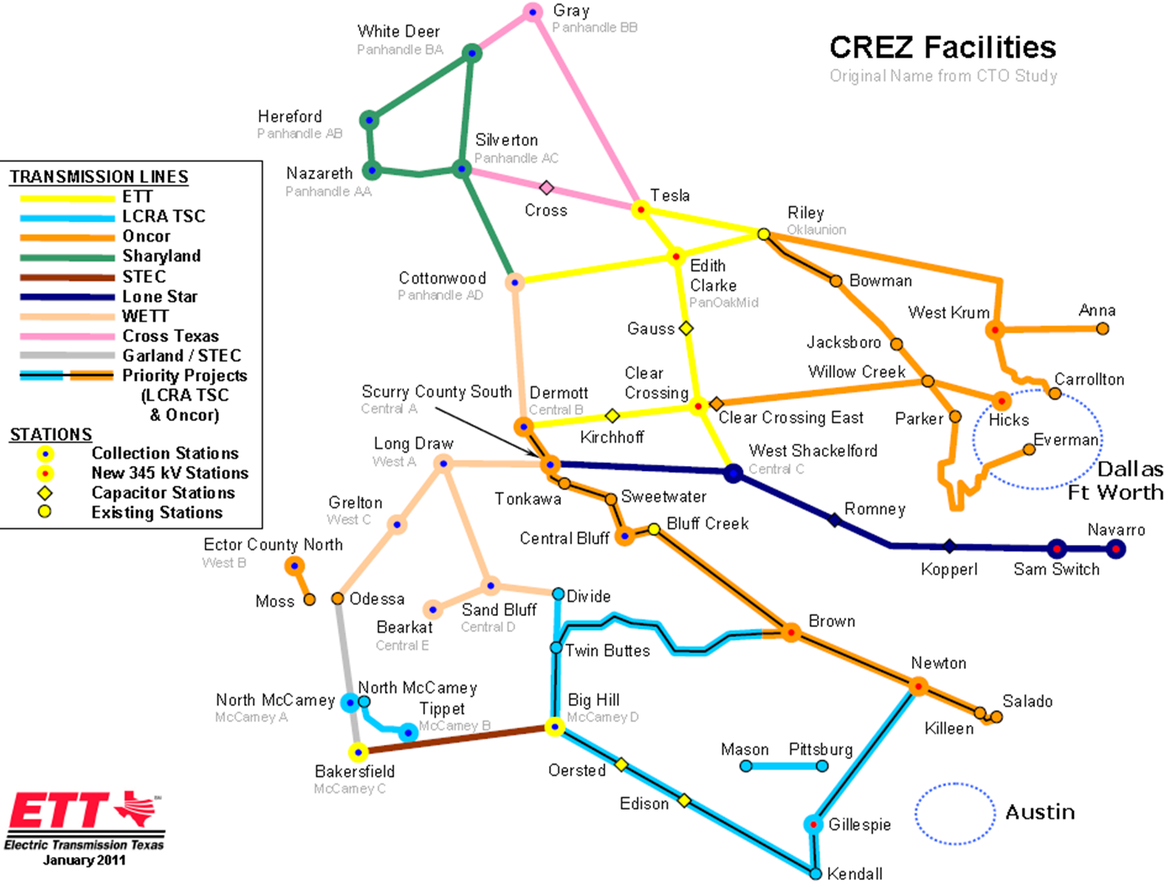

Slide 5
Current Schedule
In-service
In-service
Thanksgiving
CC – Clear Crossing
WS – West Shakelford
EC – Edith Clarke
T – Tesla
*Edith Clarke – Clear Crossing outages are bifurcated to allow generation output during inspections

Slide 6
Current Productivity
Winter Storm Uri
New Year
Break

Slide 7
Other Discussion Items
2022 and Beyond Tentative Plan
Additional Capacity Efforts
Network upgrades for GTC’s (all economic)
New technology to reduce impedance, congestion, other issues
Accountability issues to address in Texas
Winterization certification/planning/additional work
Storm quick response performance plan
Transmission line availability (99.95%)
1.00 –[(hours out x miles) / (1852 circuit miles x 8760 hrs)]

