Slide 1
NPRR902 Implementation
Workshop
Jonathan Levine
ERCOT Senior Corporate Counsel
April 22, 2021

Slide 2
NPRR902 Implementation Workshop
Agenda
Overview of NPRR902, ERCOT Critical Energy Infrastructure Information (ECEII)
Market Participant Requirements
User Security Administrator (USA) assignment of ECEII-eligible Digital Certificates
MIS Secure Area and Certified Area information classified as ECEII
Next Steps
Questions

Slide 3
Overview of NPRR902

Slide 4
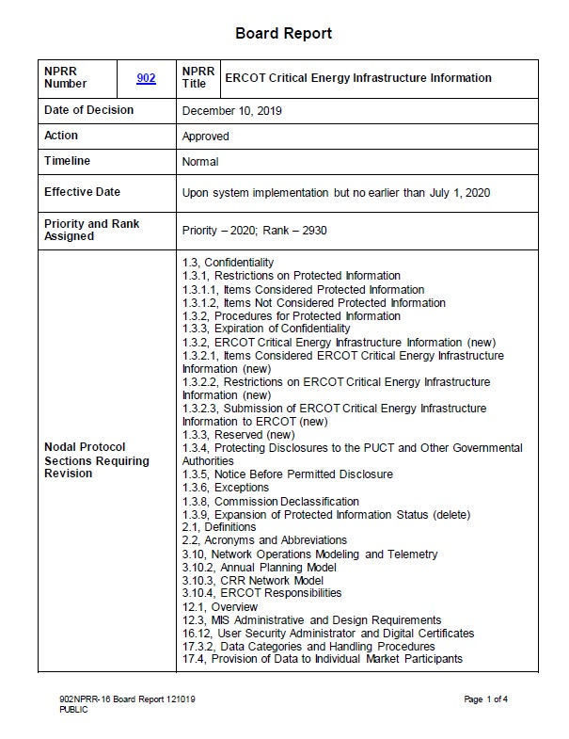

NPRR902 Implementation Workshop
Overview of NPRR902 – Procedural History
NPRR902, ERCOT Critical Energy Infrastructure Information
Sponsored by ERCOT and posted September 28, 2018
  In addition to TAC and subcommittee discussions, ERCOT hosted three workshops on NPRR902
Unanimously approved by the ERCOT Board December 10, 2019
Full implementation currently scheduled for June 1, 2021

Slide 5
NPRR902 Implementation Workshop
Overview of NPRR902 – Highlights of NPRR902
NPRR902 clarifies parties’ responsibilities regarding information that poses a security-related risk (ECEII)
Highlights:
Defines ECEII and adds lists of items that are considered ECEII
Specifies the restrictions imposed upon parties that receive or create ECEII
Provides a framework for the submission of ECEII to ERCOT
Creates a process for contesting ERCOT determinations regarding confidentiality status
Allows Market Participants to restrict individual access to ECEII within their organizations through the use of ECEII-eligible Digital Certificates
  MIS Secure and Certified Area postings are being classified as ECEII or non-ECEII
  Per Protocols, only access to MIS Secure and Certified Area postings is impacted by Digital Certificate changes (not other applications)

Slide 6
NPRR902 Implementation Workshop
Overview of NPRR902 – ECEII Definition
Section 2.1 Definitions
ERCOT Critical Energy Infrastructure Information (ECEII)
Specific engineering, vulnerability, or detailed design information concerning proposed or existing ERCOT System Infrastructure that:
(a) Relates details about the production, generation, transportation, transmission or distribution of energy;
(b) Could foreseeably be useful to a person planning an attack on ERCOT System Infrastructure;
(c) Is exempt from mandatory disclosure under the Freedom of Information Act, 5 U.S.C. § 552, and has not been disclosed to the public through lawful means; and
(d) Does not simply give the general location of the ERCOT System Infrastructure.
The ECEII definition is modeled closely after the federal definition of Critical Energy Infrastructure Information (CEII) – See 18 CFR 388.113(c)(2) – but is not identical

Slide 7
NPRR902 Implementation Workshop
Overview of NPRR902 – ECEII List
Section 1.3.2.1 Items Considered ERCOT Critical Energy Infrastructure Information
(1) ECEII includes but is not limited to the following, so long as such information has not been disclosed to the public through lawful means:
(a) Detailed ERCOT System Infrastructure locational information, such as Global Positioning System (GPS) coordinates;
(b) Information that reveals that a specified contingency or fault results in instability, cascading or uncontrolled separation;
(c) Studies and results of simulations that identify cyber and physical security vulnerabilities of ERCOT System Infrastructure;
(d) Black Start Service (BSS) test results, individual Black Start Resource start-up procedures, cranking paths, and ERCOT and individual TSP Black Start plans;
(e) ERCOT, TDSP, and Resource emergency operations plans;
(f) Detailed ERCOT Transmission Grid maps, other than maps showing only small portions of the ERCOT Transmission Grid such as those included in Regional Planning Group (RPG) Project ERCOT Independent Review reports;
(g) Detailed diagrams or information about connectivity between ERCOT’s and other Entities’ computer and telecommunications systems, such as internet protocol (IP) addresses, media access control (MAC) addresses, network protocols, and ports used; and
(h) Any information that is clearly designated as ECEII in writing by the Disclosing Party at the time the information is provided to Receiving Party, subject to the procedures set forth in paragraph (3) of Section 1.3.2.2, Submission of ERCOT Critical Energy Infrastructure Information to ERCOT.

Slide 8
NPRR902 Implementation Workshop
Overview of NPRR902 – Super ECEII
“Super ECEII” Concept – Protocol Section 1.3.2(4)
Section 1.3.2 ERCOT Critical Energy Infrastructure Information
(4) Different types of ECEII may involve different levels of security risk. In its discretion, ERCOT may restrict Market Participant access to ECEII created or received by ERCOT that poses a high level of security risk, provided that ERCOT shall disclose such information to any Transmission and/or Distribution Service Provider (TDSP) upon request and may disclose such information to any other Market Participant that ERCOT determines has a legitimate reliability-based need for that information, subject to the requirements and restrictions of this Section 1.3, Confidentiality. If ERCOT determines that ECEII that is required to be posted on the ERCOT website or MIS Secure Area pursuant to these Protocols or an Other Binding Document poses a high level of security risk, ERCOT shall remove such information from the ERCOT website or MIS Secure Area notwithstanding such posting requirement, and shall promptly submit a Revision Request to remove the requirement to post such information. If the Revision Request is withdrawn or rejected, ERCOT shall restore any information required to be posted to the MIS that had been removed pursuant to this paragraph.
Examples of ECEII that poses a high level of security risk (“Super ECEII”):
  Information concerning stability-related Generic Transmission Constraints, which must be redacted before related information is posted (Protocol Section 3.10.7.6(3)(d))
  Certain information regarding possible equipment outages during a Geomagnetic Disturbance (GMD) event is posted to the MIS Certified Area for TSPs (Section 6 of the 2020 Benchmark GMD Vulnerability Assessment Scope and Process)

Slide 9
NPRR902 Implementation Workshop
Overview of NPRR902 – Classifications and Access
Not ECEII, not on MIS Secure/Certified
Not ECEII, but on MIS Secure/Certified
ECEII (but not high-level security risk) on MIS Secure/
Certified
ECEII posing a high level of security risk
General Public
Assuming not Protected Information
MP personnel with a DC (does not need to be ECEII-eligible)
MP personnel with an ECEII-eligible DC
TDSPs upon request + any other MP that ERCOT determines has a legitimate reliability-based need for that information

Slide 10
Market Participant Requirements

Slide 11
NPRR902 Implementation Workshop
New Market Participant Requirements
Section 1.3 Confidentiality
(2) As used in this Section 1.3:
(a) “Receiving Party” means ERCOT, the IMM or any Market Participant in its capacity as the recipient of Protected Information or ECEII from one of the others.
(b) “Disclosing Party” means ERCOT, the IMM or any Market Participant in its capacity as the provider of Protected Information or ECEII to one of the others.
(c) “Creating Party” means ERCOT, the IMM or any Market Participant in its capacity as the creator of any ECEII specifically listed in Section 1.3.2.1, Items Considered ERCOT Critical Energy Infrastructure Information.
(d) To disclose means to directly or indirectly disclose, reveal, distribute, report, publish, or transfer Protected Information or ECEII to any party other than to the Disclosing Party.

Slide 12
NPRR902 Implementation Workshop
New Market Participant Requirements
Section 1.3.2 ERCOT Critical Energy Infrastructure Information
(1) ERCOT, the IMM, or any Market Participant may not disclose ECEII to any other Entity except as specifically permitted in this Section and in these Protocols.
Exceptions are in Section 1.3.6
  Similar but not identical to the exceptions applicable to Protected Information. Include but are not limited to:
    If required by law
    If required to resolve a dispute
    To TSPs or DSPs engaged in planning and operations activities
    To a vendor or prospective vendor of goods and services
    To NERC or Texas RE if required for compliance
    To members of certain working groups or task forces
  Under many exceptions, the party seeking to disclose ECEII must make reasonable efforts to restrict public access or enter into a confidentiality agreement with the party to whom the ECEII will be disclosed

Slide 13
NPRR902 Implementation Workshop
New Market Participant Requirements
Section 1.3.2 ERCOT Critical Energy Infrastructure Information
(5) A Receiving Party or Creating Party of ECEII shall adopt procedures to ensure that ECEII is securely maintained and the organization’s internal distribution of ECEII is reasonably restricted to appropriate individuals.
(6) A Receiving Party or Creating Party may not knowingly use ECEII for any illegal purpose.
Restriction on internal distribution can be facilitated through the use of ECEII-eligible Digital Certificates
Consider what measures your organization should adopt depending on the nature and extent of its ERCOT participation, the information it produces or receives, workforce security practices, etc.

Slide 14
NPRR902 Implementation Workshop
New Market Participant Requirements
Section 1.3.2 ERCOT Critical Energy Infrastructure Information
(7) Before disclosing ECEII to a representative or agent of the Receiving Party or Creating Party, the Receiving Party or Creating Party shall require a nondisclosure agreement with that representative or agent, except that a nondisclosure agreement shall not be required for the Receiving Party or Creating Party to disclose ECEII to that party’s attorney.
If a Market Participant intends to use an outside consultant that may need access to ECEII, the Market Participant should condition the work upon the consultant’s agreement to maintain the confidentiality of any ECEII that the consultant receives.

Slide 15
NPRR902 Implementation Workshop
New Market Participant Requirements
Section 1.3.2.2 Submission of ERCOT Critical Energy Infrastructure Information to ERCOT
(1) ECEII submitted to ERCOT shall be clearly labeled on the cover page and pages or portions of the information or otherwise clearly identify the information for which ECEII treatment is claimed, to the extent practicable. The submission of information labeled as ECEII constitutes a representation by the submitter that the information is ECEII as defined in these Protocols. The submitter shall also segregate those portions of the information that contain ECEII wherever feasible.
(2) Failure to request ECEII treatment or failure to conspicuously label or segregate ECEII information submitted to ERCOT in accordance with paragraph (1) above may result in non-ECEII treatment of the information by ERCOT and release of the information to the public.
ERCOT will protect information it determines is ECEII regardless of whether it is labeled.
However, to ensure ECEII treatment upon submission to ERCOT, Market Participants should label all material containing ECEII. Example:
This report contains ERCOT Critical Energy Infrastructure Information (ECEII). DO NOT DISTRIBUTE OR COPY WITHOUT EXPRESS PERMISSION

Slide 16
NPRR902 Implementation Workshop
New Market Participant Requirements
Redaction example #1 (use RED ITALIC TEXT or blackout):
Based on the study results, GENERATION RESOURCE meets the following RMR criterion:
ii. there is an instability or cascading under the following conditions:
(C) Unavailability of a generating unit, followed by Manual System Adjustments, followed by the contingency loss of a generating unit, transmission circuit, common tower outage, transformer, shunt device, or FACTS device;
The analysis also confirmed that GENERATION RESOURCE has a more than 2% unloading Shift Factor on TRANSMISSION LINE NAME/RATING transmission lines, and the unloading impact on those lines from the Generation Resource output is greater than 5%. Detailed AC contingency analysis results for each of the four scenarios listed in the above table may be found in Appendix A.

Slide 17
NPRR902 Implementation Workshop
New Market Participant Requirements
Redaction example #2 (use RED ITALIC TEXT or blackout):
Based on the study results, GENERATION RESOURCE meets the following RMR criterion:
ii. there is an instability or cascading under the following conditions:
(C) Unavailability of a generating unit, followed by Manual System Adjustments, followed by the contingency loss of a generating unit, transmission circuit, common tower outage, transformer, shunt device, or FACTS device;
The analysis also confirmed that GENERATION RESOURCE has a more than 2% unloading Shift Factor on TRANSMISSION LINE NAME/RATING transmission lines, and the unloading impact on those lines from the Generation Resource output is greater than 5%. Detailed AC contingency analysis results for each of the four scenarios listed in the above table may be found in Appendix A.

Slide 18
NPRR902 Implementation Workshop
New Market Participant Requirements
Section 1.3.5 Notice Before Permitted Disclosure
(1) Before making any disclosure under Section 1.3.6, Exceptions, the Receiving Party shall promptly notify the Disclosing Party in writing and, with the exception of information disclosed pursuant to paragraph (3) of Section 1.3.6, shall assert confidentiality and take reasonable steps to cooperate with the Disclosing Party in seeking to protect the Protected Information or ECEII from disclosure by confidentiality agreement, protective order, aggregation of information, or other reasonable measures. Notwithstanding the foregoing, ERCOT is not required to provide notice to the Disclosing Party of disclosures made under items (1)(b) or (1)(l) of Section 1.3.6.
(2) If the Disclosing Party is not also the Creating Party, upon receipt of the notice required by paragraph (1) above, the Disclosing Party shall promptly notify the Creating Party, unless, after making reasonable efforts, the Disclosing Party is unable to identify the Creating Party.
Be mindful of other notification requirements, which include:
  Section 1.3.6(3)(e)(iii): “Each Disclosing Party, other than ERCOT, shall provide Notice to each Creating Party whose information has been disclosed pursuant to this paragraph (e) [which authorizes ERCOT to disclose ECEII to government officials in emergency].”
  Section 1.3.6(3)(f)(i): “The Receiving Party or Creating Party shall provide Notice to ERCOT and all Market Participants materially impacted by the disclosure [of ECEII without prior ERCOT authorization in an emergency] as soon as practicable, but no later than 24 hours following the disclosure.”

Slide 19
USA Assignment of ECEII-eligible Digital Certificates

Slide 20
NPRR902 Implementation Workshop
Digital Certificates
Section 12.1 Overview
(2) The MIS Secure and Certified Areas provide restricted access to ERCOT Critical Energy Infrastructure Information (ECEII), to the extent that the Protocols or any Other Binding Document requires such information to be posted thereon. All ECEII posted on the MIS Secure or Certified Area shall be subject to the restrictions in Section 1.3.2, ERCOT Critical Energy Infrastructure Information. ECEII posted on the MIS Secure or Certified Area may be accessed only by those individuals that are issued ECEII-eligible Digital Certificates.
Section 16.12 User Security Administrator and Digital Certificates
(2)* ERCOT Critical Energy Infrastructure Information (ECEII) posted on the Market Information System (MIS) Secure or Certified Area may be accessed only by those individuals that are issued ECEII-eligible Digital Certificates.
* in relevant part

Slide 21

NPRR902 Implementation Workshop
Digital Certificates
A new role, ICE_M_VIEW_ECEII, will control access to ECEII postings on MIS
ECEII-eligible Digital Certificates required to access ECEII posted on MIS Secure and Certified Areas
  i.e. Digital certificates with the new ICE_M_VIEW_ECEII role
USAs can now assign the new role to Digital Certificates of users that require ECEII access
  Detailed instructions in Market Notice M-A021021-01 General
To minimize loss of access, USAs must assign the new role to user Digital Certificates prior to June 1, 2021

Slide 22
MIS Secure Area and
Certified Area information classified as ECEII

Slide 23

NPRR902 Implementation Workshop
MIS Secure/Certified Information Classified as ECEII
Categories of items classified as ECEII (preliminary and not exclusive):
Network Operations Model and other data sets
Black Start documents
Geomagnetic Disturbance (GMD) documents
Generic Transmission Limits (GTLs)/Generic Transmission Constraints (GTCs)
Real-Time Congestion Reports (Chronic or Severe Constraints)
Generation Interconnection or Change Request
(GINR)-related Information
Dynamic Data information
ERCOT System Stability Screening Studies
Remedial Action Scheme (RAS) information
Resource Asset Registration Form (RARF)
Generator Data
Detailed Transmission System maps
ERCOT designates information as ECEII if it (A) is on the list of items considered ECEII in Section 1.3.2.1 (the “ECEII List”); or (B) otherwise meets the ECEII definition in Section 2.1
Upon NPRR902 implementation, the ERCOT Market Information List (EMIL) will identify whether or not a posting is designed as ECEII

Slide 24
NPRR902 Implementation Workshop
MIS Secure/Certified Information Classified as ECEII
Network Operations Model and other data sets
Network Operations Model
  TSP version of CIM Network Model
  TSP version of Test Network Operations Model
  Redacted CIM Network Model
Annual Planning Model
  Redacted Network Operations Test Model
CRR Network Models (Annual and Monthly)
Steady State Power Flow Base Cases
System Protection Base Cases
GIC System Model
Why ECEII?
These items meet the ECEII definition in Section 2.1, as the Network Operations Model or other data sets would likely be sought-after tools for someone planning an attack on ERCOT System infrastructure

Slide 25
NPRR902 Implementation Workshop
MIS Secure/Certified Information Classified as ECEII
Black Start documents
ERCOT Black Start Restoration Plan
Transmission Operator Black Start plans
Why ECEII?
These meet item (1)(d) of ECEII List (“Black Start Service (BSS) test results, individual Black Start Resource start-up procedures, cranking paths, and ERCOT and individual TSP Black Start plans”)

Slide 26
NPRR902 Implementation Workshop
MIS Secure/Certified Information Classified as ECEII
Geomagnetic Disturbance (GMD) documents
ERCOT Geomagnetic Disturbance Operating Plan
GMD Planning Studies
GIC System Model and related documents
Why ECEII?
Postings meet item (1)(c) (“Studies and results of simulations that identify cyber and physical security vulnerabilities of ERCOT System Infrastructure”) and/or (1)(e) (“ERCOT, TDSP, and Resource emergency operations plans”) of the ECEII List

Slide 27
NPRR902 Implementation Workshop
MIS Secure/Certified Information Classified as ECEII
Generic Transmission Limits (GTLs)/Generic Transmission Constraints (GTCs)
Generic Transmission Limits
Generic Transmission Constraints Methodology
Generic Transmission Constraints Market Comments
Why ECEII?
Postings meet item (1)(b) (“Information that reveals that a specified contingency or fault results in instability, cascading or uncontrolled separation”) and (c) (“Studies and results of simulations that identify cyber and physical security vulnerabilities of ERCOT System Infrastructure”) of the ECEII List

Slide 28
NPRR902 Implementation Workshop
MIS Secure/Certified Information Classified as ECEII
Real-Time Congestion Reports (Chronic or Severe Constraints)
Monthly Real-Time Congestion Report - Chronic or Severe Constraints
Daily Real-Time Congestion Report - Exceeded Constraints Not Activated
Why ECEII?
Postings meet item (1)(b) (“Information that reveals that a specified contingency or fault results in instability, cascading or uncontrolled separation”) and (c) (“Studies and results of simulations that identify cyber and physical security vulnerabilities of ERCOT System Infrastructure”) of the ECEII List

Slide 29
NPRR902 Implementation Workshop
MIS Secure/Certified Information Classified as ECEII
Generation Interconnection or Change Request (GINR)-related Information
GINR-related Studies, such as Full Interconnection Studies (full posted to Certified Area, redacted posted to Secure Area) and supporting documents
  Steady State
  System Protection
  Dynamic and Transient Stability
  Facility
  Sub-synchronous Resonance (SSR)
Why ECEII?
Postings contain studies that meet item (1)(b) (“Information that reveals that a specified contingency or fault results in instability, cascading or uncontrolled separation”) or (c) (“Studies and results of simulations that identify cyber and physical security vulnerabilities of ERCOT System Infrastructure”) of the ECEII List

Slide 30
NPRR902 Implementation Workshop
MIS Secure/Certified Information Classified as ECEII
Dynamic Data information
Dynamic Data Studies
ERCOT Dynamic Assessment
DWG Meeting Minutes and Presentations
Why ECEII?
Postings include dynamics data and critical contingencies of instability, and meet item (1)(b) of the ECEII list (“Information that reveals that a specified contingency or fault results in instability, cascading or uncontrolled separation”)

Slide 31
NPRR902 Implementation Workshop
MIS Secure/Certified Information Classified as ECEII
ERCOT System Stability Screening Studies
Transient Stability Screening Study for ERCOT System
Voltage Stability Screening Study for ERCOT System
Why ECEII?
Postings include the critical contingencies of identified instability, and meet item (1)(b) of the ECEII list (“Information that reveals that a specified contingency or fault results in instability, cascading or uncontrolled separation”)

Slide 32
NPRR902 Implementation Workshop
MIS Secure/Certified Information Classified as ECEII
Remedial Action Scheme (RAS) information
Submitted RASs
Approved RASs
Why ECEII?
RASs may be used to manage instability; postings meet item (1)(b) of the ECEII List (“Information that reveals that a specified contingency or fault results in instability, cascading or uncontrolled separation”)

Slide 33
NPRR902 Implementation Workshop
MIS Secure/Certified Information Classified as ECEII
Resource Asset Registration Form (RARF) Generator Data
RARF data in spreadsheet format
Why ECEII?
RARF data typically includes detailed locational information (GPS coordinates to several decimal places) and therefore meets item (1)(a) of the ECEII List (“Detailed ERCOT System Infrastructure locational information, such as Global Positioning System (GPS) coordinates”)

Slide 34
NPRR902 Implementation Workshop
MIS Secure/Certified Information Classified as ECEII
Detailed Transmission System maps
No longer updated but still available on the MIS Secure Area
Why ECEII?
Posting meets item (1)(f) of the ECEII List (“Detailed ERCOT Transmission Grid maps, other than maps showing only small portions of the ERCOT Transmission Grid such as those included in Regional Planning Group (RPG) Project ERCOT Independent Review reports”)

Slide 35
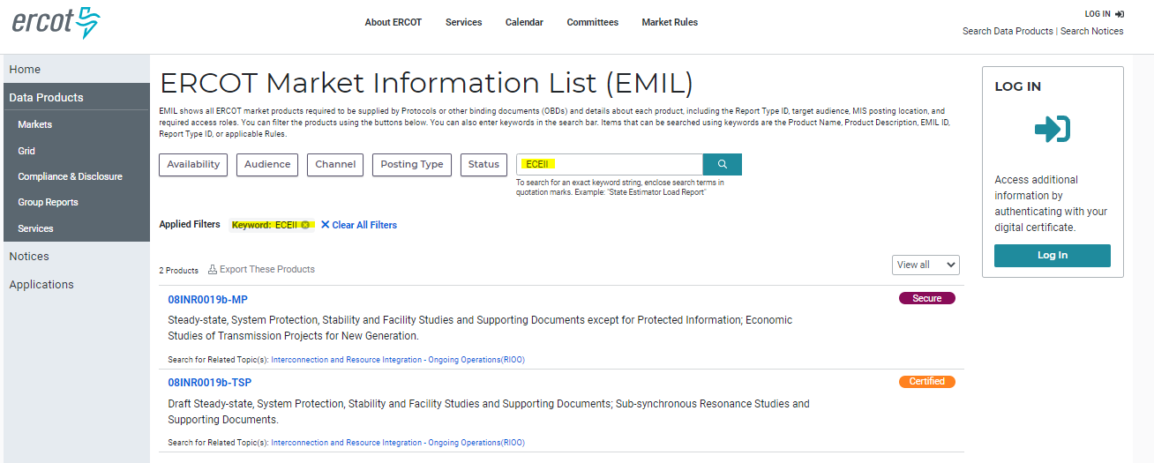
NPRR902 Implementation Workshop
MIS Secure/Certified Information Classified as ECEII
Using the ERCOT Market Information List (EMIL) (https://mis.ercot.com/public/), a user can locate all data products that have been identified as ECEII by entering ECEII in the Keyword search field. This will return all data products that have been flagged as ECEII (ECEII = Yes).

Slide 36
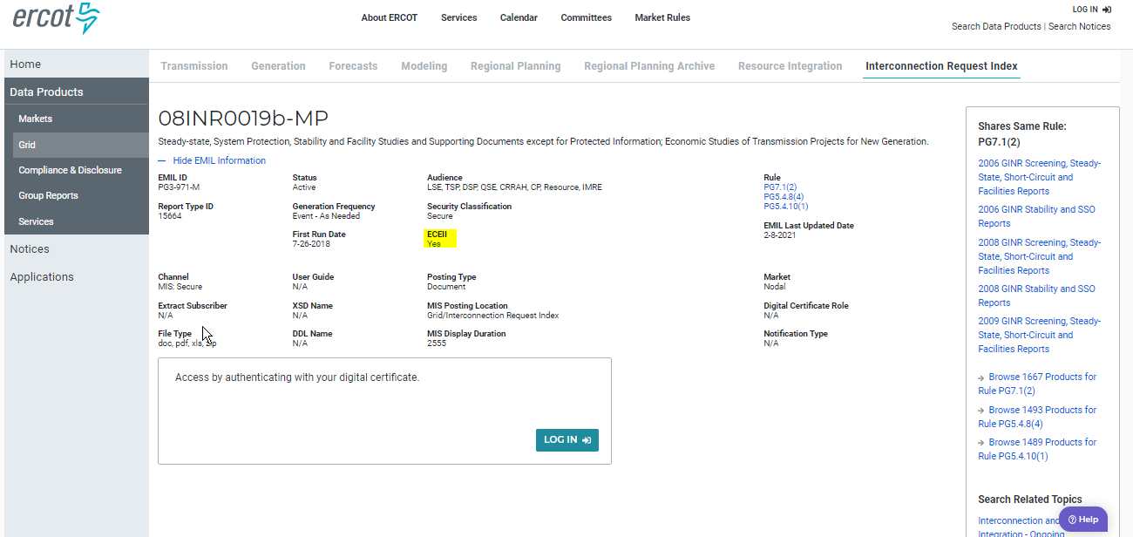
NPRR902 Implementation Workshop
MIS Secure/Certified Information Classified as ECEII
The ECEII flag is visible on the Data Product Details page.

Slide 37
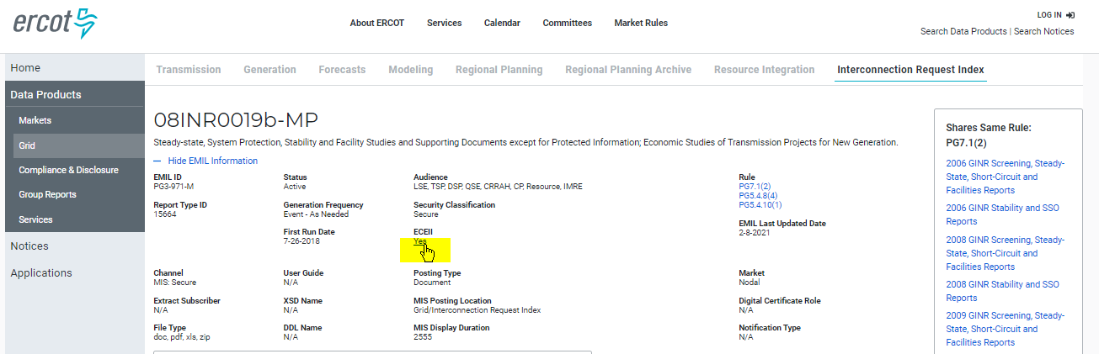
NPRR902 Implementation Workshop
MIS Secure/Certified Information Classified as ECEII
A user can also click on the ECEII flag ‘Yes’ indicator to view all ECEII data products.

Slide 38
Next Steps

Slide 39

NPRR902 Implementation Workshop
Next Steps
Get ready for full implementation (June 1, 2021)
  Market Notices 30 and 10 days before go-live
  Ability for USAs to assign ECEII role to Digital
  Certificates is now available
Follow-up Revision Requests to reclassify
non-ECEII on MIS Secure as Public
  As noted in the Revision Description for
  NPRR902, the MIS Secure Area was intended
  to be used for ERCOT to provide routine Market Participant access to information that is sensitive for security reasons – i.e., ECEII
  Goal is that MIS Secure Area will only house ECEII (for holders of ECEII-eligible Digital Certificates, the MIS Certified Area will still have both ECEII and non-ECEII)
Follow-up NPRR to expand and refine ECEII List (Section 1.3.2.1)
Continued discussions with stakeholders on ways to improve rules and possible tools to facilitate compliance

Slide 40
NPRR902 Implementation Workshop
Questions?

