Slide 1
ERCOT Winter Storm Review of Demand-Side Resources and Other Related Topics
ERCOT Staff
April 16, 2021 DSWG Meeting

Slide 2
ERS Fleet Performance – Loads and Generators
Note: the ERS fleet performance depicted above is a representation of the aggregate megawatts for ERS resources and does not reflect how they will be assessed for performance during each individual ERS deployment event.

Slide 3
ERS Fleet Performance – Loads and Generators
Monday February 15th, 2021 most significant day of ERS deployment and obligation during the Winter Event
The majority of the fleet is deployed and exhausted on the same day within 12 hours of the first deployment. A few ERS Loads remain obligated into subsequent days.
MW baseline significantly higher than MW actuals prior to first ERS VDI
Baselines account for what demand (MW) would have been under normal operating conditions for the day – most ERS Loads were consuming much lower than normal heading into the event
As an ERS fleet in aggregate, the response generally met or exceeded the aggregate obligation
EEA Level 3 forced outages start ~1:20am and remain in effect throughout the entire event day

Slide 4
ERS Fleet Performance – Load Only with WS
Note: the ERS fleet performance depicted above is a representation of the aggregate megawatts for ERS resources and does not reflect how they will be assessed for performance during each individual ERS deployment event.

Slide 5
ERS Fleet Performance – Load Only without WS
Note: the ERS fleet performance depicted above is a representation of the aggregate megawatts for ERS resources and does not reflect how they will be assessed for performance during each individual ERS deployment event.

Slide 6
ERS Fleet Performance – Load Only
Demand on Sunday February 14th, 2021 shows signs of load reduction prior to the first ERS deployment
Based on responses to ERCOT RFIs, this was driven by a number of factors including weather related issues, local TDSP outages, closed businesses due to weather, in response to conservation notices, and price response.
As a fleet in aggregate, ERS Loads generally over-provided relative to their combined obligation during the Winter Event
On average, fleet-level ERS Load reduction was 30%-35% above the combined fleet-level obligation during the first 12 hours after the first deployment (prior to majority of ERS Load fleet exhaustion)
Preliminary analysis indicates ERS Load portfolios also performed relatively well during the individual deployment events
ERS Loads experiencing forced outages generally performed successfully relative to their baselines and obligations
Loads still provide reduction during forced outages as their demand goes to zero, which may have also contributed to over-provision

Slide 7
ERS Fleet Performance – Generator Only
Note: the ERS fleet performance depicted above is a representation of the aggregate megawatts for ERS resources and does not reflect how they will be assessed for performance during each individual ERS deployment event.

Slide 8
ERS Fleet Performance – Generator Only
Activity on Sunday February 14th, 2021 shows export from ERS Generators prior to the first ERS deployment
As a fleet in aggregate, ERS Generators generally failed to meet their combined obligation during the Winter Event
On average, fleet-level ERS Generator exports were 50%-55% below the combined fleet-level obligation during the first 12 hours after the first deployment (prior to exhaustion of the ERS Generator fleet)
Based on responses to ERCOT RFIs, supply constraints, refueling issues, and forced outages were the primary factors affecting performance
Unlike ERS Loads, ERS Generators experiencing forced outages generally failed to perform relative to their obligations
Generators are unable to perform (export) for ERS during forced outages
Even prior to the forced outages, the ERS Generator Fleet was only meeting 70%-75% of its combined obligation

Slide 9
Lessons learned – ERS
Review Weather-Sensitive limitations on deployments based on Winter event
Discuss and add clarifying language related to ERS Renewal start date
Discuss modification/elimination of scheduled unavailability / planned maintenance
Discuss whether certain types of Loads should be prohibited from ERS participation and, if so, who should be responsible for managing prohibition

Slide 10
Non-Controllable Load Resource Event Timeline
Feb. 15th
01:09 – VDI deploying Groups 1 and 2
01:11 – XML deploying Groups 1 and 2
01:49 – Frequency drops below 59.7Hz
60 MW of obligated, undeployed LRs trip off
02:05 – XML hourly XML to all resources sustaining deployment
02:09:48 – XML recalling most LRs
02:16:12 – XML recalling the remaining LRs
Both recall instructions due to miscommunication within ERCOT Control Room

Slide 11
Non-Controllable Load Resource Event Timeline
Feb. 15th Continued…
04:17:02 – XML deploying Group 1
04:20:50 – XML recalling Group 1 and deploying Group 2
04:26:18 – XML deploying Group 1 and redeploying Group 2
All Load Resources deployed
05:05 – Hourly XML to all resources sustaining deployment
Repeated until recall
Feb. 19th
09:01:28 – VDI recalling all Load Resources
09:05:02 – XML recalling all Load Resources

Slide 12
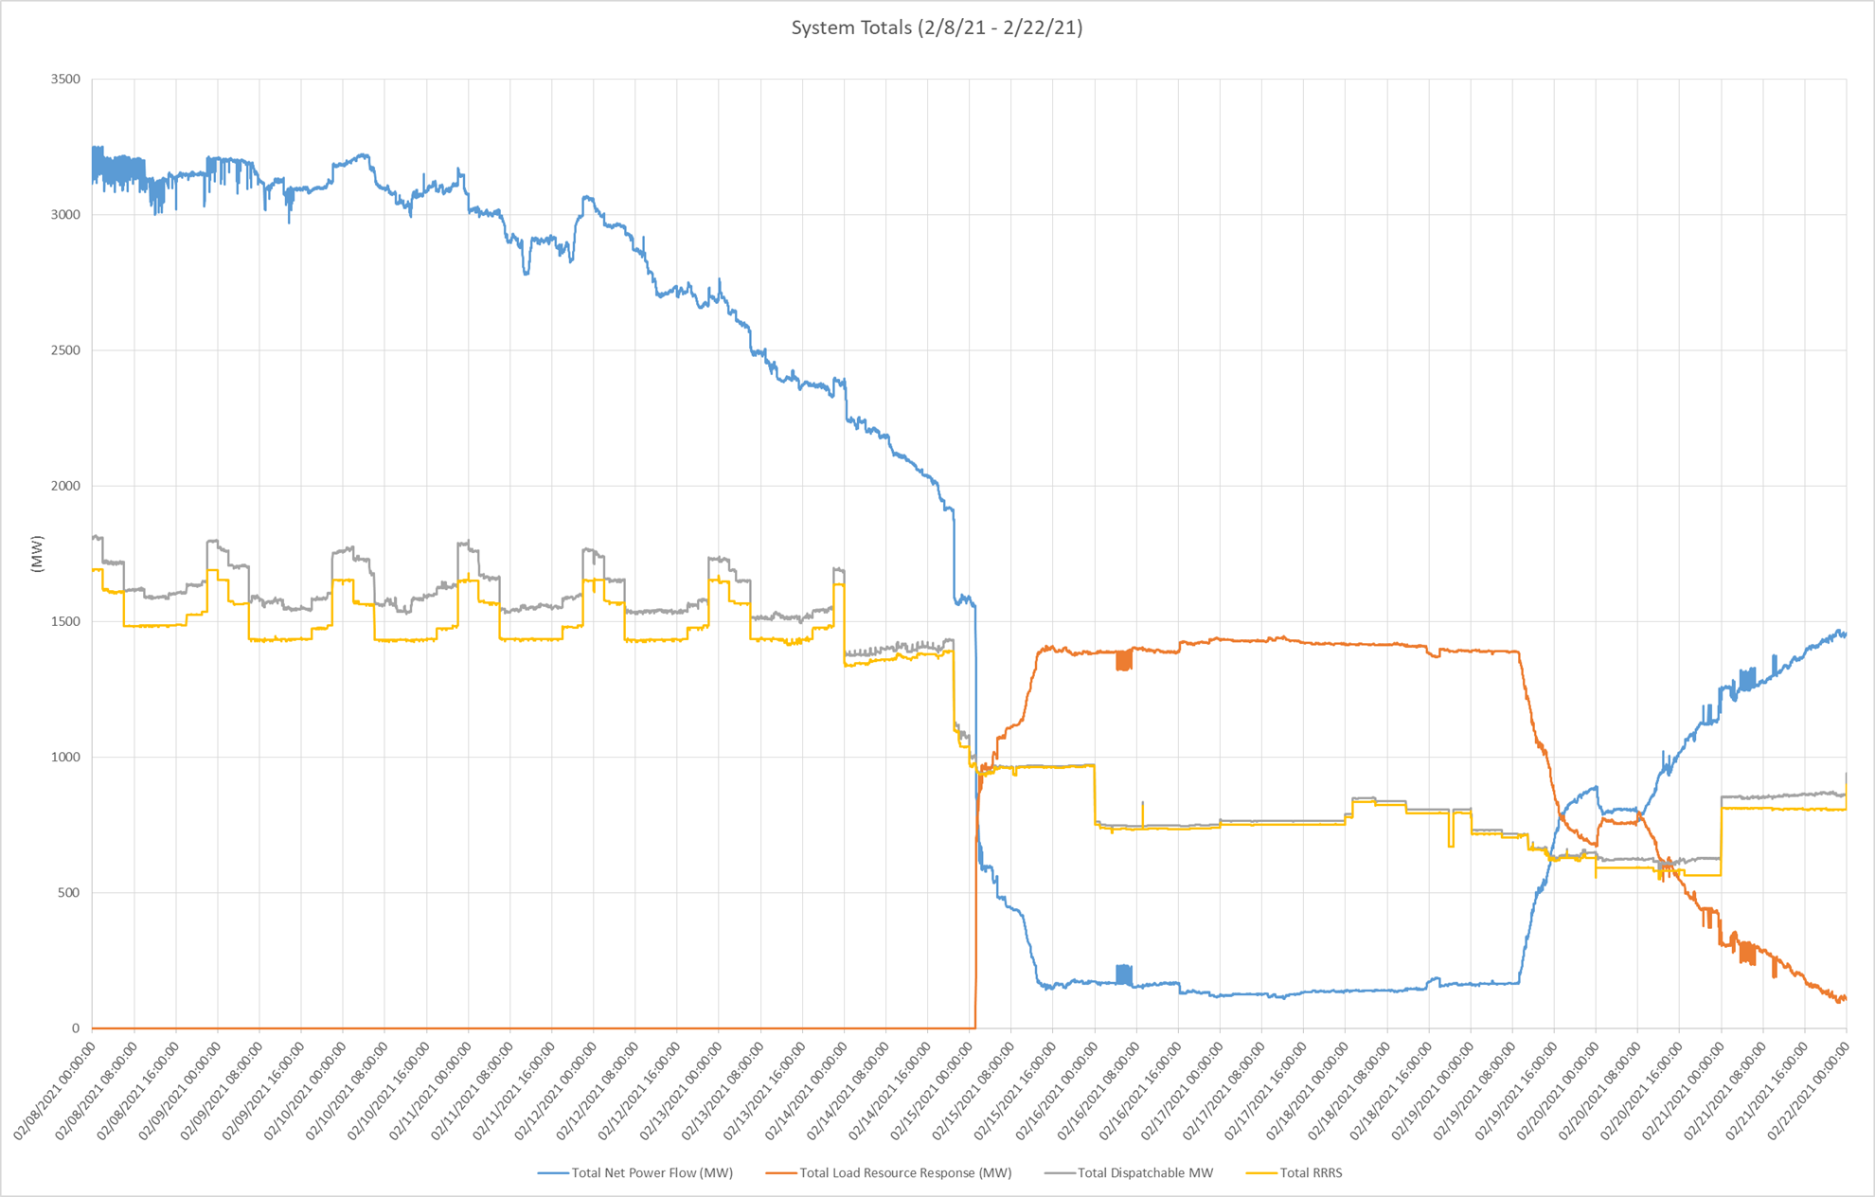
Load Resource Response

Slide 13
Load Resource Response
Load Resources load level starts declining on Feb. 12th
List of reasoning based on RFI responses
Controls affected by extreme cold temperatures resulting in shut down of processes
TDSP outages affected LRs ability to return to operation and therefore meet their AS responsibility
Extreme temperatures affected various fluids in the processes resulting in equipment failures
Lack of raw materials during event impacted ability to make final products
Fuel supply issues to back up generation
Telemetry issues prevented remote control of loads
Loss of other essential utilities resulting in shutdown
Some oil production sites rely on trucking options to move oil and water. These were limited due to weather conditions and in some cases sites had to be shut down
Supplier limitations were not able to respond and provide assistance when needed to restore processes
Load Resources still not at pre-event load levels by Feb. 22nd

Slide 14
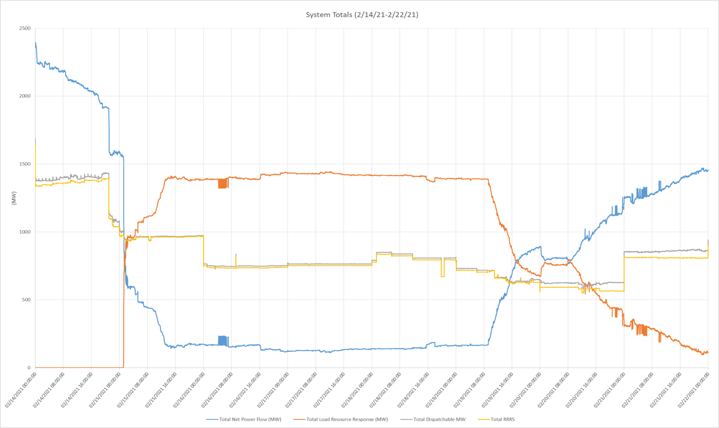
Load Resource Response

Slide 15
Load Resource Response
Initial response did not meet 10 minute requirement
~70% in 10 minutes
Total response
~130% sustained response during event based on telemetered responsibility at VDI
~97% sustained response during event based on telemetered responsibility at on Feb. 14th
Several Failures at QSE level requiring resource level performance evaluation
NPC-LPC less than RRS obligation for many resources leading up to event
Oscillations during event due to telemetry issues

Slide 16
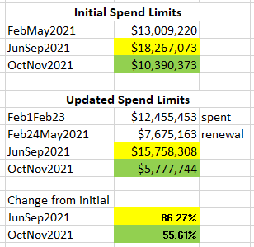
Review of ERS RFP for Jun-Sep SCT
$12,455,453
$7,675,163
Note: Offers for all subsequent SCTs in 2021 need to take into consideration the reduced spend limits

