Slide 1
TDTMS Update
RMS
Sheri Wiegand, TDTMS Leadership
April 14th, 2021

Slide 2
TDTMS
Update
Decommissioning for TLS 1.0 is planned for early Q2 with 10-day market notice
MarkeTrak performance remains basically solid – only miss was API Query
May Retail Release – extended outage – commencing Saturday, May 1st @ 2PM impacting same day enrollments from 2PM – 7PM. Oncor, AEP, and TNMP will accept safety-net MVIs on AMSR meters via CRIP/REP Desk portals
Discussion of ERCOT MIS API functionality w/ ability to view via API as is in the GUI
All system SLAs are met – only on 2/4 were 814_20s held
Review of Switch Hold Removal Required Documents – DRAFT RMGRR is forthcoming – i.e. required fields and noting Warranty Deed is not acceptable documentation
Briefly reviewed DRAFT SCR for Administrative MarkeTrak Enhancements – ERCOT reviewing now

Slide 3
TDTMS
MarkeTrak Subtype Review – YE 2020

Slide 4
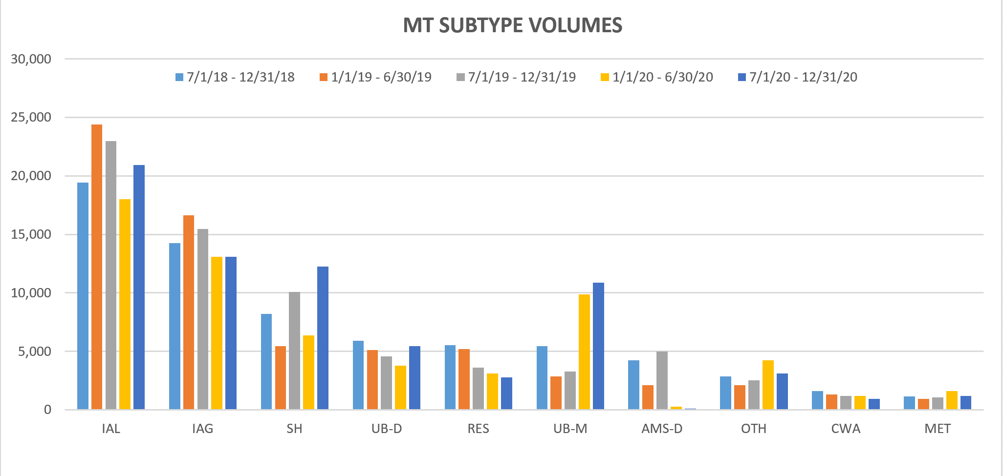
TDTMS
MarkeTrak Subtype Review – YE 2020
Market Rule still elevated as ERP concluded in Q3 2020
Higher volume of Switch Hold Removals resulting from ERP conclusion and offering of DPPs
Drop in AMS LSE Disputes with improved data quality of LSE files
D2D activity opened up later in 2020 potentially contributing to higher volume of IAGs/IALs
Market participant stabilization period post system conversion continued into latter half of 2020 with increased volume of U&B – Missing and Siebel Changes

Slide 5
TDTMS
ERCOT’s IAG report from December 2020 stats
Notables from report:
Volume of IALs are up and have been increasing over the last couple of years
Offenders (REPs with higher percentage of IAGs to transactions) remain the same as some REPs have continuously maintained percentages > 1% for an entire year
Switch/Enrollment activity has increased toward the end of 2020, likely a result of COVID impacts

Slide 6
TDTMS
Inadvertent Gain - Unexecutable Subtype Analysis
~44,000 IAS MTs, from July 2019 to July 2020 were reviewed to determine:
Primary reasons for Unexecutable – IAGs, IALs, and Rescissions
Breaking down time required for each transition to provide insight into opportunities for efficiency

Slide 7
TDTMS
Inadvertent Gain - Unexecutable Subtype Timeline Analysis
Breaking down time required for each transition to provide insight into opportunities for efficiency

Slide 8
TDTMS
Next Meeting – April 23rd, Friday @ 9:30 WebEx
On the Agenda:
May Retail Release – final logistics
System instances and MarkeTrak Monthly Performance Review
Follow Up on ERCOT MIS API Functionality
Switch Hold Removal Required Documents
DRAFT SCR Switch Hold Repository
DRAFT SCR Administrative MT Enhancements
MT Subtype Analysis – Data Requirements

