Slide 1
Feb 2021 Winter Event
RRS Deployment
PRC
Non FME Reports
April 8, 2021
PDCWG

Slide 2
RRS Deployment Data

Slide 3
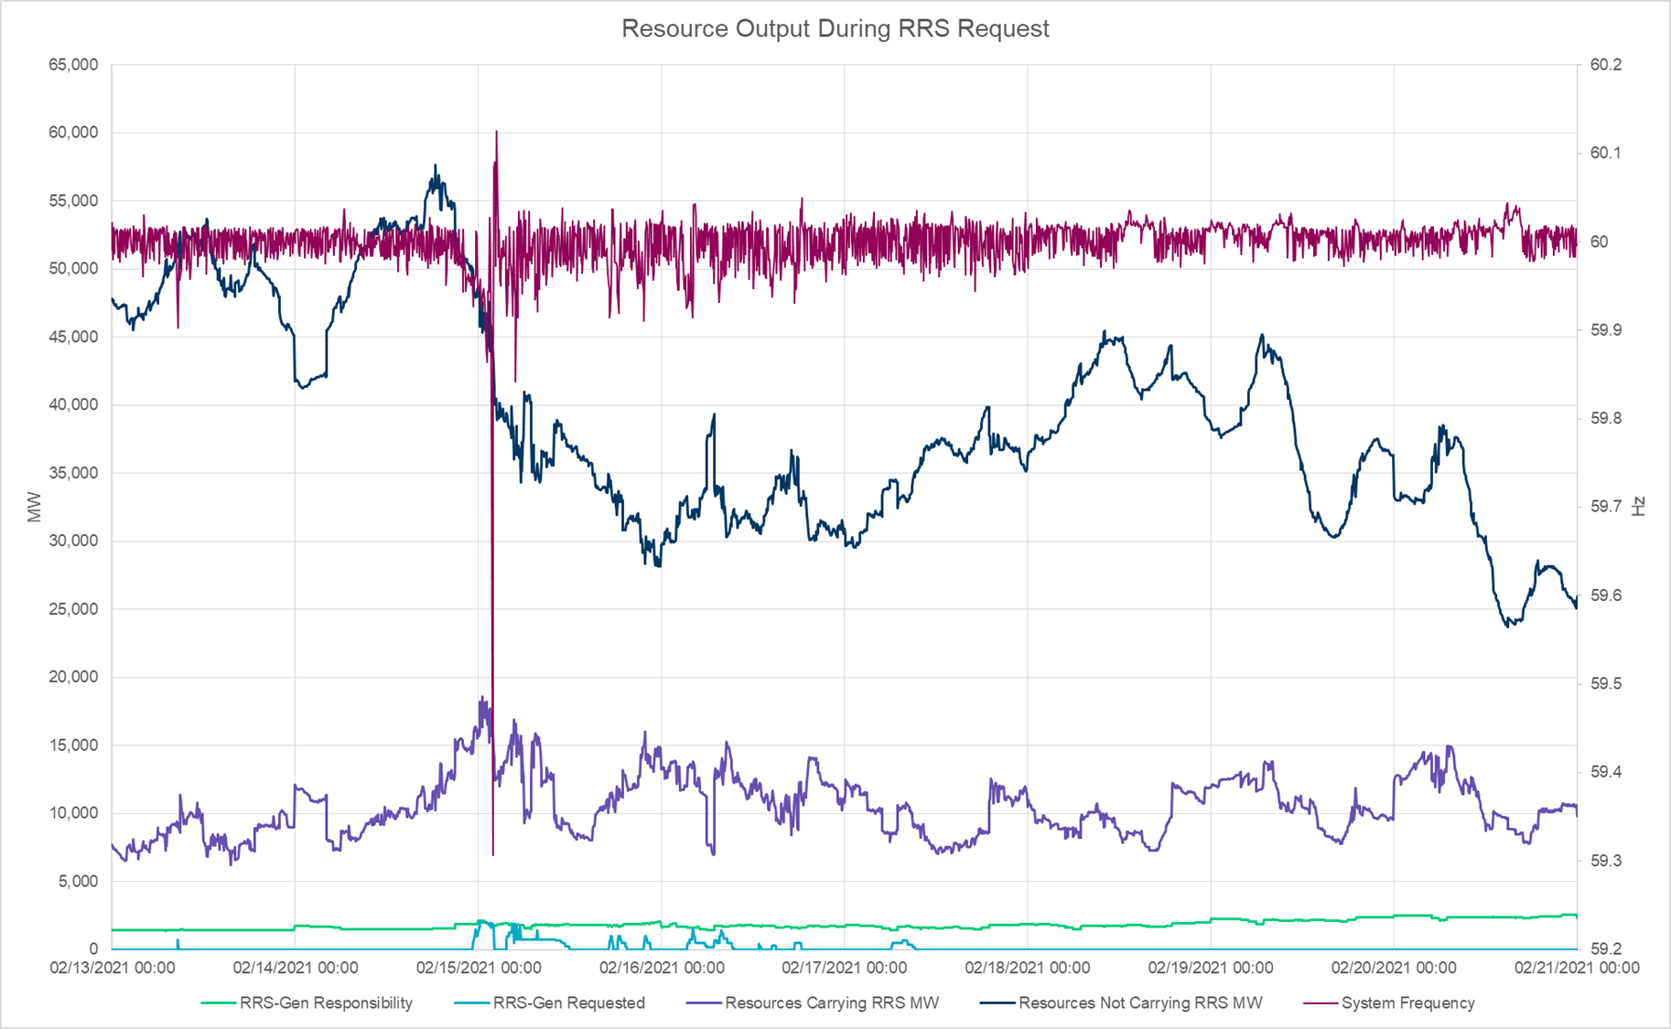
Output of RRS Providers and Non-RRS Providers During Feb 13-20

Slide 4
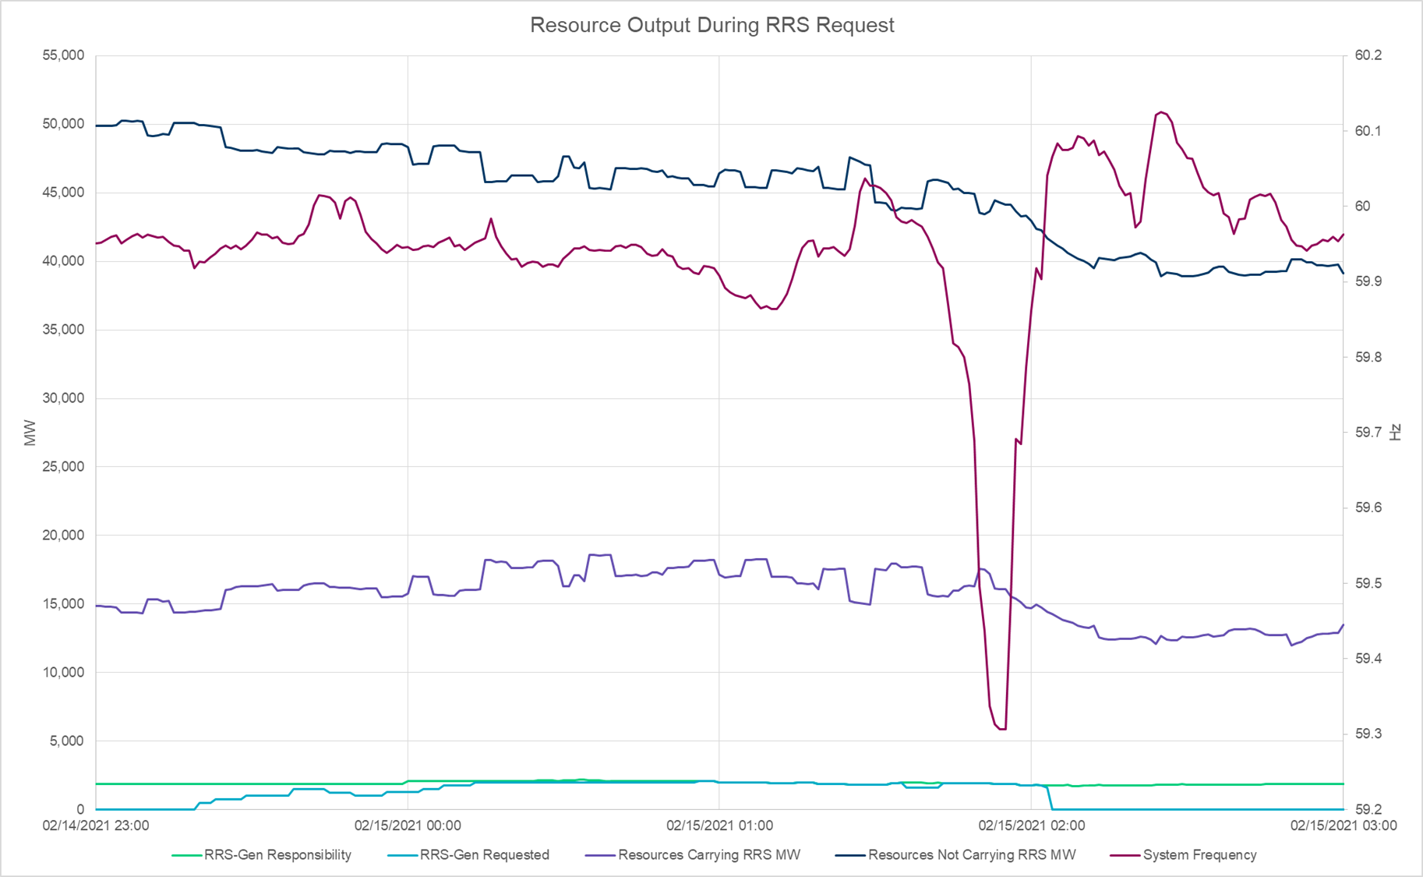
Output of RRS Providers and Non-RRS Providers During Feb 15th Low Frequency Event

Slide 5
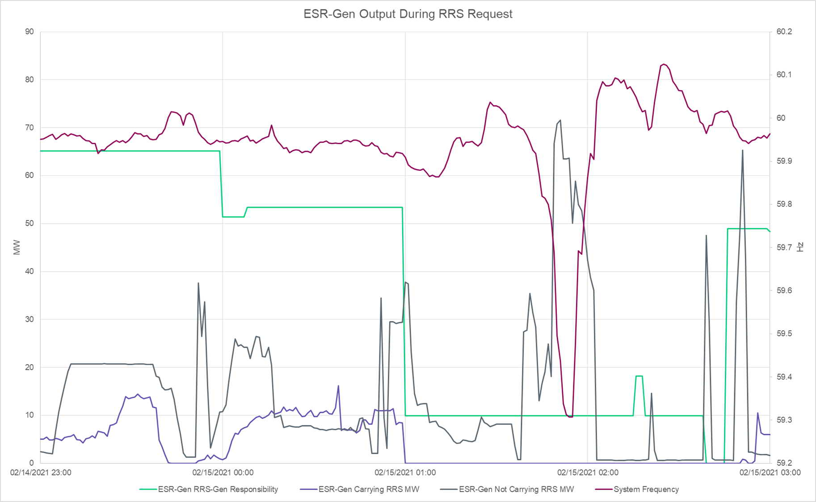
Output of ESR-Generators During Feb 15th Low Frequency Event

Slide 6
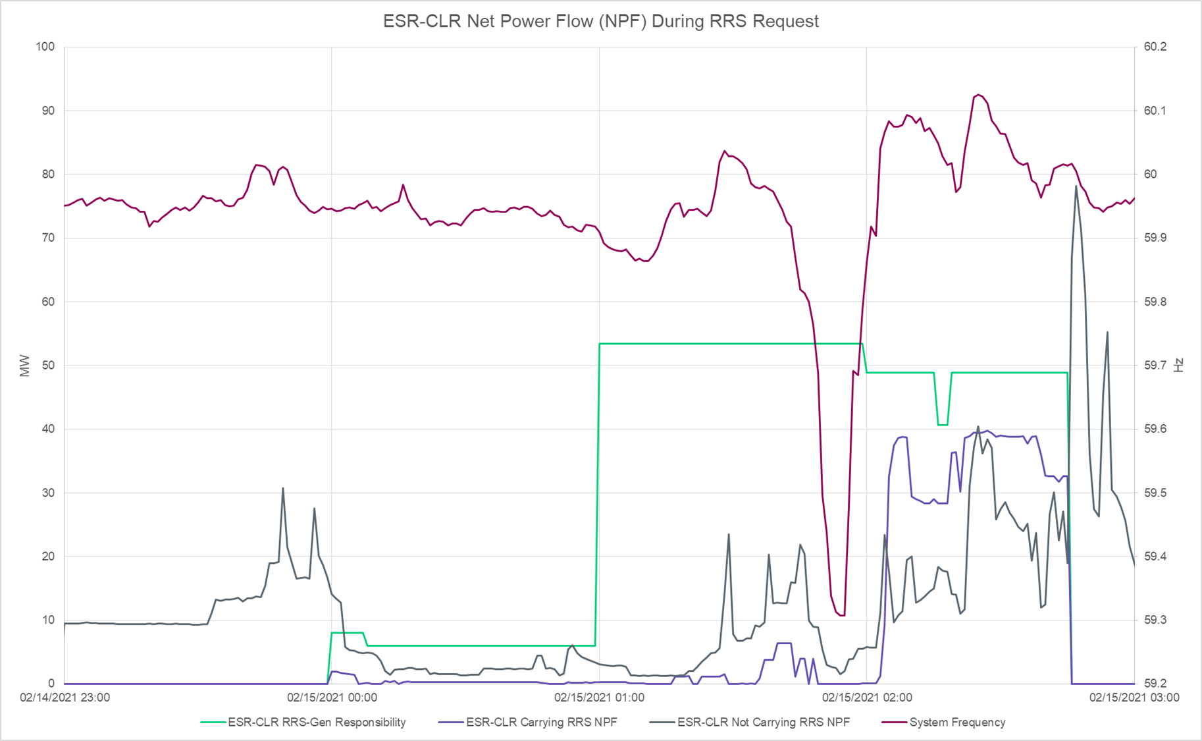
Net Power Flow (NPF) of ESR-CLRs During Feb 15th Low Frequency Event

Slide 7
Review Of PRC During Feb 15 Early Morning

Slide 8
Physically Responsive Capacity (PRC)
PRC is a representation of the total amount of frequency responsive Resource capability On-Line in Real-Time. Per Nodal Protocol Section 6.5.7.5, PRC is the sum of 7 components
PRC = PRC₁ + PRC₂ + PRC₃ + PRC₄ + PRC₅ + PRC₆ + PRC₇
PRC₁: maximum of 20% of an On-Line Generation Resource’s
frequency responsive headroom.
PRC₂: maximum of 20% of an On-Line Wind Generation Resource’s (WGR)
headroom. Only WGRs with PFR capability are included.
PRC₃: hydro-synchronous condenser headroom
PRC₄: RRS supplied from Load Resources controlled by high-set
under-frequency relay
PRC₅: capacity from Controllable Load Resources active in SCED and
carrying Ancillary Service Resource Responsibility
PRC₆: capacity from Controllable Load Resources active in SCED and
carrying Ancillary Service Resource Responsibility
PRC₇: capacity from Resources providing FFR
PRC from Generation
PRC from Hydro
PRC from Load Resource

Slide 9
PRC Composition during 1 am hour on Feb 15
Monday Feb 15, 2021

Slide 10
PRC Review Summary between 1:23 and 1:55 on Feb 15
Analysis was conducted on the 20 Generation Resources that were on an average contributing more than 10 MW to PRCGen contributing a between 678 MW to 1088 MW to PRCGen during this timeframe.
These Generation Resources were either experiencing operational issues and were in the process of ramping down or tripping but hadn’t updated their HSL thus making it look like there was frequency responsive headroom OR
were operating at/near the top of their capability and were telemetering HSLs that made it look like there may be frequency responsive headroom.
It is estimated that at any given time, between 520 MW and 950 MW of PRC that was being accounted from these resources was incorrect/unavailable.

Slide 11
Non Fme Report

Slide 12
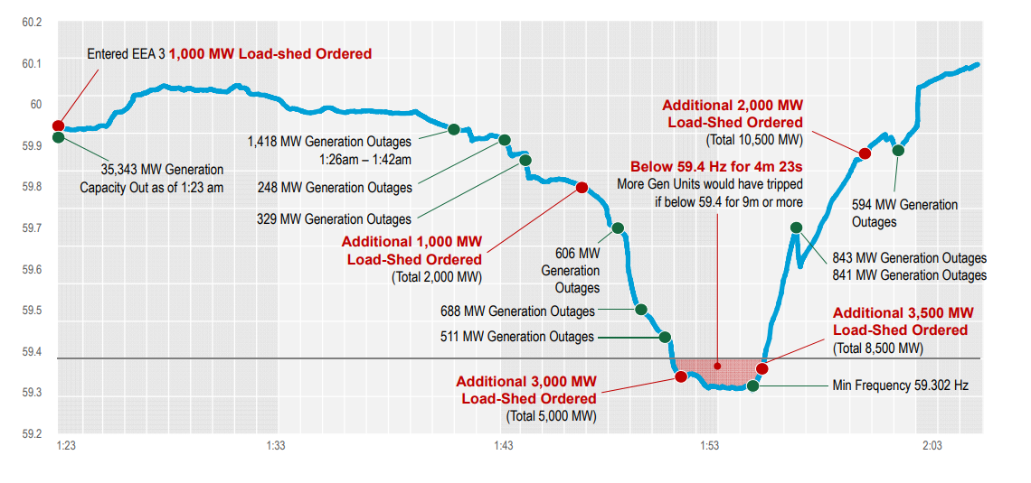
Rapid Decrease in Generation Causes Frequency Drop

Slide 13
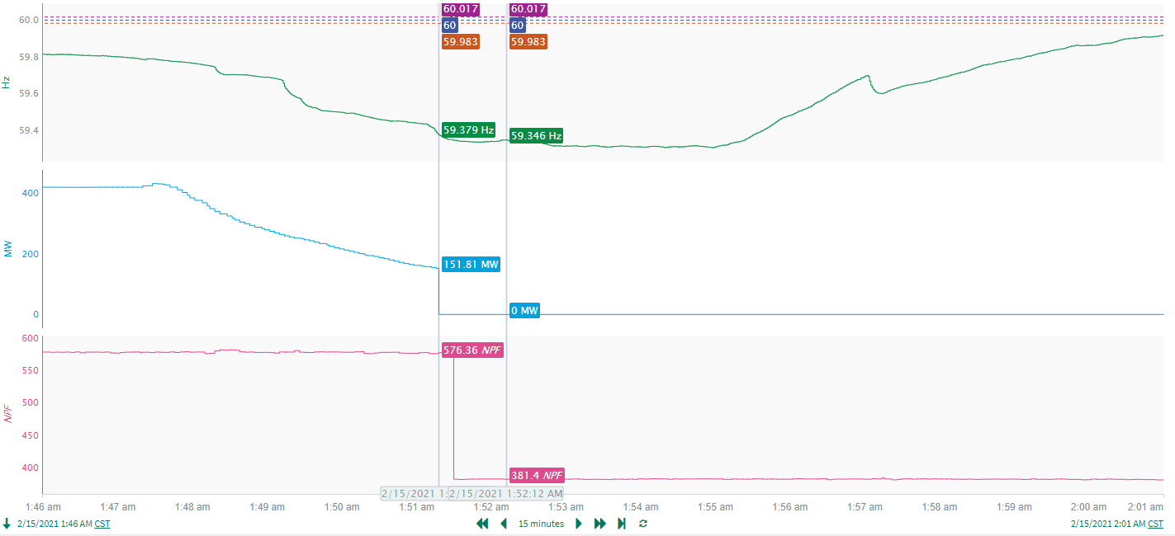
Non-FME @ 1:51:17
Tripped Resource#1
Tripped Resource#2
Notes:
Resource1 experienced a run-back while carrying 430.75 MW. Loss of 151.81 MW when the unit tripped offline.
Resource2 experienced a partial trip of 195MW while carrying 582.8 MW.
Starting Frequency: 59.379 Hz
Trip Reason:
Resource1: Tripped due to frozen sensing line providing control signal to main boiler feed pump.
Resource2 : Instrumentation/controls failure.

Slide 14
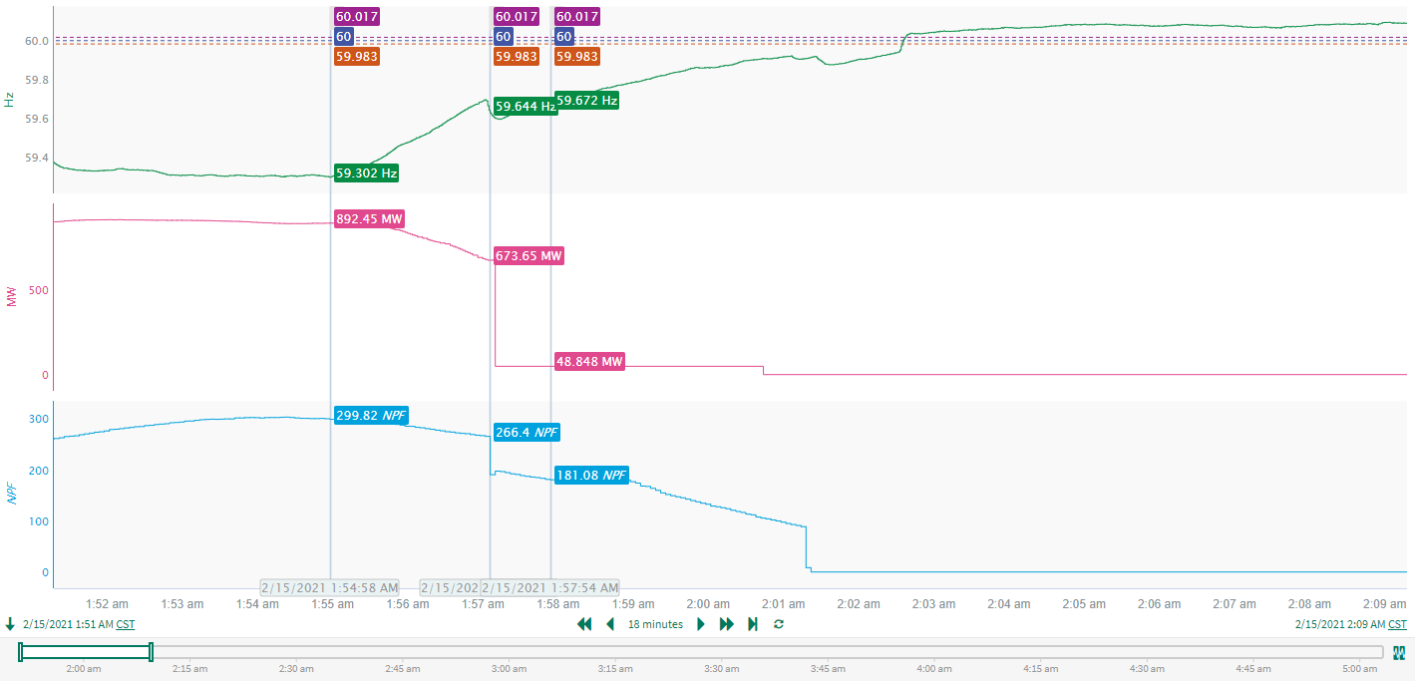
Non-FME @ 1:57:05 (The event after 59.3Hz)
Tripped Resource#1
Tripped Resource#2
Notes:
Resource 1 experienced run back while carrying 890 MW. Loss of 674.92 MW when unit tripped offline.
Resource 2 experienced a partial trip of 68 MW while carrying 266.4 MW.
Starting Frequency: 59.644 Hz
Trip Reason:
Resource 1 : Significant frequency changes impacting plant systems.
Resource 2 : Tripped due to instrumentation/controls failure.

