Slide 1
ERCOT Frequency Control Report
March 2021
ERCOT
Operations Planning
PDCWG | April 8th, 2021

Slide 2
Summary of March 2021
CPS1: 166.89%
Current CPS1 12-Month Rolling Average: 169.30%
3 BAAL Exceedance(s)
6 hourly CPS1 score below 100%
BAAL-003 Events have updated through 2019
2019 BAAL-003 FRM Performance: -811.14
2021 RMS1 Statistics
Mean: 17.01 mHz
Min: 12.01 mHz
Max: 60.59 mHz
Energy Statistics
Total Energy: 27,223,416 MWh
Wind Energy: 10,485,979 MWh
Percent Energy from Wind: 38.52%
Solar Energy: 10,410,55 MWh
Percent Energy from Solar: 3.82%
Minimum System Inertia
Mean: 132,989 MW*s
Max: 188,463 MW*s on Mar 19th
Min: 109,029 MW*s on Mar 22nd
Notes:
2018 BAAL-003 FRM Performance: -843.17

Slide 3
Frequency Control
CPS1, BAAL, & RMS1

Slide 4
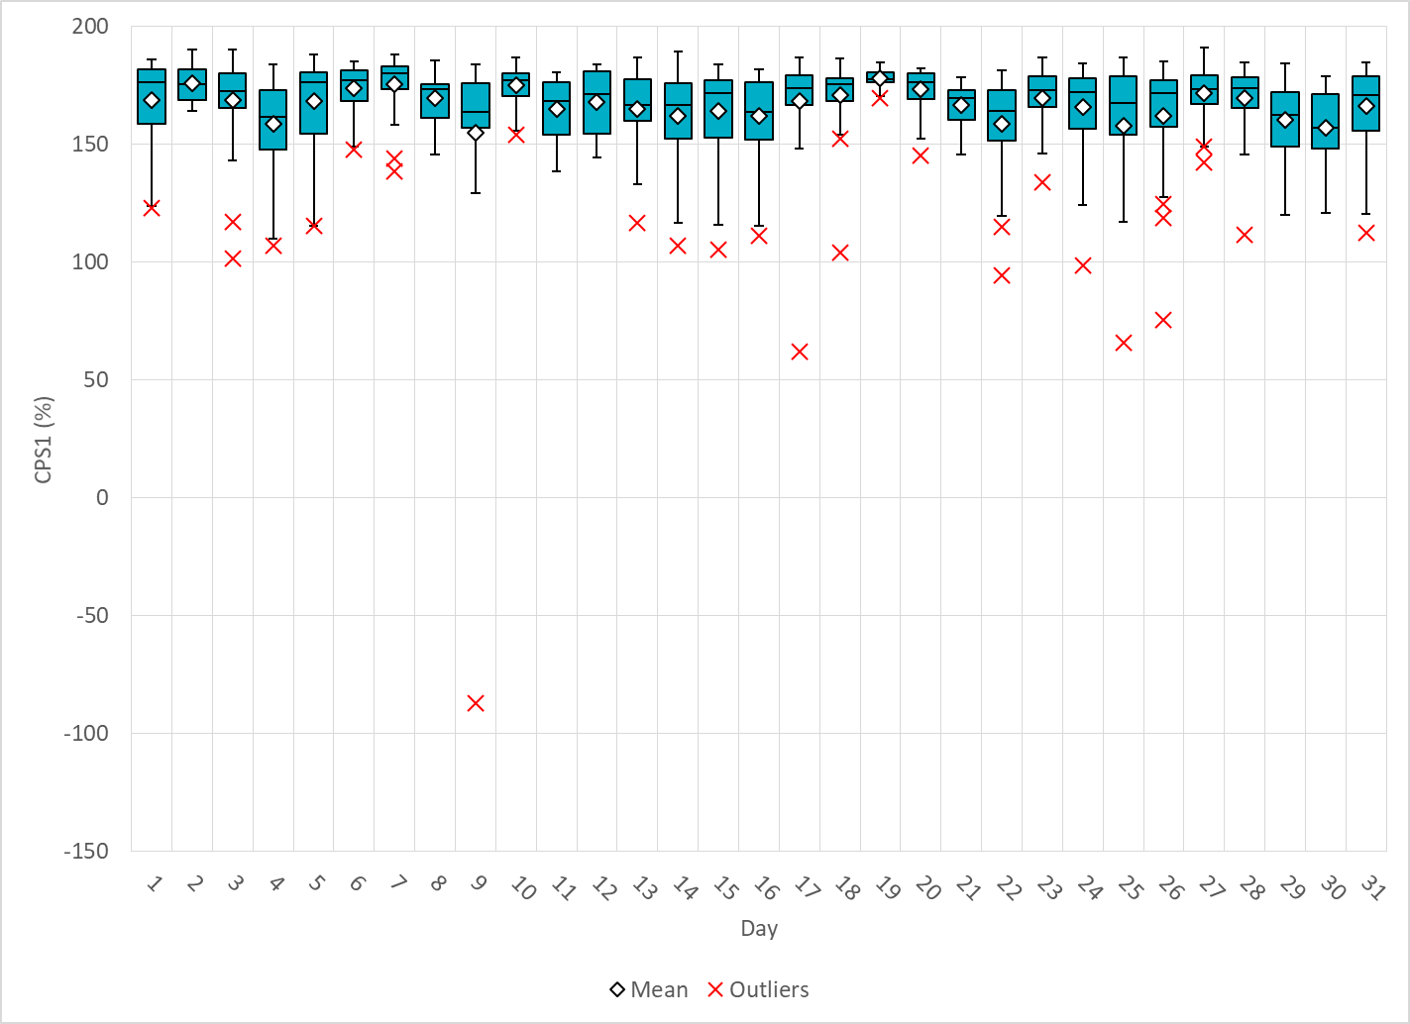
Hourly CPS1 by Day
Mar-21 CPS1 (%): 166.89
Notes:
-87.3.04% @ 03/09/2021 16:00
Expected Generation Deviation
Expected gen dev remained negative for most of the hour. The largest expected gen dev was -700 MW @ 16:09 mostly due to wind and solar.
IRR Ramps
Wind generation consistently ramped down during first half of the hour from 20800 MW to 19350 MW (1450 MW). During the later half of the hour, solar was ramping down for the day.
Regulation: Regulation up exhausted during the period of negative expected gen. dev.
Other
SCED was run manually multiple times. Manual offset of 250 MW @ 16:24, 500 MW @ 16:29, 650 MW @ 16:37, 1000 MW @ 16:50
A total of 715.98 MW of RRS was deployed at 16:33
2. 62.08% @ 03/17/2021 17:00
Expected Generation Deviation
Expected gen dev remained negative for most of the hour. The largest expected gen dev was -1700 MW @ 17:53, mostly due to wind and solar.
IRR Ramps
Wind generation consistently ramped down throughout the hour from 19470 MW to 17534 MW (1936 MW). The largest down ramp was -393MW/5 Min. Coincides with the solar ramp down of about 1380 MW.
Regulation: Regulation up exhausted during the period of negative expected gen. dev.
Other
Manual offset of 250 MW was applied at 17:49.
3. 94.22% @ 03/22/2021 16:00
Expected Generation Deviation
The Expected gen dev was negative throughout the hour. The largest expected generation dev was -2336 MW @ 16:47, mostly due to wind ramp down.
IRR Ramps
Wind generation was on down ramp throughout the hour from 18100 MW to 14454 MW (3646 MW). The largest down ramp of 615 MW/5 Min between 16:45 and 16:50.
Solar ramped down by about 600 MW during the first half of the hour
Regulation: Regulation up was exhausted for during the period of negative expected gen dev.
Other
Manual offset of 200 MW was applied @ 16:45.
4. 98.64% @ 3/24/2021 23:00
Expected Generation Deviation
The Expected gen dev is negative during the periods of wind ramp down. The largest expected gen dev was -2380MW @ 23:07.
IRR Ramps
Wind generation was on down ramp for most part of the hour. The largest ramp down of 480 MW/5 Min between 23:05 to 23:10 and 468 MW/5 Min between 23:45 and 23:50.
Regulation: Regulation down exhausted during the period of negative expected gen dev.
5. 65.75% @ 03/25/2021 00:00
Expected Generation Deviation
The Expected gen dev was negative during the later half of the hour. The largest expected generation dev was -2600MW @ 00:58, mostly due to wind ramp down.
IRR Ramps
Wind generation was on down ramp from 12495 MW to 10765 MW (1730 MW) between 00:45 and 01:00. The largest down ramp of 535 MW/5 Min between 00:55 and 01:00.
Regulation: Regulation up was exhausted for during the period of negative expected gen dev.
Other
Manual offset of 350 MW was applied @ 00:58 and a total of 644 MW of RRS was requested at 00:59.
6. 75.65% @ 03/26/2021 23:00
Unit Derates/Trips
Several large thermal resources came offline during this hour.
Expected Generation Deviation
The largest expected generation dev was -1722 MW @ 23:55, mostly due to the thermal resources coming offline.
Regulation: Regulation up was exhausted for during the period of negative expected gen dev.
Other
SCED was run multiple times. Manual offset of 500 MW was applied @ 23:10 and 700 MW @23:12.
A total of 662 MW of RRS was requested at 23:10.

Slide 5
BAAL Exceedances & Violations
There were 3 BAAL exceedance(s) in Mar
Notes:
Occurred on 03/09/2021 (2) and 3/30/2021 (1)

Slide 6
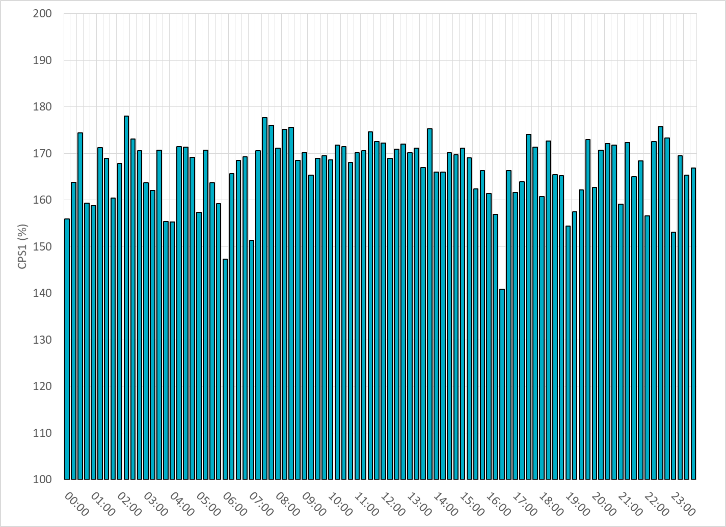
15-Minute Average CPS1%
Mar-21 CPS1 (%): 166.89

Slide 7
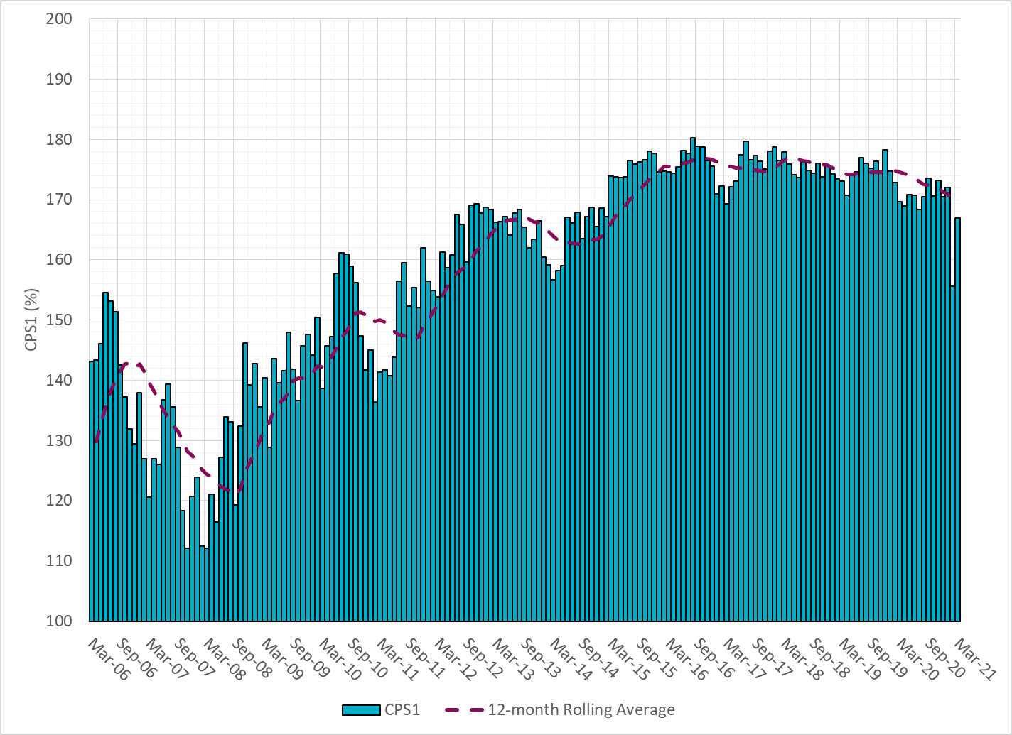
12-Month Rolling Average CPS1
Current 12-Month Rolling Average: 169.30%

Slide 8
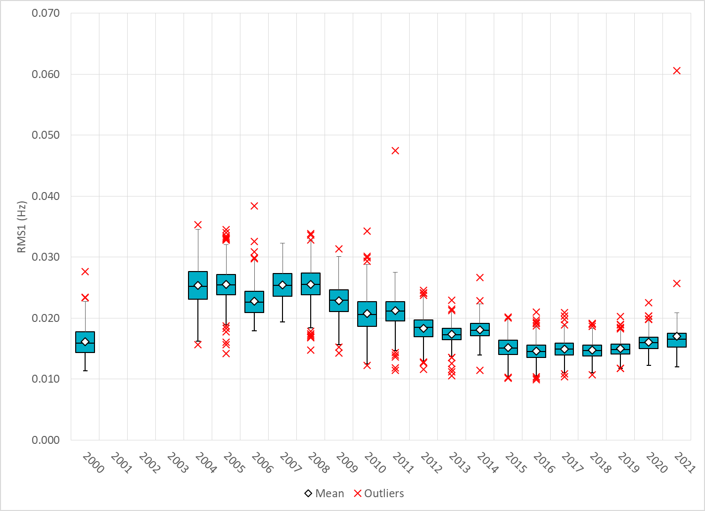
Daily RMS1 of ERCOT Frequency by Year
Notes:
Mean: 17.01 mHz
Min: 12.01 mHz
Max: 60.59 mHz

Slide 9
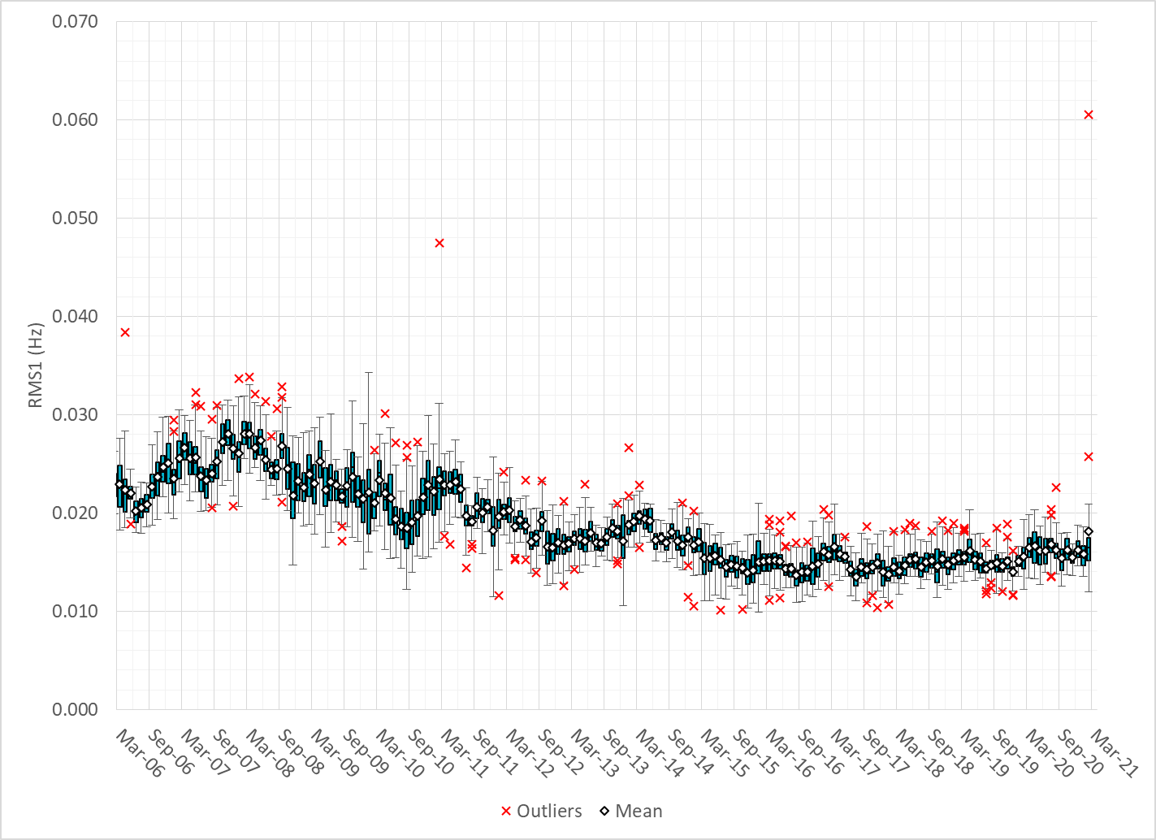
Daily RMS1 of ERCOT Frequency by Month

Slide 10
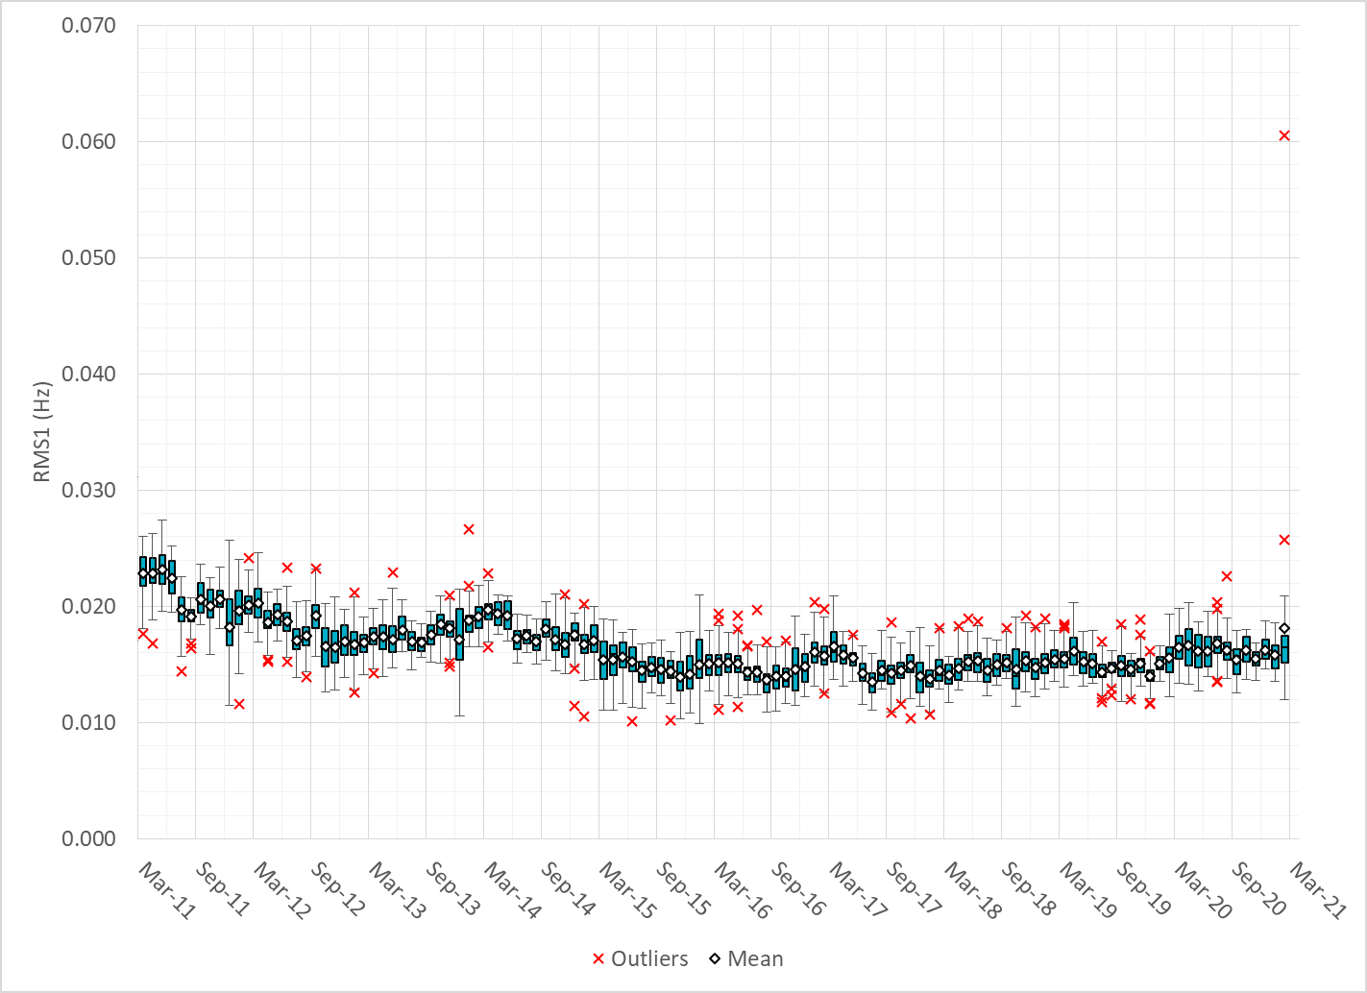
Daily RMS1 of ERCOT Frequency by Month

Slide 11
Frequency Profile Comparison

Slide 12
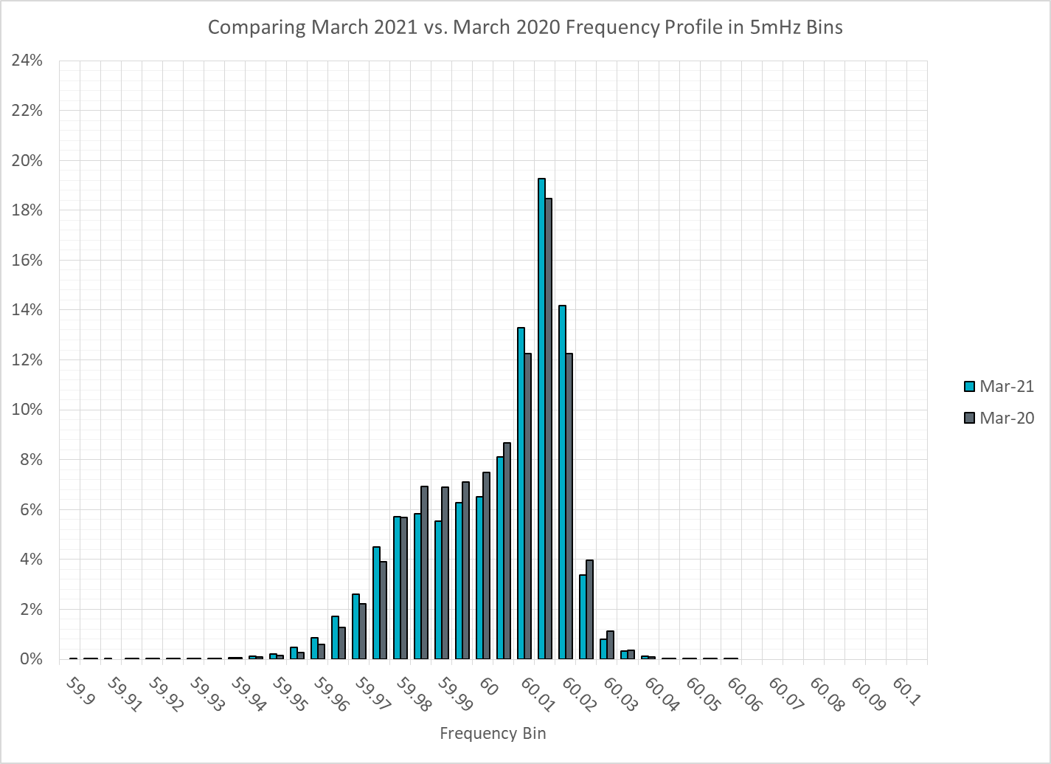
Frequency Profile Comparison

Slide 13
Frequency Profile Comparison

Slide 14
Time Error Correction

Slide 15
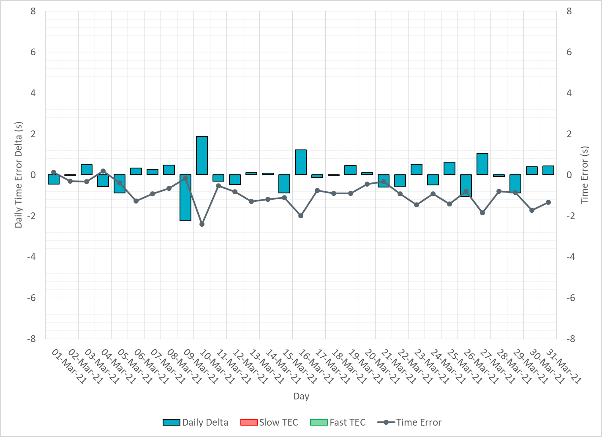
ERCOT Daily Time Error

Slide 16
Time Error Corrections Log Summary
There have been no time error corrections since December 2016

Slide 17
BAL-003 Performance

Slide 18
Op. Year 2019 BAL-003 Selected Events – Update
Notes:
BAL-003

Slide 19
Op. Year 2019 BAL-003 FRM Performance - Update
Notes:
OP2018: FRO = -381.0, FRM_median = -843.17, FRM_average = -959.7
OP2019: FRO = -381.0, FRM_median = -811.14, FRM_average = -892.5
OP2020: FRO = -425.0,

Slide 20
ERCOT Energy Statistics

Slide 21
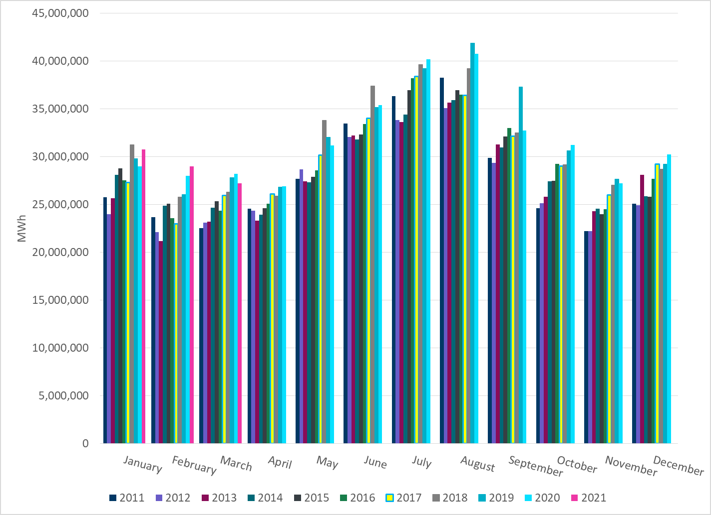
Total Energy
Notes:
27,223,416 MWh

Slide 22
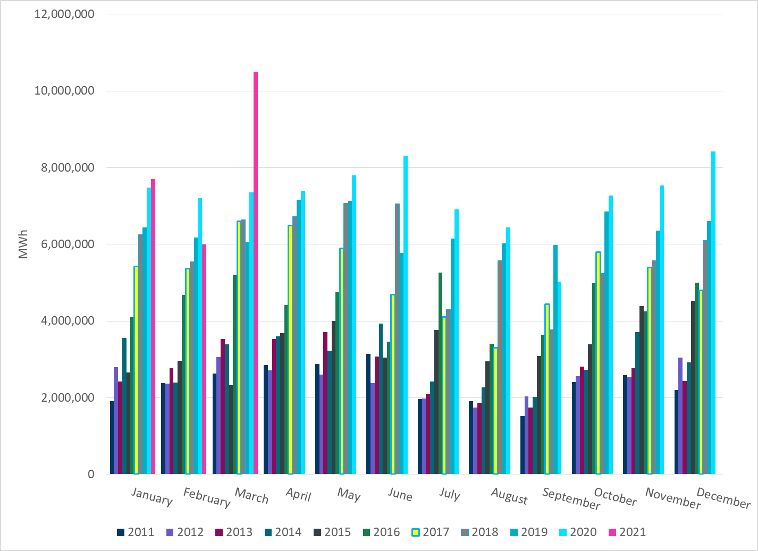
Total Energy from Wind Generation
Notes:
10,485,979 MWh

Slide 23
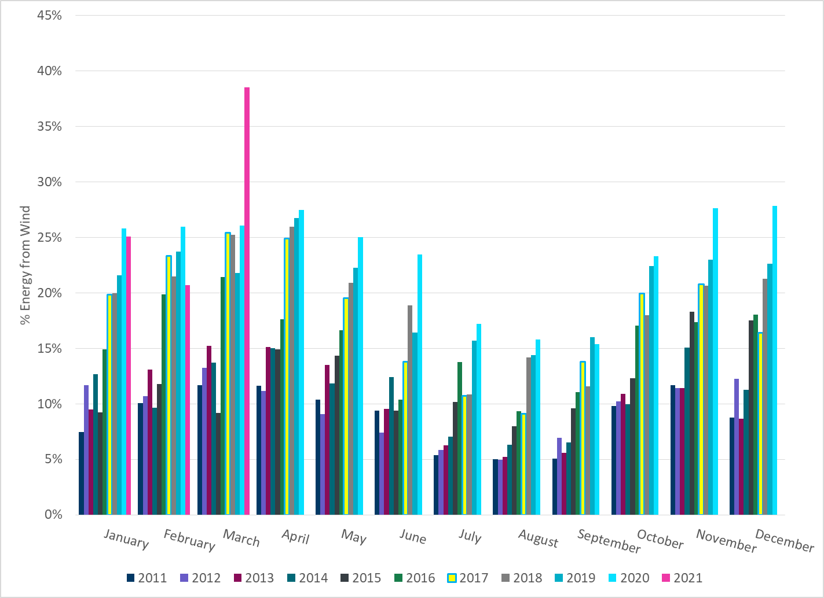
% Energy from Wind Generation
Notes:
38.52%

Slide 24
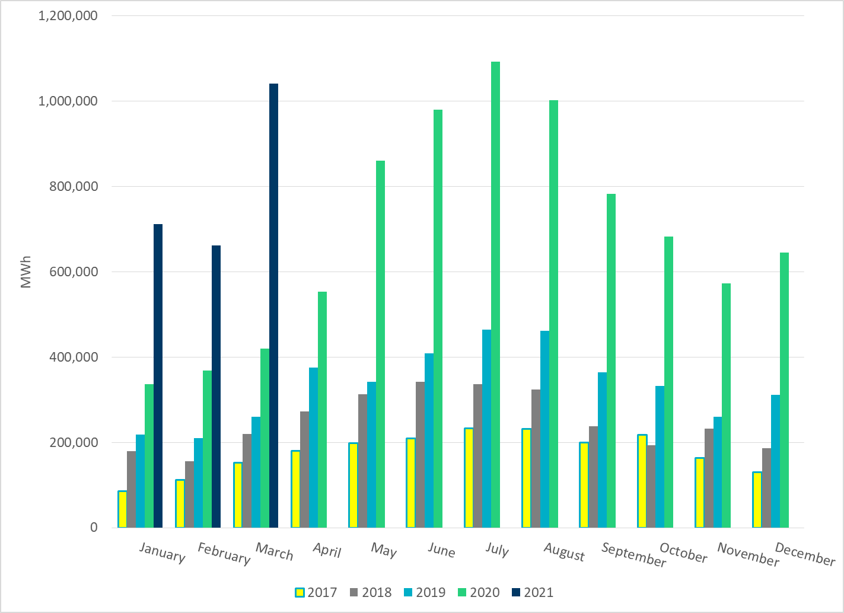
Total Energy From Solar Generation
Notes:
10,410,55 MWh

Slide 25
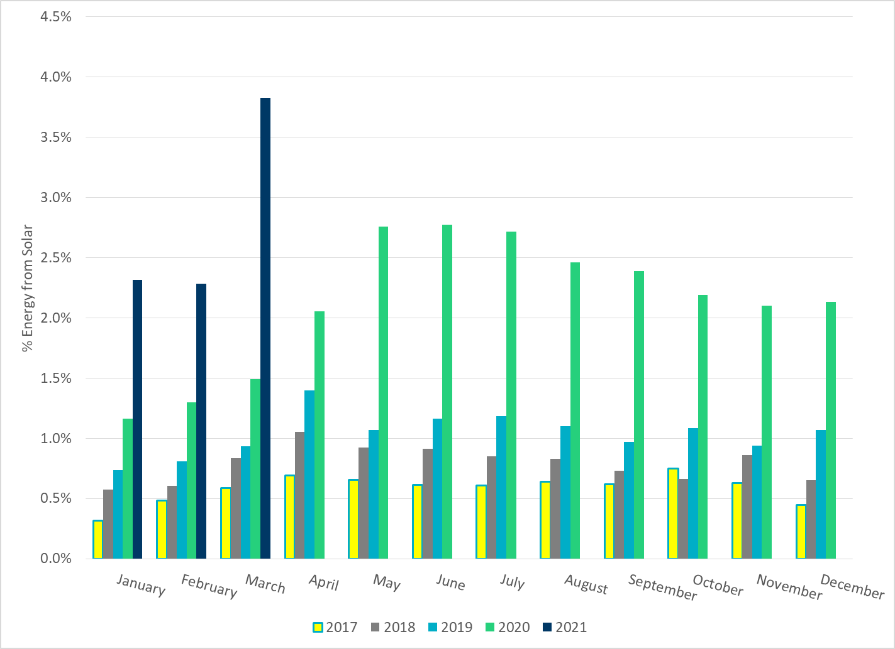
% Energy from Solar Generation
Notes:
3.82%

Slide 26
ERCOT System Inertia

Slide 27
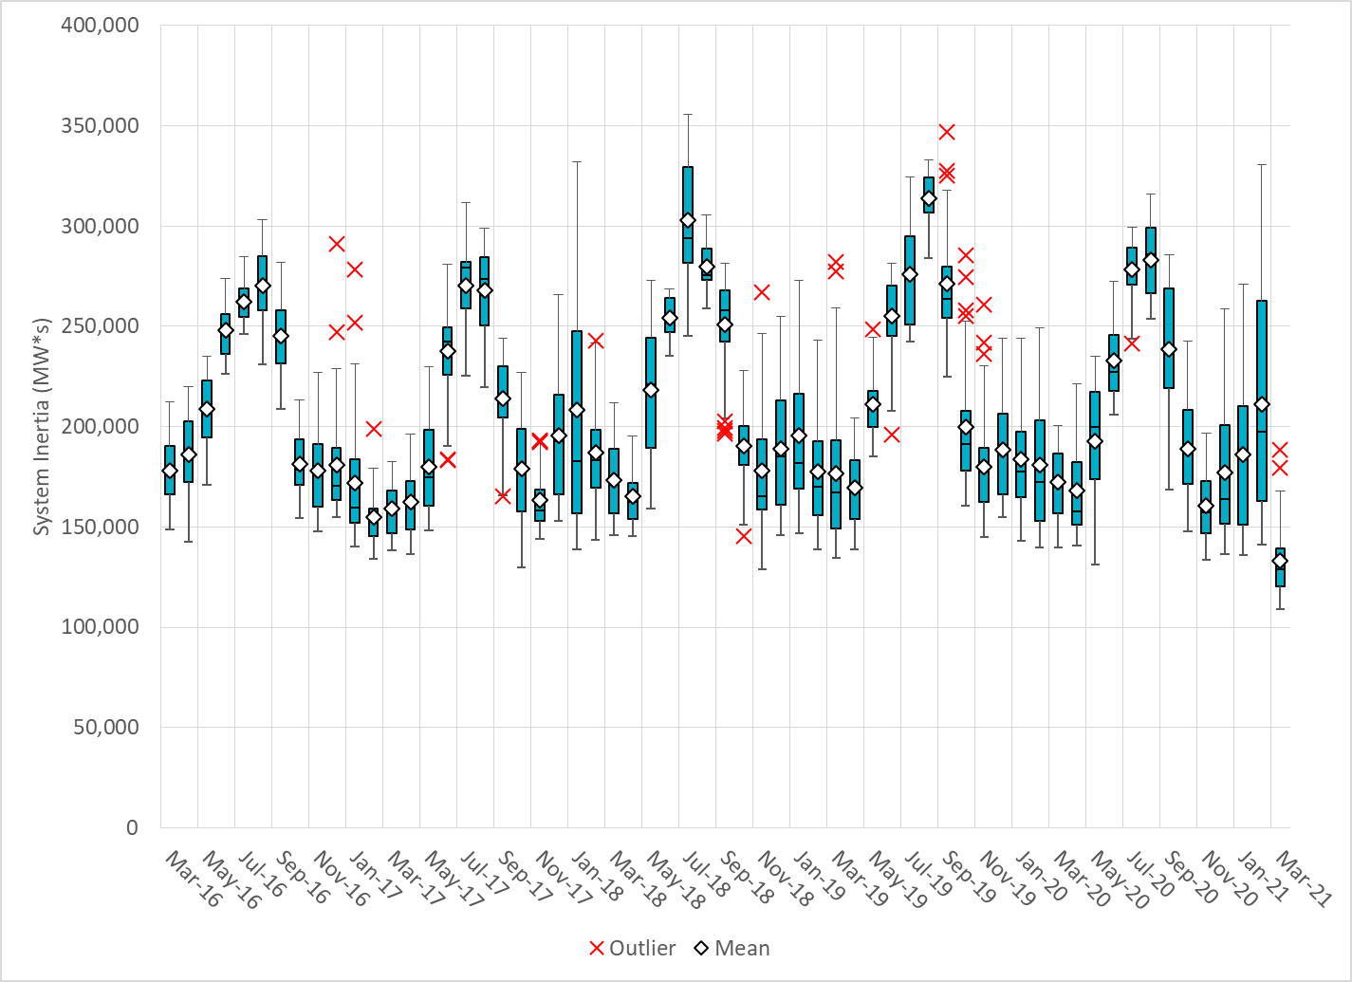
Daily Minimum System Inertia
Notes:
Minimum Inertia = 109,029 MW*s on 3/22/2021
Previous Minimum was 128,759 MW*s on 11/3/2018.
Data:
Mean: 132,989 MW*s
Max: 188,463 MW*s on Mar 19th
Min: 109,029 MW*s on Mar 22nd

Slide 28
Questions?
Thank you!

