Slide 1
ERCOT Frequency Events
March 2021
ERCOT
Operations Planning
PDCWG | April 8th, 2021

Slide 2
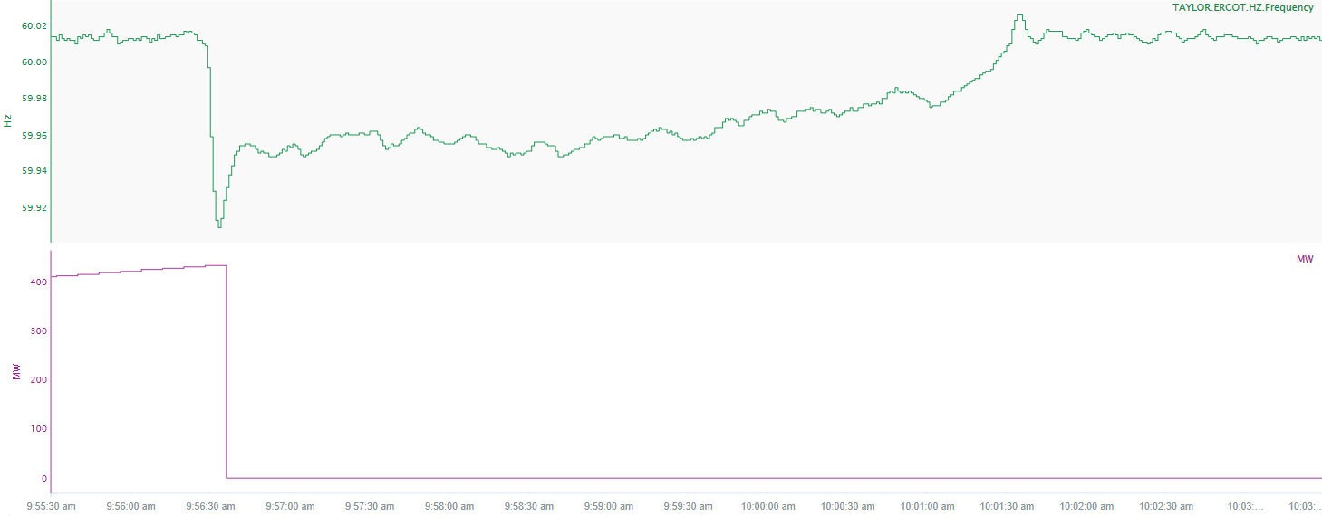
3/3/2021 09:56:28 (FME)
Notes:
Unit tripped offline while carrying 429 MW
Starting Frequency: 60.009 Hz
Minimum Frequency: 59.909 Hz
A-C Time: 5 seconds
Recovery Time (back to deadband): 4 minutes and 37 seconds
RRS Deployed: 0 MW
Trip Reason: High water wall temperature
Contextual Information: A total of 128 MW of regulation up was deployed during the event

Slide 3
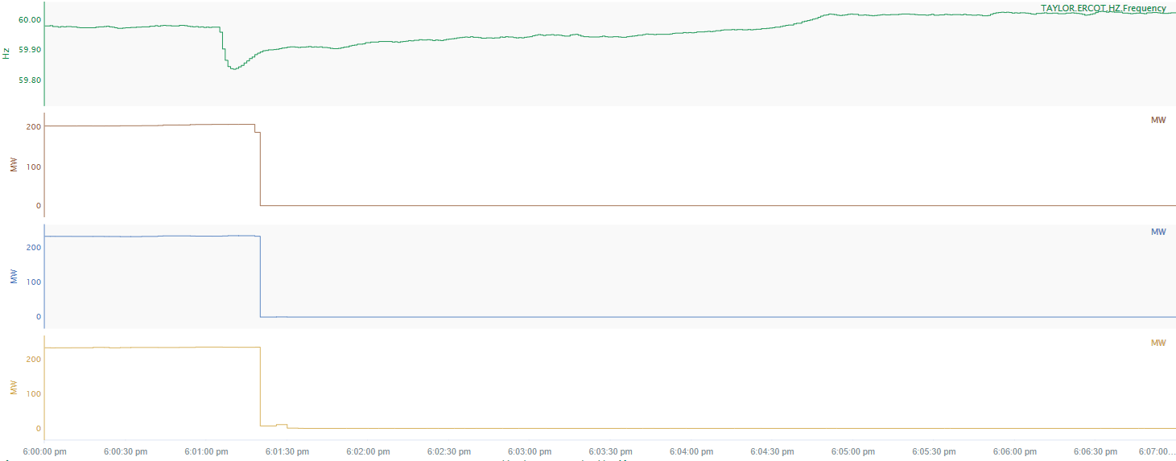
3/30/2021 18:01:04 (FME)
Notes:
Three units tripped offline while carrying a total of 673 MW
Starting Frequency: 59.975 Hz
Minimum Frequency: 59.834 Hz
A-C Time: 6 seconds
Recovery Time (back to deadband): 3 minutes and 27 seconds
RRS Deployed: 820.75 MW
Trip Reason: No information available.
Contextual Information: Total of 450 MW of regulation up was deployed during the event.

Slide 4
Questions?
Thank you!

