Slide 1
Proposed Changes to RARF/RIOO, SARA, and CDR
Supply Adequacy Working Group
April 23, 2021
Kevin Hanson
Principal Analyst

Slide 2
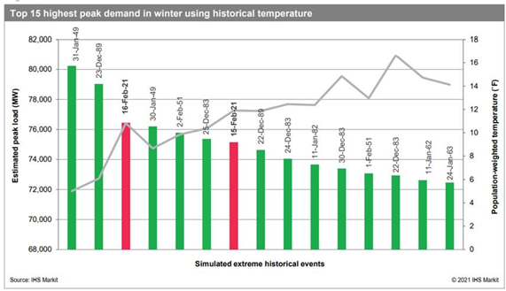
How much load could there have been?
ERCOT estimated 76,819 MW for the February 2021 event
Winter 2011 event is not in the Top 15 days

Slide 3
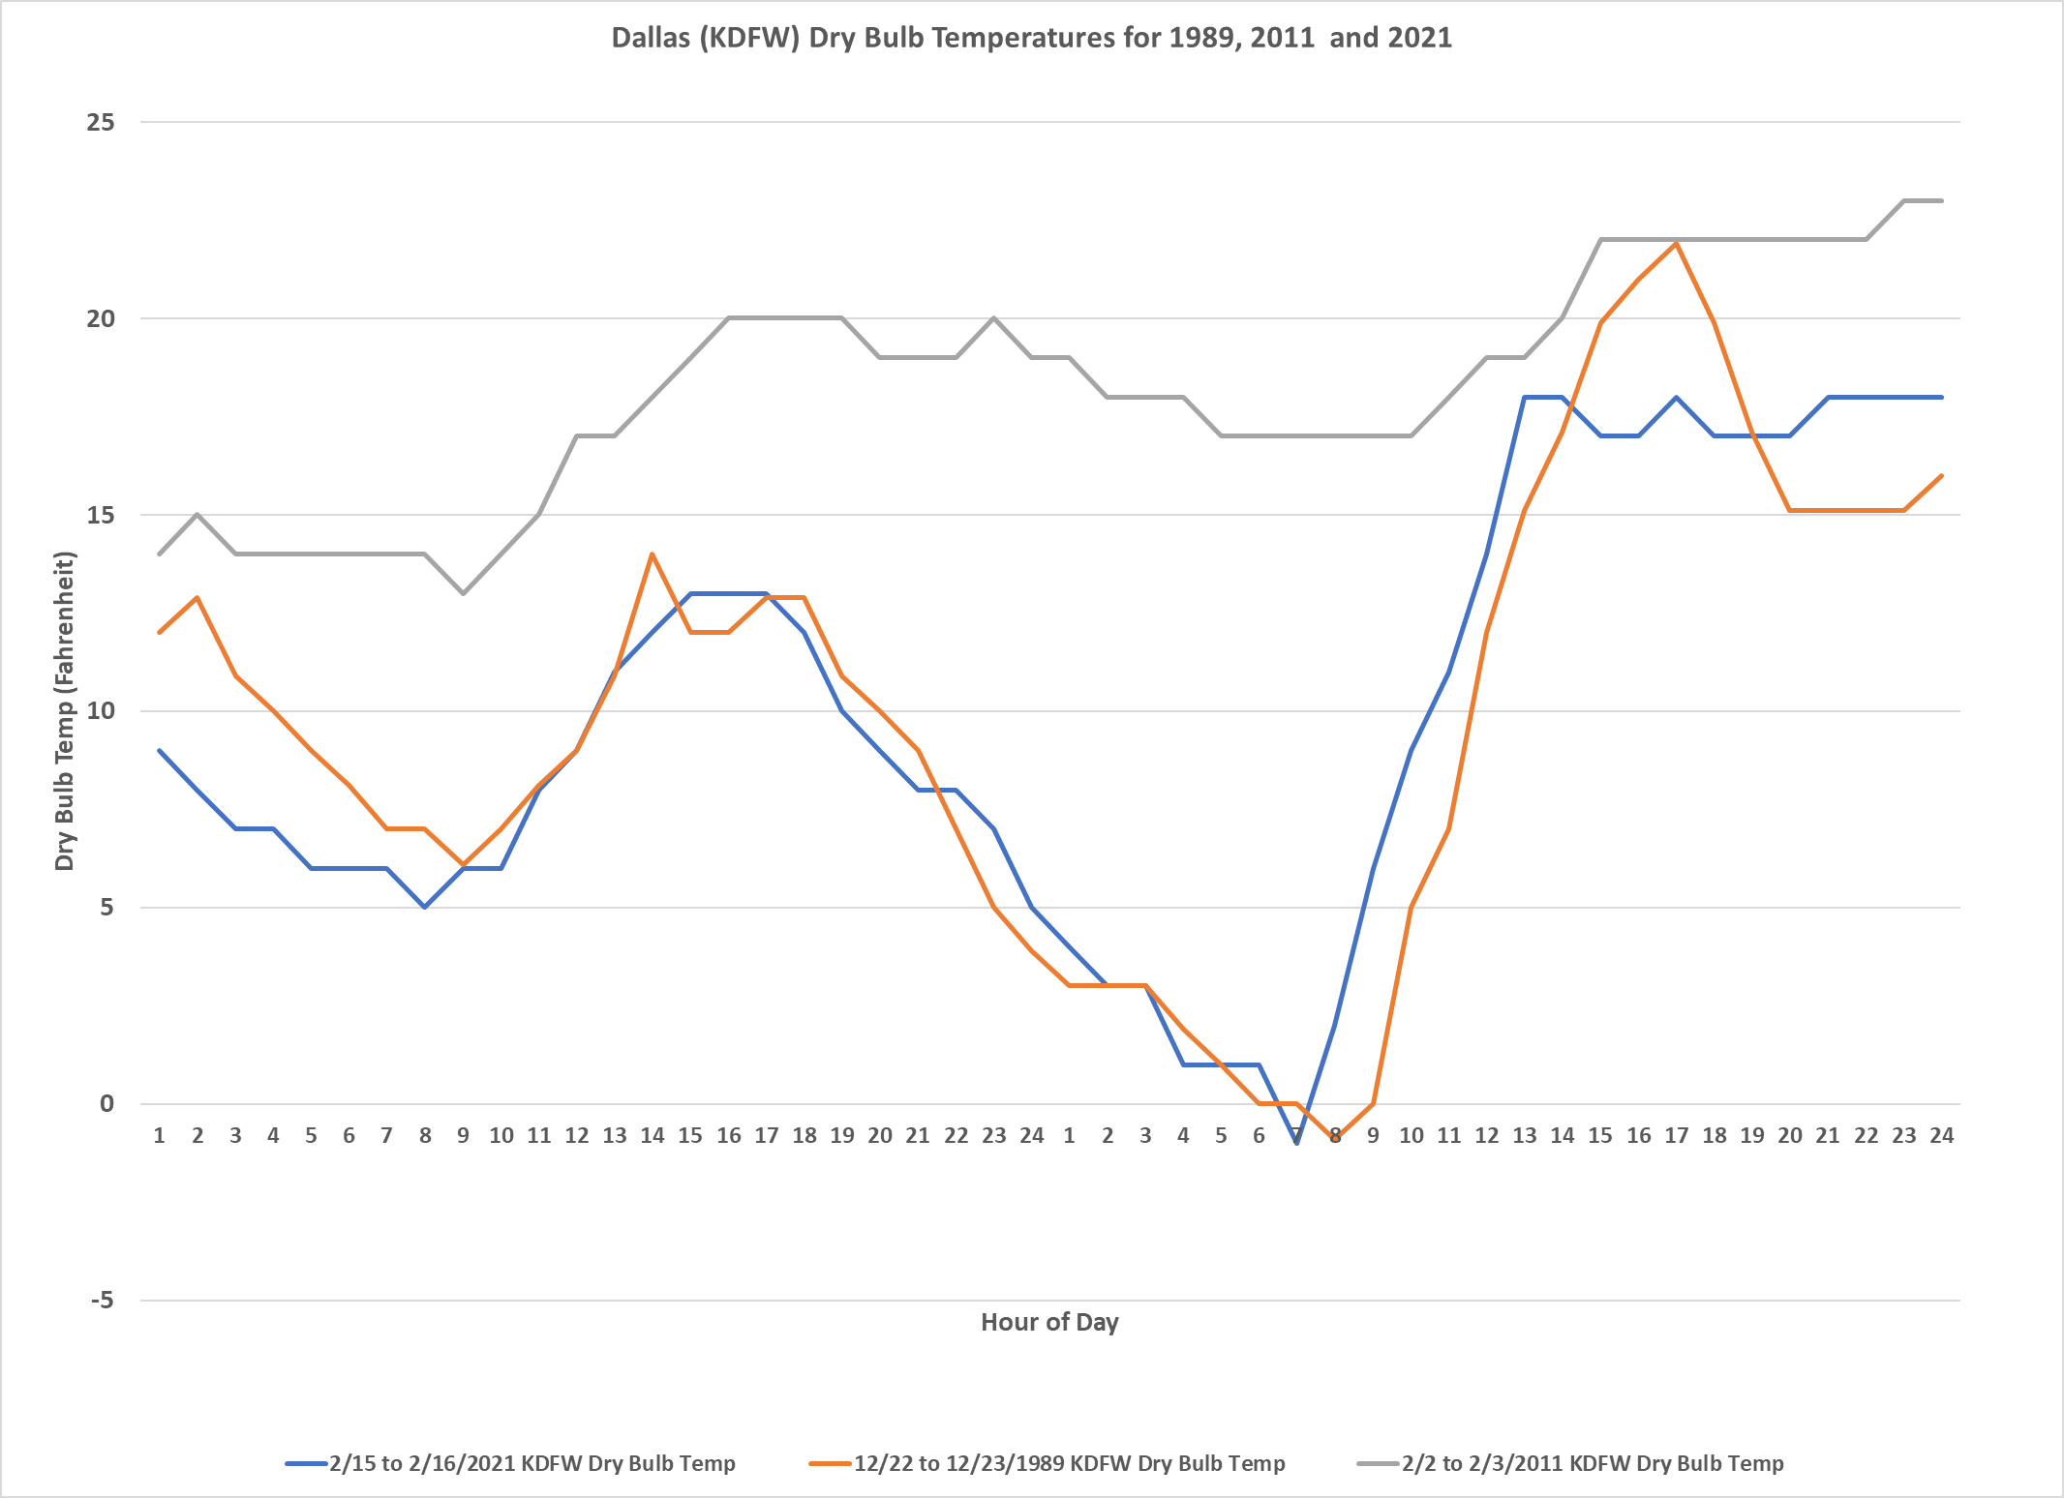
Dallas Cold Weather Days in 1989, 2011, and 2021

Slide 4
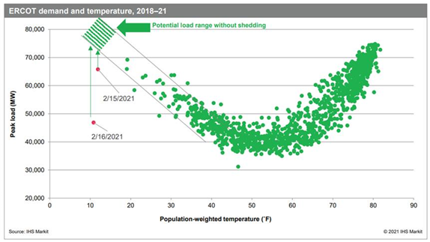
How does the temperatures impact it?
ERCOT estimated 76,819 MW for the February 2021 event

Slide 5
Items to Discuss
Potential changes to RARF/RIOO
Potential changes to SARA and CDR

Slide 6
Potential changes to RARF/RIOO
Capabilities of power plants
    Currently ERCOT uses Summer and Winter Ratings
    Propose having Ratings based on Temperature
      Filings would have HSL and LSL capabilities every 10 degrees Fahrenheit from 0 to 130
    In addition, auxiliary load at each 10 degrees as well
  Number of pipelines to plants and type of contracts available on those pipelines
    Include up to 5 fields to showing pipeline name
    Include up to 5 fields to show the type of natural gas contracts available to the power plant: firm, interruptible, or both

Slide 7
Potential changes to SARA and CDR
  ERCOT wide temperature scenarios
    Each season would includes the span of historical temperatures from 1950 to 2021 (and ongoing) that have impact the ERCOT market
      For instance, winter may be 0 to 90 degrees.
    The weighting would be based on historical locational loads per the load forecasting team at ERCOT.
  Time of Day Maximum Loads
    ERCOT load forecasting team would look at the expected time of day of the historical temperatures
  Load forecast using the temperatures and the historical weather year that represents the worst case scenarios
  Incorporate in Auxiliary load by resource class assumptions by temperature level
  Incorporate details of percentage of gas power plants with none, one, or two or more pipelines with Firm contract capability
  Have ERCOT meteorologist highlight temperature expectations for this upcoming season

Slide 8
Example of topics for new SARA and CDR

Slide 9
Description of Initials
RARF - Resource Asset Registration Form
RIOO – Resource Integration & On-going Operations
CDR – Capacity, Demand, and Reserves Report
SARA – Seasonal Assessment of Resource Adequacy
HSL – High Sustained Limit
LSL – Low Sustained Limit

