Slide 1
Market Credit Working Group update to the Wholesale Market Subcommittee
Brenden Sager, Austin Energy, Chair
Seth Cochran, Direct Energy, Vice Chair
7 April 2021

Slide 2
MCWG update to WMS
General Update
26 March 2021 Joint MCWG/CWG WEBEX Meeting
7 NPRRs reviewed for their credit impacts NPRR 1023 supported for positive credit impacts; remaining considered operational without credit impacts
NPRR 1023 for Credit Implications (vote)
This Nodal Protocol Revision Request (NPRR) modifies the way that ERCOT handles the repossession of a Congestion Revenue Right (CRR) portfolio resulting from a Market Participant default. The current process of offering the repossessed CRRs in a one-time auction may not fully realize the potential value of the repossessed CRR portfolio, which can in turn result in increased uplift to the market.
This NPRR establishes a means for liquidating a repossessed CRR portfolio over time by utilizing the Financial Security held by ERCOT for the Defaulting CRR Account Holder for Settlement purposes. This NPRR also modifies the process for forfeiture of CRRs resulting from non-payment or late payment of an Invoice by a CRR Account Holder, and proposes liquidating forfeited CRRs in the same manner as repossessed CRRs.
Committee members support because improves current process
Credit Work Group believes this NPRR will have beneficial credit impacts over the current methodology as the valuation of the portfolio should be higher offsetting more of the default as well as dividing the risk of the portfolio over more participants. CRR Repossessions – will not be in place for CRRs repossessed from defaulting counterparties resulting from the 2021 Winter Storm event.

Slide 3
NPRR’s non-credit impacts
Review NPRRs for Credit Implications (vote)
1060NPRR Improvements to ERS Testing Requirements and Other ERS Items.
1065 NPRR Implementation Adjustment for NPRR917.
1066NPRR Interconnection of Existing Generation Owned by a Municipally Owned Utility (MOU) or Electric Cooperative (EC) Transferring Load into the ERCOT System.
1069NPRR Align Ancillary Service Responsibility for ESRs with NPRR987.
979NPRR Incorporate State Estimator Standards and Telemetry Standards into Protocols.
1062NPRR Modify IDR Meter Requirement and Eliminate IDR Meter Requirement Report.

Slide 4
MCWG update to WMS
Review and Discussion of Credit Work Group Goals (approved)
Review the ongoing impact on Market Participant credit exposure and collateral requirements resulting from the incorporation of a forward price curve-based methodology
Clarify the market’s risk tolerance/appetite level and provide regular updates on credit exposure to the ERCOT Board
Evaluate and quantify potential market risk under current credit rules and for reviewing rules in flight
Effectively communicate credit risk to the market
Examine current Protocol language to determine how effectively current calculations capture actual credit risk
Review proposed credit assessment methodology and provide guidance to ERCOT
The group have reviewed and approved 2021 Goals.

Slide 5
MCWG update to WMS
DC Energy proposal to modify Future Credit Exposure in calculation of collateral obligation
Seth Cochran at DC Energy presented the modifications to CRR Future Credit Exposure slide to the group. This deck of slide once presented in April 2020. DC energy feels the treatment of CRR PTP Options and CRR PTP Obligations within the forward calculation are not equitable. CRR PTP Obligations on opposite paths did offset but not for an obligation with an option. The rolling average price for the volume-weighted portfolio is separate from the option position; which results in a credit liability.
DC recommends:
Calculate one portfolio adder that includes options and obligations together which option brings the credit value of the portfolios to parity with settlement exposure only has upside
This modification brings symmetry to the portfolio adder by appropriately accounting for the impact of options and obligations in portfolio before determining its worst case
The change would reflect the risk reducing value of the option product and the actual risk of a portfolio

Slide 6
MCWG update to WMS
Discuss Credit Scoring Model from ERCOT’s Mark Ruane
Mark Ruane provided an updated slide to the group, which the slide incorporated the model weighting changes from January CWG/MCWG discussion.
The group have questions about effectiveness of model predicting Brazos and Rayburn short-payment, bankruptcy processes, ERCOT’s ability to recover short-payment amount, lienholder position, etc.
Group supports enhancing credit analysis however concerns about consequences of analysis such as lowering unsecured thresholds, increasing credit obligations, margin calls, etc.
Discussion ended prematurely over Winter Storm concerns and Group will push implementation to lower priority

Slide 7
MCWG update to WMS
Winter Storm presentation and discussion
Discussion within the group about the uplift share, uplift amount, short-payment recovery timing, potential uplift amount in the credit report, more transparency and disclose to the market when a participant was suspended by ERCOT due to default, etc.
Not clear if Brazos and Rayburn will receive allocation of their own default
PUC looking at people leaving market without paying invoices and re-entering after default allocation
If a participant leaves owing money they do not leave in good standing
Want a requirement to pay amounts outstanding before coming back
Defaulting amounts will be in TPE
Brazos filed bankruptcy; the case is still pending from the court from the next direction
MIS “default uplift report” ratio reported
Interplay between Standard Form Market Participant Agreement and protocol language
Legal is working on resolving conflicts before uplifts published
Once this is figured out, there could be massive margin calls “on that day”
80+ years to pay off defaults under existing language with 2.5MM monthly limits
Want to dedicate subsequent meetings on storm issues
The group would like ERCOT to set a meeting time to discuss this specific topic when EROCT legal present is for questions and answers.

Slide 8
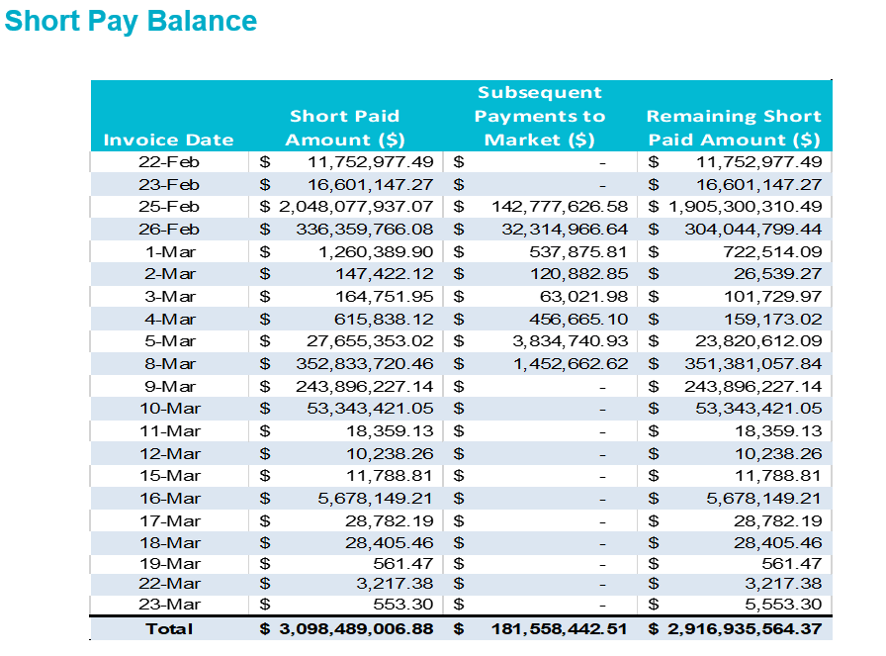
MCWG update to WMS
Note: short-pay amounts do not include the auction revenue drawdown

Slide 9
MCWG update to WMS
ERCOT Updates
Market-wide average TPE increased from $ 362.8 million in January to $ 4,521.1 million in February
TPE increased mainly due to higher Real-Time and Day-Ahead Settlement Point prices and higher Forward adjustment Factors in February compared to January
Due to the winter event, adjustments were made to the TPE calculation in February
TPE ranged from $ 317.01 million to $13.95 billion in February
Discretionary Collateral is defined as Secured Collateral in excess of TPE,CRR Locked ACL and DAM Exposure
Average Discretionary Collateral increased from $ 1,378.5 million to $3,254.2 million
The increase in Discretionary Collateral is largely due to increase in Secured Collateral.
Number of active Counter-Parties decreased by 2

Slide 10
MCWG update to WMS
New Business
Future CWG meetings for the foreseeable future will concentrate just on the various outcomes and consequences of the Winter Storm Event and ERCOT has promised to answer several Market Participant questions at the April 21st meeting and provide greater transparency into which Market Participants have withdrawn from the market (voluntarily or not) and details of monies owed.
ERCOT Legal has been asked to attend the next CWG meeting as well to provide an update on Winter Storm credit related matters and details of what can and can not be disclosed to the market at this time.

