Slide 1
PDCWG Report to ROS
Chair: Chad Mulholland, NRG
Vice Chair: Jimmy Jackson, CPS
ROS
April 1st, 2021

Slide 2
Report Overview & Notes
Report Overview
Meeting Minutes
Frequency Control Report

Slide 3
Meeting Minutes
PDCWG Meeting 03/10/2021
ERCOT Reports
Texas RE update
February Cold Weather Event Discussion

Slide 4
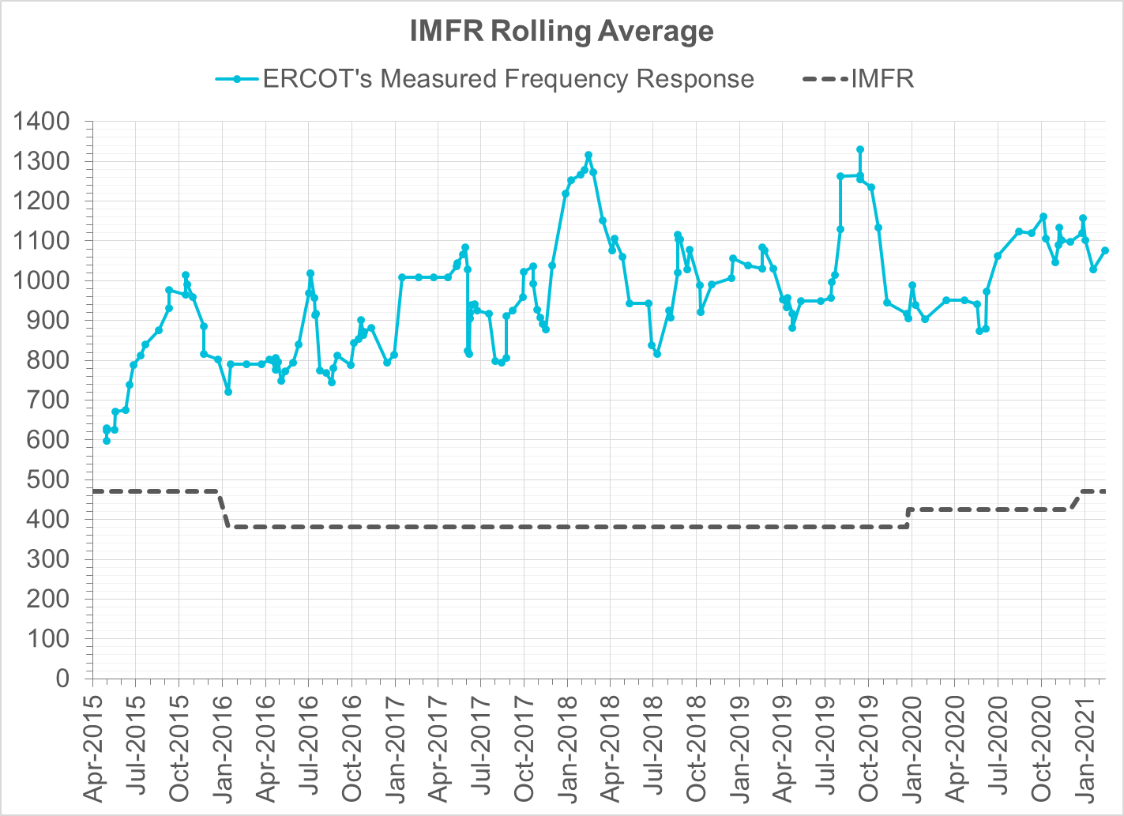
Interconnection Minimum Frequency Response (IMFR) Performance
IMFR Performance currently 1076.58 MW/0.1Hz
Frequency Response Obligation (FRO): 471 MW/0.1 Hz

Slide 5
Frequency Control Report
February 2021

Slide 6
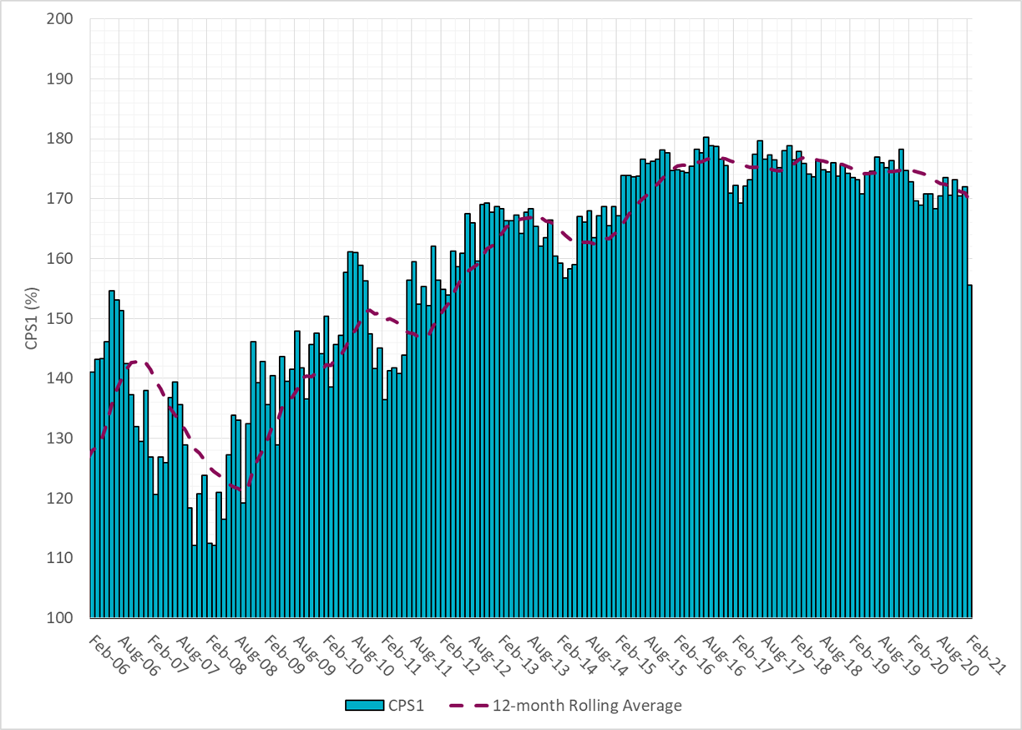
CPS1 Performance

Slide 7
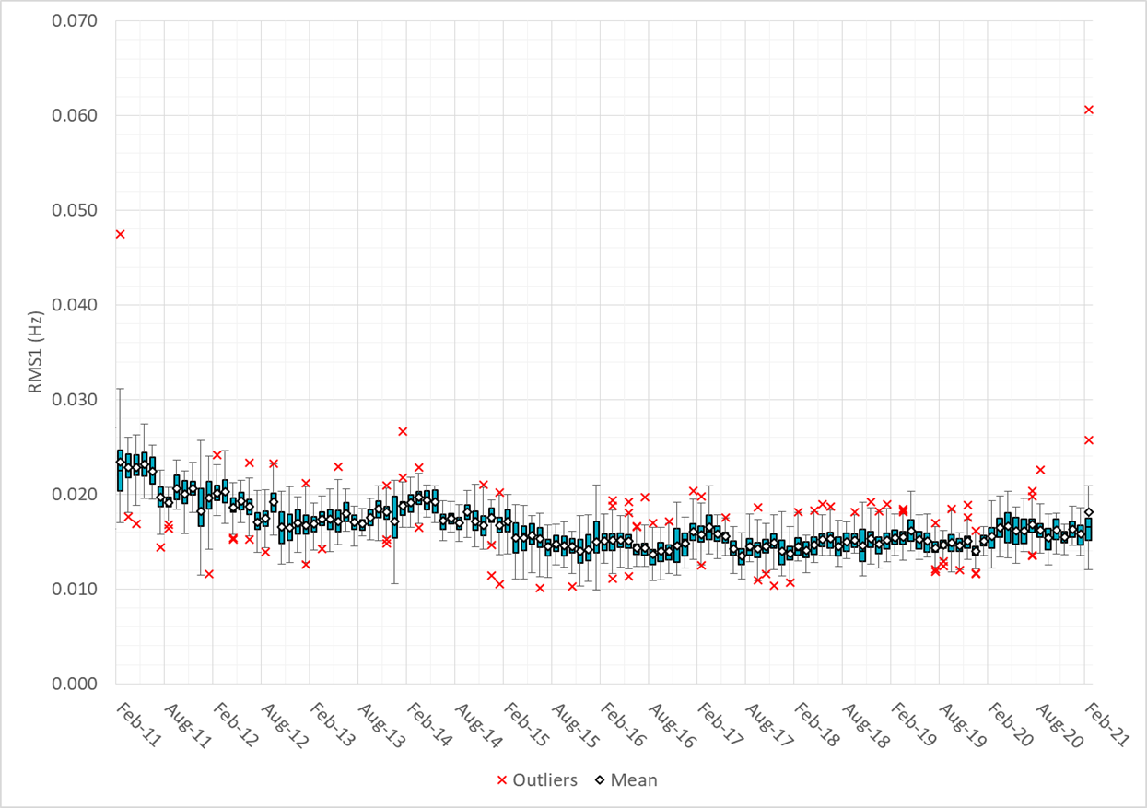
RMS1 Performance of ERCOT Frequency

Slide 8
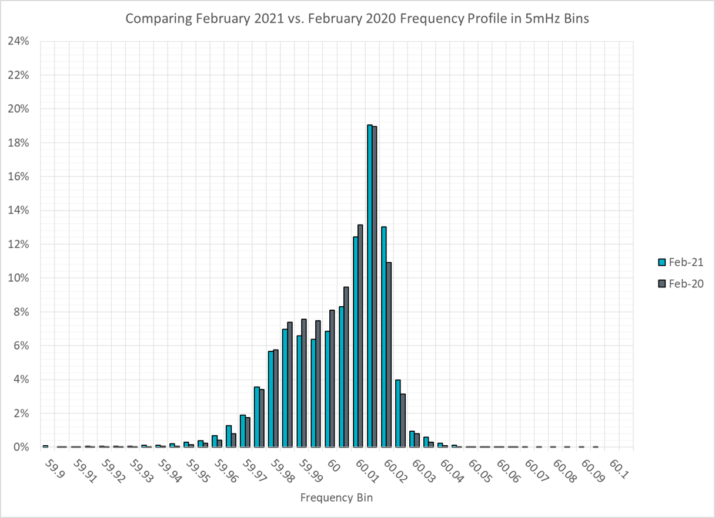
Frequency Profile Analysis

Slide 9
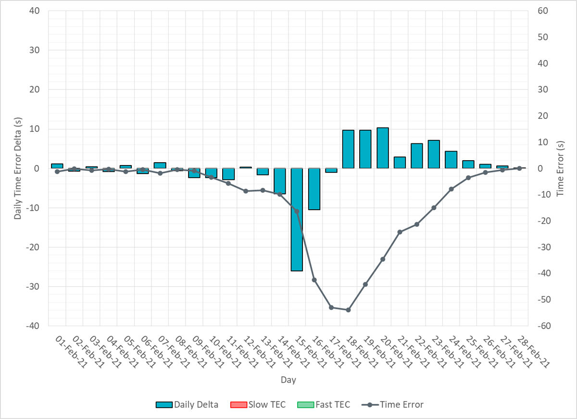
Time Error Corrections

Slide 10
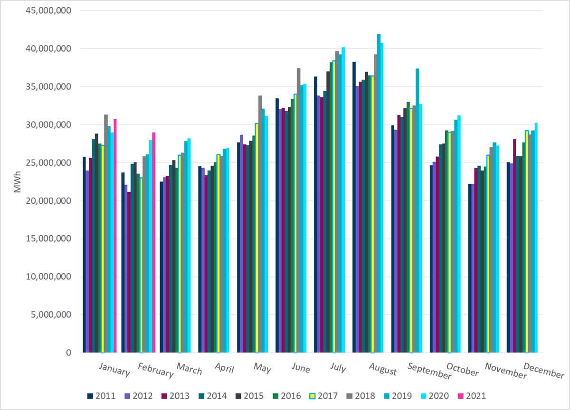
ERCOT Total Energy
Notes:
28,982,244 MWh

Slide 11
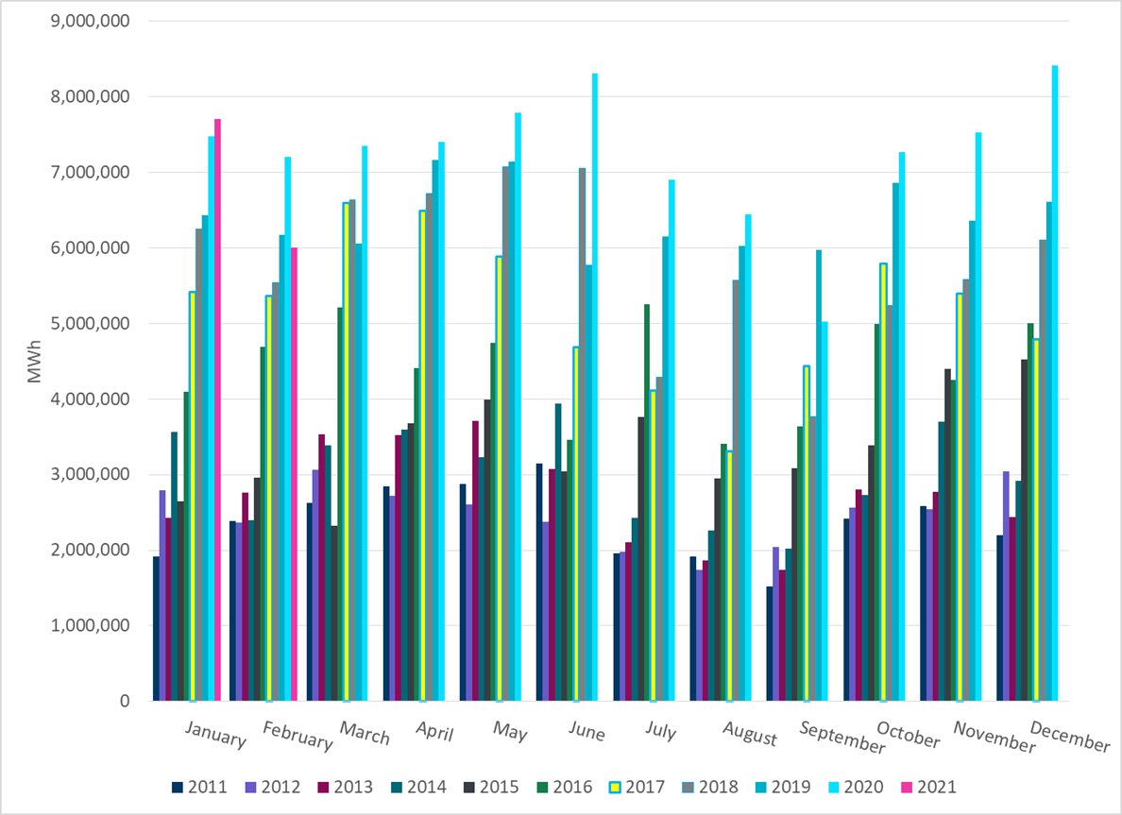
ERCOT Total Energy from Wind Generation
Notes:
5,999,684 MWh

Slide 12
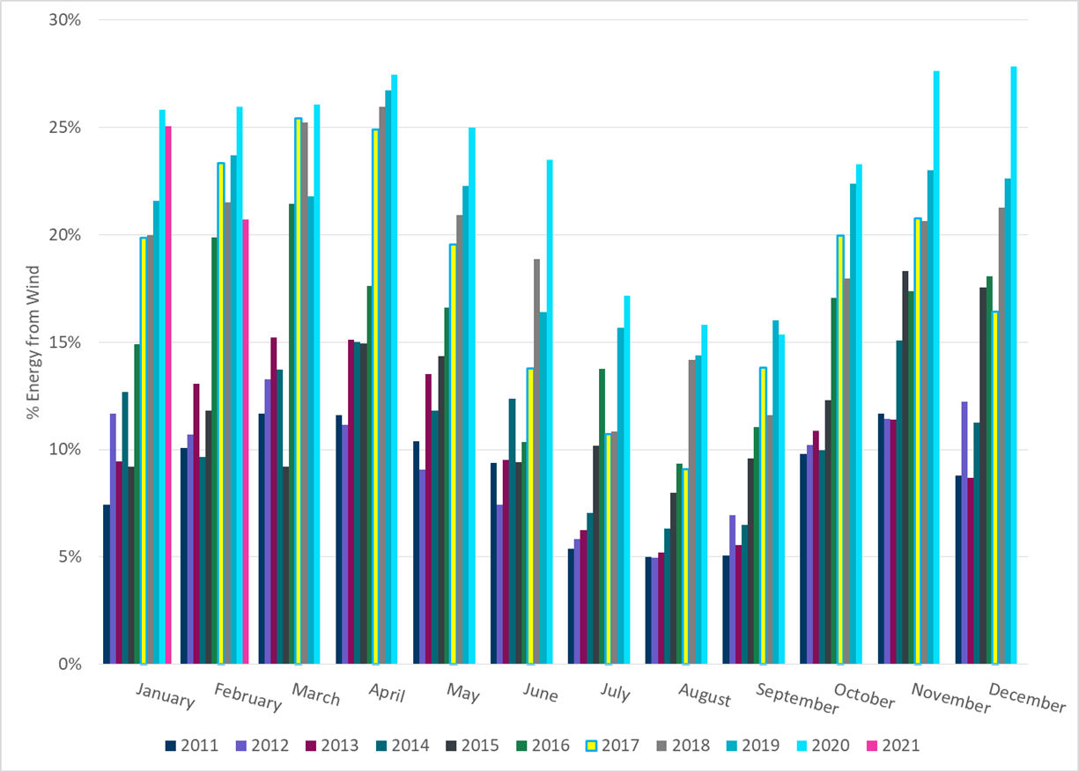
ERCOT % Energy from Wind Generation
Notes:
20.70%

Slide 13
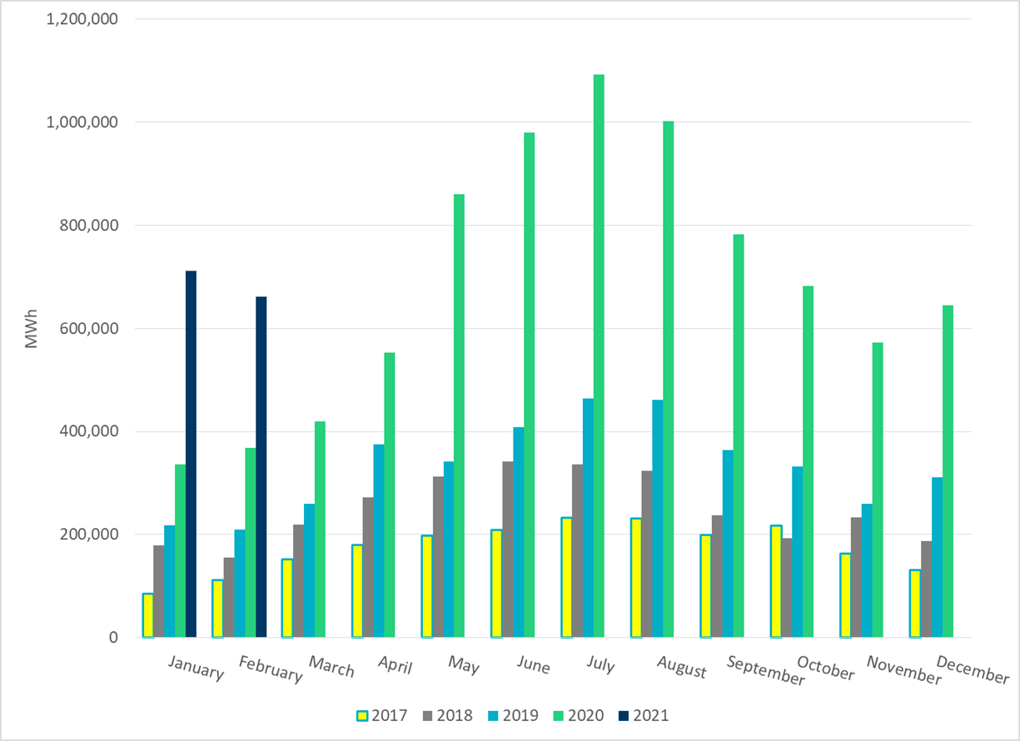
ERCOT Total Energy from Solar Generation
Notes:
660,966 MWh

Slide 14
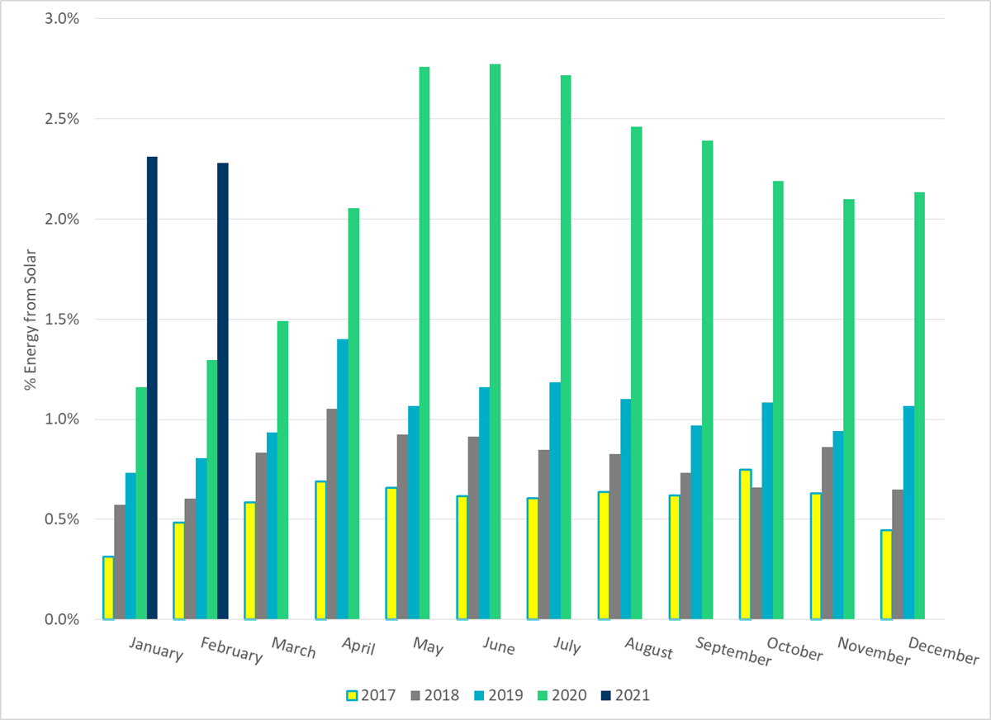
ERCOT % Energy from Solar Generation
Notes:
2.28%

Slide 15
Questions?

