Slide 1
Unregistered DG Workshop
DER Status and Possible Actions
Clayton Stice
03-30-2021

Slide 2
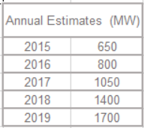
Estimated Total DG Growth in ERCOT 2015-2019 (MW)*
Includes rooftop solar and community solar < 1 MW
181%
*
31%
Note: This estimate includes new NOIE reporting per NPRR891 and excludes generation data informally reported by investor-owned utilities for generation that would typically be considered backup or emergency generation. *Generation not included in previous reports, but registered as SODG with ERCOT.
* Chart will be updated once 2020 data is available
http://www.ercot.com/content/wcm/key_documents_lists/195745/2015_to_2019_DER_data_v1_pdf.pdf

Slide 3
Settlement-Only Distributed Generation in ERCOT (2010-2020)
SODGs are:
<10 MW
If >1 MW and inject to grid, must register with ERCOT
If <1 MW, registration optional
Accumulated Count
Non-renewables
Renewables

Slide 4
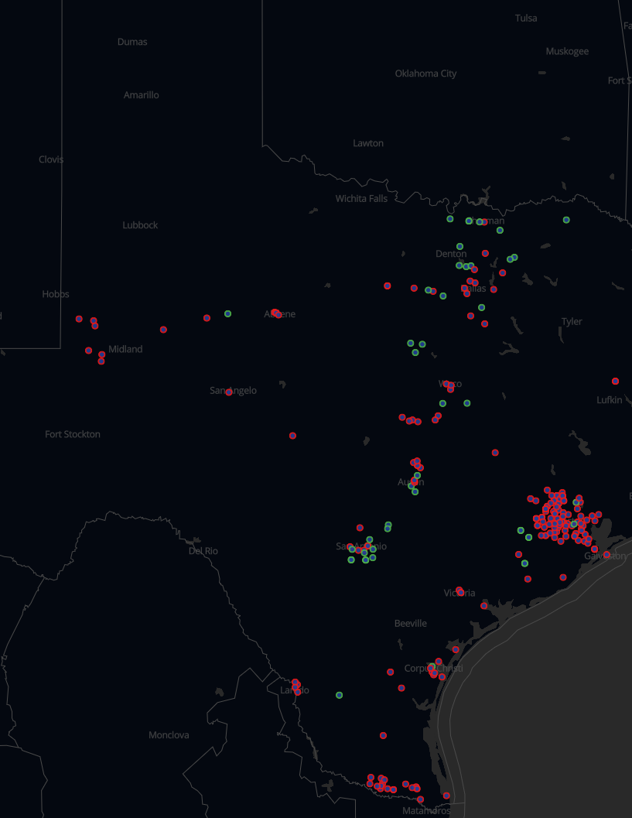
DGRs and SODGs
Red circles represent DGRs and Distribution Energy Storage Resources (DESRs)
  41 sites totaling ~370 MW
Circles represent SODGs, with magenta being controllable and green being non-controllable
  292 sites totaling ~931 MW (2020 data)
http://www.ercot.com/content/wcm/key_documents_lists/214480/DGR_workshop_X_update.pptx

Slide 5
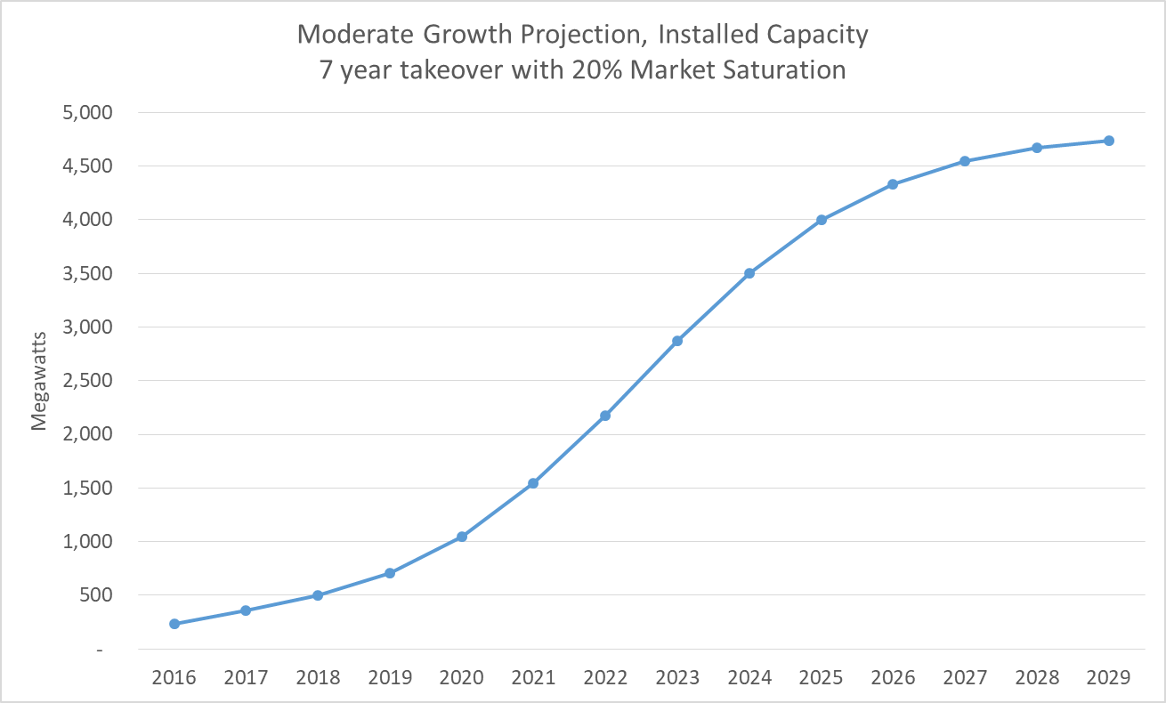
2019 SAWG Moderate Growth Projection
http://www.ercot.com/content/wcm/key_documents_lists/195745/SAWG_April_2020_Solar_PV_Growth_Projection_Discussion.pptx

Slide 6
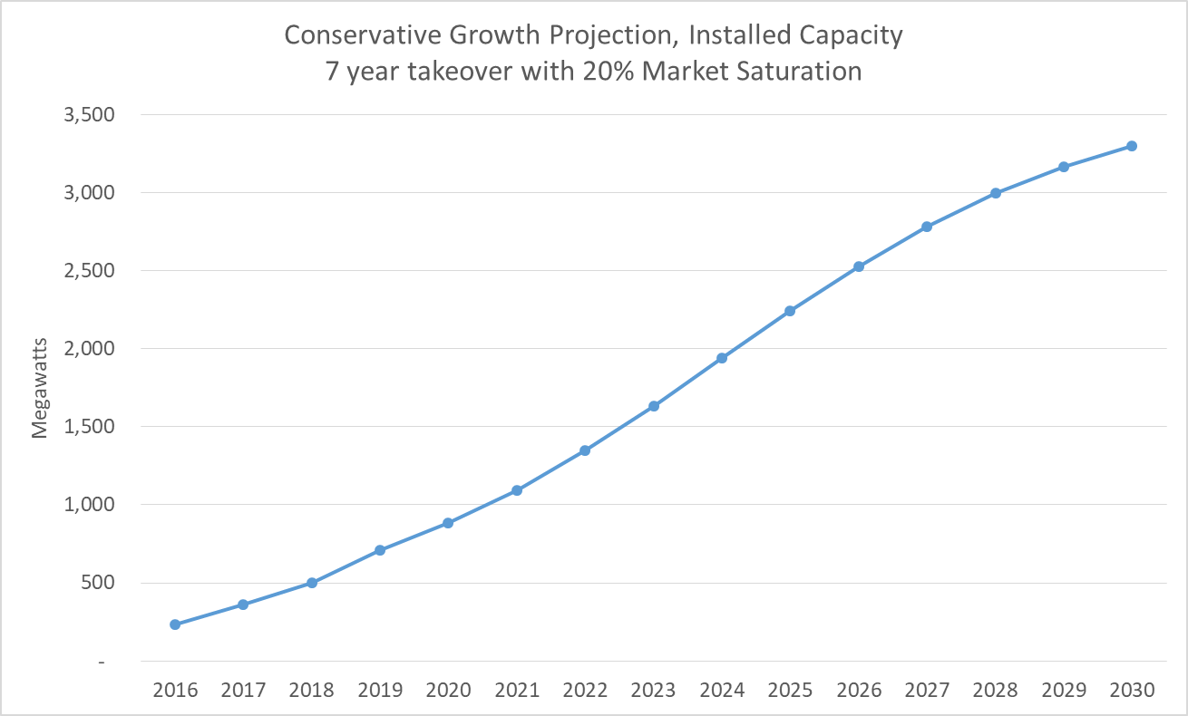
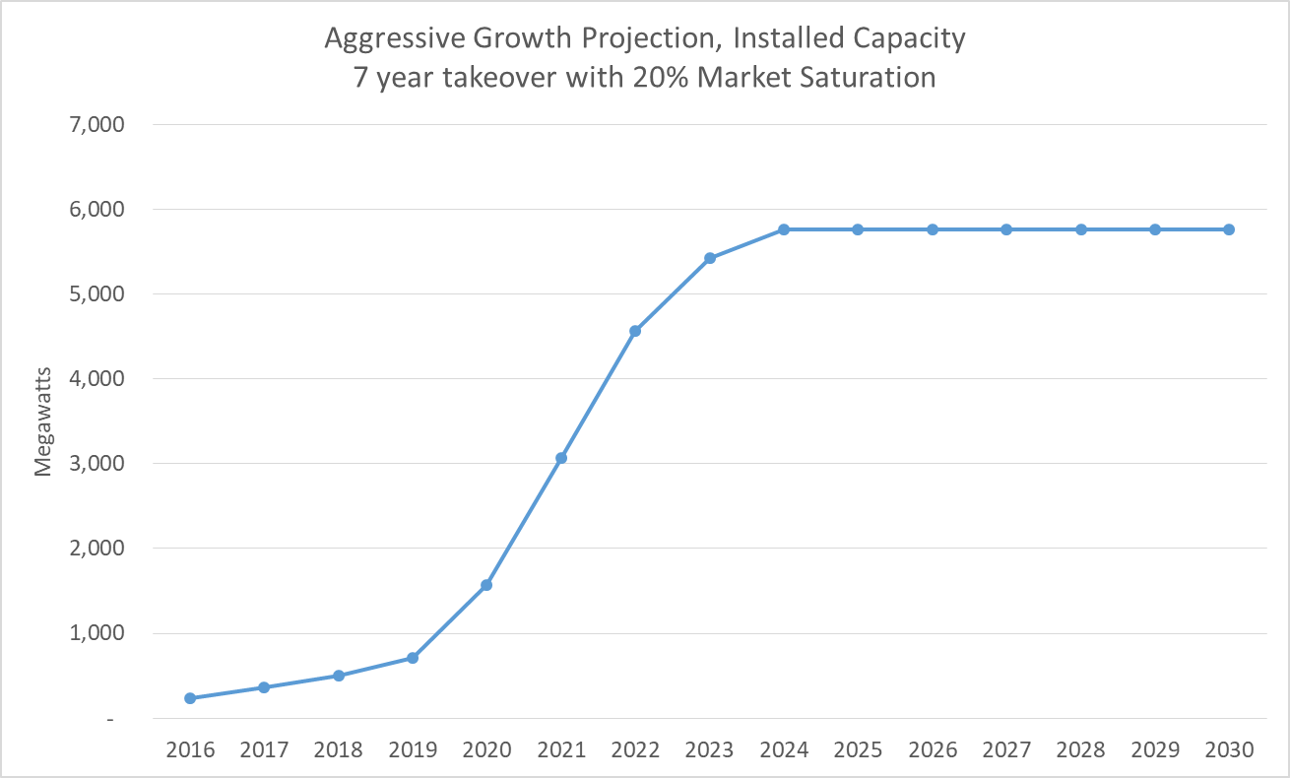
2019 SAWG Alternate Growth Projections
Scenarios yield widely varying projections
  Conservative reaches 3000 MW by 2029
  Moderate reaches 3000 MW by 2024 and 4500 MW by 2027
  Aggressive reaches 3000 MW by 2021 and 6000 MW by 2025
http://www.ercot.com/content/wcm/key_documents_lists/195745/SAWG_April_2020_Solar_PV_Growth_Projection_Discussion.pptx

Slide 7
Current Unregistered DG Reporting
Two different methods currently exist:
  TDSPs ->premise data using Load Profile Template
    Excel spreadsheet method was originally acceptable for small numbers of Unregistered DG
      Not really viable long-term for larger volumes of information (>2,000/month)
      TDSPs require significant advance notice for implementation of new method
    No current method for updating/revising existing ESIIDs when DG is modified/expanded
  NOIEs -> Aggregate data using Unregistered DG Form
    Annual reports per NPRR891
    separated in <50kW and >50kW
      Quarterly for NOIEs with > 2 MW of total <50kW

Slide 8
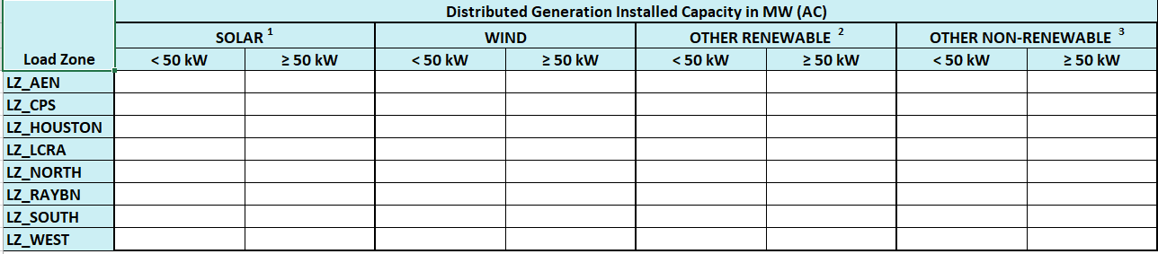
Unregistered DG Reporting Formats
TDSP Load Profile Template – appendix D
http://www.ercot.com/content/wcm/current_guides/53524/Appendix_D_Profile_Decision_Tree_v2.0_080120.xlsx
NOIE UDG Reporting http://www.ercot.com/content/wcm/key_documents_lists/186804/NOIE_Unregistered_DG_Reporting_Form.xlsx
 | Date of Request | mm/dd/yyyy
 | ESI ID | IA Date | Max PV Output (Inverter) Capacity (kW-AC) | not used | Total PV Array Capacity (kW- DC) | Total Wind Capacity (kW) | Total Other: Renewable Capacity (kW) | Total Other: Non-Renewable Capacity (kW)
1 | XXXX | mm/dd/yyyy | 2 |  | 2.2

Slide 9
Revised Unregistered Data Requested
Improve consistency/usability of PV data
  Max PV output is inverter nameplate in kW-AC
  Total PV array in kW-DC
Add information required for DG type and location
  Include fuel type for Non-renewable
  Include Energy Storage data
  Transmission-level POI (Substation)
  Planning Data identified in their presentation

Slide 10
Workshop Discussions
ERCOT envisions a single process to collect this information and use it in processes that both ERCOT and TSPs benefit from the information collected.
  TDSPs and NOIEs both use same “process”
  UDG information to be included in NMMS
Potential changes
  Step 1: Update SSWG Manual
  Step 2: NPRR for sections 3.2.5.1->3.2.5.3
    Unregistered DG Reporting
  LPG may choose to retire Load Profile Template
  Other?

