Slide 1
Planning Data Requirements
John Bernecker
Manager, Transmission Planning Assessment
Unregistered DG Workshop
March 30, 2021

Slide 2
Background
Appropriate representation of DER in planning assessments is needed to understand their impacts and maintain reliability
  Aggregate impact matters
Unregistered DG isn’t just rooftop solar, but can also be large community solar projects
  Can be multiple in a local area
Planning decisions are being made for 5-6 years in the future with limited visibility of what is connected to the system today
  Reliability risk of not identifying project(s) that are needed
  Risk of identifying project(s) that are not needed

Slide 3
NERC Guidelines and Standards
DER Data Collection for Modeling in Transmission Planning Studies
  Developed by NERC System Planning Impacts from Distributed Energy Resources Working Group (SPIDERWG)
  Includes recommended data reporting requirements for collecting sufficient data to model aggregate DERs
  Related to MOD-32-1 R1 and Attachment 1
Parameterization of the DER_A Model
  Includes a modeling framework for DER
TPL-001-4 R1 requires representation of DER in planning models

Slide 4
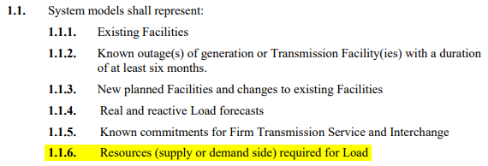
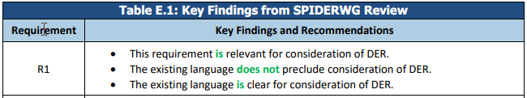
NERC Guidelines and Standards
TPL-001-4
White Paper: Assessment of DER Impacts on NERC Reliability Standard TPL-001

Slide 5
Goals
Step 1: Consistent representation of DGR/DESR, SODG, and Unregistered DG in planning cases
Step 2: Represent DGR/DESR, SODG, and Unregistered DG as separate aggregations by transmission-level POI using generator models
Goal | On Track?
 | DGR / DESR | SODG | Unregistered DG
Step 1: Consistent representation | ✓ | ✓ | ✗
Step 2: Aggregation process | ✓ | ✓ | ✗

Slide 6
Step 1: Unregistered DG
Update SSWG Procedure Manual to reflect a common practice for representing Unregistered DG by midyear 2021
  Unregistered DG contributions should be embedded in SSWG load forecasts
    Most common current practice per SSWG poll
  An out-of-service load with an ID of “DG” should be modeled at the transmission-level POI to maintain visibility
    Addresses visibility concerns raised by some SSWG representatives
Implement the updated common practice in the October 2021 SSWG base cases

Slide 7
Step 2: Overview
DGR/DESR, SODG, and Unregistered DG will be represented as separate aggregations by transmission-level POI using generator models
Aggregation rules based on fuel type and technical specifications
Generator buses will have the same nominal kV as the transmission-level POI
ERCOT and TSPs will determine default equivalent impedance to be used
Impedance for specific locations may be changed by individual TSPs

Slide 8
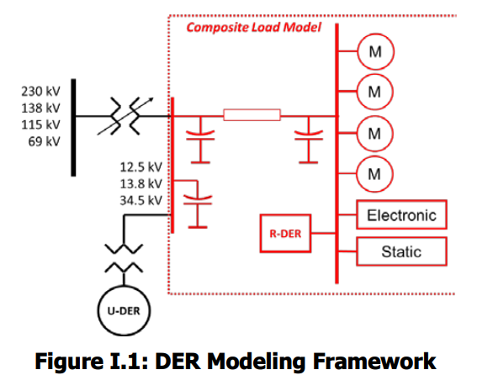
Step 2: Modeling Framework
NERC SPIDERWG
ERCOT

Slide 9
Step 2: Overview Example

Slide 10
Step 2: Data Requirements
Collect and store un-aggregated information
  Transmission bus
  Capacity
  Minimum output
  Fuel type / technology
  In-service date
  UVLS flag
  UFLS flag
  Nameplate energy rating and RTE for storage
Aggregation tool/process to populate planning models
  Flexibility needed for aggregation rules

Slide 11
Appendix I
Step 1: Further Details

Slide 12
Step 1: DGR/DESR and SODG
DGR/DESR
  ERCOT will continue modeling using current practices
  Committed and dispatched using current SSWG methodology
  TSPs will not embed in load forecasts nor represent with a negative load
SODG
  ERCOT will represent as generators using simple models
  TSPs will not embed in load forecasts nor represent with a negative load
  Use long-term proposal IDs to differentiate fuel types

Slide 13
Step 1: SODG Commitment and Dispatch
ID Code | Resource Category | Dispatch Level
JA | Battery | Offline
JB | Solar | Consistent with CDR solar percent capacity contribution
JC | Natural Gas | Offline
JD | Diesel | Offline
JE | Wind | Consistent with CDR wind percent capacity contribution
JF | Landfill Gas | Offline
JG | Hydro | Offline
JH | Other Inverter | Offline
JI | Other Sync | Offline

Slide 14
Step 1: DWG Cases
DGR/DESR and SODG
  Use RE-provided dynamic models, if available
  Use DER_A for IBRs if RE does not provide a dynamic model or dynamic model is insufficient
  Use generic dynamic models for synchronous DGR if RE does not provide a dynamic model or dynamic model is insufficient
  Potentially GNET some SODG
UDG
  Dynamic models will not be explicitly represented
  DWG will not modify representation from SSWG cases

Slide 15
Step 1: DGR/DESR Parameterization - IBRs
Follow NERC Reliability Guideline Parameterization of the DER_A Model
  Assume IEEE Std. 1547-2018 parameters for DGR/DESR
  Assume IEEE Std. 1547-2003 parameters for grandfathered DGR/DESR and SODG
ERCOT Nodal Operating Guide
  Adjust for those with VRT and/or FRT exemptions

Slide 16
Step 1: DG Parameterization Documentation
DWG Procedure Manual revisions
  Summarizes how DWG will represent DGRs and SODGs
New Parameterization Guideline
  ERCOT would like a DWG-approved process for developing parameterization assumptions

Slide 17
Step 1: Summary DWG Representation
 | DGR/DESR* | SODG*
Submitted model | 172 MW, 19 units
DER_A | 62 MW, 7 units | 100 MW, 10 units**
GNET |  | 157 MW, 30 units**
Offline |  | 562 MW, 202 units
*Numbers subject to adjustment due to DGRs completing RARFs, new SODG registrations, etc.
**SODG DER_A and GNET numbers based on a 10 MW threshold

Slide 18
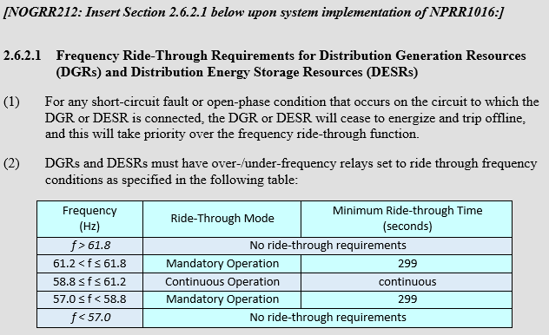
ERCOT Nodal Operating Guide
2 DESRs gave notice that they are not capable of meeting this requirement

Slide 19
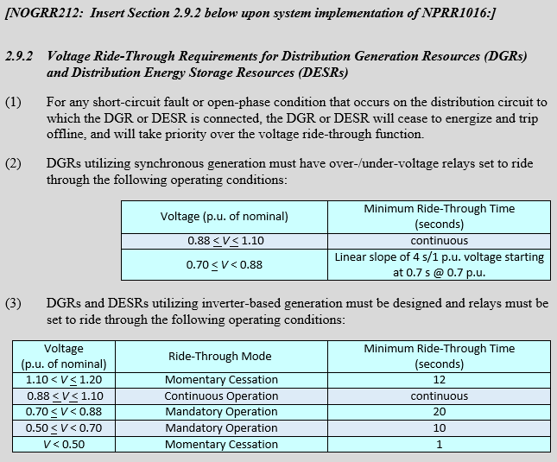
ERCOT Nodal Operating Guide
6 DESRs gave notice that they are not capable of meeting this requirement

Slide 20
Appendix II
Step 2: Further Details

Slide 21
Step 2: DGR/DESR
ERCOT will represent using aggregate generator models based on data in RIOO
Unit IDs used to identify fuel type and technical specifications
Generator bus names are “DGR_” + transmission-level POI identifier
Not embedded in ERCOT load forecasts
No ERCOT DGR forecast
Added to planning cases once individual DGR meets milestone for inclusion
Unit ID | Fuel Type | Technical Specs
D0 | Battery | IEEE 1547-2018
D1 | Solar | IEEE 1547-2018
D2 | Natural Gas | IEEE 1547-2018
D3 | Diesel | IEEE 1547-2018
D4 | Wind | IEEE 1547-2018
D5 | Landfill Gas | IEEE 1547-2018
D6 | Hydro | IEEE 1547-2018
D7 | Other Inverter | IEEE 1547-2018
D8 | Other Sync | IEEE 1547-2018
DA | Battery | PUCT 25.212
DB | Solar | PUCT 25.212
DC | Natural Gas | PUCT 25.212
DD | Diesel | PUCT 25.212
DE | Wind | PUCT 25.212
DF | Landfill Gas | PUCT 25.212
DG | Hydro | PUCT 25.212
DH | Other Inverter | PUCT 25.212
DI | Other Sync | PUCT 25.212

Slide 22
Step 2: SODG
ERCOT will represent using aggregate generator models based on data in RIOO
Unit IDs used to identify fuel type and technical specifications
Generator bus names are “SODG_” + transmission-level POI identifier
Not embedded in ERCOT load forecasts
  Resource telemetry will be needed
No ERCOT SODG forecast
Added to planning cases once individual SODG meets milestone for inclusion
Unit ID | Fuel Type | Technical Specs
J0 | Battery | IEEE 1547-2018
J1 | Solar | IEEE 1547-2018
J2 | Natural Gas | IEEE 1547-2018
J3 | Diesel | IEEE 1547-2018
J4 | Wind | IEEE 1547-2018
J5 | Landfill Gas | IEEE 1547-2018
J6 | Hydro | IEEE 1547-2018
J7 | Other Inverter | IEEE 1547-2018
J8 | Other Sync | IEEE 1547-2018
JA | Battery | PUCT 25.212
JB | Solar | PUCT 25.212
JC | Natural Gas | PUCT 25.212
JD | Diesel | PUCT 25.212
JE | Wind | PUCT 25.212
JF | Landfill Gas | PUCT 25.212
JG | Hydro | PUCT 25.212
JH | Other Inverter | PUCT 25.212
JI | Other Sync | PUCT 25.212

Slide 23
Step 2: Unregistered DG
ERCOT will represent using aggregate generator models if the capacity for a given fuel type and technical specification at a transmission-level POI exceeds 1 MW
Unit IDs used to identify fuel type and technical specifications
Generator bus names are “UDG_” + transmission-level POI identifier
Embedded in ERCOT load forecasts
ERCOT will forecast rooftop solar growth
Unit ID | Fuel Type | Technical Specs
K0 | Battery | IEEE 1547-2018
K1 | Solar | IEEE 1547-2018
K2 | Natural Gas | IEEE 1547-2018
K3 | Diesel | IEEE 1547-2018
K4 | Wind | IEEE 1547-2018
K5 | Landfill Gas | IEEE 1547-2018
K6 | Hydro | IEEE 1547-2018
K7 | Other Inverter | IEEE 1547-2018
K8 | Other Sync | IEEE 1547-2018
KA | Battery | PUCT 25.212
KB | Solar | PUCT 25.212
KC | Natural Gas | PUCT 25.212
KD | Diesel | PUCT 25.212
KE | Wind | PUCT 25.212
KF | Landfill Gas | PUCT 25.212
KG | Hydro | PUCT 25.212
KH | Other Inverter | PUCT 25.212
KI | Other Sync | PUCT 25.212

